Slide 1
ZigBee Infrastructure using DIGI Gateway and TI CC2650 SensorTags
Adam Holler, Clay McKinley – Students
Dr. Aleksander Malinowski - Advisor
Notes:
[A]

Slide 2
Outline
Problem Statement
Review of Prior Research
ZigBee
Devices
Protocol
Standards
Block Diagram
Specifications
Parts Ordered/Inventory
Software
Troubleshooting
Schedule
Division of Labor
Conclusions
Citations
Notes:
[A]
What ZigBee is
What we learned
What we did
What we recommend moving forward

Slide 3
Problem Statement
Our goal was to research into ZigBee communication protocol as an alternative to Bluetooth.
How exactly data is transmitted between ZigBee devices
The structure of a ZigBee mesh network and the roles of each device
What low-power capabilities were available to extend battery life of sensors
What benefits over Bluetooth does ZigBee offer and is it the better choice for certain applications
Notes:
[C]

Slide 4
Review of Literature/Prior Work
Researched into communication protocols: Bluetooth Low Energy & ZigBee vs Wi-Fi, 6LoWPAN, etc.…
Read various IEEE papers on ZigBee capabilities
Notes:
[C]
For our prior work and research we looked into how ZigBee compares with other communication protocols.
As you can see in the figure Bluetooth and ZigBee blow everything else out of the water in terms of power consumption.
We also got a lot of good information on how ZigBee functions and its mesh network capabilities

Slide 5
ZigBee
ZigBee is an IEEE 802.15.4 based specification
A way to link hundreds of devices in a single mesh network.
ZigBee Pro, a more popular version, is capable of linking up to 64,000 devices
Notes:
[C]
Released before BLE
Be sure to mention this figure here!

Slide 6
ZigBee End Devices
Reduced Function Devices (RFDs)
Awake
Gather sensor data
Send data to ZigBee router or coordinator
Sleep
Sensor waits a specified amount of time before waking up to transmit again
RFDs do not have to constantly receive data, so a sleep cycle is ideal for extending battery life
Notes:
[C]
Under IEEE 802.15.4 which ZigBee is based around, RFDs and FFDs are individually defined
Mention that these end devices can only do a 1-to-1 pairing

Slide 7
ZigBee Routers
Fully Functional Devices (FFDs)
Capable of sending, receiving and even collecting data on its own
Acts as messenger by routing information between other nodes
Buffers data to be sent to sleeping end devices attached to the router
Must be continually powered
Notes:
[C]
Emphasize how critical it is that the router can act as a messenger which allows nodes which are normally too far apart to still share data.

Slide 8
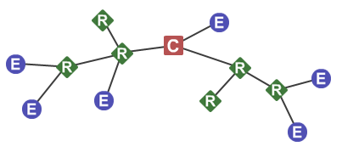
ZigBee Coordinators
Selects the channel and PAN IDs for the network
Can perform all the functions of a router including interfacing with end devices
Manages other functions to maintain the network
Must be continuously powered
Only 1 per network
Notes:
[C]

Slide 9
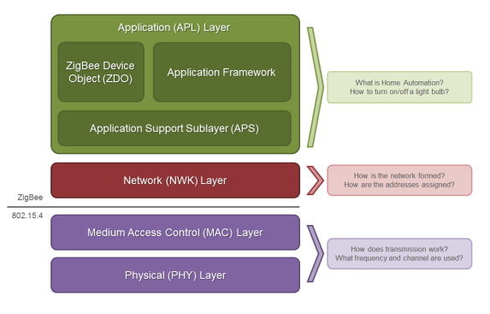
ZigBee Stack Layers
PHY
receive sensitivity, channel rejection, output power, number of channels, chip modulation, and transmission rate. 2.4 GHz ISM band, 250 kb/s data rate
MAC
Manages RF data transactions. Transmission retry and acknowledgment management, and collision avoidance techniques
Network
Adds routing capabilities for RF data packets. Traverse multiple devices to route data
APS (AF)
Application layer that defines various addressing objects including profiles, clusters, and endpoints.
ZDO
Application layer that provides device and service discovery features and advanced network management capabilities.
Notes:
[A]
Most network protocol use layers to separate different components to describe functions and components, as shown here
*run through each layer*, physical, medium access control, network, application layer containing application support sub-layer (or application framework) and ZigBee device objects
Zigbee is built on the physical layer and MAC sub-layer defined in the IEEE 802.15.4 standard. (IEEE 802.15.4 is a technical standard which defines the operation of low-rate wireless personal area networks, which is also the basis for ISA100.11a, WirelessHART, MiWi, 6LoWPAN, Thread and SNAP)
These layers handle low-level network operations such as addressing and message transmission/reception.
The Zigbee specification defines the Network layer and the framework for the application layer. The Network layer takes care of the network structure, routing, and security. The application layer framework consists of the Application Support sub-layer (APS), the Zigbee device objects (ZDO) and user-defined applications that give the device its specific functionality, such as the type of devices.

Slide 10
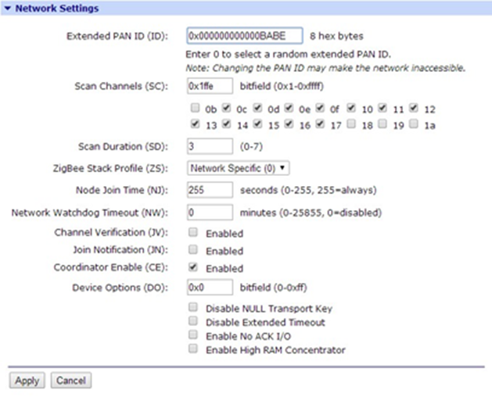
ZigBee Protocol
Zigbee networks are called personal area networks (PANs).
Each network is defined with a unique PAN identifier
Zigbee supports both a 64-bit (EPID) and a 16-bit PAN ID (PID). Devices on the same Zigbee network must share the same 64-bit and 16-bit PAN IDs.
Notes:
[A]
They either are pre-configured with a PAN ID to join, or they can discover nearby networks and select a PAN ID to join.

Slide 11
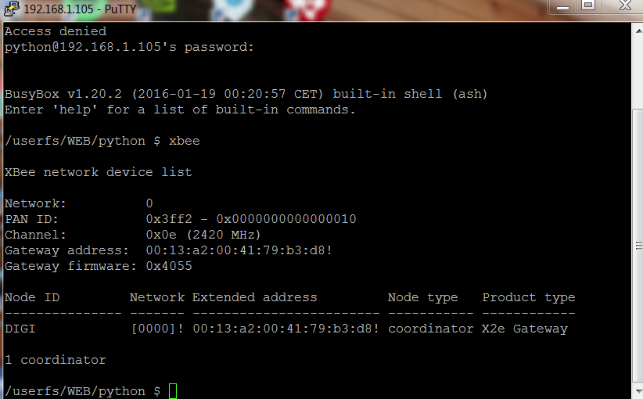
ZigBee Protocol Continued
Zigbee routers and end devices should be configured with the EPID of the network they want to join, and they typically acquire the PID when they join a network.
During a conflict, the Zigbee stack can perform PAN ID conflict resolution to change the PID
Notes:
[A]
Since the 16-bit PAN ID only allows up to 65,535 unique values, and the device randomly selects the 16-bit PAN ID, provisions exist in Zigbee to detect if two networks (with different 64-bit PAN IDs) are operating on the same 16-bit PAN ID.

Slide 12
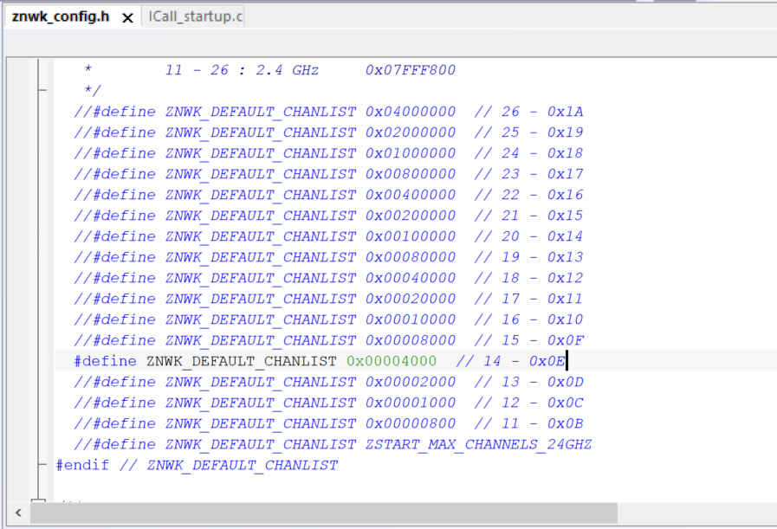
ZigBee Operating Channels
ZigBee uses direct-sequence spread spectrum modulation and operates on a fixed channel.
The 802.15.4 PHY defines 16 operating channels (channels 11 to 26) in the 2.4 GHz frequency band.
Notes:
[A]
generated with a particular bandwidth is deliberately spread in the frequency
Modulation
Resulting wideband channel more noisy, allowing for greater resistance to unintentional and intentional interference with high data rate

Slide 13
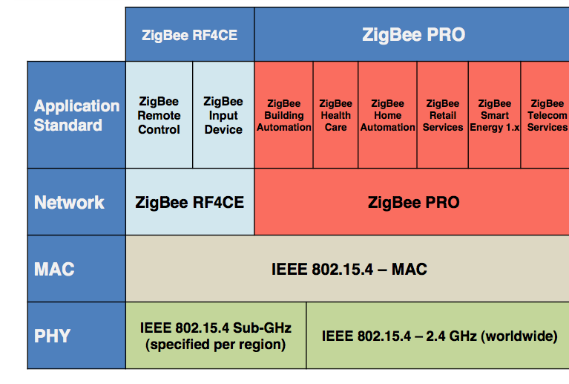
ZigBee Home Automation (HA) Standard
Notes:
[A]
HA is a public application standard profile, maintained by the ZigBee Alliance
Coordinator Commands

Slide 14
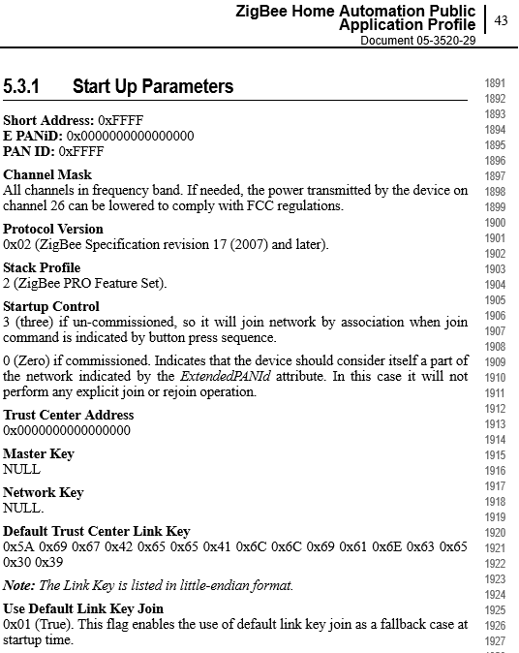
ZigBee Home Automation (HA) Standard
Gateway Commands:
ZS = 2
AP = 1
AO = 3
EE = 1
EO = 2
KY = ZigBeeAlliance09
Notes:
[A]
SensorTag already setup for HA standard
ZigBee PRO
API operating mode without escaped characters
Enable ZDO passthrough of ZDO requests to the serial port that are not supported by the Xbee stack
Enable encryption
Enable as a trust center (smart energy)
The Key

Slide 15
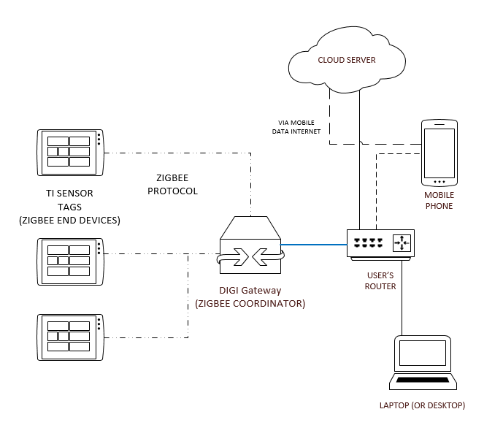
Block Diagram for our System
Notes:
[C]

Slide 16
Device Specifications
TI Sensor Tag (CC2650STK wireless MCU)
10 low-power sensors, including ambient light, digital microphone, magnetic sensor, humidity, pressure, accelerometer, gyroscope, magnetometer, object temperature and ambient temperature.
Ultra low power, coin cell battery, ARM Cortex-M3.
Uses Zigbee or 6LoWPAN.
Digi XBee® Gateway
Protocols: UDP/TCP, DHCP. Security: SSL tunnels, WEP-40, WEP-104, WPA/WPA2, Authentication with PSK and EAP
OS: Digi Embedded Linux
SimpleLink SensorTag Debugger DevPack
Small form-factor XDS110 debugger
Notes:
[A]
ZigBee device can communicate with your Wi-Fi router and connect to the Internet

Slide 17
Parts Ordered and Inventory
4x BLUETOOTH SENSOR TAG * 296-38831-ND
3x DEBUGGER FOR SENSORTAG * 296-42039-ND
1x Networking Modules XBee Gateway ZigBee to Ethernet Intl * 888-X2E-Z3C-E1-W
1x Capacitive soil moisture sensor
Micro USB cables, Personal Computers
Notes:
[A]

Slide 18
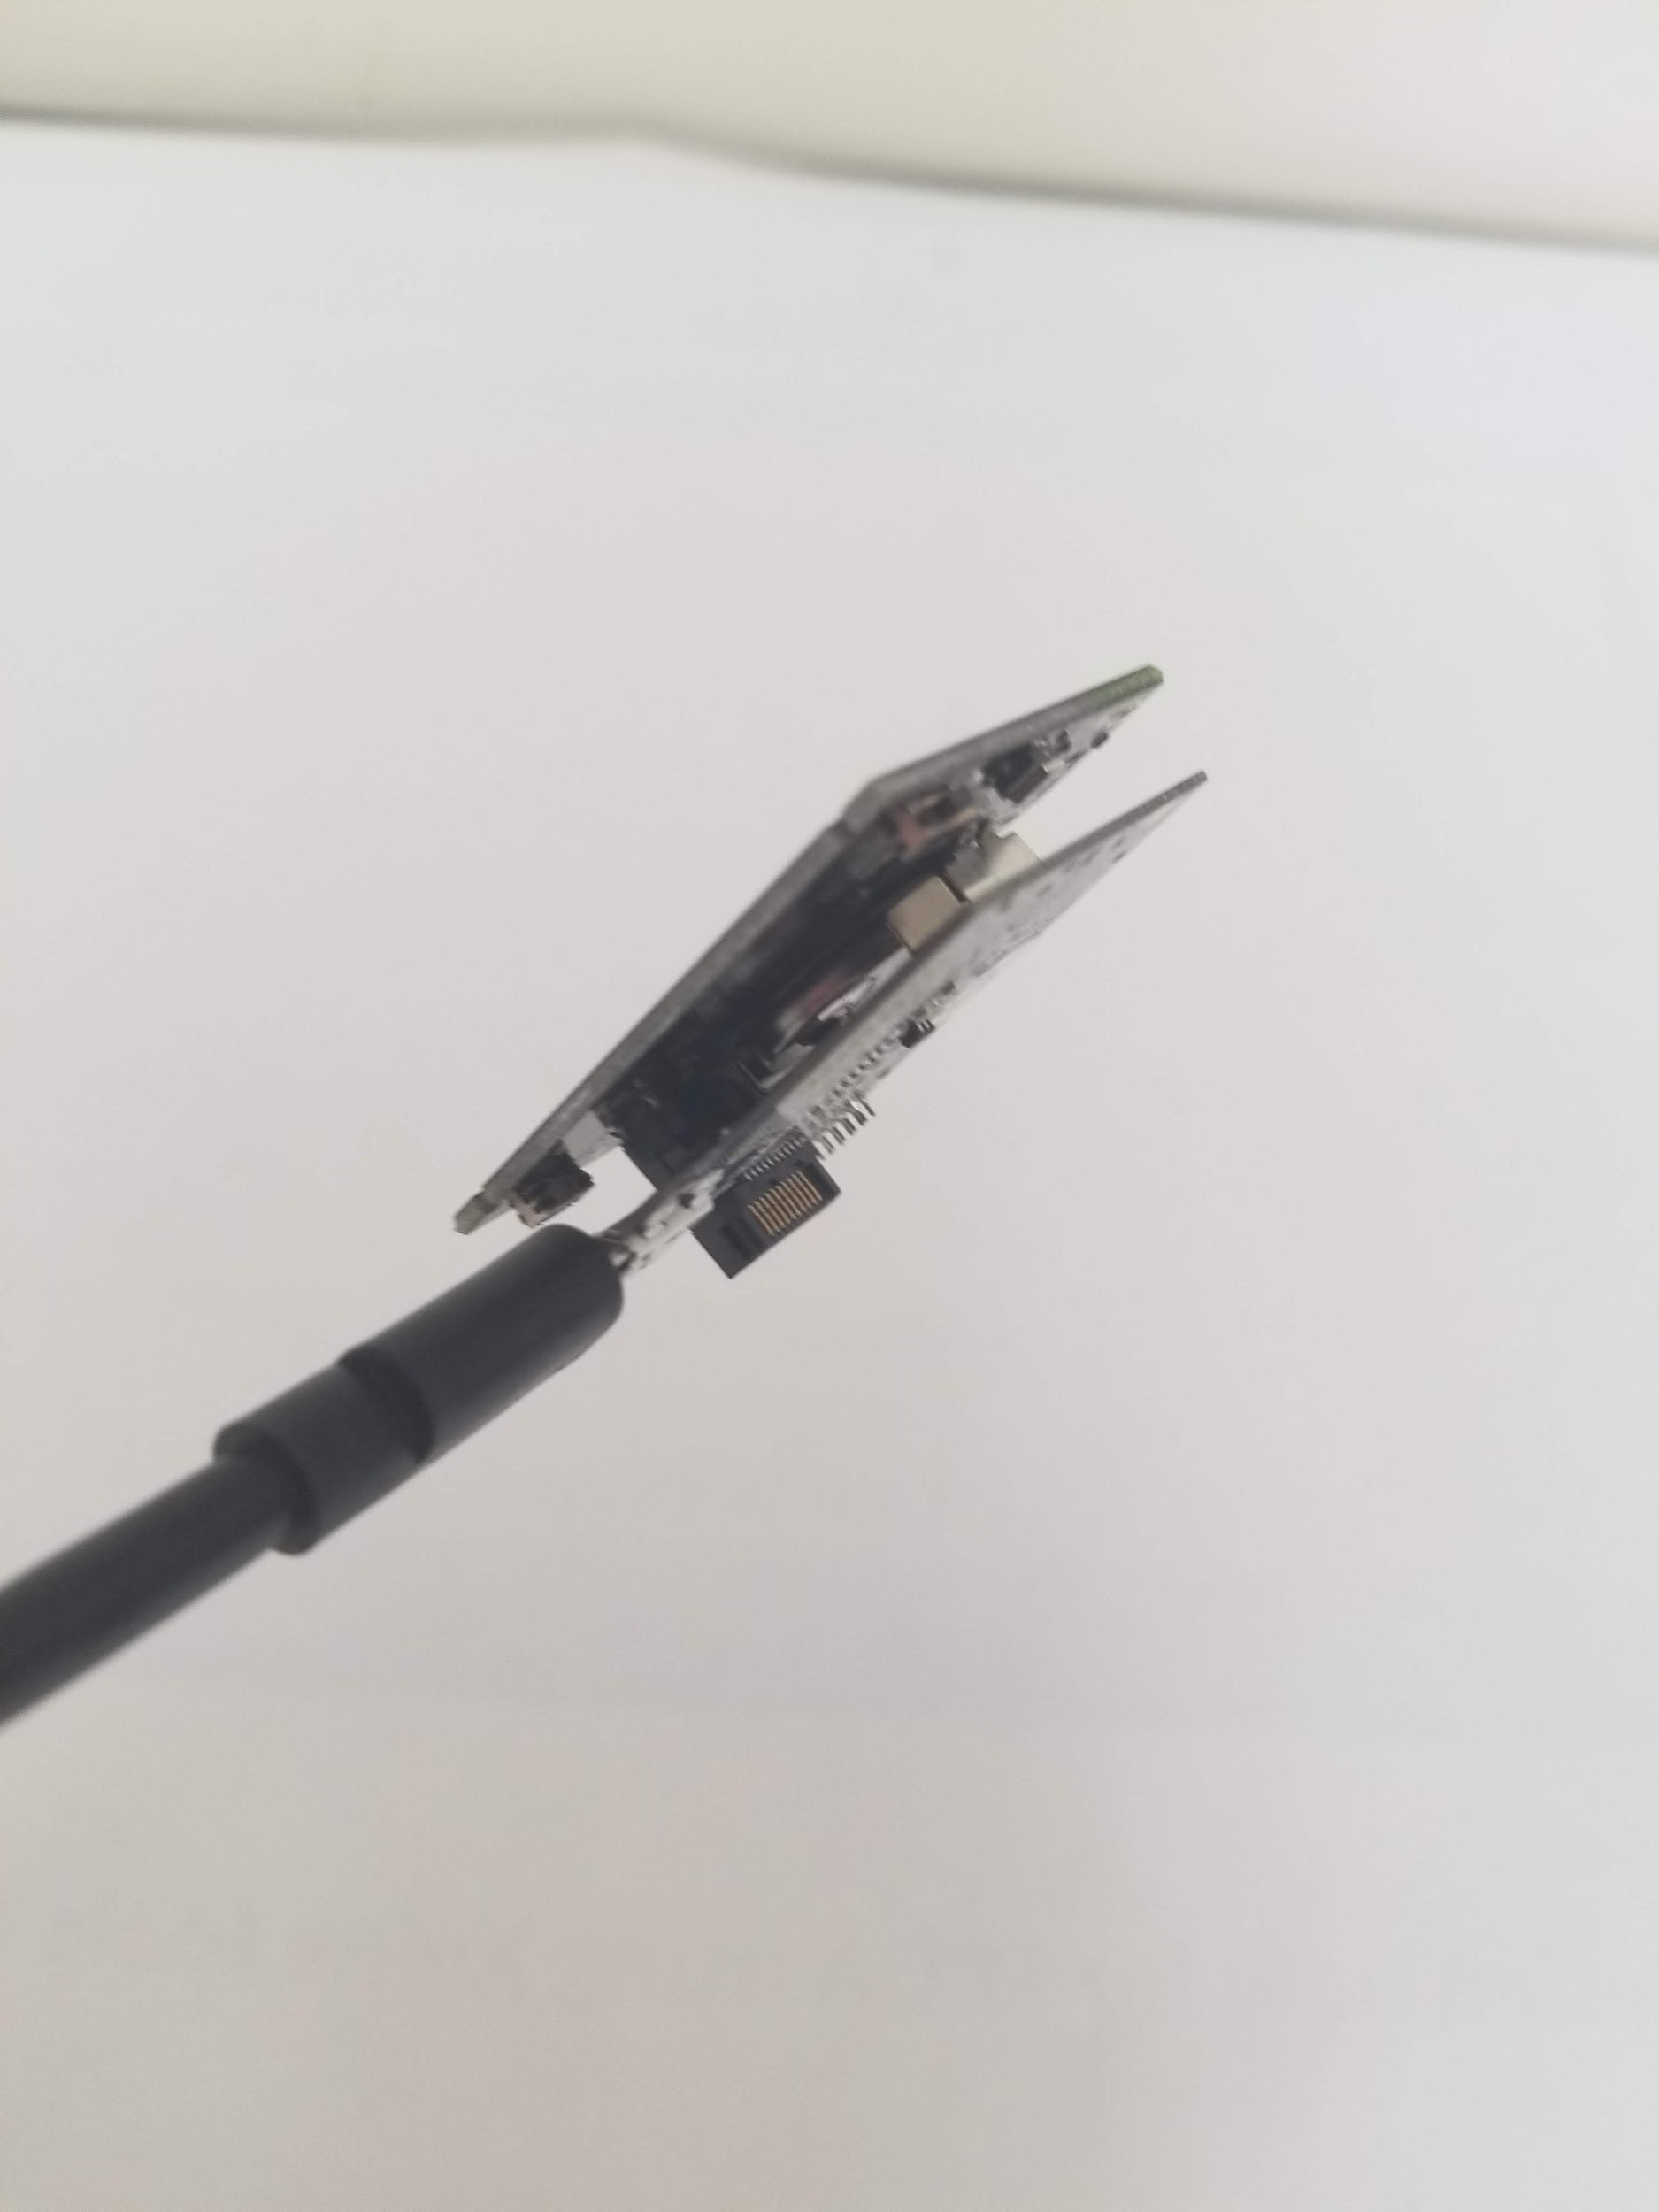
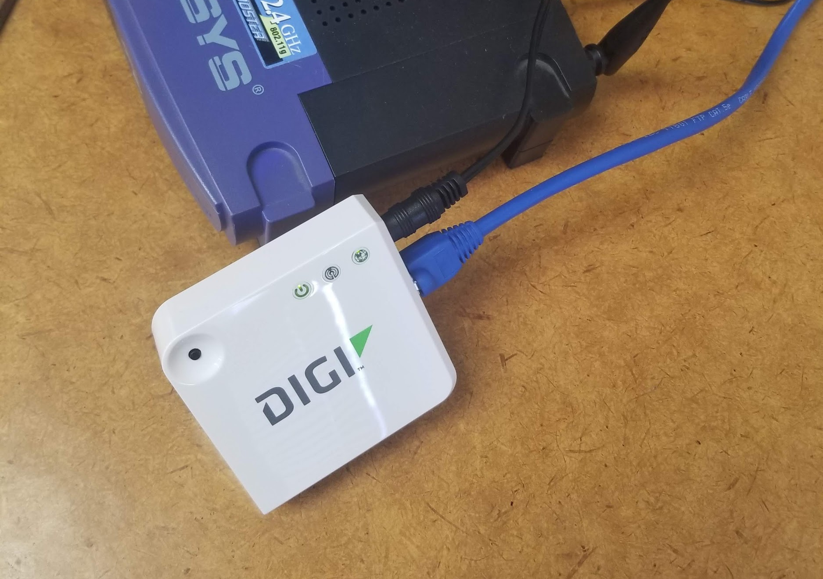
Parts Ordered and Inventory
Notes:
[A]
Note coin cell

Slide 19
Software
TI SensorTag App
Allows the change of specific settings such as sensor sampling time
Could be used to download the ZigBee stack profile
Flash Programmer 2
Loads .hex and .out files to the TI SensorTag via USB to debugger
DIGI Device Cloud
Used to remotely monitor and configure the DIGI gateway
Can download/upload python files
Pycharm 2018.3.5
Our choice for editing python code on the DIGI gateway
Notes:
[C]

Slide 20
Software Continued
Code Composer Studio
Easy to use, able to create test programs for TI SensorTags
Unfortunately, ZigBee capability is exclusive another IDE listed below
IAR Embedded Workbench
Our primary compiler and debugger for the TI SensorTags
ZigBee sample code required use of this IDE
Plagued with constant bugs
Expensive
Notes:
[C] Part of the code for ZigBee on the sensortags actually checks if IAR was used and will end the program if it was not

Slide 21
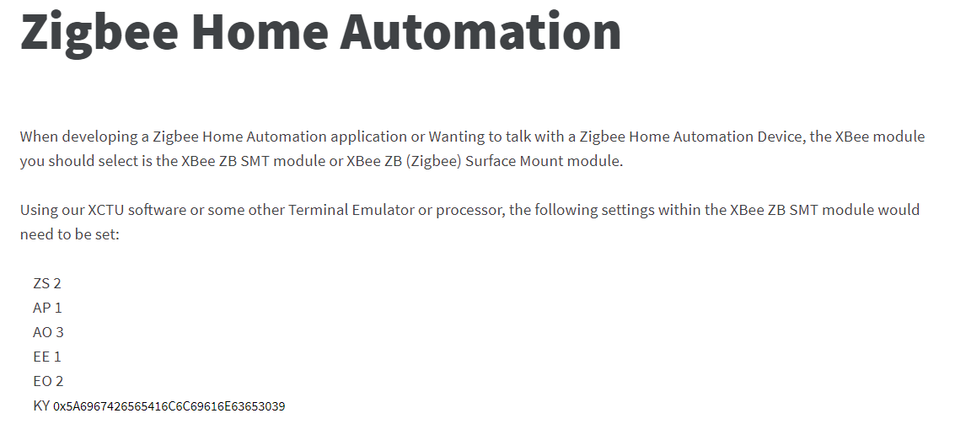
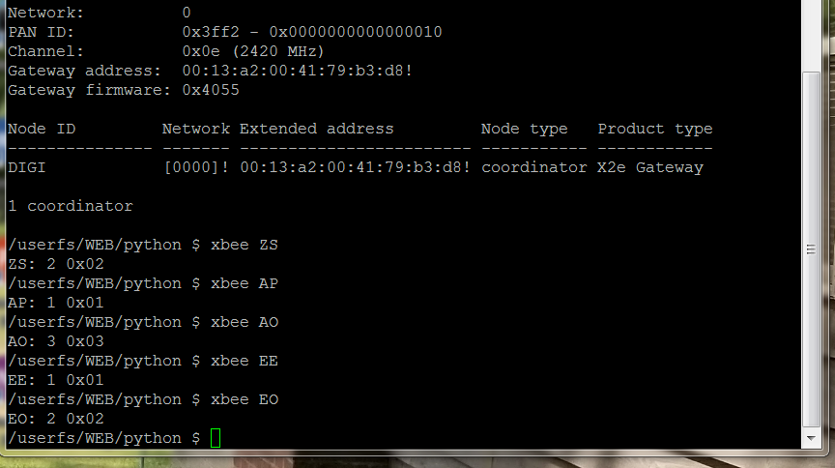
Troubleshooting Compatibility
Adjusted settings of SensorTag and DIGI Gateway
Little Success
Little assistance from documentation from both TI and DIGI
Compatibility issue(s)
Notes:
[A]
Lack of help on official forums
XBEE

Slide 22
Schedule
Timeline:
Fall Semester - Researched products for project and ZigBee
October - acquired components
February - Focused on finding firmware (ZigBee Stack) for SensorTag
March - Setup IAR, DIGI gateway, and started troubleshooting connection
April - Continued ZigBee/XBee troubleshooting and documentation
May - Finish final paper and presentation
Notes:
[A]

Slide 23
Division of Labor
Division of Labor
Typically combined effort by following agile pair programming
One would be the ‘driver’ who wrote code or changed ZigBee settings
The other would be the ‘navigator’ who checked changes and kept the overall goal of these changes in mind
These roles were switched often
Split into one person programming SensorTag and other programming DIGI gateway
Notes:
[C]
Clay worked on setting up gateway, until we used putty
Adam used putty and had IAR first then clay after license went out

Slide 24
Conclusion
Use of DIGI’s XBee is situational to where only DIGI devices will be interfaced with
Some companies have their own ‘brand’ of ZigBee with questionable cross compatibility
Beware inaccurate advertising
Next step would be understanding the ZCL (ZigBee Cluster Library)
Notes:
[C]
“Proprietary”
The ZigBee Cluster Library (ZCL) is intended to act as a repository for cluster functionality that is developed by ZigBee and, as a consequence, it will be a working library with regular updates as new functionality is added. A developer constructing a new application SHOULD use the ZCL to find relevant cluster functionality that can be incorporated into the new application so as not to “re-invent the wheel”. This also allows applications to be developed with more of an object oriented style approach.

Slide 25
Citations
[1] J. Lee, Y. Su and C. Shen, "A Comparative Study of Wireless Protocols: Bluetooth, UWB, ZigBee, and Wi-Fi," IECON 2007 - 33rd Annual Conference of the IEEE Industrial Electronics Society, Taipei, 2007, pp. 46-51.
[2] swrr134c.pdf CC2650 SensorTag Texas Instruments
[3] https://www.digi.com/resources/documentation/Digidocs/90002002/Default.htm#Containers/cont_operation.htm%3FTocPath%3DOperation%7C_____0
[4] A. Dementyev, S. Hodges, S. Taylor and J. Smith, "Power consumption analysis of Bluetooth Low Energy, ZigBee and ANT sensor nodes in a cyclic sleep scenario," 2013 IEEE International Wireless Symposium (IWS), Beijing, 2013, pp. 1-4.
[5] J. Lee, M. Dong and Y. Sun, "A preliminary study of low power wireless technologies: ZigBee and Bluetooth Low Energy," 2015 IEEE 10th Conference on Industrial Electronics and Applications (ICIEA), Auckland, 2015, pp. 135-139.
[6] N. Baker, "ZigBee and Bluetooth strengths and weaknesses for industrial applications," in Computing & Control Engineering Journal, vol. 16, no. 2, pp. 20-25, April-May 2005.
[7] E. Antonopoulos, K. Kosmatopoulos and T. Laopoulos, "Reducing power consumption in pseudo-ZigBee sensor networks," 2009 IEEE Instrumentation and Measurement Technology Conference, Singapore, 2009, pp. 300-304.
[8] A. A. Essa, Xuan Zhang, Peiqiao Wu and A. Abuzneid, "ZigBee network using low power techniques and modified LEACH protocol," 2017 IEEE Long Island Systems, Applications and Technology Conference (LISAT), Farmingdale, NY, 2017, pp. 1-5.
[9] Itsuki Tanabe, Hiroshi Sasaki and Li Zheng, "An ultra low power ZigBee module - AA batteries with life expectancy of 10 or more years!," 2008 5th International Conference on Networked Sensing Systems, Kanazawa, 2008, pp. 245-245.

