Slide 1
Electrochemical Impedance Spectroscopy Board
Will Anderson
Advisor: Dr. Huggins

Slide 2
Agenda
Problem Background
Problem Objectives
Review of Literature
Functional Description
Technical Description
Schedule

Slide 3
Problem Background
Battery dependency and usage at an all-time high
Need to use batteries efficiently and reliably
Two most common battery capability metrics:
State of Charge (SOC)
State of Health (SOH)

Slide 4
State of Charge
A metric that reports percentage of energy remaining as compared to maximum energy ^{[5]}
Multiple established methods of calculating:
Coulomb Counting
Open Circuit Voltage lookup table

Slide 5
State of Health
A subjective method able to inform user of overall condition and performance capabilities of battery ^{[5]}
Great deal of uncertainty
Many proposed methods require bulky and expensive equipment
Not viable for most battery management systems

Slide 6
Problem Objective
A lightweight, compact, low power, and inexpensive solution must be found for a real-time SOH monitor to be attached to a deployable battery.

Slide 7
Review of Potential State of Health Methods
Linear Approximation
Single Cell Impedance
Weighted Average
Log Book Function
Electrochemical Impedance Spectroscopy (EIS)

Slide 8
Linear Approximation
Crude measure of SOH
Based on roughly linear deterioration of capacity
Remaining cycle life can be estimated ^{[7]}

Slide 9
Single Cell Impedance
Simple and fast method ^{[7]}
Pulses battery with single high frequency excitation
Measures the high frequency resistance
Provides only information about electrolyte conductivity
Many aging effects only recognized at lower frequencies
Only suitable approach for recognizing behavior trends

Slide 10
Weighted Average
Measuring many cell parameters and combining their effects on age to estimate SOH ^{[7]}
Parameters: capacity, internal resistance, self-discharge,etc
Fuzzy logic often used to make sense of all the data

Slide 11
Log Book Function
Utilizing the battery usage history to estimate SOH ^{[7]}
Usage conditions: charge/discharge cycles, extreme operating conditions, battery abuse
Different because does not measure any parameters
No test equipment needed
Adds a lot of complexity and cost to the battery system

Slide 12
Electrochemical Impedance Spectroscopy
Established for laboratory experiments ^{[6]}
Perform impedance measurement at many frequencies to obtain impedance spectrum
All aging effects seen in results due to range of frequency
Can then produce:
Frequency Response Curve
Nyquist Plot

Slide 13
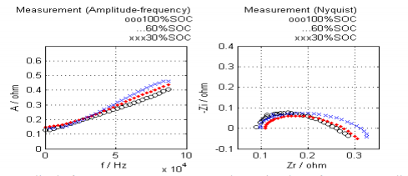
Electrochemical Impedance Spectroscopy Plots
Figure 1: Frequency Response and Nyquist Plots ^{[1]}

Slide 14
Electrochemical Impedance Spectroscopy
Basic Principle^{[1]}:
Input excitation signal -> observe response
Small sinusoidal voltage input
Linearity in response yields sinusoidal current output
Complex Impedance calculation:
Z(w)= V(w)/ I(w)

Slide 15
Problem Solution
EIS determined to be most effective solution
Proper implementation hopes to:
Enhance accuracy of SOC and SOH measurements
Fine tune individual cell balancing
Extend discharge cycles
Shorten charge cycles
Provide second life benefits

Slide 16
Problem Objective
Sandia National Labs has developed “EIS Board”
Points of difference from other EIS battery analyzers:
Inexpensive and lightweight solution
All calculations to be done on-board in real-time
Capable of utilizing EIS on deployable battery systems
My objective:
Write all of the firmware in order to implement the board
Test the board on power supply
Prove concept
Time allowing: Test on batteries and match to theoretical results

Slide 17
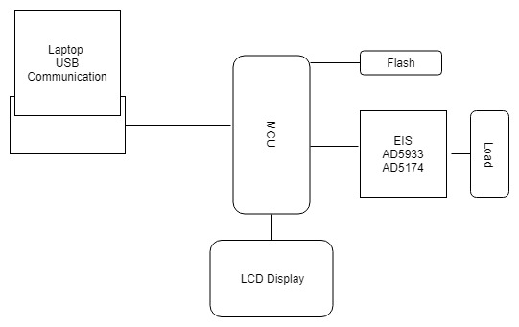
High Level EIS Board Block Diagram
EIS Board
Figure 2: High Level EIS Board Block Diagram

Slide 18
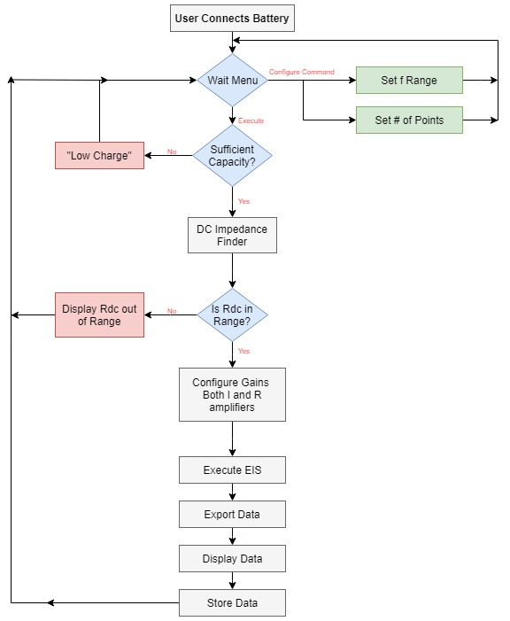
Software Flow of Functionality
Figure 3: Software Flow of Functionality

Slide 19
Functional Requirements
The system will have efficient firmware written for:
USB Communication
LCD Display
SPI and I2C Communication to EIS Hardware
The system will send and receive data from a load
The system will analyze the data and report results to user
The system will implement on-board EIS in real-time

Slide 20
Board Technical Specifications
Components/Parts List:
PIC24FJ128GB204 Microcontroller
AD5933 Impedance Converter
AD5174 Variable Gain Controller
NDH-C12832A1Z LCD Display
CP2102-GM USB Chip (Laptop, USB Cable)
25AA02UID Flash Memory

Slide 21
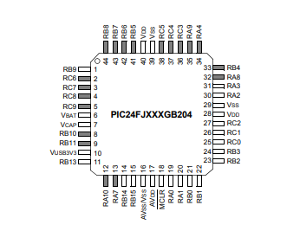
PIC24FJ128GB204 Microchip Microcontroller ^{[8]}
Extreme low-power features
Programmatically secure
High-performance CPU
SPI/I2C Communication
Figure 4: Microcontroller Pinout Diagram ^{[8]}

Slide 22
AD5933: Impedance Converter and Network Analyzer
Overview:
Combines on board frequency generator with 12 bit ADC^{[2]}
Allows for external impedance to be excited by known freq
Process:
ADC samples the impedance response
On-board DSP engine performs DFT of response
Complex impedance found by dividing transform of voltage by transform of current

Slide 23
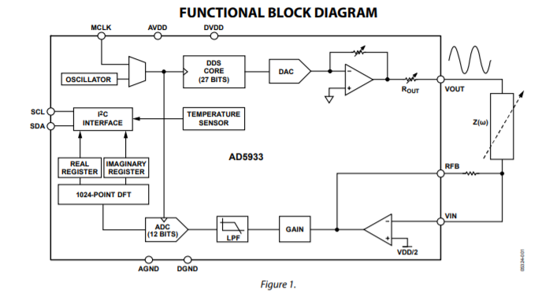
AD5933: Impedance Network Analyzer
Current to voltage amplifier
Determined by Rfb
Figure 5: Functional Block Diagram of AD5933^{[2]}

Slide 24
Example Usage of AD5933
DFT Operation ^{[2]}:
Calculated for each point in the frequency sweep
Where:
X(f) is power in signal at frequency f
x(n) is ADC output
cos(n) and sin(n) come from DDS core
Real and imaginary parts of X(f) stored in respective registers

Slide 25
Example Usage of AD5933
Impedance Calculation Using Gain Factor ^{[2]}:
Gain Factor is calculated upon calibration
Real register= A (decimal value)
Imaginary register= B (decimal value)
Magnitude= ((A)² + (B)²)^{1/2} = M
Impedance= 1/(Gain Factor x M) = Z (ohms)

Slide 26
AD5174: Digital Rheostat
Overview:
Variable gain control capabilities ^{[3]}
Designed to operate as a true variable resistor
Our Application:
Needed for configuring the gain
Allows handling of lower and higher impedance readings than typically capable in just having AD5933

Slide 27
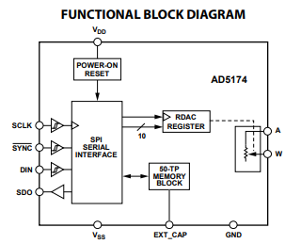
AD5174: Digital Rheostat
Figure 5: Functional Block Diagram of AD5174 ^{[3]}

Slide 28
Schedule
Month | Week 1 | Week 2 | Week 3 | Week 4
November | Project Proposal Draft (11/6) | Project Presentation Draft (11/13) | Presentation Practice | Proposal & Presentation Due
December | Website Development | Receive EIS Board | Firmware Development | Firmware Development
January | Firmware Development
February | Firmware Development | Firmware Development | Self-Check (2/19) | Firmware Development
March | Progress Evaluation (3/5) | Firmware Development | Testing Firmware | Testing Firmware
April | Final Report Draft (4/5) | Poster Print (4/11) Conference Abstract (4/12) | Presentation Draft (4/23) | Presentation Practice
May | Project Conference (5/4) | All Deliverables Complete (5/7)

Slide 29
Questions?

Slide 30
References
[1] Wang Li, Gen Wang Liu, and Fu He Yang. Design of Automatic Measurement System of Lithium Battery Electrochemical Impedance Spectroscopy Based on Microcomputer. Applied Mechanics and Materials, 241-244:259– 264, December 2012.
[2] “AD5933,” 1 MSPS, 12-Bit Impedance Converter, Network Analyzer. [Online]. Available: https://www.analog.com/en/products/ad5933.html#product-overview. [Accessed: 06-Nov-2018]
[3] “AD5174,” Single-Channel, 1024-Position, Digital Rheostat with SPI interface and 50-TOP Memory. [Online]. Available: https://www.analog.com/en/products/ad5174.html [Accessed: 06-Nov-2018]
[4] Uwe Tr¨oltzsch, Olfa Kanoun, and Hans-Rolf Tr¨ankler. Characterizing aging effects of lithium ion batteries by impedance spectroscopy. Electrochimica Acta, 51(8-9):1664–1672, January 2006.
[5] F. Huet, “A review of impedance measurements for determination of the state-of-charge or state-of-health of secondary batteries,” Journal of Power Sources, vol. 70, pp. 59-69, Jan 30 1998.
[6] A. Christensen and A. Adebusuyi, "Using on-board electrochemical impedance spectroscopy in battery management systems," 2013 World Electric Vehicle Symposium and Exhibition (EVS27), Barcelona, 2013, pp. 1-7. doi: 10.1109/EVS.2013.6914969
[7] “State of Health (SOH) Determination.” Battery and Energy Technologies, Woodbank Communications Ltd, www.mpoweruk.com/soh.htm.
[8] Microchip Technologies, https://www.digikey.com/product-detail/en/microchip-technology/PIC24FJ128GB204-I-PT/PIC24FJ128GB204-I-PT, Digikey Electronics, [Accessed: 03-Nov-2018].

