Slide 1
Self-Activating Fall Alert
Presented by: Hayley Langley and Sean Miller
Advised by: Dr. Imtiaz

Slide 2
Outline
Introduction
Review
Review of Literature
Previous Work
Proposal
Problem Statement
Significance
Functional Requirements
Specifications
Current Progress
Device Design
Parts List
Hardware and Software Block Diagram
Broad Overview of the System
Simulation of Data Collection
Project Plan
Division of Labor
Deliverables for ECE 499
Schedule for Completion
Conclusion

Slide 3
Introduction
Every 11 seconds, an elderly is treated in the emergency room for a fall; every 19 minutes, an older adult dies from a fall. [1]
Problems with Current Solutions
Inappropriately go off and difficult to maintain
Not self-automated
Fees
Previous Work
The device was created
Data collection was started
Our Plan
Energy Efficiency
More accuracy of fall detection

Slide 4
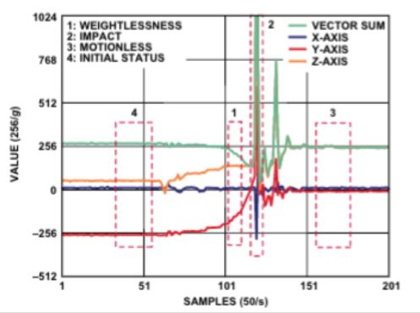
Review of Literature
Ideal location to collect acceleration data is the waist
Used an ADXL345, contains a 3-axis accelerometer
Magnitude of the acceleration, establish a threshold
Data to expect in Figure 1-1
Figure 1-1 Expected Data

Slide 5
Previous Work
Falls were successfully detected
Post-fall alerts were delivered effectively
Software Designed
Matlab
Which was too slow for real-time applications
C++
Worked well for real-time application
Designed a cost-effective, highly configurable fall/inactivity detection system
User-Friendly
Improved of current solutions

Slide 6
Problem Statement
A considerable population of senior citizens who have dementia, Alzheimer’s, or some other disease that affects their balance and coherence.
Therefore they could become incapable of contacting help
If these senior citizens fall then they may need medical attention, as such it becomes necessary for them to be able to contact help.
There is substantial evidence suggesting the longer a senior citizen is left unaided after a fall, their injuries will become more severe.
As such, it becomes necessary to design systems that can detect when someone falls, and automatically contacts assistance, therefore minimizing their time left unaided.

Slide 7
Significance
Falls present a very serious issue for senior citizens with one fifth of all falls causing a serious injury.
Annually 2.8 million people are seen in the emergency room for falls; 800,000 of them will need to be hospitalized for injuries received from that fall.
These falls cost 31 billion dollars annually.
Additionally, these falls cause serious injuries to senior citizens as 95 percent of hip fractures are caused from falling. These falls could also cause some sort of traumatic brain injury[1].
One in three seniors has Alzheimer's disease or some other form of dementia at the time of their death.

Slide 8
Significance (continued)
There are more than 5 million Americans currently living with Alzheimer's and this number is projected to approach 16 million by 2050.
Medical devices such as life alert naturally assumes the user knows that they are wearing the device, and hence have the ability to interact with it.
In the case of dementia patients, this assumption fails.
Medical devices have been developed to contact assistance for fallen seniors, but these devices provide no post processing.

Slide 9
Functional Requirements
Inputs
An acceleration vector
IMU generates an acceleration vector in real and polar coordinates
Power
Device requires energy to run
Outputs
Call for help
Capable of contacting assistance if fall occurs
Data stream
Contains raw data from the device
Used for post analysis
Signal for indicating prolonged inactivity
Modes
Active
Check the acceleration data and check for a fall
Sleep
Is used to save power by taking less samples when patient is inactive

Slide 10
Specifications
Sampling Rate of Data: 0.3 microseconds
Sampling Frequency: 16 MHz
Length of Device Battery Life Maximized
Accurately Report Falls
Reduce the Number of False Positives
Reliable Data Transfer
User Friendly
Minimization of Device Size
Minimization of Energy Consumption of Device
Notes:
Satisfy Nyquist Sampling Criterion
96% fall detection
5% false positives
Reliable Data Transfer
Minimum Battery Life

Slide 11
Current Progress
Preparing the Data Collection Device
Collect Data
Begin the data analytics necessary for this project
Chosen prototype that is to be distributed to volunteers
Create a database of data
Selected new hardware
Old device was discontinued
More reliable for data

Slide 12
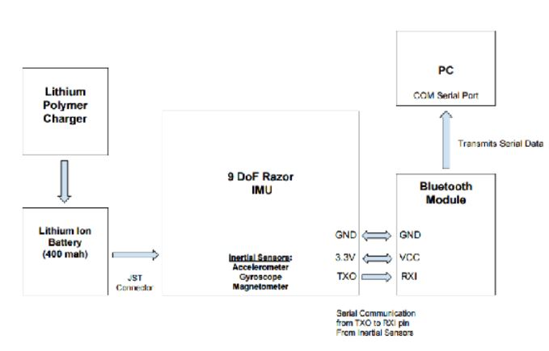
Device Design
Figure 1-2 Block Diagram of Device

Slide 13
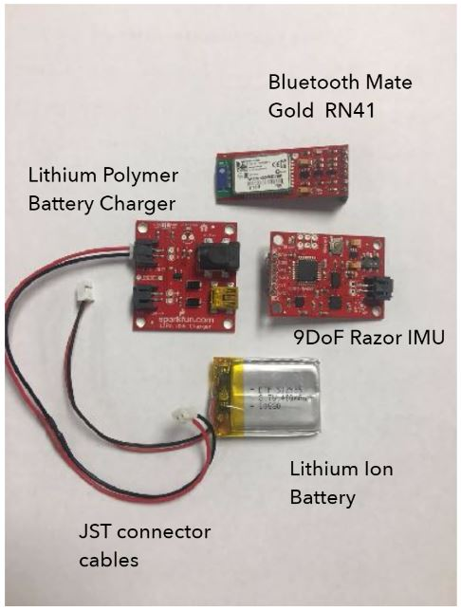
Parts List
9DOF Razor IMU
Bluetooth Mate Gold Module
400mAh Lithium-Ion Battery
JST Connector (Male-to-Male)
Figure 1-3 Device Components

Slide 14
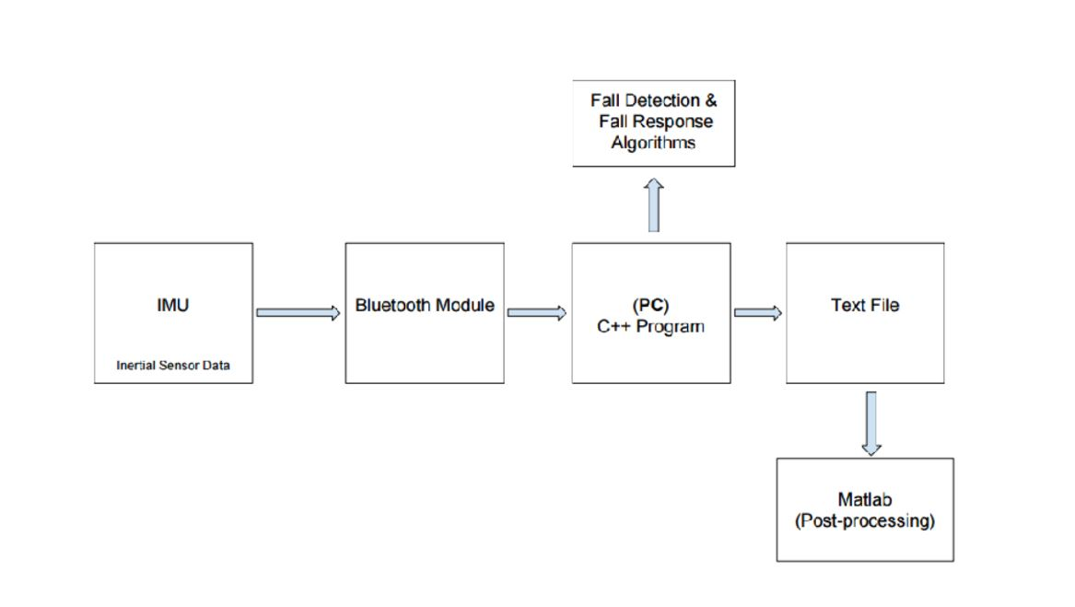
Hardware and Software Block Diagram
Figure 1-4 Block Diagram of Device and Software

Slide 15
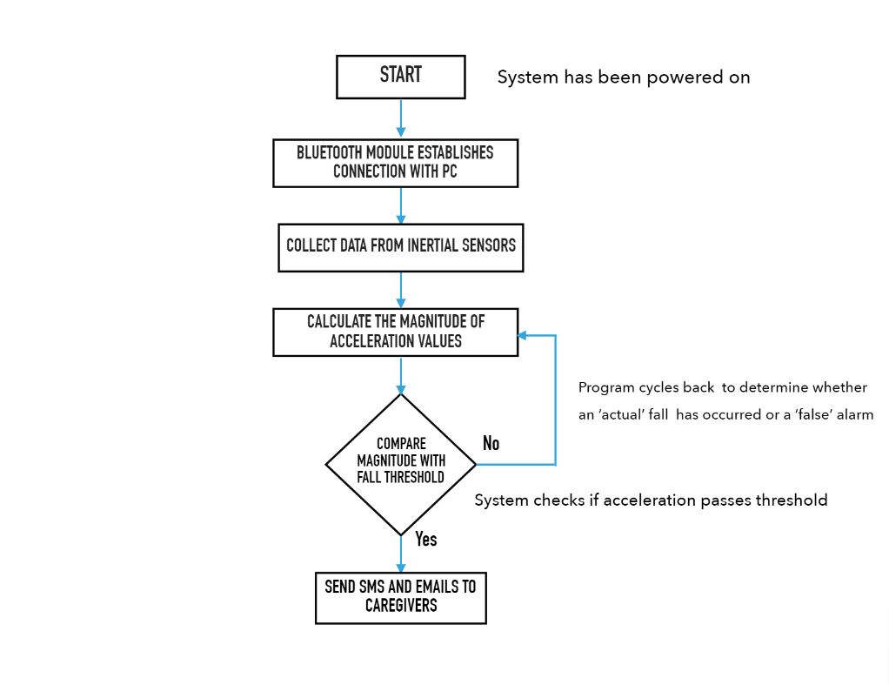
Broad Overview of the System
Figure 1-5 Flowchart of System

Slide 16
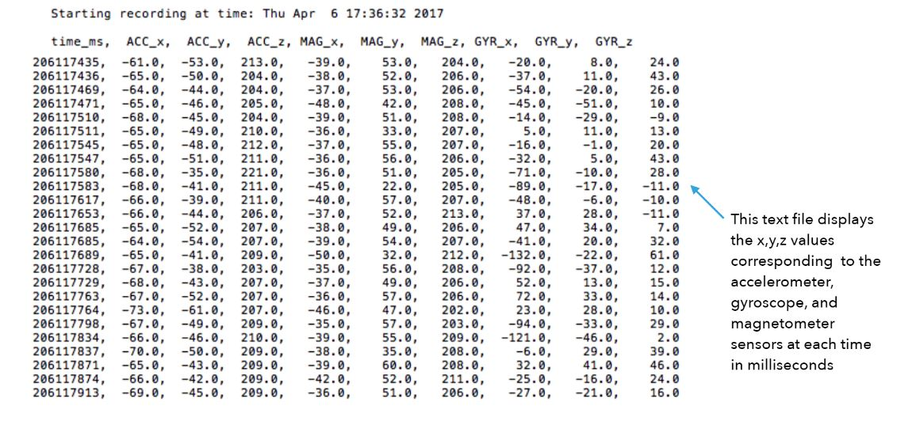
Simulation of Data Collection
Figure 1-6 Screenshot of Data

Slide 17
Project Plan
Design software drivers will constantly record the user’s movement data
Recorded if the user’s movement data is consistent with a fall
Some of this data will be stored for later comparison and data analysis, otherwise the data will be overwritten
For a fall to be recognized initially the acceleration of the user must be both near the gravitational acceleration constant, as well as decreasing suddenly
Using a Google account to send texts to the user’s designated contacts

Slide 18
Project Plan (Continued)
Once the device is capable of these functionalities
Distribute the prototype to fall risk volunteers
The prototype transmits anonymized data preceding the fall for statistical analysis
Analyzed by an artificial neural network.
Several volunteers who are not at a risk of falling will be given the device
Establish a baseline muscle usage for low-fall risk individuals
Coefficients will then be calculated for muscle movement
Used to see what muscle is not performing optimal

Slide 19
Main Focus of Project
Write Device Drivers
More accurate detection
Eliminate false positives
More control of the device
Minimize Energy Consumption
Maximize Battery Life of the Device

Slide 20
Division of Labor
Statement of Problem – Sean and Hayley
Functional Requirements – Sean and Hayley
Proposal - Sean and Hayley
Proposal Presentation – Hayley
Part Ordering -Sean
Data Collection -Hayley
Previous Device Working -Hayley
Algorithms - Sean

Slide 21
Deliverables for ECE 499
Table 1-1 Schedule of Assignments
Due Dates | Assignments
December 7th, 2017 | Project Website
February 15th, 2018 | Midpoint Project Progress Self-Check
March 9th , 2018 | Student Expo Registration
March 29th, 2018 | Final Report
March 30th, 2018 | Student Expo Abstract
April 5th, 2018 | Poster Print
April 10th, 2018 | Expo Poster Setup
April 12th, 2018 | Expo Poster Judging
April 13th, 2018 | Award Ceremony
April 17th, 2018 | Final Presentation
May 1st, 2018 | All Deliverables Completed and Uploaded to Website

Slide 22
Schedule of Completion
Table 1-2 Schedule of Milestones
Due Dates | Milestones
November 15th, 2017 | Device Ready for Data Collection
January 31st, 2018 | Data Collection Started, if not earlier
February 11th, 2018 | Writing of the Drivers
March 1st, 2018 | Testing of the Drivers
March 20th, 2018 | ANN and Coefficients Tested

Slide 23
Conclusion
Improve the detection accuracy
Maximize Battery life
Ultimately this device could improve the treatment of falls
Allows falls to be treated at the source
This could reduce the amount of falls, and therefore reduce the amount of effort society must spend on falls.

Slide 24
References
[1] “Important Facts about Falls | Home and Recreational Safety | CDC Injury Center.” [Online]. Available: https://www.cdc.gov/homeandrecreationalsafety/falls/adultfalls.html. [Accessed: 16-Nov-2017].
[2] “Latest Alzheimer’s Facts and Figures,” Latest Facts & Figures Report | Alzheimer’s Association, 17-Sep-2013. [Online]. Available: //www.alz.org/facts/overview.asp. [Accessed: 16-Nov-2017].
[3] FallAlert2017, Contribute to Self-Activating-Fall-Alert development by creating an account on GitHub. 2017.

Slide 25
Questions?

