Slide 1

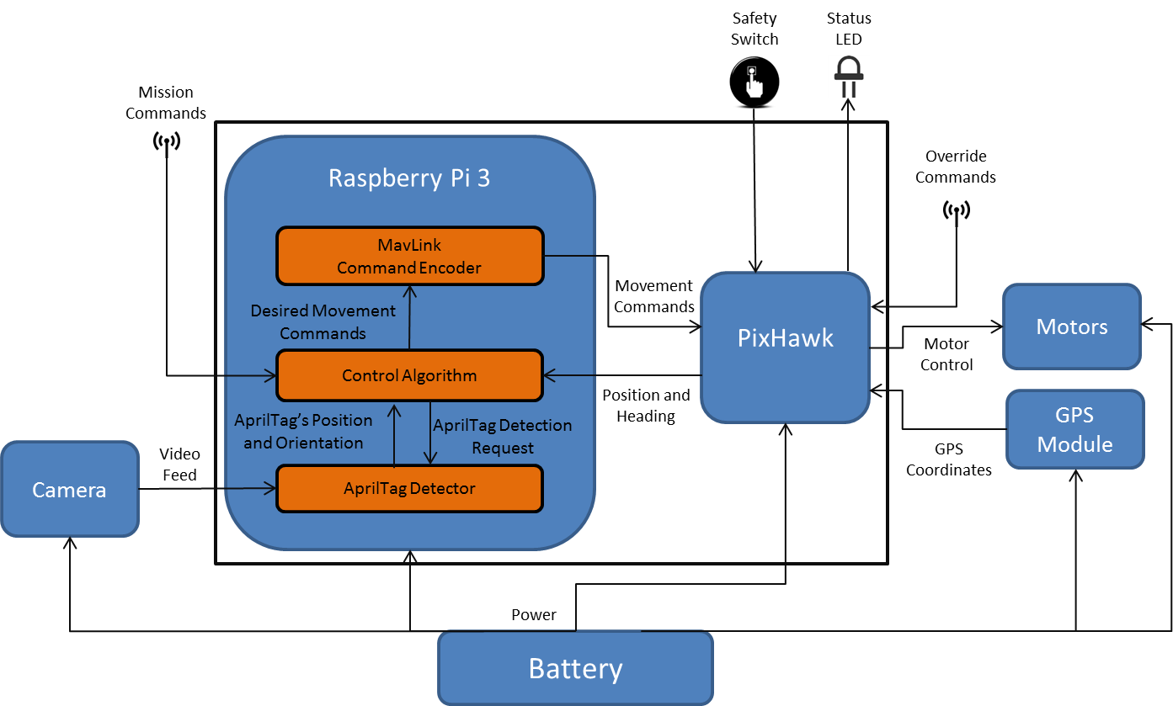
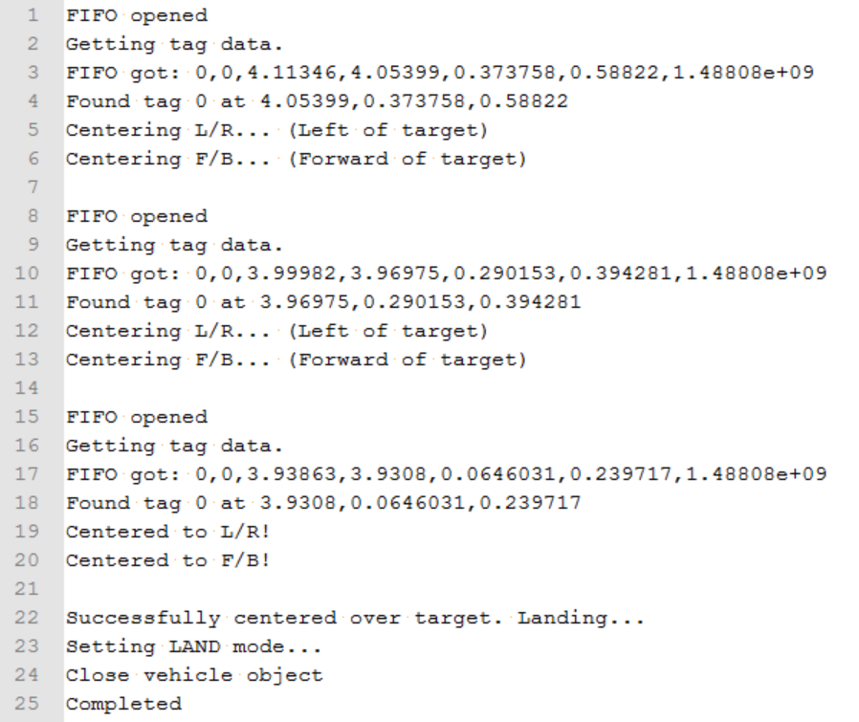
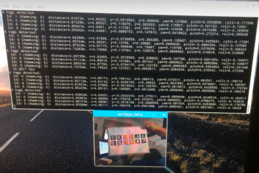
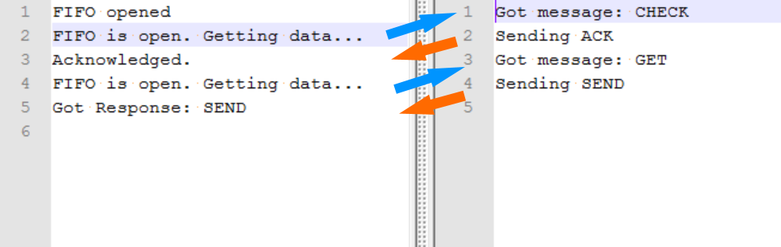
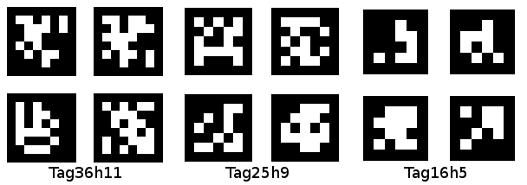
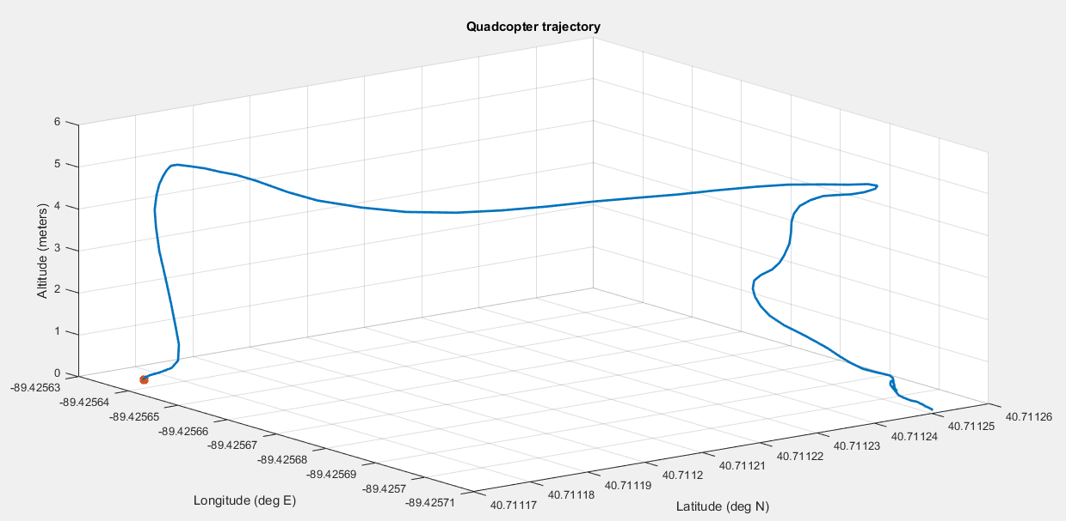
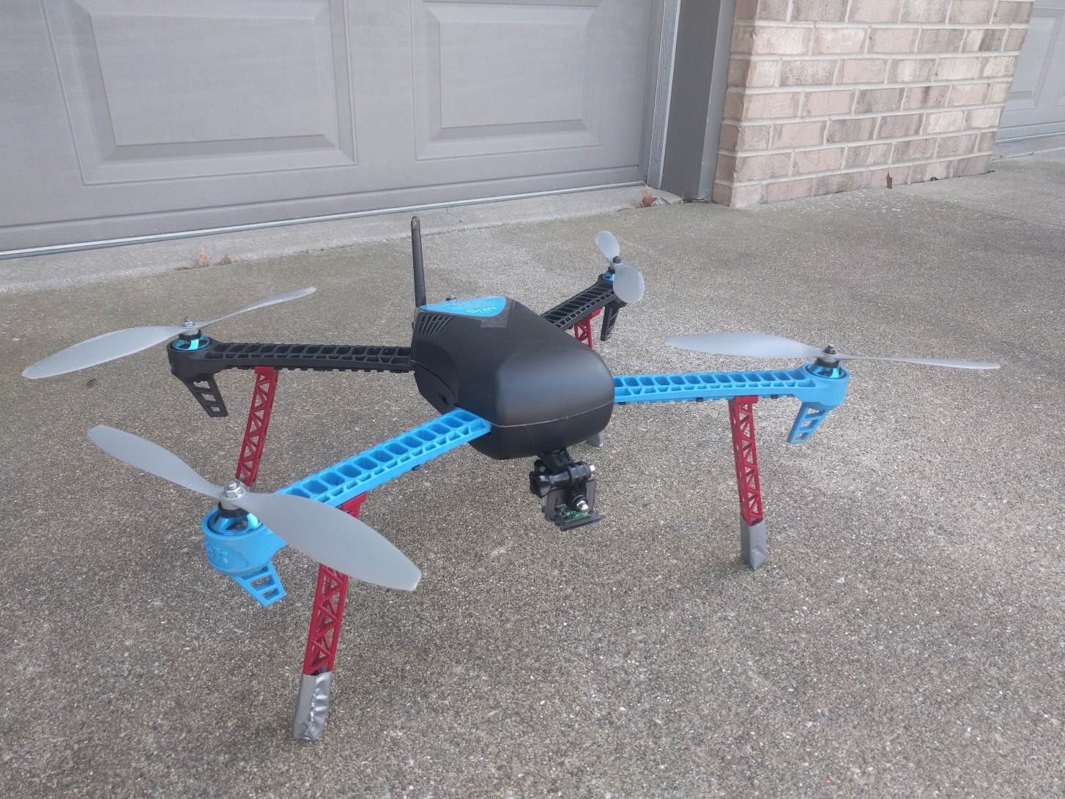
Vision Based Autonomous Control of a Quadcopter
By Zach Engstrom, Jeff Deeds, Caleb Gill, and Zack Woods
Advised by Drs. Yufeng Lu, Jing Wang, and In Soo Ahn
Motivation
System Block Diagram
Results
Results (cont.)
Unmanned Aerial Vehicles (UAVs) have been widely used in a variety of civilian applications including industrial inspection, remote sensing for mapping and surveying, and emergency response. The ever-improving technology in sensing and computation makes it possible to broaden the applications of UAVs. In this project, an autonomous quadcopter is designed to take off and execute mission plans under the guidance of system vision input.
Objective
The autonomous quadcopter should complete the mission as follows.
1. Take off autonomously and reach a specified altitude.
2. Fly to the target specified by GPS coordinates.
3. Locate the target by identifying the AprilTag.
4. Center over the target.
5. Land by the target.
Figure 8: An Example of a Successful Mission
Figure 3: System Block Diagram
Figure 5: An Example of AprilTag Detection
Conclusion and Future Work
System Flow Chart
In this project, a vision-based autonomous control of a quadcopter has been designed. The quadcopter successfully completes the mission plan autonomously under the guide of vision input. The AprilTag-based vision tracking algorithm has been proved to be robust to lighting condition and view angles.
Future work:
Better quadcopter platform for higher thrust to weight ratio, longer battery life and speedy computation
Implement search algorithms to cover a large viewing area
Include obstacle avoidance algorithms to operate in more complex environments (extra sensors needed)
Multiagent configuration for swarm intelligence
Figure 6: An Example of Named Pipe Communication
(Left: Python Client, Right: C++ Server)
Figure 1: Examples of AprilTag used for robot tracking
Platform
3DRobotics Iris+ Quadcopter
Autopilot: Pixhawk PX4
Embedded Vision System: Raspberry Pi 3
with Camera
Module V2
References
Choi, Hyunwoong, Geeves, Mitchell, Alsalam, Bilal, & Gonzalez, Luis F. (2016).
Open source computer-vision based guidance system for UAVs onboard decision making. In
2016 IEEE Aerospace Conference, 5-12 March 2016, Yellowstone Conference Center, Big
Sky, Montana. http://eprints.qut.edu.au/93430/
E. Olson, "AprilTag: A robust and flexible visual fiducial system," 2011 IEEE International
Conference on Robotics and Automation, Shanghai, 2011, pp. 3400-3407.
doi: 10.1109/ICRA.2011.5979561
Figure 7: An Example of Quadcopter Movement
(Star = Launch Location)
Figure 2: Autonomous Quadcopter
Acknowledgement
Figure 4: System Flow Chart
This project is partially supported by Air Force Research Laboratory Grant FA8750-15-1-0143 (Dr. Jing Wang, 2014-2017)

