Slide 1
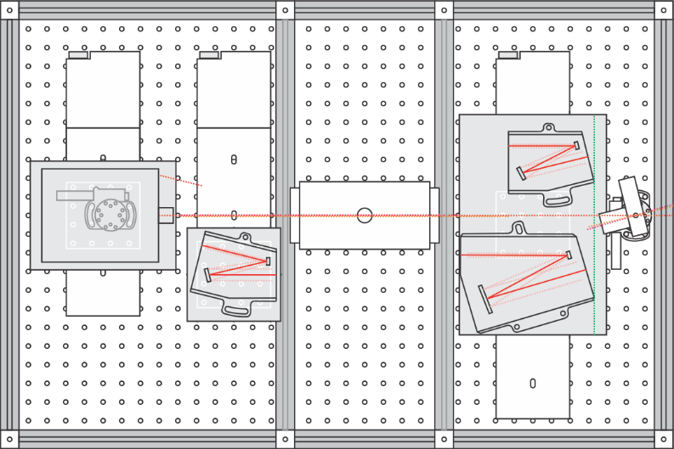
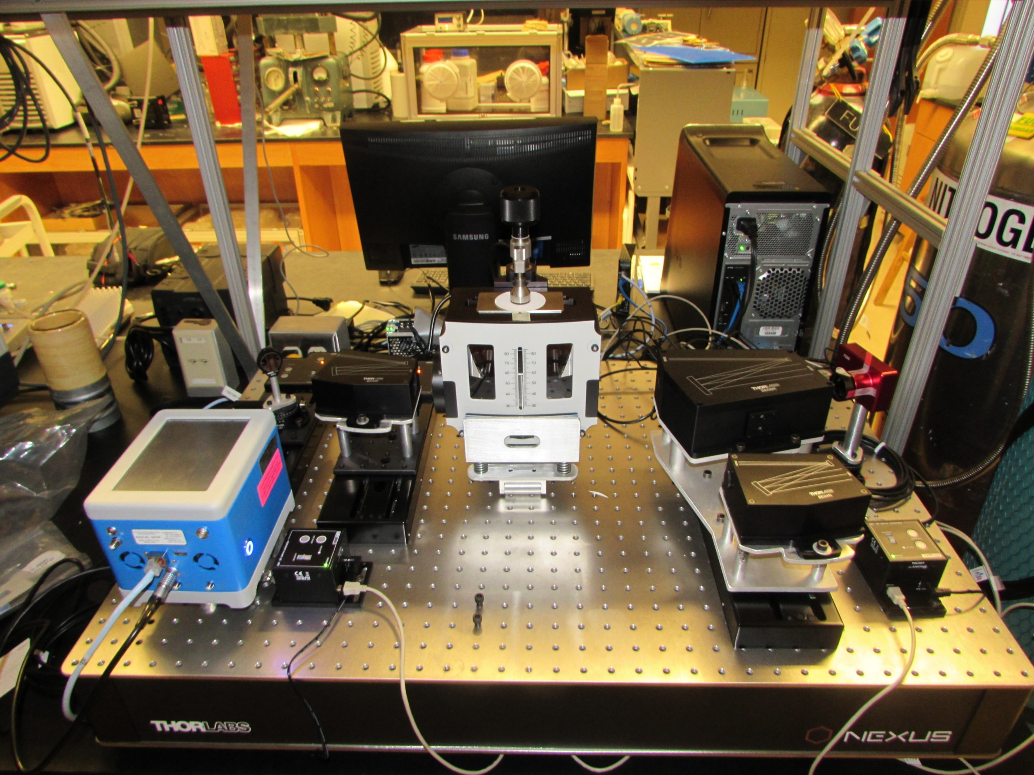
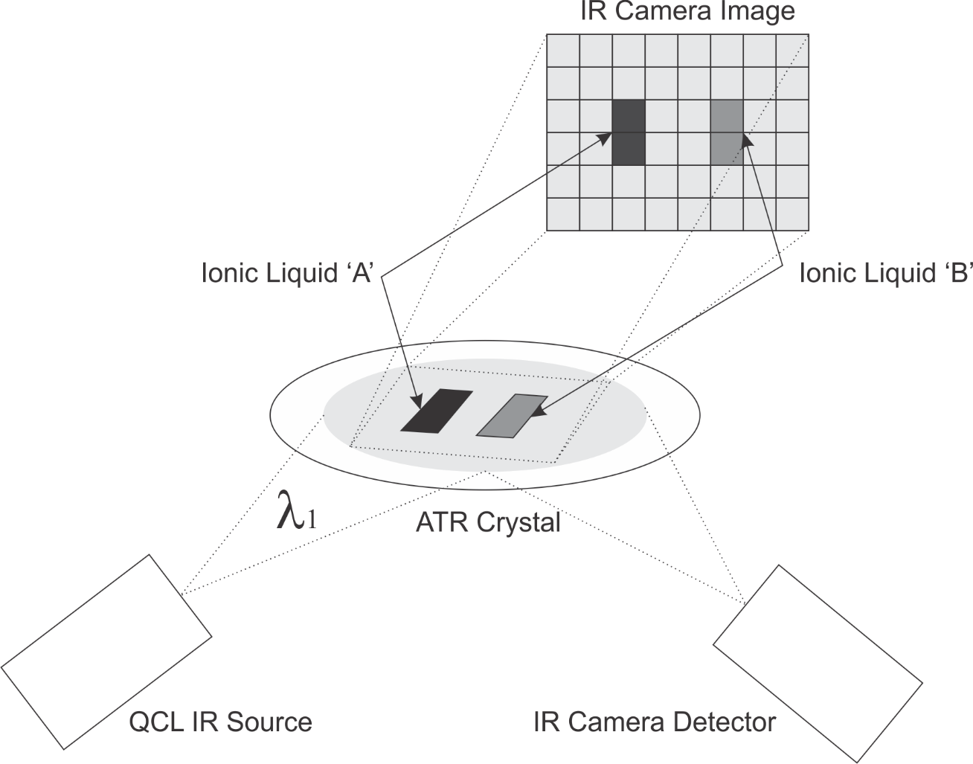
Two Dimensional Infrared Spectroscope with Time Averaging
By: Brent Leinonen Advised by: Dr. Aleksander Malinowski and Dr. Luke Haverhals
Work done
Abstract
Work that was done this semester includes the following:
Development of GUI
Integration of USB Relay for remote on/off
Working with customer
An Infrared Spectrometer is an instrument mainly used by chemists to allow the identification of chemical bonds within molecules and some ionic materials. Many types of chemical bonds absorb unique sets of frequencies of the infrared light. One can use that knowledge to determine when there is a certain bond (and therefore a certain type of molecule) in the researched material. The main drawback of standard infrared spectrometers is that the instruments are configured to only allow the interrogation of a relatively small portion of the material (i.e., the average spectroscopy within an relatively narrow region of interest). Here, we detail the development of an infrared spectrometer that enables much larger two-dimensional areas to be interrogated ‘pixel by pixel’. This allows much more sophisticated analyses of various types of materials to be performed.
Purpose and Applications
The ability to research a larger area over time allows us to gather a thorough understanding of the structure and dynamics of Ionic liquids, a promising alternative to traditional solvent-solute electrolytes.
Conclusion
Although there is still much work that needs to be done, we have made significant progress this semester with the development of a GUI and other successes.

