Slide 1
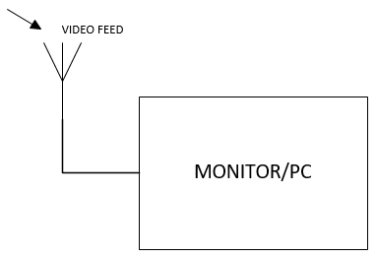
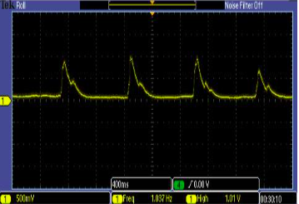
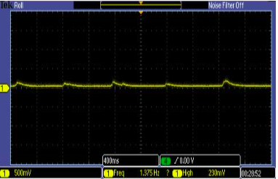
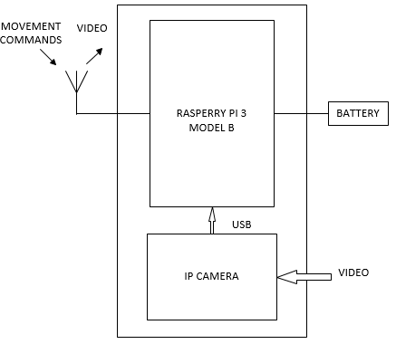
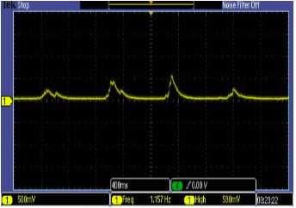
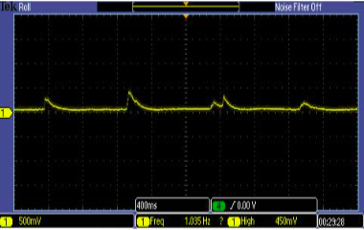
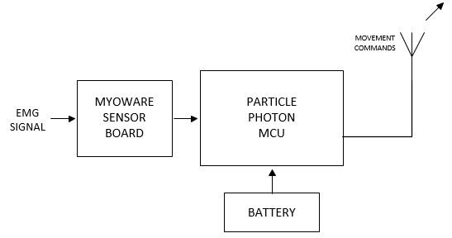
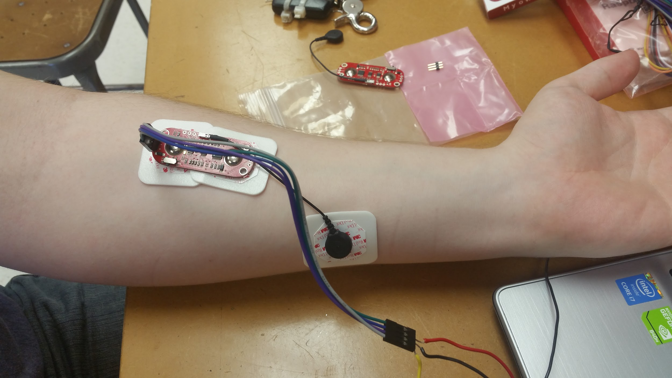
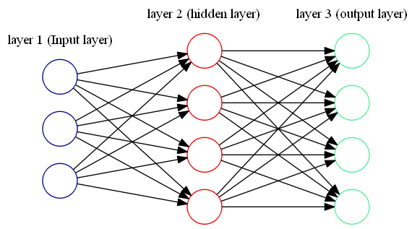
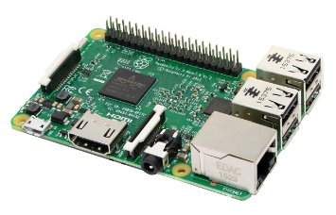
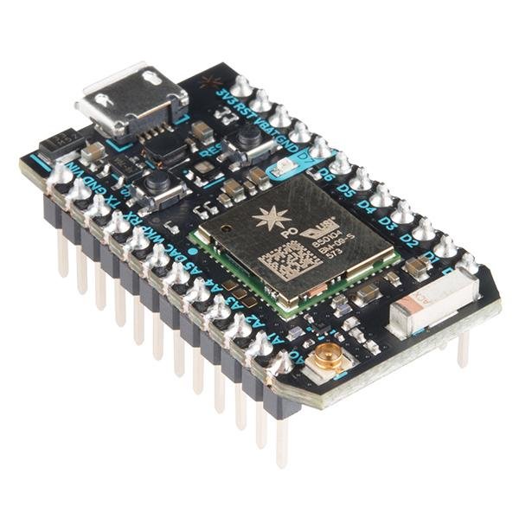
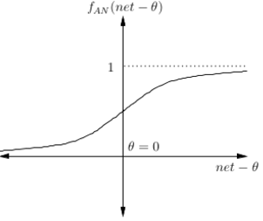
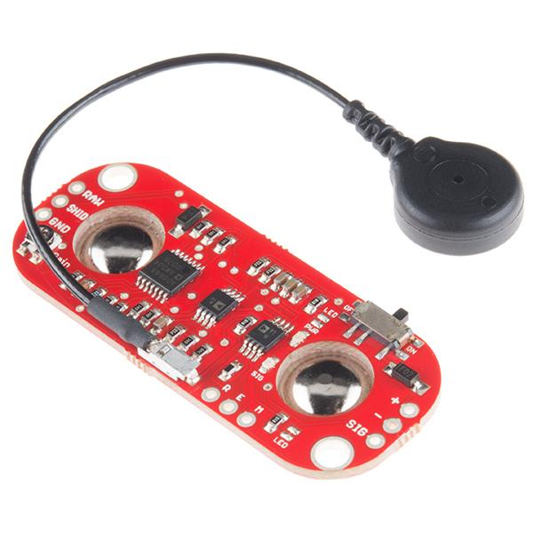
EMG-HUMAN MACHINE INTERFACE SYSTEM
Jonathan Morón, Thomas DiProva, John Cochrane
Advisors: In Soo Ahn, and Yufeng Lu Department of Electrical and Computer Engineering, Bradley University, Peoria ^{IL, USA}
Introduction
System Block Diagram
Figure 9. Wrist Figure 10. Index Finger
Figure 11. Middle Finger Figure 12. Fist
Figure 13. Sensor Placement
This project has a multitude of future applications. In the medical field the use of EMG signals generated from muscles could be applied to assisted motion and exoskeletons. Benefiting stroke or paralysis victims. This technology is also useful as a means of controlling robots or other platforms since it is noninvasive and reliable.
All subsystems can successful in communicating with each other through a TCP/IP network. A Mobile Hotspot is established to have a reliable communication network. The Raspberry Pi 3 is able to read the correct commands and generate PWM to specification. Along with controlling the speed and direction of the wheel robot, the Pi also hosts a website for video feedback.
The neural network classifies and calibrates the users recorded finger movement EMG signals. The network learns the given inputs upon the system has completed calibration. The EMG control subsystem successful sends the respective commands to move the mobile robot platform while simultaneously having a live video feed from the IP camera attached to the Raspberry Pi 3.
.
EMG Classification Signals
Electromyogram (EMG) signals are generated by muscles when activated by the nervous system which generates electric potential. Surface EMG electrodes (sEMG) can be used to assess the muscle motion by attaching the sensors to the skin above the desired muscle. EMG signals can be useful for developing systems to improve the ability of living for those with psychomotor skill disabilities. The medical field has benefited from intensive research in EMG signals.
This project aims to develop an EMG-based human machine interface system for in home assistance, especially for disabled people. A wearable Wi-Fi sensor board is used to record sEMG signals and send out wireless control commands. A wheeled robot is controlled wirelessly and equipped with feedback vision system. The video monitoring system assists the user for navigation of the robot.
Raspberry PI 3 Model B
The Raspberry Pi microcomputer receives movement instructions from the Photon Particle which directs the service robot
platform to move.
Figure 1. Raspberry Pi 3
Particle Photon
The Particle Photon microcontroller runs artificial neural network for classification. It also utilizes analog-to-digital (A/D) converter and its WIFi capabilities to interface with the EMG sensor board and Raspberry Pi 3 respectively.
Figure 2. Particle Photon
MyoWare Muscle Sensor Board
The MyoWare board includes instrumental amplifiers to amplify the raw EMG signal, and provides the EMG data for the Particle Photon microcontroller board.
Figure 3. MyoWare sensor board
VIDEO MONITORING SYSTEM
SERVICE ROBOT SYSTEM
Objective
EMG CONTROL SYSTEM
Figure 4. System Block Diagram
Hardware
EMG Classification: Artificial Neural Network
Significance
Figure 5. Artificial Neural Network
The EMG control system utilizes an artificial neural network to recognize the patterns of EMG segments of specific motions. Pattern recognition is done by signal feature extraction of the wave complexity, root mean squared, and mean average value. The network uses a sigmoid nonlinear function to push the linear input to the probability that an input belongs to a specific motion. Utilizing the softmax function for the output layer generates the probability of each motion for the input in relation to the other motions.
Conclusion
Figure 6. Activation Function
Figure 7. Sigmoid Equation
Figure 8. Output Classifier
REFERENCES
[1] Keating, Jennifer. "Relating Forearm Muscle Electrical Activity To Finger Forces." (n.d.): Worcester Polytechnic Institute, May 2014.

