Slide 1
Modular Rapid Monitoring System
Timothy Kritzler and Joseph Mintun
Sponsor: Martin Engineering, Illinois
Advisors: Dr. Malinowski and Dr. Ahn
Bradley University Electrical and Computer Engineering
October 1, 2015

Slide 2
Agenda
Problem Background
Design Approach
Economic Analysis
Schedule
Division of Labor
Societal and Environmental Impacts

Slide 3
Problem Background
Sponsored by Martin Engineering
Modular Rapid Monitoring System
Logs analog and digital signals.
Ability to easily add additional inputs.
Low cost design.
Past Project Progress
Team in class of 2015 worked on same project.
Goal: Continue development to make a “proof-of-concept” system for sponsor.

Slide 4
Problem Background
System logging data within 50 ms after boot.
Accelerometer and ADC operating at 600 Hz.
Permanently store the first five minutes of incoming data.
Permanently store the five minutes of data after power down.
Keep cost under $300.

Slide 5
Design: Approach
Two subsystems
Sensor Interface System (SIS)
Acquires data from ADC and accelerometer.
Calculates RPM using ADC voltage/current.
Stores in rotary buffer.
Sends data via UART.
Gateway Interface System (GIS)
Receives and stores data from SIS.
Hosts web server that displays data to user.
Wireless ad-hoc network to access server.

Slide 6
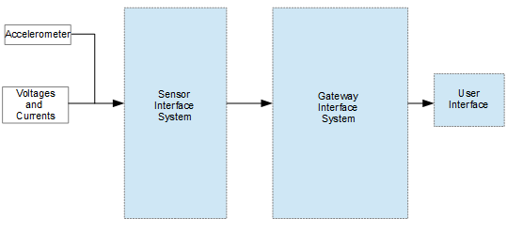
Design: System Block Diagram
Figure 1: System Block Diagram

Slide 7
Design: Solution
Sensor Interface System (SIS)
Atmel UC3-A3 Xplained.
ADXL335 Accelerometer.
UART communication.
Custom embedded firmware.

Slide 8
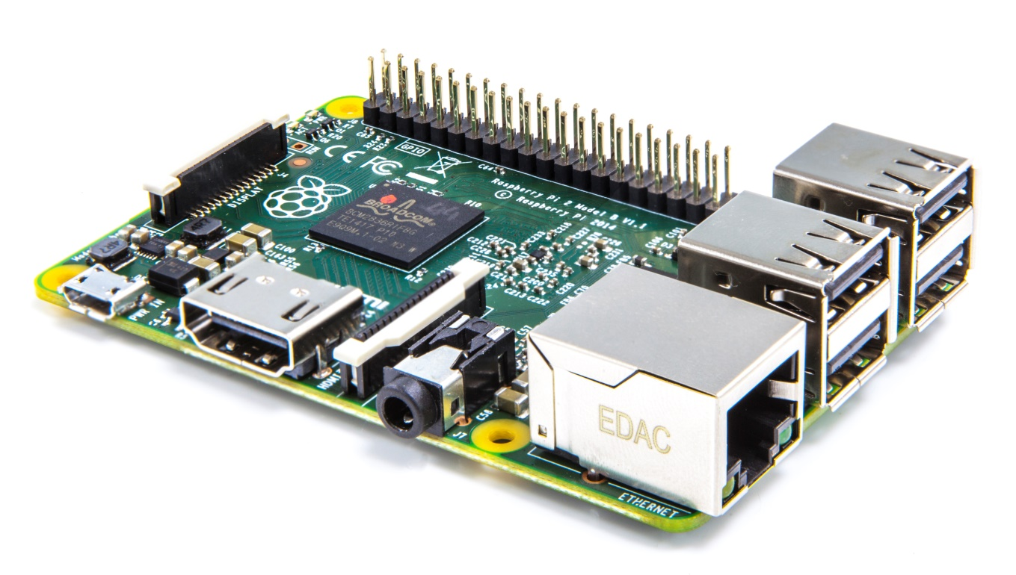
Design: Solution
Gateway Interface System (GIS)
Raspberry Pi.
RT5370 USB Wi-Fi dongle.
UART communication.
Lightweight embedded Linux.

Slide 9
Design: Alternate Solutions
Overall design must stay the same due to given constraints and previous work.
Alternate Components
Sensor Interface System (SIS)
Many variations of Atmel UC3 Xplained.
Gateway Interface System (GIS)
Beaglebone Black.
Other ARM based boards.

Slide 10
Design: Key Skills and Research
Sensor Interface System (SIS)
Experience with Atmel 8-bit microcontrollers and C programming from ECE 103, 205, 322, 471.
Analog I/O, I2C, and UART communications were covered in ECE 322.
Need to research different approach used in 32-bit systems.

Slide 11
Design: Key Skills and Research
Gateway Interface System (GIS)
Experience with operating systems and microcontroller Linux from ECE 472.
Peripheral access covered in ECE 471.
Need to research driver setup and boot time optimization for embedded Linux.

Slide 12
Design: Facilities
Development
All programming can be completed in Bradley ECE labs.
Any assistance can be provided from Dr. Alexander Malinowski and Dr. In Soo Ahn.
Testing
Primary testing will be done in Bradley ECE labs.
If ahead of schedule, onsite testing at Martin Engineering will be arranged.

Slide 13
Design: Testing Criteria
Sensor Interface System (SIS)
Boot time
Data acquisition
Amplitude and frequency
Rotary Buffer
I²C and accelerometer
UART communication to Gateway Interface System

Slide 14
Design: Testing Criteria
Gateway Interface System (GIS)
Boot time
UART communication to Sensor Interface System
Web server
Ethernet communication first
Wi-Fi communication
Check driver works by connecting to access point
Create ad-hoc network and connect to web server

Slide 15
Design: Testing Criteria
SIS and GIS combined
Data acquired is displayed on web server.
Accelerometer and ADC.
Accuracy of data.
Speed of data update on web server.
Boot times are synchronized with the rotary buffer.

Slide 16
Economic Analysis: Components
Table 1: Components Cost
Part | Cost | Store
Raspberry Pi | $30.00 | Element14 Online Store
Atmel UC3-A3 Xplained | $31.25 | Atmel Online Store
ADXL335 Accelerometer | $15.00 | Sparkfun Online Store
2x 2A Micro USB Power Adapter | $7.99 | Amazon
RT5370 USB Wi-Fi Adapter | $11.99 | Amazon
Total Cost: $96.23
Much less than $300 constraint!

Slide 17
Economic Analysis: Total Cost
All software used is either “Open Source” or provided free from developer.
Bradley ECE Department has all equipment necessary.
Total cost of project is only that of the components: $96.23

Slide 18
Economic Analysis: Production
Martin Engineering has not provided any production information.
Quantity required and cost of installation is unknown.
Martin Engineering will set customer price.

Slide 19
Schedule: Deliverables
Table 2: Deliverables Schedule
Task | Start | Finish | Duration
Proposal Presentation | 9/16/2015 | 9/30/2015 | 2 weeks
Proposal Documentation | 10/1/2015 | 10/14/2015 | 2 weeks
Webpage Release | 10/12/2015 | 10/26/2015 | 2 weeks
Progress Presentation | 10/26/2015 | 11/17/2015 | 3 weeks
Performance Review | 11/17/2015 | 12/1/2015 | 2 weeks

Slide 20
Schedule: Technical
Table 3: Technical Schedule
 | Task | Start | Finish | Duration
SIS | Develop ADC controller | 9/8/2015 | 9/29/2015 | 3 weeks
 | Develop Serial Communication with GIS | 9/29/2015 | 10/20/2015 | 3 weeks
 | Optimize Rotary Buffer for the Data | 10/20/2015 | 11/10/2015 | 3 weeks
 | Accelerometer Interfacing | 11/10/2015 | 12/8/2015 | 4 weeks
 | Data Storage During GIS Boot | 12/8/2015 | 1/28/2016 | 5 weeks
 | Correct Timings for Sending Data | 1/28/2016 | 2/16/2016 | 3 weeks
GIS | Research and decide base OS | 9/8/2015 | 9/24/2015 | 3 weeks
 | Interface Wifi | 9/29/2015 | 10/8/2015 | 2 weeks
 | Develop UART Access program | 10/13/2015 | 11/5/2014 | 4 weeks
 | Develop lightweight web server | 11/10/2015 | 11/26/2015 | 3 weeks
 | Optimize boot time | 12/1/2015 | 1/28/2016 | 3 weeks
 | Optimize Web server GUI | 2/2/2016 | 2/11/2016 | 2 weeks
 | Combined SIS/GIS Testing and debugging | 2/16/2016 | 3/10/2016 | 4 weeks

Slide 21
Division of Labor
Joseph Mintun
Sensor Interface System
Web Page
Timothy Kritzler
Gateway Interface System
Web Page

Slide 22
Impacts
Who is affected?
Ethics
Safety
Liability
Risks

Slide 23
Summary
Problem Background
Design Approach
Economic Analysis
Schedule
Division of Labor
Societal and Environmental Impacts

Slide 24
Modular Rapid Monitoring System
Timothy Kritzler and Joseph Mintun
Sponsor: Martin Engineering, Illinois
Advisors: Dr. Malinowski and Dr. Ahn
Bradley University Electrical and Computer Engineering
October 1, 2015

Slide 25
Full Gantt Chart
Table 3: Gantt Chart

Slide 26
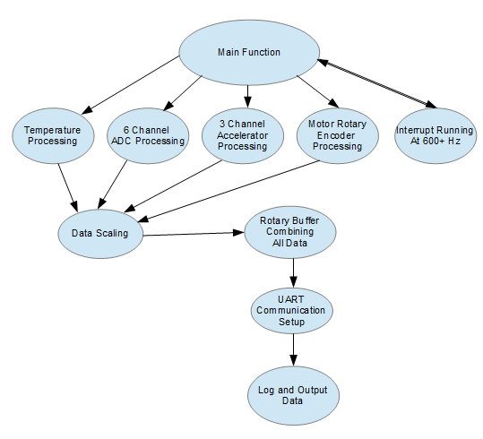
Software Flow Chart
Figure 3: Software Flow Chart

