Slide 1
RF to DC Rectifier Project Proposal
Brandon White
Advisor: Dr. Prasad Shastry
Department of Electrical and Computer Engineering
10/6/15

Slide 2
Agenda
Past Project
Problem Background
Constraints
Design Approach
Subsystem Block Diagram
Nonfunctional Requirements
Functional Requirements
Economic Analysis
Scheduling
Societal and Environmental Impacts
Conclusion

Slide 3
Problem Background (Bradley)
Project from 2014
Sergio Sanchez, Tyler Hoge, & Elie Baliss
Dr. Prasad Shastry
Wireless Power Transfer System
Commercial Parts
915MHz frequency
2 Meters between antennas

Slide 4
Bradley Cont.
Second system design of rectenna
Functioned at 5.8 GHz
1 Watt power transferred
Was not completed
Closely related

Slide 5
Constraints
Must output DC
Must connect to an antenna at its input terminal
Must operate in frequency range between 5.725GHz and 5.875GHz

Slide 6
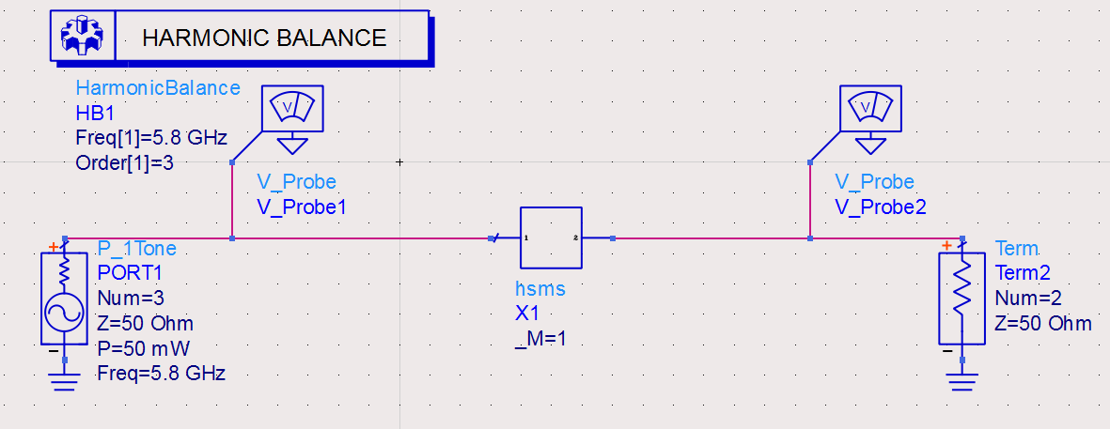
Design Approach
HSMS -2860 Schottky Detector Diode
Anode
Cathode

Slide 7
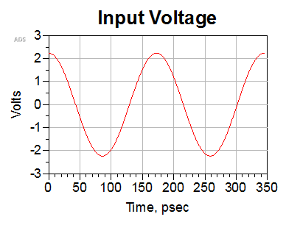
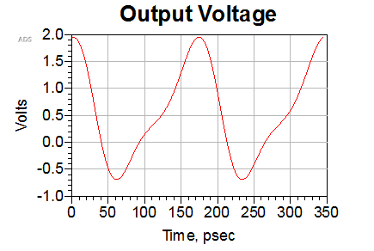
Design Approach

Slide 8
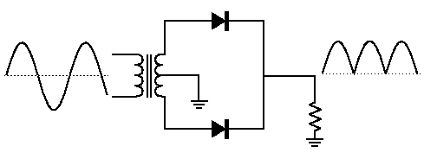
Design Approach
Two Diode Full Wave Rectifier

Slide 9
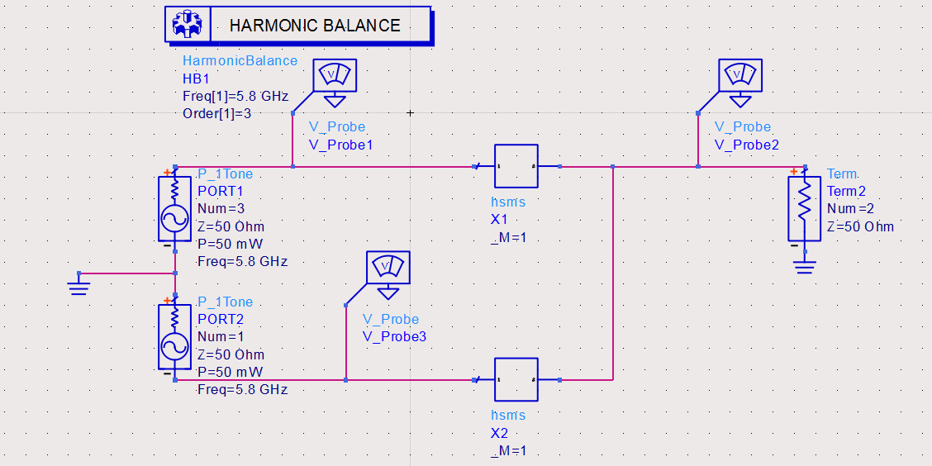
Design Approach

Slide 10
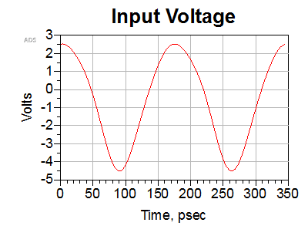
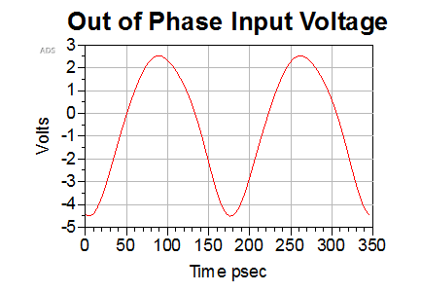
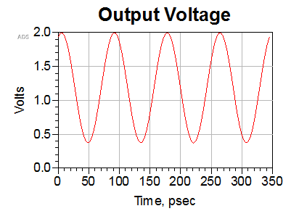
Design Approach

Slide 11
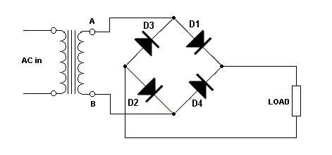
Design Approach
Diode Bridge Circuit

Slide 12
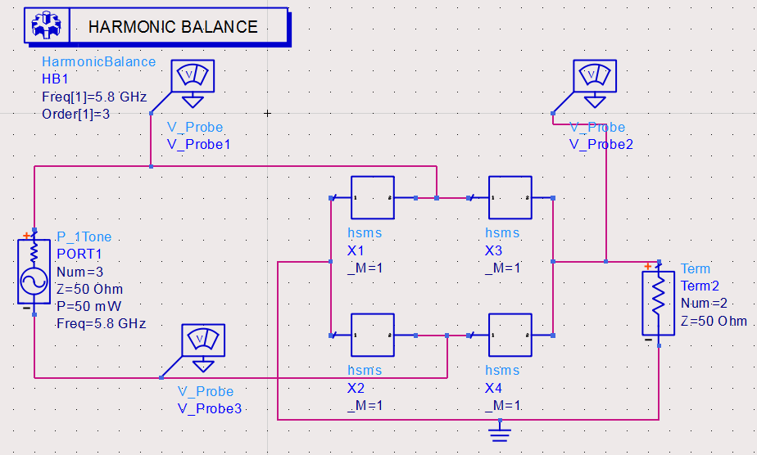
Design Approach

Slide 13
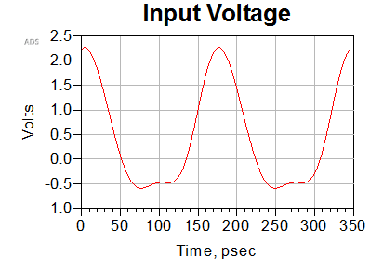
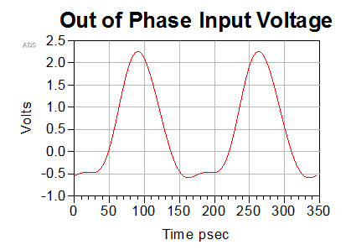
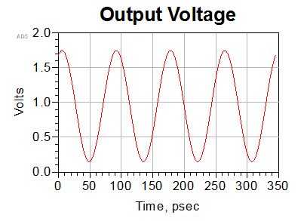
Design Approach

Slide 14
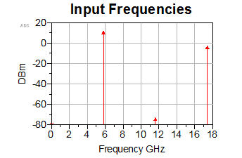
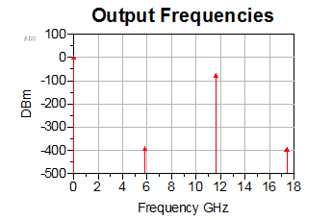
Design Approach

Slide 15
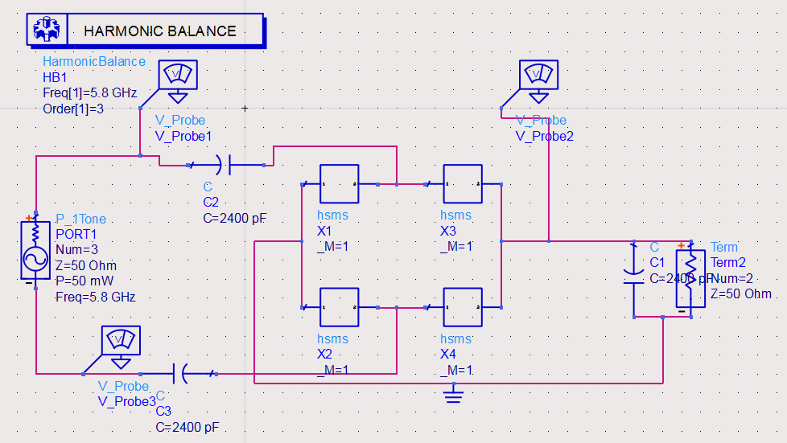
Design Approach

Slide 16
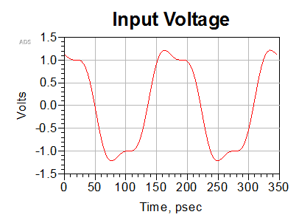
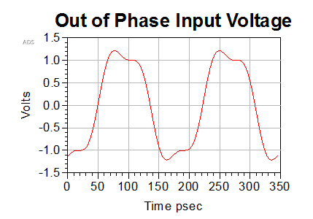
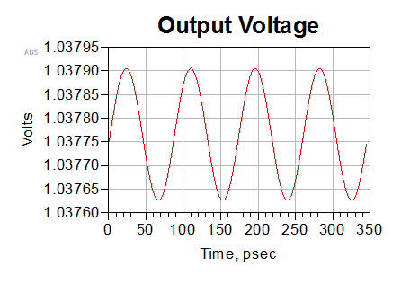
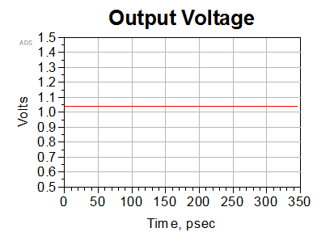
Design Approach

Slide 17
Design Approach
Efficiency Chart
Friis Transmission Formula

Slide 18
Design Approach
Subsystem Block Diagram

Slide 19
Nonfunctional Requirements
Objectives list for RF to DC converter:
Conversion should be efficient
Should be small
Should be safe to use
Should be cost efficient to produce

Slide 20
Functional Requirements
Functions for RF to DC converter:
Should convert RF to DC
Should filter out harmonic frequencies generated by rectifier circuit
DC output filter should create a DC output
Should be matched to antenna input impedance

Slide 21
Functional Requirements
Specifications for RF to DC converter:
Will work in the frequency range of 5.725GHz to 5.875GHz
Will attach to an antenna at its input

Slide 22
Economic Analysis
Feasible to produce at a low cost
Cheap components being used in design
Massive market
Not ready for commercial use yet

Slide 23
Schedule
ID | Task Name | Start | Finish | Duration | Spring 2015 - Spring 2016
1 | Research | Spring 2015 | Spring 2016 | 40 Weeks
2 | Diode Selection | Fall 2015 | Fall 2015 | 1 Week
3 | Diode Configuration | Fall 2015 | Mid Fall 2015 | 6 Weeks
4 | Filter Design | Mid Fall 2015 | Mid Fall 2015 | 6 Weeks
5 | Impedance Matching | Mid Fall 2015 | End Fall 2015 | 6 Weeks
6 | Purchase Parts | End Fall 2016 | End Fall 2015 | 1 Day
7 | Circuit Implementation | Beginning Spring 2016 | Mid Spring 2016 | 12 Weeks
8 | Contact Manufacturor | Mid Spring 2016 | End Spring 2016 | 1 Week
9 | Test Product | End Spring 2016 | End Spring 2016 | 3 Weeks

Slide 24
Societal and Environmental Impacts
Convenience
Safe
Potential to be used in the future
Less efficient than wired power transfer
Trade-off

Slide 25
Conclusion
RF to DC rectifier
Continuation of 2014 project
Design Approach
Efficiency
Endless Possibility

Slide 26
Questions?

Slide 27
Metrics for Objectives
0 – 5 point scale
5 highest
0 lowest
Efficiency
Size
Safety
Cost

Slide 28
References
[1] Boaventura, Alirio, et al. "Optimum Behavior." IEEE Microwave Magazine Mar.-Apr. 2013: 26-35. Print.
[2] Flynn, Brian W., and Kyriaki Fotopoulou. "Rectifying Loose Coils." IEEE Microwave Magazine Mar.-Apr. 2013: 48-54. Print.
[3] Lin, James C. "Wireless Power Transfer for Cell Phones or Other Mobile Communication Devices and Biological Implications." IEEE Microwave Magazine July-Aug. 2013: 18-22. Print.
[4] Scheeler, Robert, Sean Korhummel, and Zoya Popovic. "A Dual-Frequency Ultralow-Power Efficient 0.5-g Rectenna." IEEE Microwave Magazine Jan.-Feb. 2014: 109-14. Print.
[5] Shinohara, Naoki. Wireless Power Transfer via Radiowaves. Hoboken: ISTE, 2014. Print.
[6] Wireless Power Transfer System (2014). Print.

