Slide 1
RF to DC Converter for Wireless Power Transfer Systems
Brandon White
Advisor: Dr. Prasad Shastry

Slide 2
Agenda
Project Application
Project Overview
Literature Review
Block Diagram
Project Design
Simulation Results
Test Results
Conclusions

Slide 3
Project Application
Near-field wireless power transfer systems currently in use
Industry working towards far-field wireless power transfer systems

Slide 4
Project Overview
Convert radio frequency (RF) signal to direct current (DC) power
Functions in the FCC regulated ISM band that includes 5.8GHz
Output will be DC with minimal ripple
Maximize efficiency
Minimize size

Slide 5
Literature Review
Fig 1. Efficiency of Full-Wave Rectifiers vs Input Power [1]

Slide 6
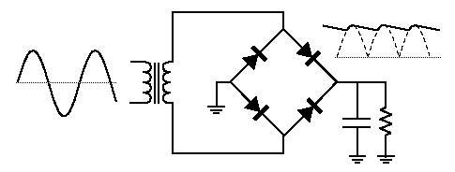
Literature Review Diode Configuration
Fig 2. Four Diode full-wave rectifier

Slide 7
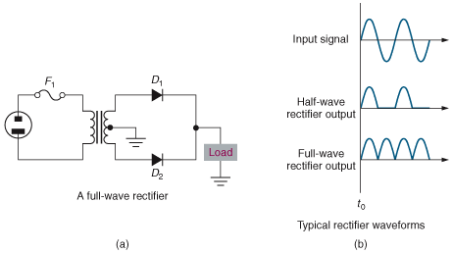
Literature Review Diode Configuration
Fig 3. Two Diode full-wave rectifier

Slide 8
Literature Review
Not new concept
High gain antennas
Efficiency expectations

Slide 9
Block Diagram
Fig 4. System Block Diagram

Slide 10
Design – Physical System
Harmonic Suppression
Diode
Balun
DC Bypass Filter
Fig 5. RF to DC converter

Slide 11
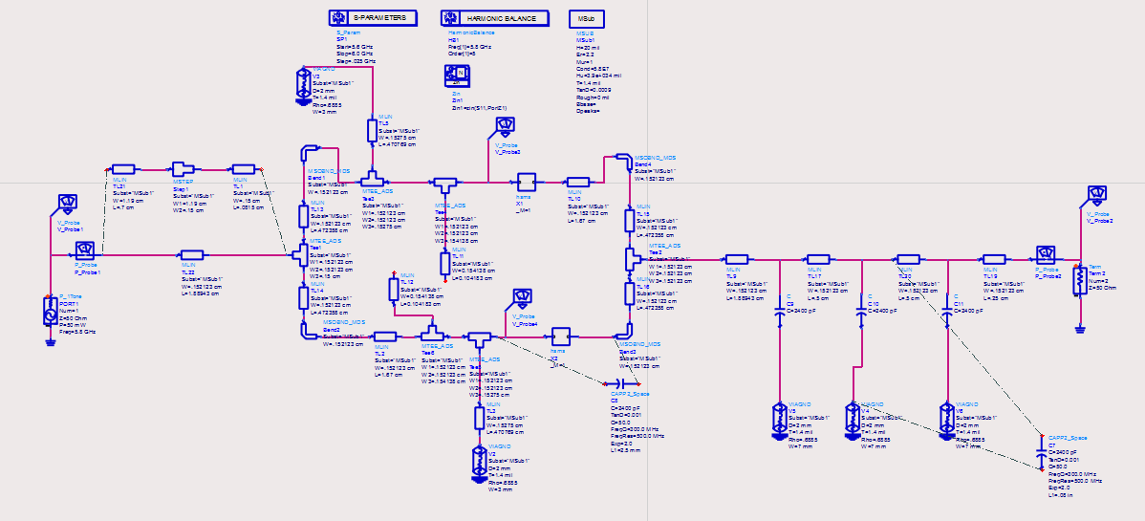
Design – ADS Schematic
Fig 6. ADS Schematic Design of RF to DC Converter

Slide 12
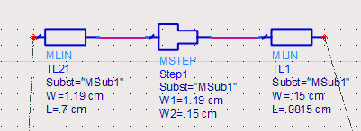
Design – Matching Network
Fig 7. ADS Schematic Design of Impedance Matching Network

Slide 13
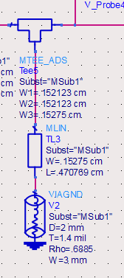
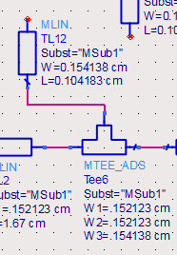
Design - Harmonic Suppression
Fig 9. Third Order Harmonic Suppression
Fig 8. Second Order Harmonic Suppression

Slide 14
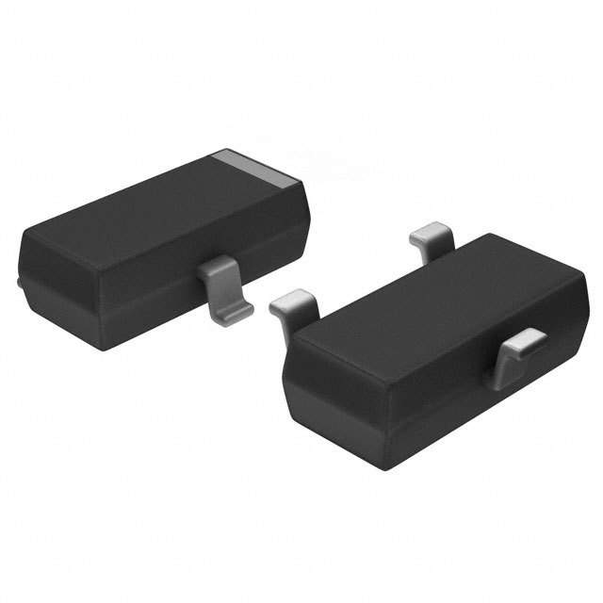
Design – Diode
HSMS-2860 Schotky detector diode
Discovered in research
Pspice file
Worked perfectly

Slide 15
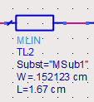
Design - Balun
Fig 10. ADS Schematic Design of Balun

Slide 16
Design – DC Bypass Filter
Fig 11. ADS Design of Output Microstrip Spacing

Slide 17
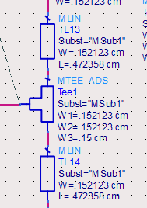
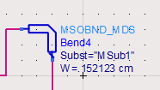
Design - Discontinuities
Fig 12. Schematic Bend
Fig 13. Schematic Tee Junction

Slide 18
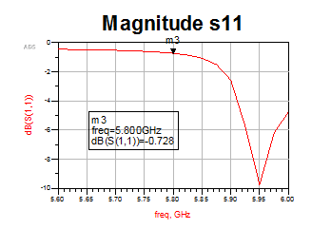
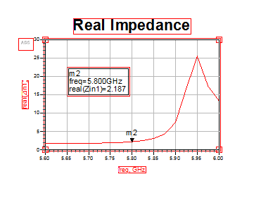
Simulation Results - Unmatched
Fig 14. Reflection Coefficient
Fig 15. Real Impedance

Slide 19
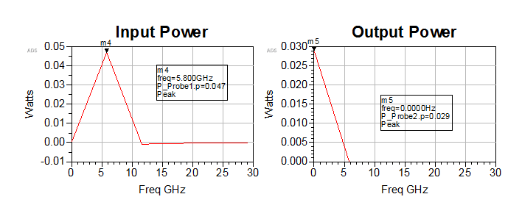
Simulation Results - Unmatched
Fig 16. Efficiency of System in ADS Simulation

Slide 20
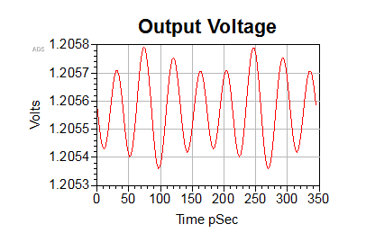
Simulation Results - Unmatched
Fig 17. Simulated Output Voltage Waveform

Slide 21
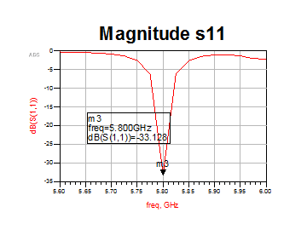
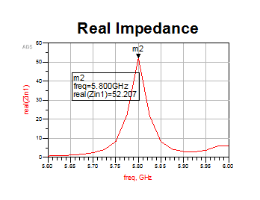
Simulation Results - Matched
Fig 18. Reflection Coefficient
Fig 19. Real Impedance

Slide 22
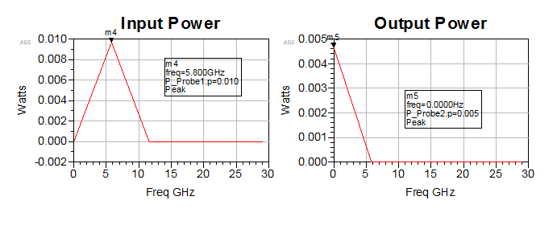
Simulation Results - Matched
Fig 20. Efficiency of System in ADS Simulation

Slide 23
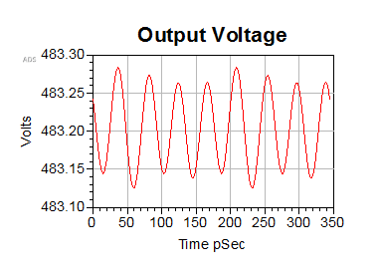
Simulation Results - Matched
Fig 21. Output Voltage Waveform of ADS Simulations (Scale in mV)

Slide 24
Testing Results – Time Domain
System Output
Fig 22. Oscilloscope voltage reading

Slide 25
Testing Results – Frequency Domain
Fig 23.
Input Signal
Frequency Power
7.13 dBm
Fig 24.
Output Signal
Frequency Power
-13.71 dBm

Slide 26
Testing Results - Efficiency

Slide 27
Testing Results – Power Transfer

Slide 28
Conclusions
Unmatched has great preliminary results
Design is very compact
Design is efficient
Design gives DC output with minimal ripple

Slide 29
For Future Work
Increase efficiency
Decrease size
Design to function at different frequencies (2.45 GHz 915 MHz)
Work towards marketable product

Slide 30
Special Thanks
Chris Mattus
Nick Schmidt
Bob Modica

Slide 31
Questions?

Slide 32
References
[1] A. Boaventura, A. Collado, N.B. Carvalho, and A Georgiadis, "Optimum Behavior" in IEEE Microwave Mag., vol. 14, no. 4, pp. 26-35, 2013.
[2] Z. Popovic, "Cut the Cord" in IEEE Microwave Mag., vol. 14, no. 4, pp. 55-62, 2013
[3] J. Zbitou, M. Latach, and S. Toutain, "Hybrid Rectenna and Monolithic Integrated Zero-Bias Microwave Rectifier" in IEEE Transactions on Microwave Theory and Techniques, vol. 54, no. 1, pp. 147-152, 2006

Slide 33
Parts List
HSMS 2860 Schottky Detector Diode
Premiertek 802.11n 2.4GHz/5~5.8GHz Dual Band 5dBi Antenna
Antenna, 5.8 GHz 19 dBi gain
Sunhans wifi signal booster

Slide 34
Appendix

