Slide 1
RF to DC Converter
Brandon White
Advisor: Dr. Prasad Shastry
Department of Electrical and Computer Engineering
November 24, 2015

Slide 2
Agenda
Problem Background
Constraints
Possible Solutions
Subsystem Block Diagram
Work Accomplished
Work Remaining
Adjustments
Conclusion
2

Slide 3
Problem Background
Continuation of 2014 Bradley University project
Wireless Power Transfer System
Commercial Parts, 915MHz
Rectenna, 5.8GHz
3

Slide 4
Constraints
Output DC: ± 2% ripple
Must function in the frequency range between 5.725GHz and 5.875GHz
4

Slide 5
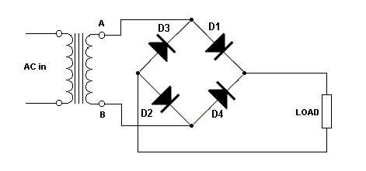
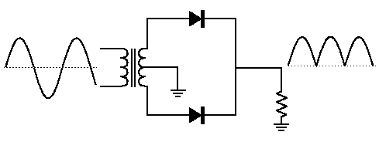
Possible Solutions
4 Diode
2 Diode
Friis Transmission Formula
5
Efficiency Chart

Slide 6
Subsystem Block Diagram
6
All subsystems of RF to DC converter project

Slide 7
Gantt Chart
Gantt chart as of proposal presentation
7

Slide 8
Work Accomplished
Balun
Substrate Selection RT/duroid 5880
Filter Progress
Inductor and Capacitor Companies
Antenna Needs
8

Slide 9
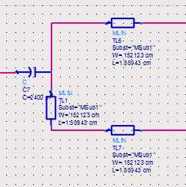
Balun
ADS Phase Shift Technique
Balun Phase Shift Technique
9

Slide 10
Gantt Chart Updated
Gantt chart as of 11/24/15
10

Slide 11
Work Remaining
Impedance Matching
Parts Ordering
Final Layout Design
Send to Manufacturer
Potential Amplifier Selection
11

Slide 12
Adjustments
Alternate Design
Filter Alterations
Harmonic Stub Omission
12

Slide 13
Conclusion
Problem Background
Constraints
Possible Solutions
Subsystem Block Diagram
Work Accomplished
Work Remaining
Adjustments
13

Slide 14
Questions?
14

Slide 15
References
[1] Boaventura, Alirio, et al. "Optimum Behavior." IEEE Microwave Magazine Mar.-Apr. 2013: 26-35. Print.
[2] Flynn, Brian W., and Kyriaki Fotopoulou. "Rectifying Loose Coils." IEEE Microwave Magazine Mar.-Apr. 2013: 48-54. Print.
[3] Lin, James C. "Wireless Power Transfer for Cell Phones or Other Mobile Communication Devices and Biological Implications." IEEE Microwave Magazine July-Aug. 2013: 18-22. Print.
[4] Scheeler, Robert, Sean Korhummel, and Zoya Popovic. "A Dual-Frequency Ultralow-Power Efficient 0.5-g Rectenna." IEEE Microwave Magazine Jan.-Feb. 2014: 109-14. Print.
[5] Shinohara, Naoki. Wireless Power Transfer via Radiowaves. Hoboken: ISTE, 2014. Print.
[6] Wireless Power Transfer System (2014). Print.
15

