Slide 1
3D Environmental Mapping and Imaging for AUVSI RoboBoat
David Bumpus, Daniel Kubik, & Juan Vazquez
Advisor: Dr. José Sánchez
Customer: Mr. Nick Schmidt
Department of Electrical & Computer Engineering
October 1, 2015

Slide 2
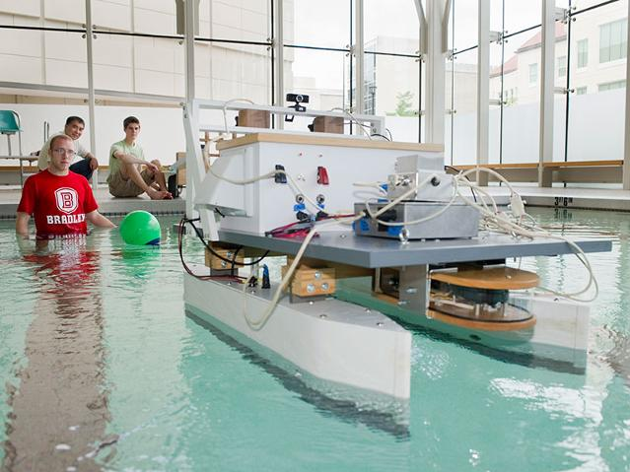
Problem Background: Significance
AUVSI – Association for Unmanned Vehicle System Int’l
International RoboBoat Competition
Bradley has attended since 2012
Bradley 2013 RoboBoat [1]

Slide 3
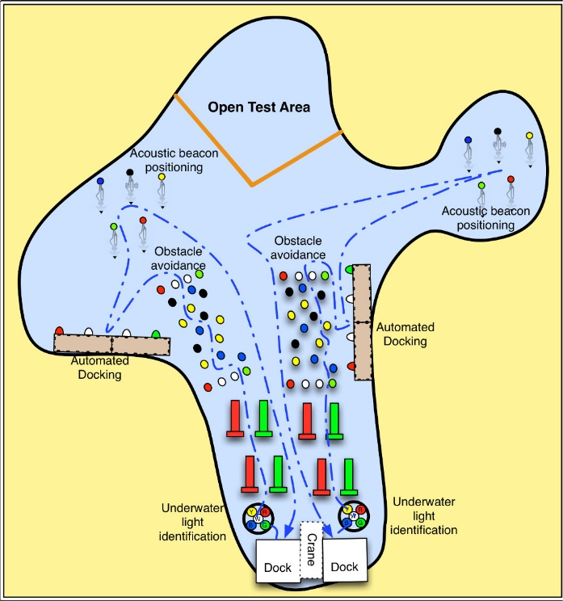
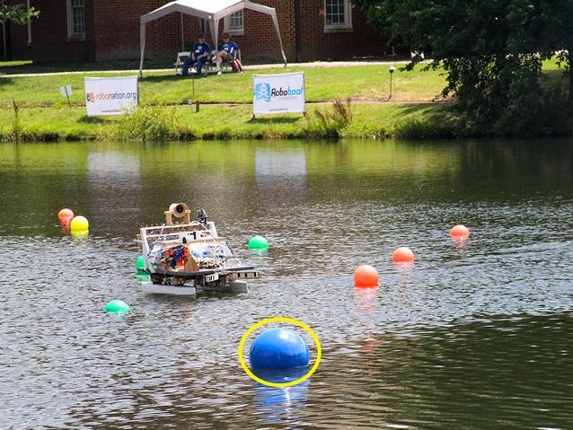
Problem Background: Significance
Boat undergoes challenges
RoboBoat navigating through course [1]
2014 RoboBoat course [2]

Slide 4
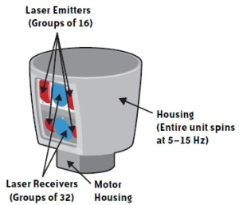
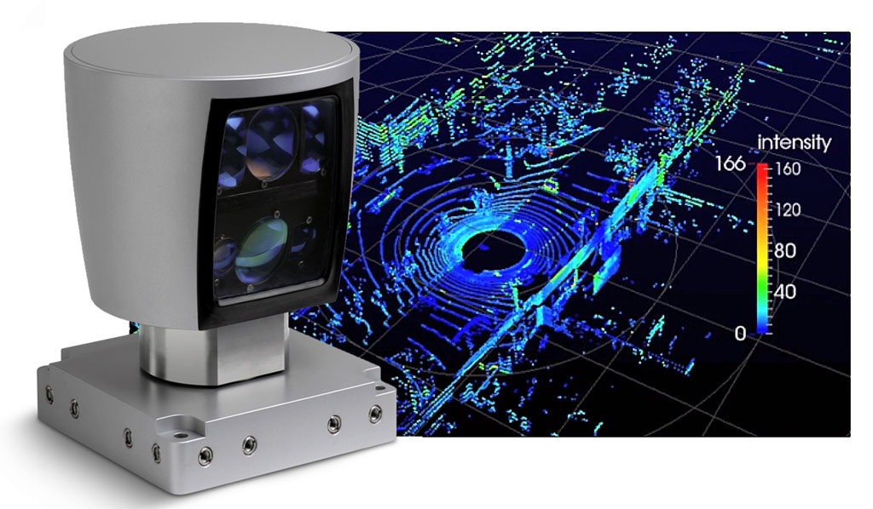
Problem Background: Significance
Lidar
Utilizes laser & interprets reflected light
Environmental mapping/distance measurement
Lidar mapping [3]
Lidar movement [4]

Slide 5
Problem Background: Goal
Lidar & camera based system
Maps surrounding environment
Overlays lidar data with image
Transmits data to boats CPU

Slide 6
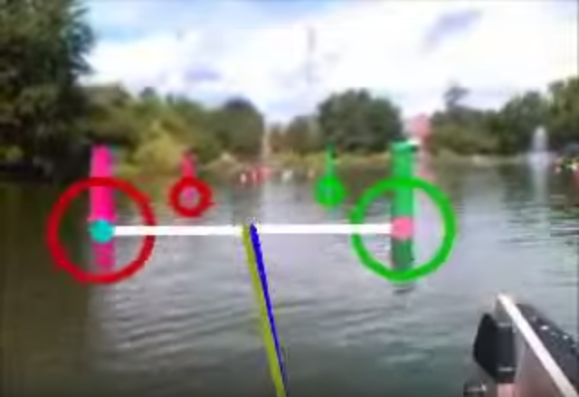
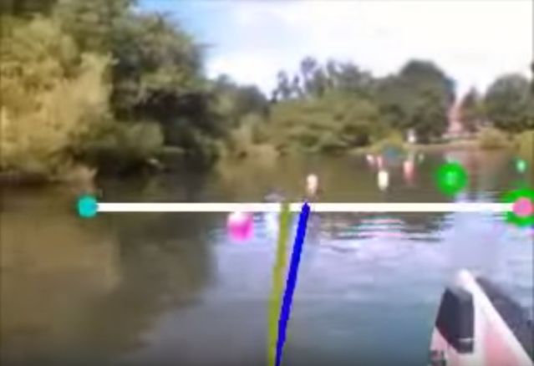
Problem Background: Motivation
Acquiring more information
https://www.youtube.com/watch?v=V4pz1FiMXfA
Boat navigation [5]
Boat struggling [5]

Slide 7
Constraints (1 of 2)
Operating voltage less than 12 V
Weight less than 3.6 kg
Current draw less than 4 A
Power consumption less than 50 W

Slide 8
Constraints (2 of 2)
Must fit within a 10 inch cube
Scanning time of less than 5 sec
Measures a horizontal distance of 9.1 m or greater
Measures a vertical distance of 3 m or greater
Operates for at least 40 minutes

Slide 9
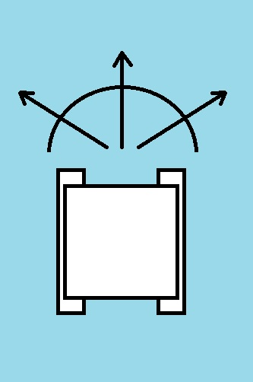
Functional Requirements (1 of 2)
Should complete a 180° scan
Should communicate with boat’s onboard electronics
NEW
OLD

Slide 10
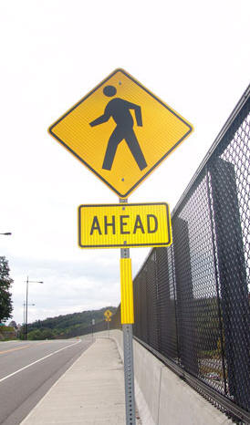
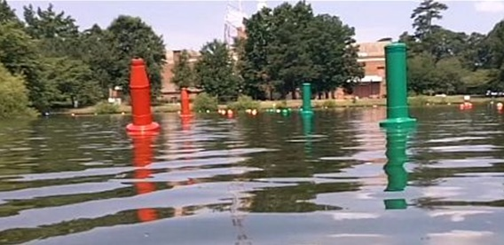
Functional Requirements (2 of 2)
Should accept and execute operational modes from user inputs
Should return depth measurements
Should return reflectivity measurements
Selecting viewing region [6]
Reflectivity differences [7]

Slide 11
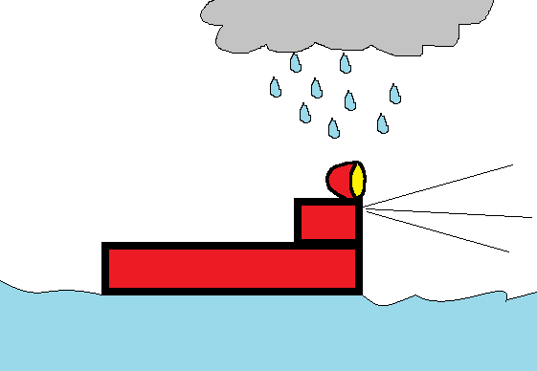
Non-Functional Requirements (1 of 2)
Waterproof
Mechanically and electrically stable
Lightweight

Slide 12
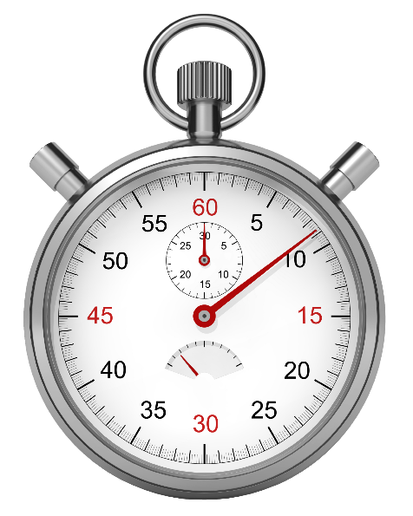
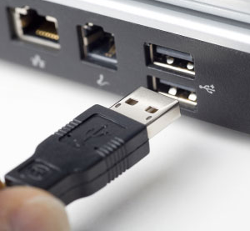
Non-Functional Requirements (2 of 2)
Configurable
Output 2D image with implied depth in a timely manner
Configurable [8]
Reflectivity differences [9]

Slide 13
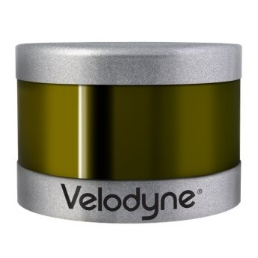
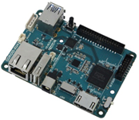
Design Approach/Method of Solution
Preferred Solution
Velodyne V-16 Puck (3D lidar)
Required Outputs
User
inputs
Odroid XU4
Feedback control
back to
webcam and lidar
Logitech C500 webcam

Slide 14
Design Approach/Method of Solution
Preferred Solution

Slide 15
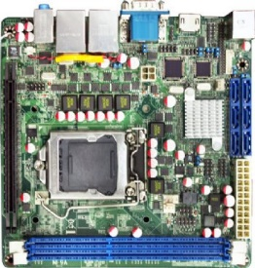
Design Approach/Method of Solution
Alternate Solution
Velodyne V-16 Puck (3D lidar)
Required Outputs
User
inputs
JNF9A-Q67 mini ITX
With Core I3-2120T
Feedback control
back to
webcam and lidar
Logitech C500 webcam

Slide 16
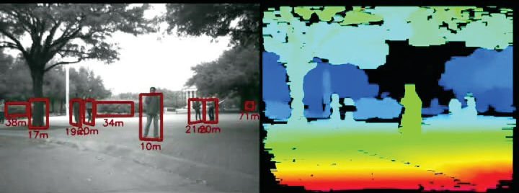
Design Approach/Method of Solution
Additional Research
Linux
Communication protocols (Ethernet, USB)
Registration
Registration [10]

Slide 17
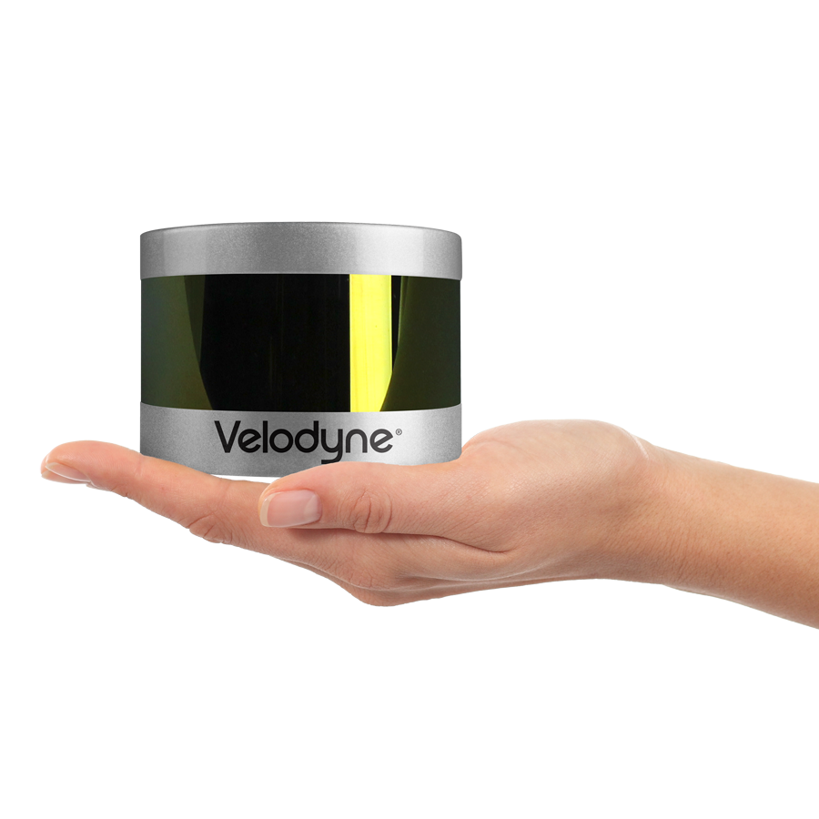
Budget
VLP-16 Puck
$7,999.00 (laser scanner)
+ 95.00 (shipping)
----------------
$8,094.00
Velodyne VLP-16 laser scanner [11]

Slide 18
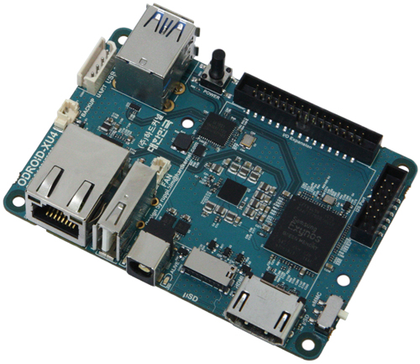
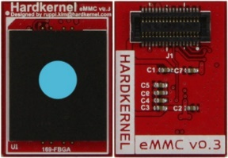
Budget
Odroid-XU4
$75.95 (Odroid)
+ 23.95 (memory card)
-----------
$ 99.90
Embedded Device & Memory[12]

Slide 19
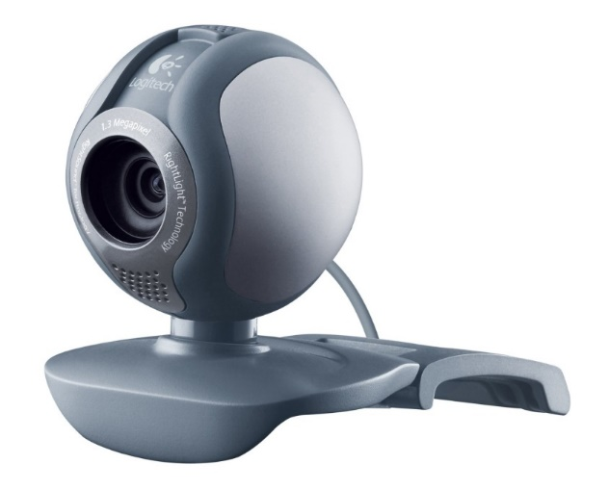
Budget
Logitech C500
$14.43 (webcam)
+ 0.00 (no shipping)
----------
$14.43
Camera [13]

Slide 20
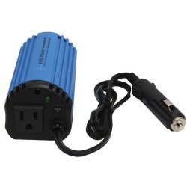
Budget
120 W Inverter
$24.99 (inverter )
+ 5.21 (shipping)
----------
$30.20
Inverter [14]

Slide 21
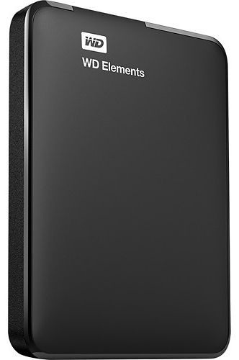
Budget
Hard drive
$60.99 (hard drive)
+ 0.00 (shipping)
----------
$60.99
Hard Drive [15]

Slide 22
Budget
Total:
$8,299.52

Slide 23
Schedule

Slide 24
Schedule

Slide 25
Division of Labor: Captains
Bumpus – Image registration implementation
Kubik – Scan data processing
Vazquez – Camera and scanner interface with embedded device/Linux OS

Slide 26
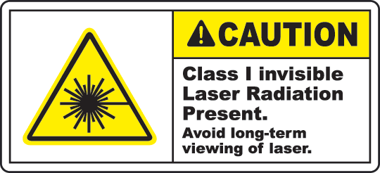
Environmental Impact
Negative
Few foreseeable consequences
Class I laser output power not hazardous to eyes
Need to recycle the components
Odroid-XU4 not ROHS certified
Hard Drive [16]

Slide 27
Summary & Conclusions
Components selected
3D laser scanner
Camera
Embedded device
Future Development
Communication interface
Registration

Slide 28
3D Environmental Mapping and Imaging for AUVSI RoboBoat
David Bumpus, Daniel Kubik, & Juan Vazquez
Advisor: Dr. José Sánchez
Customer: Mr. Nick Schmidt
Department of Electrical & Computer Engineering
October 1, 2015

Slide 29
Resources
[1] http://www.bradley.edu/inthespotlight/story/?id=b46cf284-2bd9-4efb-917e-ba6ca565cf84
[2] http://learnlab.uta.edu/roboboat/the-auvsi-roboboat-competition/
[3] http://www.4erevolution.com/wp-content/uploads/2014/07/LIDAR.jpg
[4] http://www.graphics.com/sites/default/files/old/sections/insight/beautifuldata/2.jpg
[5] Bradley University RoboBoat 2013 Qualifying Run https://www.youtube.com/watch?v=V4pz1FiMXfA
[6] http://www.mathworks.com/matlabcentral/mlc-downloads/downloads/submissions/44706/versions/1/screenshot.jpg
[7] http://americanmoldedplastic.com/images-sign-posts/Ahead-Reflective%20sign%20post%20panels.jpg
[8] http://www.computerhope.com/jargon/u/usb.jpg
[9] http://www.softwareag.com/blog/reality_check/wp-content/uploads/2013/06/Stopwatch_02.png

Slide 30
Resources
[10] http://www.criticallink.com/wp-content/uploads/2014/01/Stereo_Vision_Development_Kit_Flyer.pdf
[11] http://velodynelidar.com/vlp-16.html
[12] http://www.hardkernel.com/main/products/prdt_info.php
[13] Amazon.com
[14] http://www.criticallink.com/wp-content/uploads/2014/01/Stereo_Vision_Development_Kit_Flyer.pdf
[15] http://www.bestbuy.com/site/wd-elements-1tb-external-usb-3-0-2-0-portable-hard-drive-black/9291106.p?id=1219011381217&skuId=9291106&ref=06&loc=01&ci_src=14110944&ci_sku=9291106&extensionType=pla:g&s_kwcid=PTC!pla!!!80909755999!g!!52789345039&kpid=9291106&k_clickid=9663d0b5-9dc5-4232-8f4a-6b3adbba718b&lsft=ref:212,loc:1&ksid=9663d0b5-9dc5-4232-8f4a-6b3adbba718b&ksprof_id=8&ksaffcode=pg129&ksdevice=c&kpid=9291106
[16] http://www.safetysign.com/products/p1238/caution-class-1-label

