Slide 1

3D Environmental Mapping and Imaging for AUVSI RoboBoat
David Bumpus, Dan Kubik, & Juan Vazquez
Advisor: Dr. José Sánchez
Customer: Mr. Nick Schmidt
Department of Electrical & Computer Engineering
March 1, 2016

Slide 2
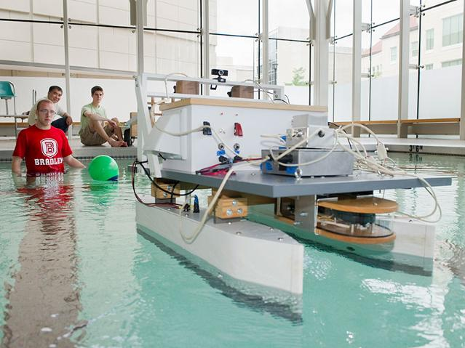
Problem Background: Significance
AUVSI – Association for Unmanned Vehicle System Int’l
  International RoboBoat Competition
  Bradley has attended since 2013
Fig. 1. Bradley 2013 RoboBoat [1]

Slide 3
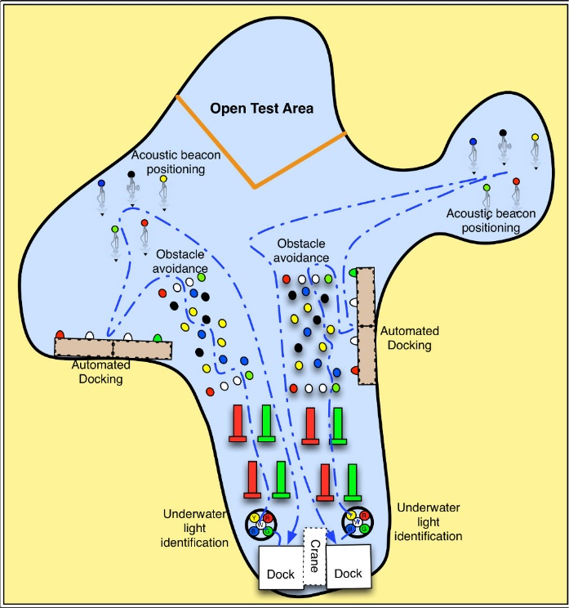
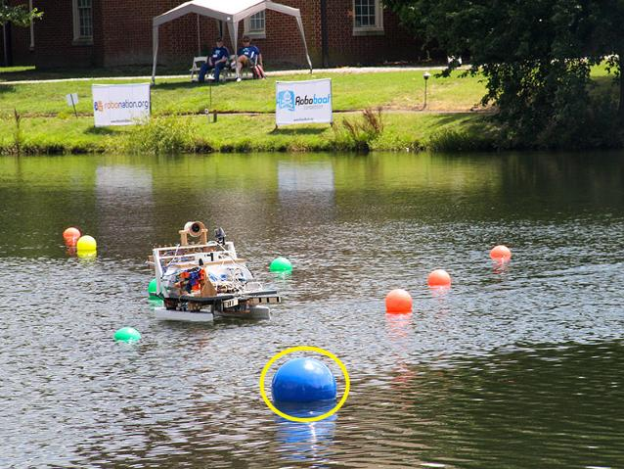
Problem Background: Significance
Boat undergoes challenges
Fig. 2. RoboBoat navigating through course [1]
Fig. 3. 2014 RoboBoat course [2]

Slide 4
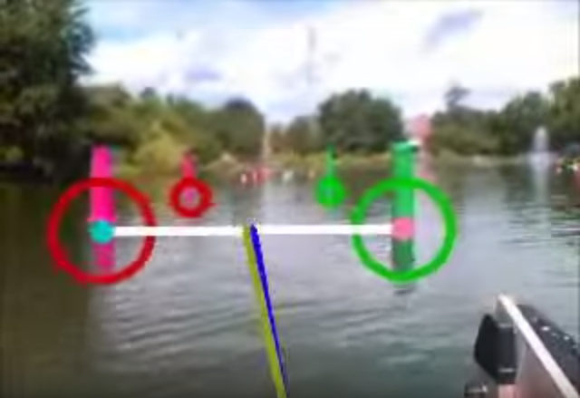
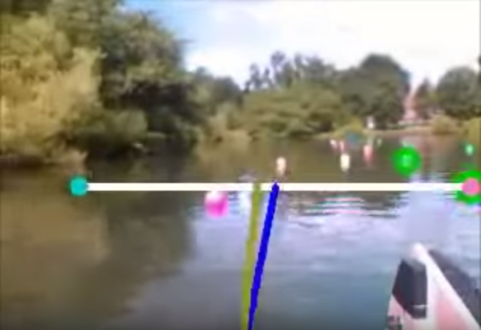
Problem Background: Motivation
Fig. 4. Boat navigation [3]
Fig. 5. Boat struggling [3]

Slide 5
Problem Background: Objective
Return:
  Distance measurements
  Camera image
  Image with distance information
  Location of nearest object

Slide 6
Juan Vazquez: Work Accomplished
Memory Partition Error Removal
VLP-16 Data Detection & Packet Read
Time Oriented Programming & Data Transmission Analysis
20%
70%
20%
20%

Slide 7
Juan Vazquez: Work Accomplished
20%
70%

Slide 8
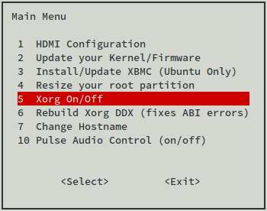
Work Accomplished: Memory Allocation
Incorrect Memory Allocation
  Full memory inaccessible
  Occurred on both microSD & EMMC
Odroid-Utility
  Built-in application
  Partition resize settings
Fig. 1. Odroid-Utility [4]

Slide 9
Juan Vazquez: Work Accomplished
20%
70%

Slide 10
Work Accomplished: Detection & Read Interface
Text file formatting
  Multiple text file creation
  Removing excess information
  Beginning at starting address (|FF|EE|)

Slide 11
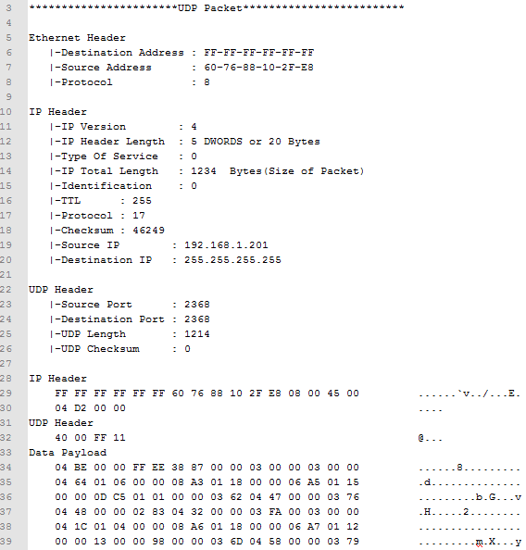
Work Accomplished: Detection & Read Interface
Fig. 2. Pre-Formatting Text File

Slide 12
Work Accomplished: Detection & Read Interface
Combining into one program
  Function creation
  Azimuth value confirmation

Slide 13
Juan Vazquez: Work Accomplished
70%
20%

Slide 14
Work Accomplished: Timing/Transmission
Main function configuration
  Infinite Loop Design
  Creating/ Overwriting one text file
  MasterBlock References

Slide 15
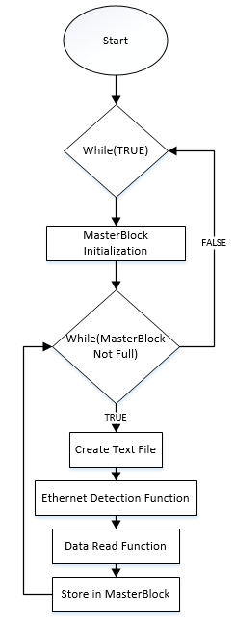
Work Accomplished: Timing/Transmission
Fig. 4. Main Function Flow Chart

Slide 16
Juan Vazquez: Future Work
Timing/Transmission
  Alternative method other than text files
  Eliminating useless |00|00| data
  Picture capture & VLP-16 timing
70%

Slide 17
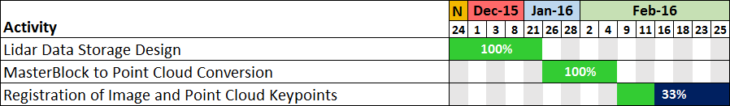
Dan Kubik: Work Accomplished

Slide 18
Dan Kubik: Work Accomplished

Slide 19
Work Accomplished: Data Storage
Text files (.txt) stream coming in
  Represent small amount of lidar data
Data is read and fed into a ‘MasterBlock’ storage class
  Repeat until MasterBlock object is “full” (360°)

Slide 20
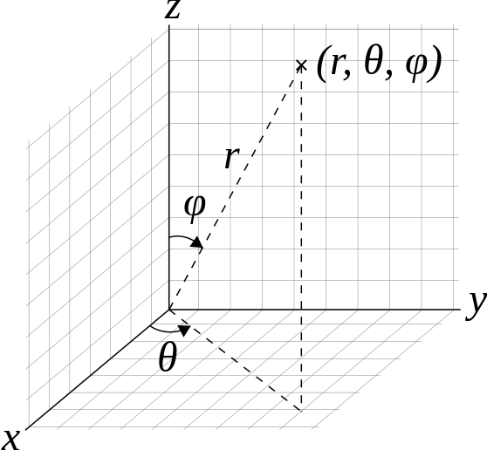
Work Accomplished: Data Storage
MasterBlock Class (C++)
  “180 Range” and “Selection Range”
  Can return values:
        Specific to a point:
          Distance ‘r’
          altitude ‘ϕ’
          Reflectivity (0-255)
        Applicable to multiple points
          azimuth ‘θ’
          Time stamp (ms)
Fig. 5. Coordinate system as used by VLP-16 laser scanner [17]

Slide 21
Dan Kubik: Work Accomplished

Slide 22

Work Accomplished: Data Conversion
  Point Cloud Library (PCL)
    3D Representation
    Keypoint Detection
    Registration
  Many “cloud” types:
    XYZ, XYZI, XYZRGB
Fig. 6. PCL logo [8]

Slide 23

Work Accomplished: Data Conversion
  Convert (r, θ, ϕ) to (x, y, z)
  ‘RecDataPoint’ class
  $X=r∗\cos\left(\text{ϕ}\right)∗\sin\left(\text{θ}\right)$
  $Y=r∗\cos\left(\text{ϕ}\right)∗cos(\text{θ})$
  $Z=r∗\sin\left(\text{ϕ}\right)$

Slide 24
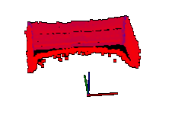
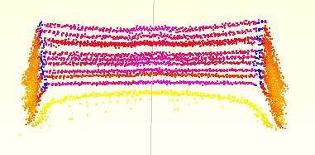
Work Accomplished: Data Conversion
Fig. 7. 3D-Viewer view of box
Fig. 8. VeloView view of box

Slide 25
Dan Kubik: Work Accomplished

Slide 26
Work Accomplished: Image in PCL
Keypoints: points of interest
  Used to compare similar pictures, lidar data, etc.
Exploring ways to get data where keypoints can be extracted and compared
PCL to PCL keypoint comparison
  Need to convert image to point cloud format
  Exploring ways to extract image file data

Slide 27
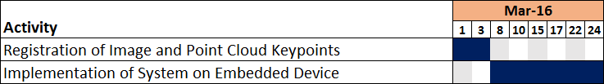
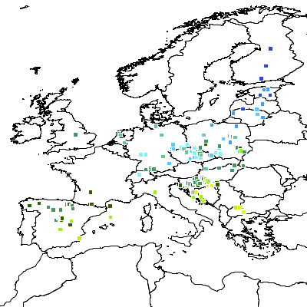
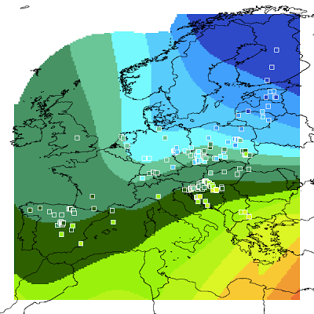
Dan Kubik: Future Work
Interpolation of lidar data to create range image
Fig. 9. Barnes interpolation [17]

Slide 28
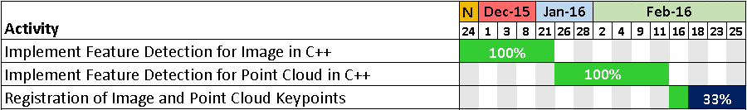
David Bumpus: Work Accomplished

Slide 29
David Bumpus: Work Accomplished

Slide 30

Work Accomplished: Image Keypoints
OpenCV:
Open Source Computer Vision Software Library
C++ Interface
Supports Linux
Scale Invariant Feature Transform (SIFT)
Fig. 9. OpenCV Logo [5]

Slide 31
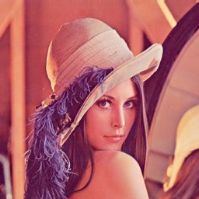
SIFT Keypoint Explanation [7]:
Robust against changes in scale or rotation of an image
Fig. 10. Robust SIFT Matching [6]

Slide 32
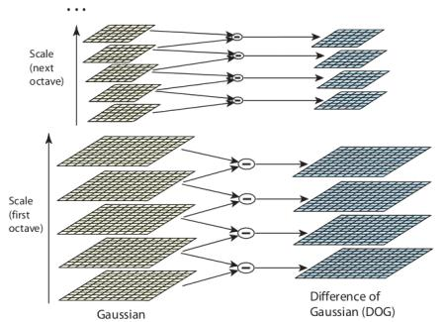
SIFT Keypoint Explanation [7]:
Step 1: Scale Space Extrema Detection
Compute Gaussian Kernels
Blob detection by varying window scale
Difference of Gaussian (DoG) maxima are potential keypoints
Fig. 11. Difference of Gaussian for different octaves in Gaussian pyramid [7]

Slide 33
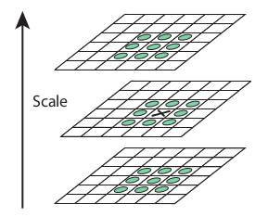
SIFT Keypoint Explanation [7]:
Step 1: Scale Space Extrema Detection
Local extrema over scale and space are potential keypoints
Fig. 12. Local extrema across multiple scales are keypoints [7]

Slide 34
SIFT Keypoint Explanation [7]:
Step 2: Keypoint Localization
Eliminate low contrast keypoints
Eliminate keypoints on edge of image
What remains are strong keypoints
Fig. 13. Eliminate weak keypoints [6]

Slide 35
SIFT Keypoint Explanation [7]:
Step 3: Orientation assignment
Gradient magnitude and direction is calculated
Create keypoint with same location and scale, but different direction
Fig. 14. Rotation invariant keypoint orientation assignment [6]

Slide 36
SIFT Keypoint Explanation [7]:
Step 4: Keypoint Descriptor
Generate unique histogram with 128 bins for each keypoint
Step 5: Keypoint Matching
Search target image keypoints for similar discriptors
Fig. 15. Keypoint Descriptor Matching

Slide 37
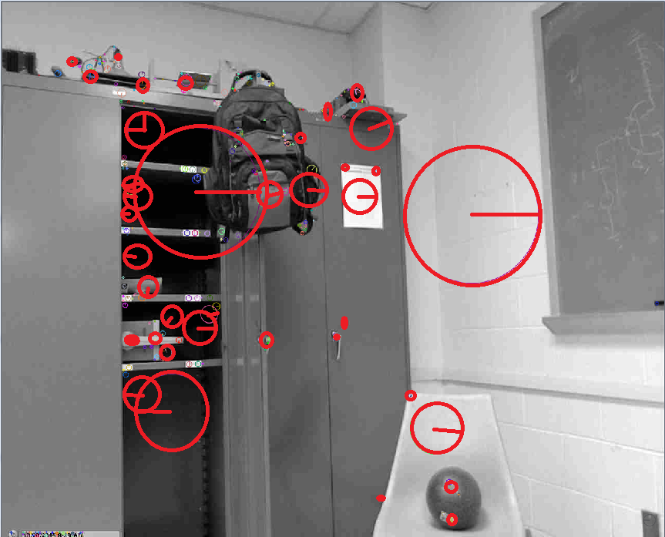
Work Accomplished: Image Keypoints
Fig. 16. SIFT Keypoint detection C++ Implementation

Slide 38
David Bumpus: Work Accomplished

Slide 39

Work Accomplished: Point Cloud Keypoints
Point Cloud Library (PCL)
Open source point cloud processing
Linux Compatible
SIFT Algorithm
Fig. 17. Point Cloud Library (PCL) logo [8]

Slide 40
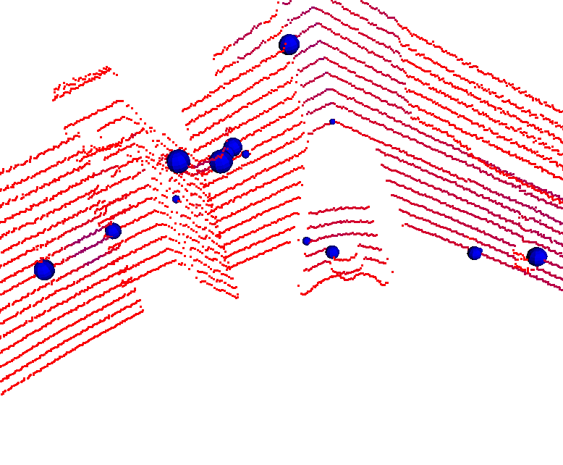
Work Accomplished: Point Cloud Keypoints
Chalkboard
Backpack
Shadow
Closet
Chair
Ball
Fig. 18. SIFT Keypoint detection in point clouds

Slide 41
David Bumpus: Work Accomplished

Slide 42
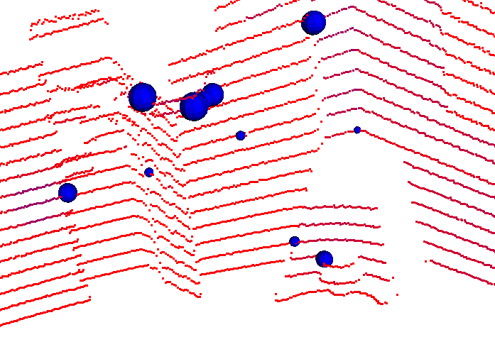
Work Accomplished: Registration
Fig. 19. Comparison of keypoints prior to registration

Slide 43
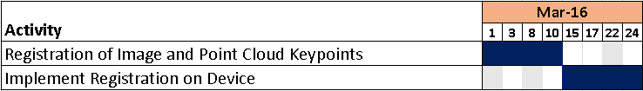
David Bumpus: Future Work
Registration of Image and Point Cloud Keypoints
  Write function for registration of different types of data
  Produce depth overlay
Work with Juan to implement on Odroid XU4

Slide 44
Conclusion
Juan
  Data detection, reading
Dan
  Data storage, registration
David
  Registration algorithm development

Slide 45
Conclusion
Progress and Future work:
  Behind schedule for registration
  Problems
    Registration: Difficulty registering 3D data with 2D data
      Compress 3D data to 2D image for registration
    Incoming Data: Speed of incoming data vs. read time

Slide 46
3D Environmental Mapping and Imaging for AUVSI RoboBoat
David Bumpus, Dan Kubik, & Juan Vazquez
Advisor: Dr. José Sánchez
Customer: Mr. Nick Schmidt
Department of Electrical & Computer Engineering
March 1, 2016

Slide 47
Additional Slides

Slide 48
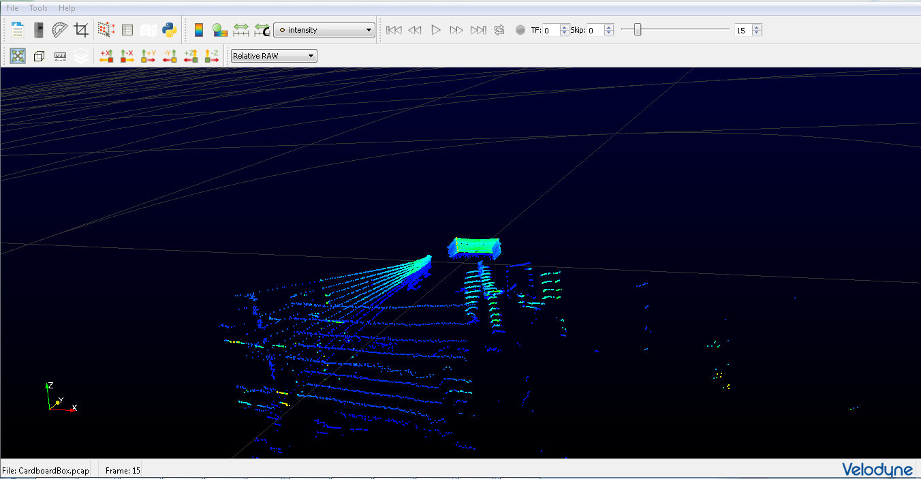
Testing of VLP-16 Puck™
Install Veloview Software
Test acquisition of data to Veloview and verify distances
Familiarize self with Veloview data manipulation
Fig. 20. Data acquisition to Veloview using VLP-16 Puck

Slide 49
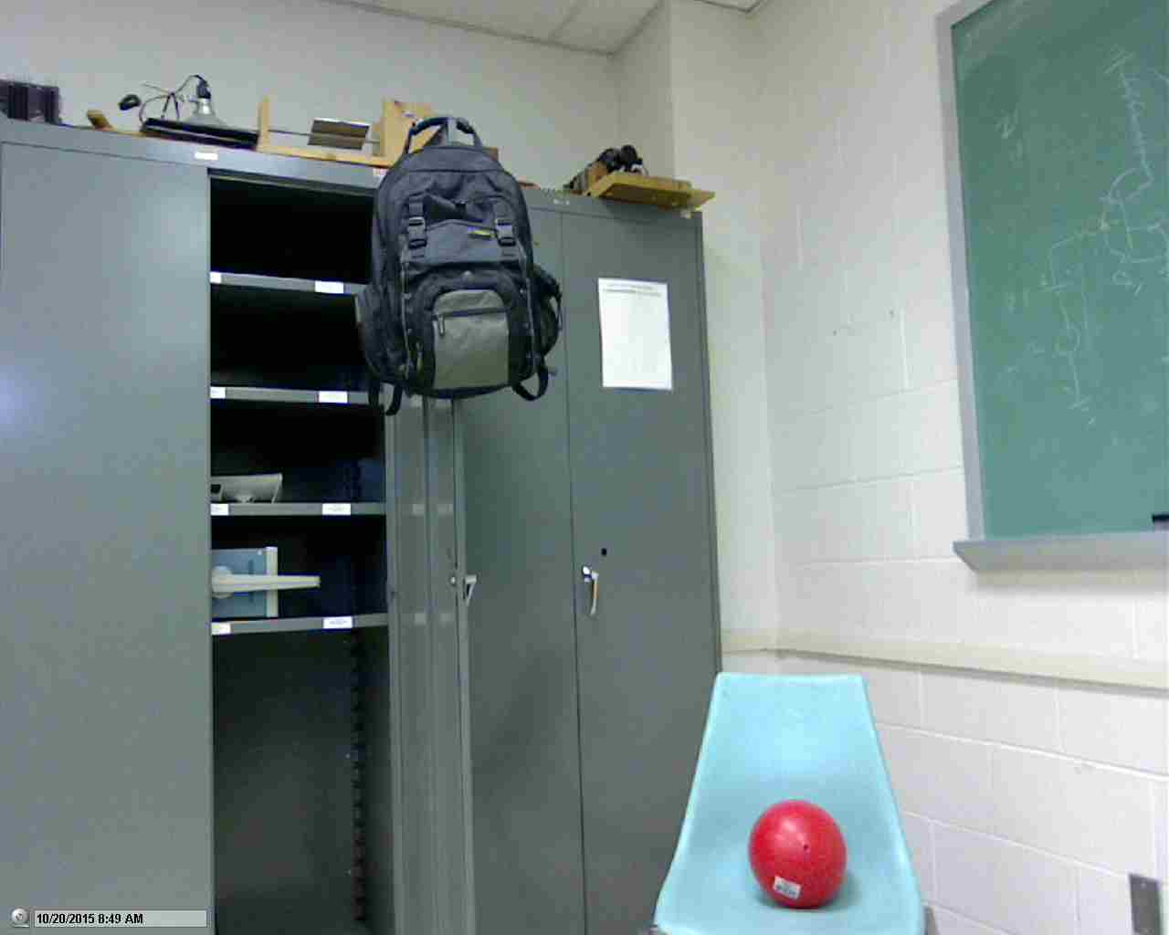
Testing of Logitech C500 Webcam
Install Logitech software
Capture images and Video
Fig. 21. Color image from Logitech C500

Slide 50
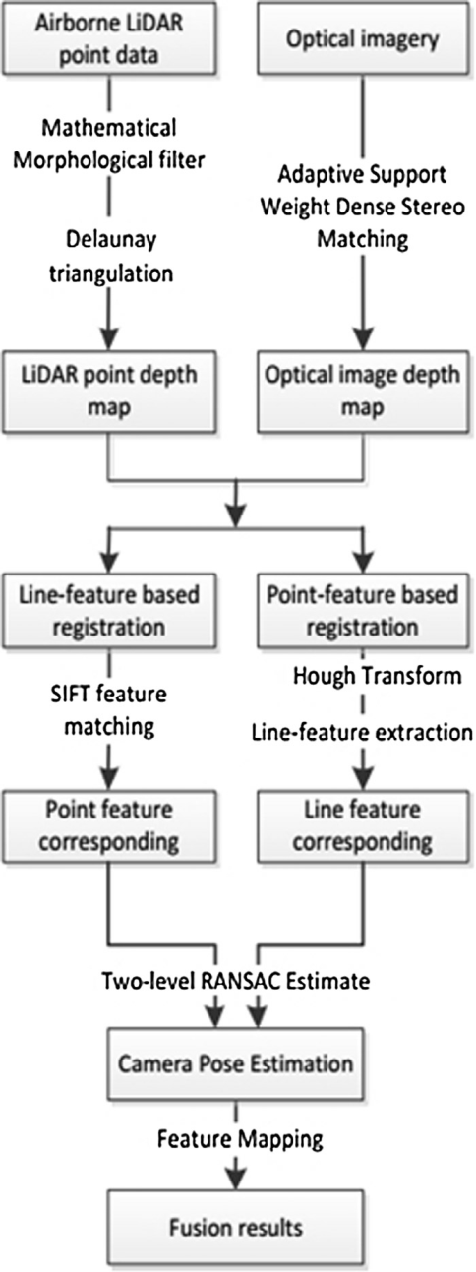
Registration Flowchart
Filter point cloud
Interpolate point cloud
Create depth maps
Feature detection
Outlier elimination
Feature matching
Fig. 22. Registration method flowchart [9]

Slide 51
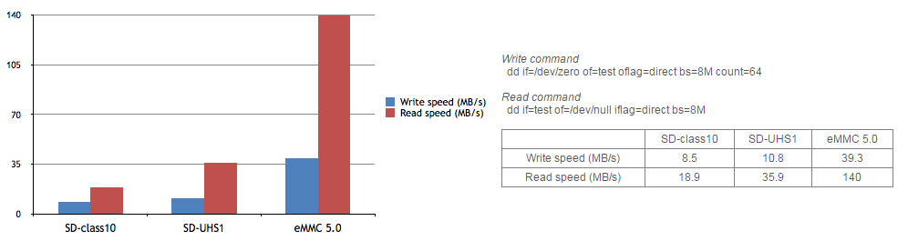
EMMC vs. microSD Card
Fig. 23. Write/Read Speed Comparison [10]

Slide 52
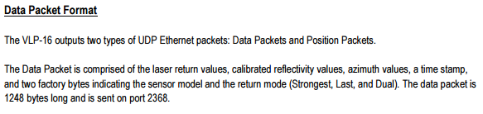
UDP Detection
Fig. 23. VLP-16 UDP Detection [11]
Current Packet Sniffer Detection
  TCP (Transmission Control Protocol)
  UDP (User Datagram Protocol)
  ICMP (Internet Control Message Protocol)
  IGMP (Internet Group Management Protocol)
  Others (Detects all Ethernet Frames)

Slide 53
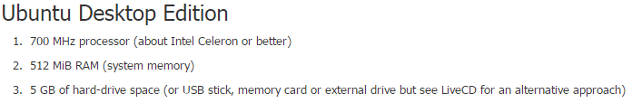
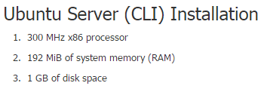
Ubuntu Desktop vs. Server
Fig. 24. Ubuntu Desktop Requirements [12]
Fig. 25. Ubuntu Server Requirements [12]

Slide 54
Creating a Bootable MicroSD Card
MiniTool Partition Wizard
  Partition creation and wiping
7zip
  Extraction of IMG.XZ file
Win32 Disk Imager
  Writing the unpacked IMG file to Micro SD card
Process can also used for flashing eMMC

Slide 55
OpenCV System Requirements [13]
Operating System: Windows, Linux or Mac
Memory (RAM): 256 MB
Hard Disk Space: 50 MB
Processor: 900 MHz

Slide 56
JPG, PNG, & PPM Comparisons [14] [15]
JPG (Joint Photographic Experts Group)
  Supports 24-bit color RGB
  Compress image data by reducing sections of images to blocks or pixels
  Compression is permanent
PNG (Portable Network Graphics)
  Supports transparency, 8-bit color, and 24-bit color RGB
  Largest of three compared formats
PPM (Portable Pixmap Utilities)
  Lowest common denominator color image file format
  Includes basic color
  Easy to format to process

Slide 57
Link to Proposal
http://ee.bradley.edu/projects/proj2016/lidar/Attachments/Project_Proposal.pdf

Slide 58
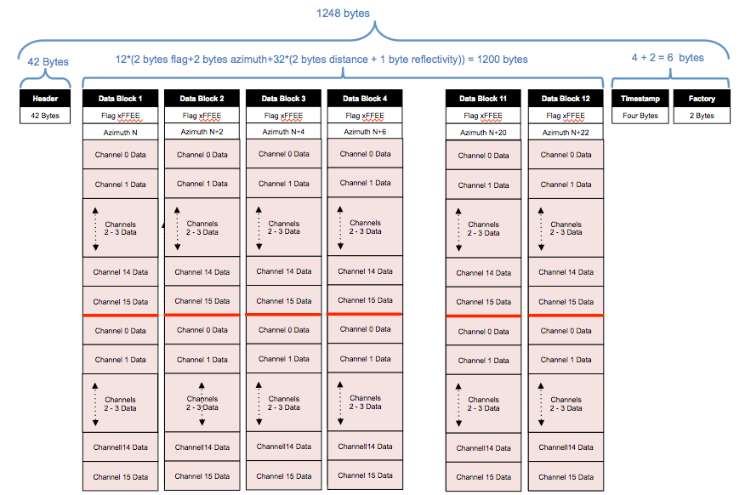
Data Diagram: Velodyne User’s Manual

Slide 59
Storage Classes
MasterBlock (“Interface”) – Flexible size
  Ensures full 180° view and selected range are received
  Contains multiple DataPackets (as many as needed from one 360° sweep)
DataPacket: Contains 12 DataBlocks and a time stamp
DataBlock: contains 2 HalfDataBlocks
HalfDataBlock: contains 16 DataPoints and an azimuth
DataPoint: contains one distance, reflectivity, and alt. ang.

Slide 60
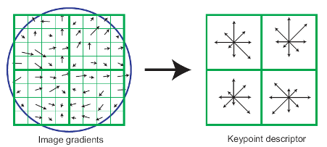
SIFT Keypoint Explanation:
Fig. 7. Computation of SIFT Keypoints [16]
First, compute gradient magnitude and orientation at each sample point around a keypoint
Use Gaussian window to provide weight to gradients
SIFT keypoint descriptors are basically a histogram of gradient orientations

Slide 61
SIFT Keypoint Explanation
Fig. 7. Computation of SIFT Keypoints [16]
SIFT descriptors have 128 dimensions at each keypoint resulting in a 128 element vector
Each keypoint descriptor is unique and can be matched to similar descriptors collected from the target image for registration

Slide 62
Resources
[1] http://www.bradley.edu/inthespotlight/story/?id=b46cf284-2bd9-4efb-917e-ba6ca565cf84
[2] http://learnlab.uta.edu/roboboat/the-auvsi-roboboat-competition/
[3] Bradley University RoboBoat 2013 Qualifying Run https://www.youtube.com/watch?v=V4pz1FiMXfA
[4] https://researchweb.iiit.ac.in/~wasif.mpg08/SIFT/image.jpg
[5]https://upload.wikimedia.org/wikipedia/commons/thumb/3/32/OpenCV_Logo_with_text_svg_version.svg/390px-OpenCV_Logo_with_text_svg_version.svg.png
[6] http://www.fmwconcepts.com/misc_tests/FFT_tests/lena_roundtrip/lena.jpg
[7] http://docs.opencv.org/master/da/df5/tutorial_py_sift_intro.html#gsc.tab=0
[8] http://pointclouds.org/assets/images/contents/logos/pcl/pointcloudlibrary_vert_large_pos.png

Slide 63
Resources
[9] Lv, Fang, and Kan Ren. "Automatic Registration of Airborne LiDAR Point Cloud Data and Optical Imagery Depth Map Based on Line and Points Features." Infrared Physics & Technology 71 (2015): 457-63. Web.
[10] http://www.hardkernel.com/main/products/prdt_info.php
[11] http://velodynelidar.com/docs/manuals/VLP-16%20User%20Manual%20and%20Programming%20Guide%2063-9243%20Rev%20A.pdf
[12] https://help.ubuntu.com/community/Installation/SystemRequirements
[13] http://getintopc.com/softwares/development/opencv-free-download/
[14] http://netpbm.sourceforge.net/doc/ppm.html
[15] http://www.howtogeek.com/howto/30941/whats-the-difference-between-jpg-png-and-gif/
[16] http://www.jarzebski.pl/media/big/publish/2016/02/cloudshell-odroidutility.png
[17] https://en.wikipedia.org/wiki/Spherical_coordinate_system#/media/File:3D_Spherical_2.svg
[18] http://lin-ear-th-inking.blogspot.com/2012/02/barnes-analysis-for-surface.html

