Slide 1
3D Environmental Mapping and Imaging for AUVSI RoboBoat
David Bumpus, Dan Kubik, & Juan Vazquez
Advisor: Dr. José Sánchez
Customer: Mr. Nick Schmidt
Department of Electrical & Computer Engineering
April 26, 2016

Slide 2
Presentation Outline
Problem Background
Functional Requirements
Project Overview
Division of Labor
Juan Vazquez
Dan Kubik
David Bumpus
Conclusion

Slide 3
Presentation Outline
Problem Background
Functional Requirements
Project Overview
Division of Labor
Juan Vazquez
Dan Kubik
David Bumpus
Conclusion

Slide 4
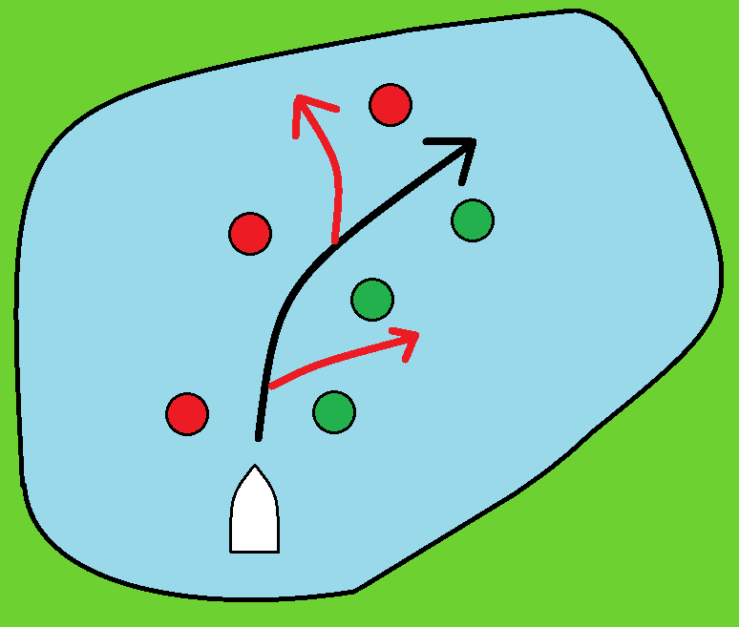
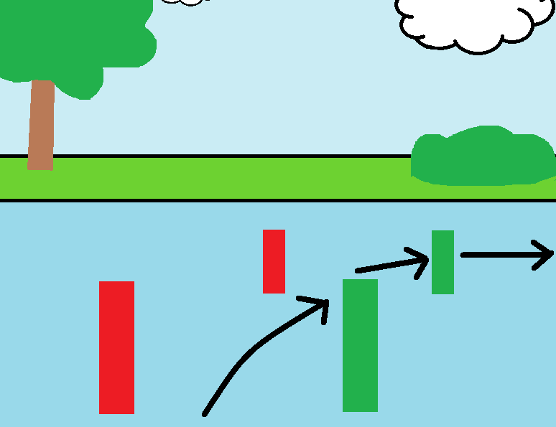
Problem Background: Motivation
Since 2013, Bradley has twice sent teams to the AUVSI RoboBoat competition
Teams have difficulty determining distances to objects from boat
Fig. 1. Potential RoboBoat paths
Fig. 2. Navigating through buoys

Slide 5
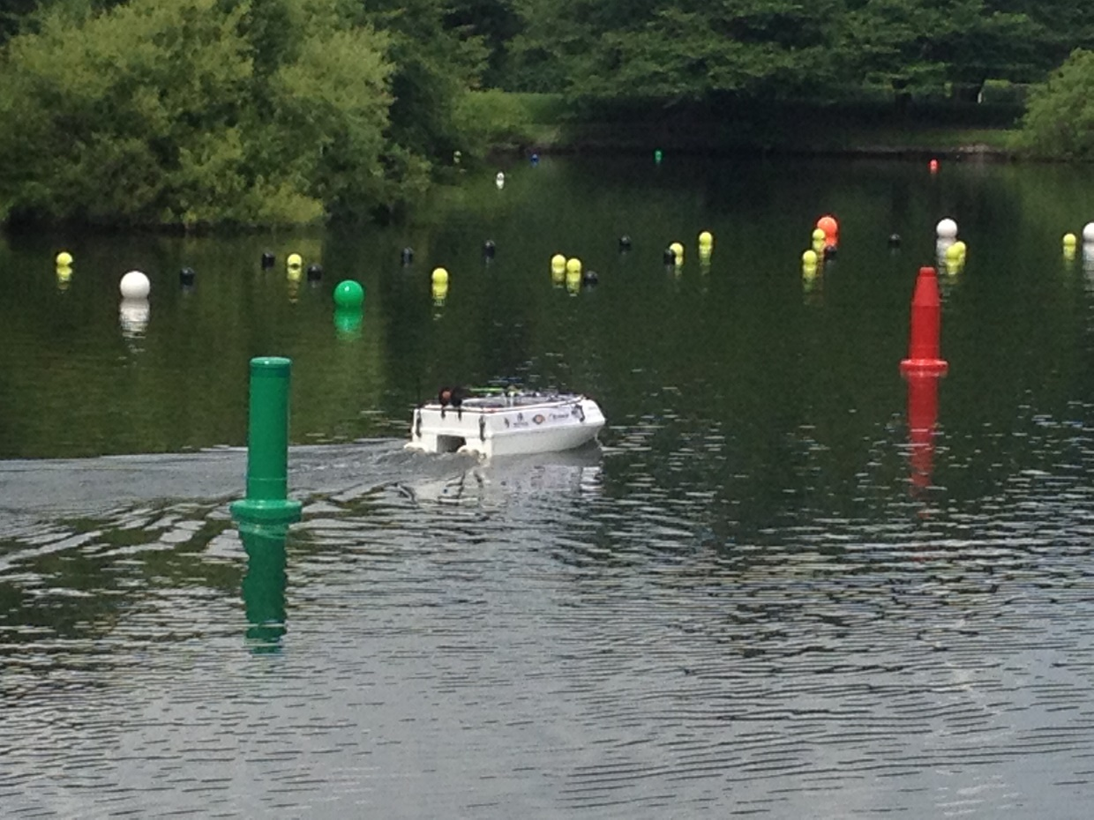
Problem Background: Motivation
Fig. 3. Boat identifying area of interest [1]

Slide 6
Problem Background: Objective
Create an accurate measurement system that:
Measures distance to objects in the boat’s surroundings
Uses lidar
Operates in real-time
Is easy to use for future boat teams

Slide 7
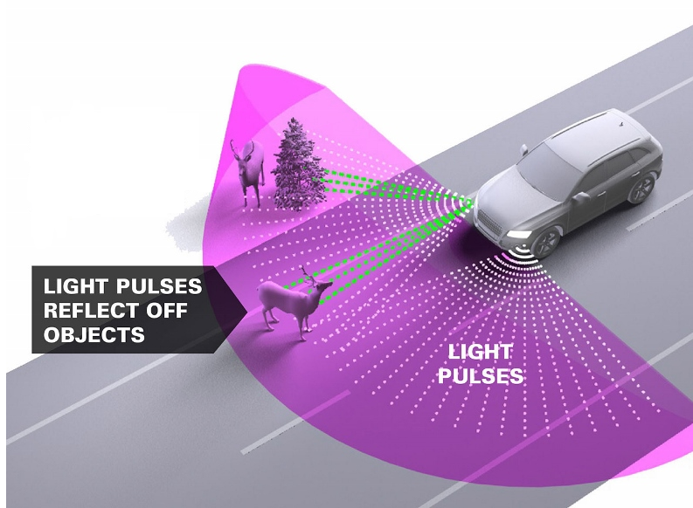
Problem Background: Significance
Lidar
“light” + “radar”
Distance and amount of light (reflectivity)
Reduces human error
Fig. 4. Application of lidar for automobile navigation [2]

Slide 8
Presentation Outline
Problem Background
Functional Requirements
Project Overview
Division of Labor
Juan Vazquez
Dan Kubik
David Bumpus
Conclusion

Slide 9
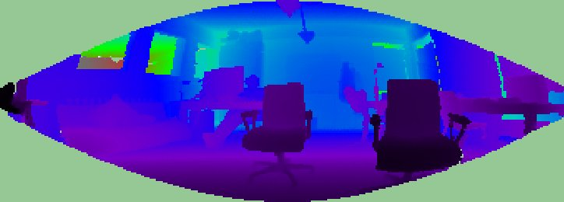
Functional Requirements
System must:
Obtain and store lidar data
Obtain camera images
Reduce lidar dataset as instructed
Register lidar data with image data
Create color overlay image representing distance
Determine nearest object location and distance
Fig. 5. A color overlay image representing registered distance information [3]

Slide 10
Presentation Outline
Problem Background
Functional Requirements
Project Overview
Division of Labor
Juan Vazquez
Dan Kubik
David Bumpus
Conclusion

Slide 11
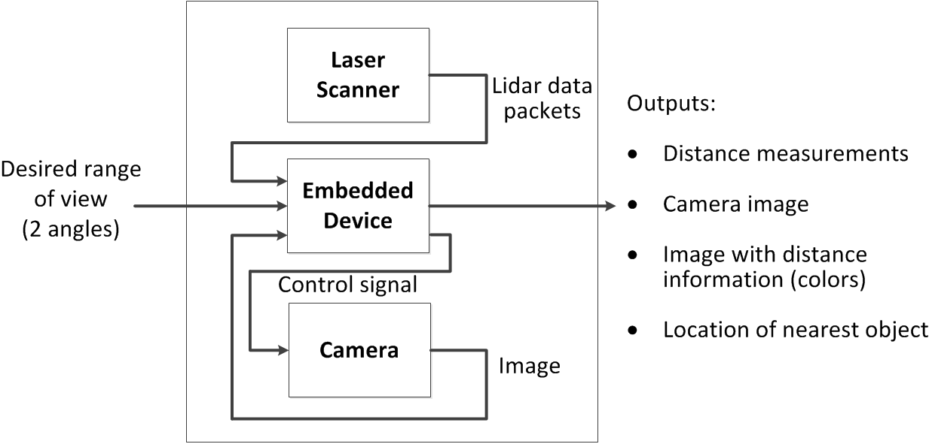
Project Overview
Fig. 6. System block diagram

Slide 12
Presentation Outline
Problem Background
Functional Requirements
Project Overview
Division of Labor
Juan Vazquez
Dan Kubik
David Bumpus
Conclusion

Slide 13
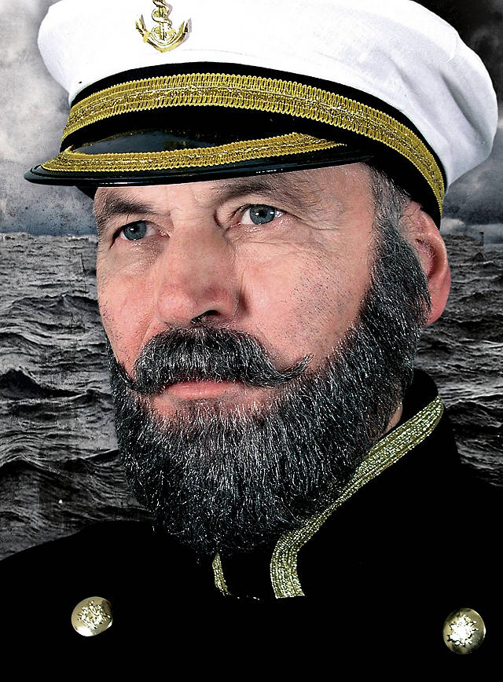
Division of Labor
Data Acquisition
Juan
Data Organization
Dan
Data Processing
David
Fig. 7. Captain [4]

Slide 14
Presentation Outline
Problem Background
Functional Requirements
Project Overview
Division of Labor
Juan Vazquez
Dan Kubik
David Bumpus
Conclusion

Slide 15
Juan Vazquez: Overview
Fig. 8. Subsystems covered in purple

Slide 16
Juan Vazquez: OS Installation
Ubuntu Server
Size
Software availability
Configurability
Fig. 9. Ubuntu Server [5]

Slide 17
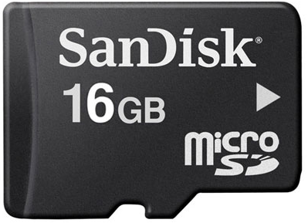
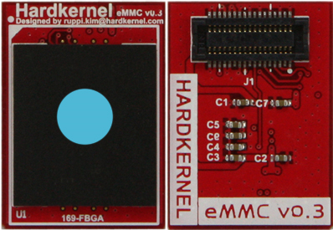
Juan Vazquez: OS Installation
Operating system booting
MicroSD
EMMC (Embedded MultiMediaCard)
Establishing network connection
Ethernet connection bridge
Fig. 10. MicroSD [6]
Fig. 11. EMMC [7]

Slide 18
Juan Vazquez: Camera Interface
Logitech C500 Linux driver
Open Source Computer Vision
Supports Linux
C++ Interface
Video capture
Image registration
Fig. 12. OpenCV [8]

Slide 19
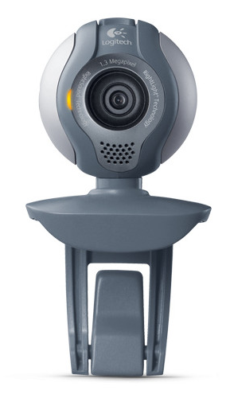
Juan Vazquez: Camera Interface
Image capture program
Live video read
Continuously capturing/overwriting
Stores in PPM (Portable Pixmap Format)
Fig. 13. Logitech C500 [9]

Slide 20
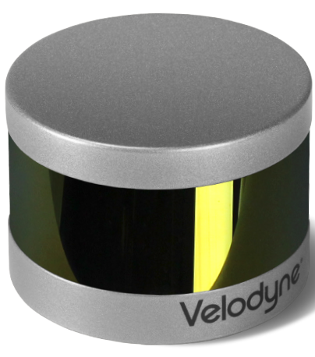
Juan Vazquez: VLP-16 Interface
Libpcap
Library for packet capture
Packet Detection
UDP (User Datagram Protocol)
Packet Storage
Text file
Fig. 14. VLP-16 [10]

Slide 21
Juan Vazquez: Detection & Read Interface
Fig. 15. Removing Unwanted Data

Slide 22
Presentation Outline
Problem Background
Functional Requirements
Project Overview
Division of Labor
Juan Vazquez
Dan Kubik
David Bumpus
Conclusion

Slide 23
Dan Kubik: Overview
Fig. 16. Subsystems covered in purple

Slide 24
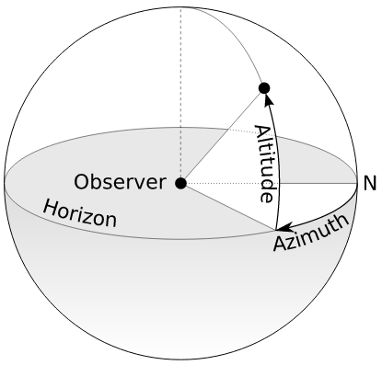
Dan Kubik: Reading lidar data
Each text file contains an encoded packet of lidar data
“ FF | EE | 7D | 70 | 6F | 06 | 02 | F3 | 06 …”
Data point
Fig. 17. Azimuth and altitude explained [11]
Initial flag
Azimuth
Reflectivity
Distance

Slide 25
Dan Kubik: Reading lidar data
Data packet:
Initial Flag
Time stamp
Scanner Information
FFEE
Data point:
Distance
Reflectivity
Altitude
x 16
Azimuth
x 24
Fig. 18. Information in a data packet

Slide 26
Dan Kubik: Organizing lidar data
Hierarchy of C++ classes:
MasterBlock
Data block
Half data block
Data packet
Data point
Highest level
Lowest level

Slide 27
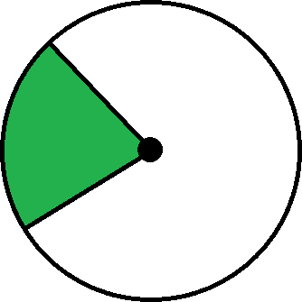
Dan Kubik: Organizing lidar data
MasterBlock – internal “interface”
Considers incoming data
Stores if data falls within “frontal” or “selection” ranges
Fills up to one 360° sweep of data
315°
0°
225°
Fig. 19. Top down view: example of a selection range

Slide 28
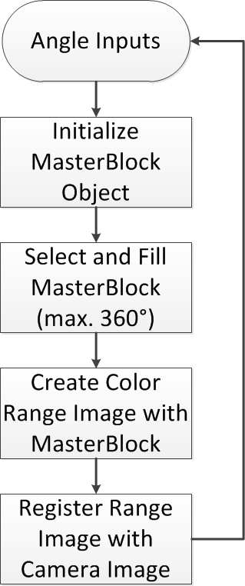
Dan Kubik: Data flow
Fig. 20. Subsystem Flowchart

Slide 29
Dan Kubik: Data flow
Fig. 20. Subsystem Flowchart

Slide 30
Dan Kubik: Data flow
Fig. 20. Subsystem Flowchart

Slide 31
Dan Kubik: Data flow
Fig. 20. Subsystem Flowchart

Slide 32
Dan Kubik: Data flow
Fig. 20. Subsystem Flowchart

Slide 33
Dan Kubik: Data flow
Fig. 20. Subsystem Flowchart

Slide 34
Dan Kubik: Data flow
Fig. 20. Subsystem Flowchart

Slide 35
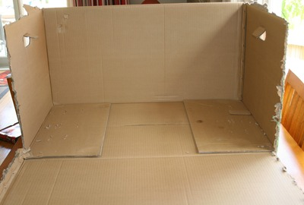
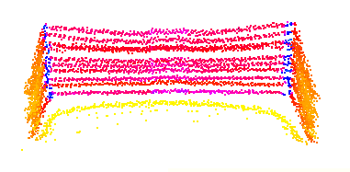
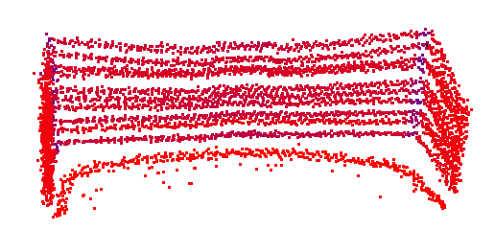
Dan Kubik: Organizing lidar results
Fig. 21. Scanned cardboard box [12]
Fig. 22. VeloView view of box
Fig. 23. 3D-Viewer view of box, created from MasterBlock object

Slide 36
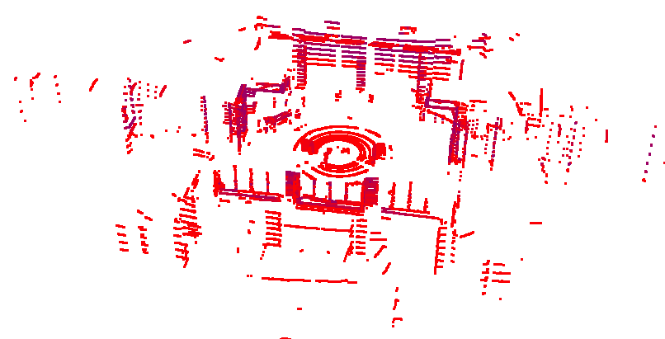
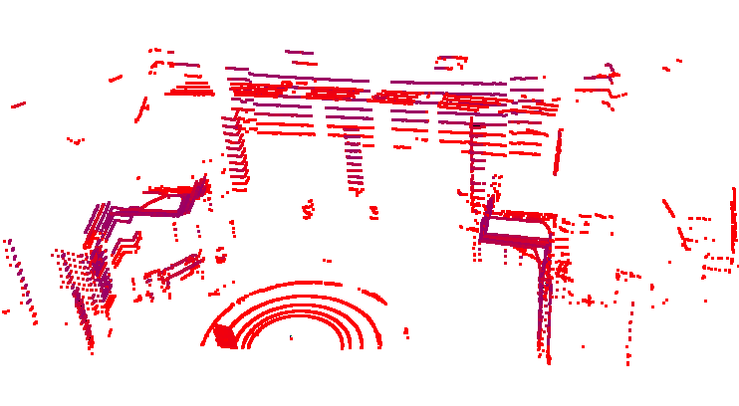
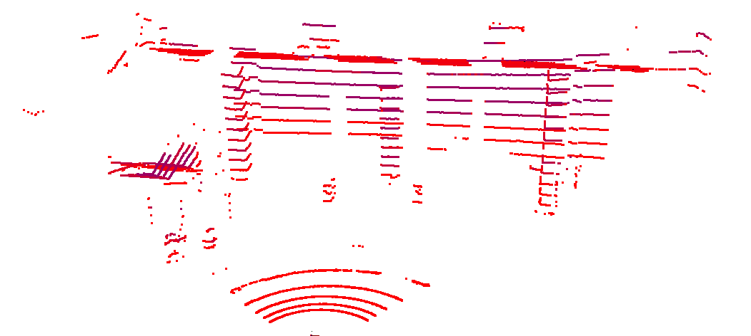
Dan Kubik: Organizing lidar results
Fig. 24. Full 360° view, input: (0, 359)
Fig. 25. Frontal 180° view, input: (270, 90)
Fig. 26. Frontal 90° view, input: (315, 45)

Slide 37
Dan Kubik: Creating color overlay
?
Fig. 27. Creating 2D color range image from 3D lidar data

Slide 38
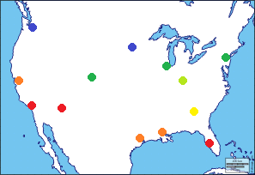
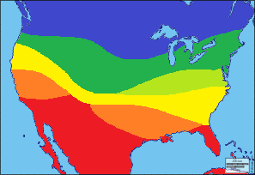
Dan Kubik: Barnes Interpolation
30s
40s
50s
60s
70s
80s
Fig. 28. Interpolating unevenly distributed data to a complete grid [13]

Slide 39
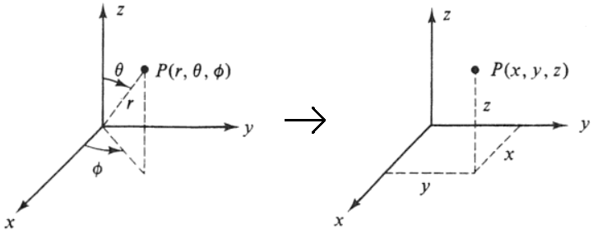
Dan Kubik: Creating color overlay
How to get to two dimensions?
Convert spherical to rectangular coordinates (X, Y, Z)
Keep X (horizontal) and Z (vertical) dimension
Use distances as interpolation values
Fig. 29. Spherical to rectangular coordinates, remove y dimension [14]

Slide 40
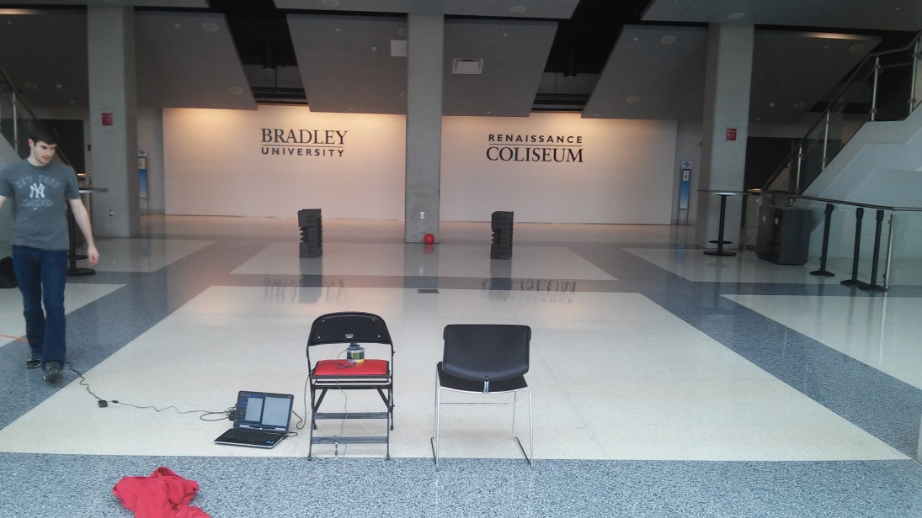
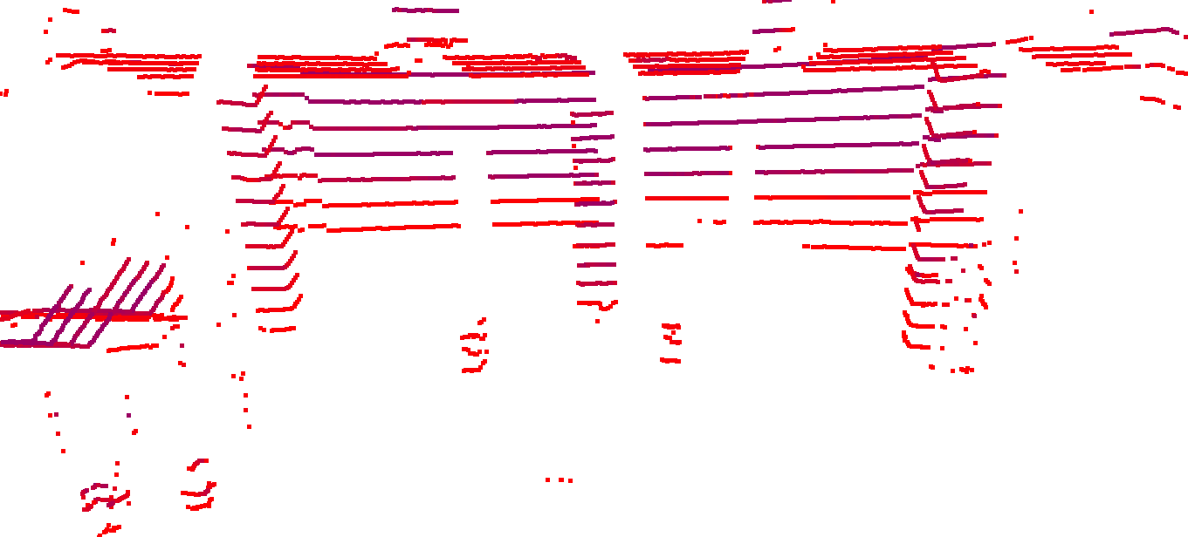
Dan Kubik: Overlay creation results
Fig. 30. Renaissance Coliseum setup
Fig. 31. Renaissance Coliseum lidar data (frontal 90°)

Slide 41
Dan Kubik: Overlay creation results
Fig. 32. Renaissance Coliseum lidar data (frontal 90°)
Far
Near
Fig. 33. Barnes Interpolation with color thresholding

Slide 42
Dan Kubik: Overlay creation results
14.0 m
First column: 11.2m
Third column: 11.8m
Right buoy: 8.26m
Back wall: 15.1m
X Center column: 10.2m (off by 0.3m)
X Left buoy: 7.87m (off by a significant margin)
12.2 m
10.5 m
8.8 m
7.0 m
5.3 m
3.5 m
1.8 m
0 m
Fig. 34. Barnes Interpolation of Renaissance Coliseum

Slide 43
Presentation Outline
Problem Background
Functional Requirements
Project Overview
Division of Labor
Juan Vazquez
Dan Kubik
David Bumpus
Conclusion

Slide 44
David Bumpus: Overview
Fig. 35. Subsystems covered in purple

Slide 45
Work Accomplished: Object Detection
Scale Invariant Feature Transform (SIFT)
Keypoint detection for object detection
Registration of Barnes interpolation with webcam image
Fig. 36. OpenCV Logo [8]
Fig. 37. A color overlay image representing registered distance information [3]

Slide 46
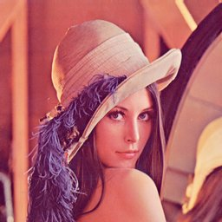
SIFT Keypoint Explanation [7]:
Robust against changes in scale or rotation of an image
Fig. 38. Robust SIFT matching [15]

Slide 47
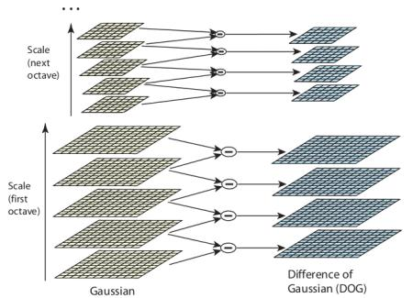
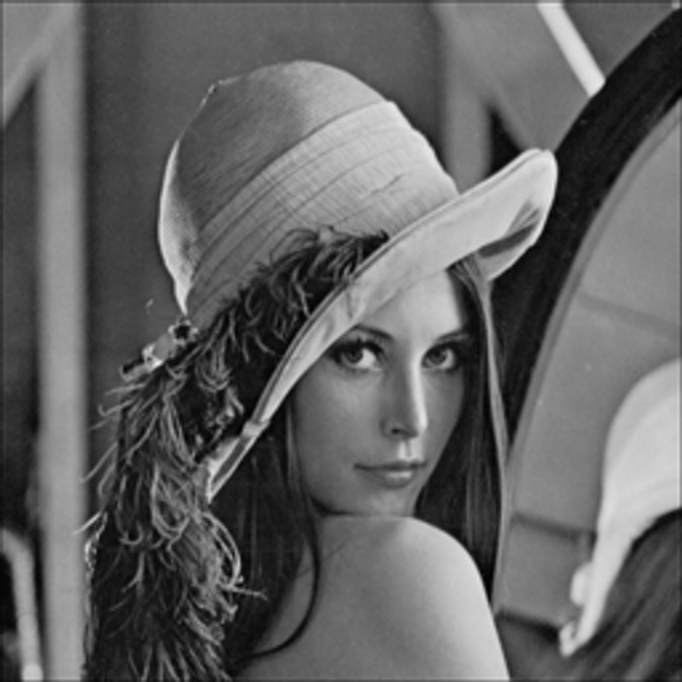
SIFT Keypoint Explanation [7]:
Step 1: Scale Space Extrema Detection
Difference of Gaussian
Subtract
Fig. 39. Difference of Gaussian for different octaves in Gaussian pyramid [16]
Result =

Slide 48
SIFT Keypoint Explanation [7]:
Step 1: Scale space extrema detection
Subtract
$$σ=2$$
$$σ=4$$
$$σ=8$$
$$σ=16$$
$$σ=32$$
Fig. 40. Difference of Gaussian explanation [17]

Slide 49
SIFT Keypoint Explanation [7]:
Step 2: Keypoint localization
Eliminate low contrast keypoints
Eliminate keypoints on edge of image
What remains are strong keypoints
Fig. 41. Eliminate weak keypoints [15]

Slide 50
SIFT Keypoint Explanation [7]:
Step 3: Orientation assignment
Gradient magnitude and direction is calculated
Create keypoint with same location and scale, but different direction
Fig. 42. Rotation invariant keypoint orientation assignment [15]

Slide 51
SIFT Keypoint Explanation [7]:
Step 4: Keypoint descriptor
Generate unique histogram with 128 bins for each keypoint
Step 5: Keypoint matching
Search target image keypoints for similar descriptors
Fig. 43. Keypoint descriptor matching

Slide 52
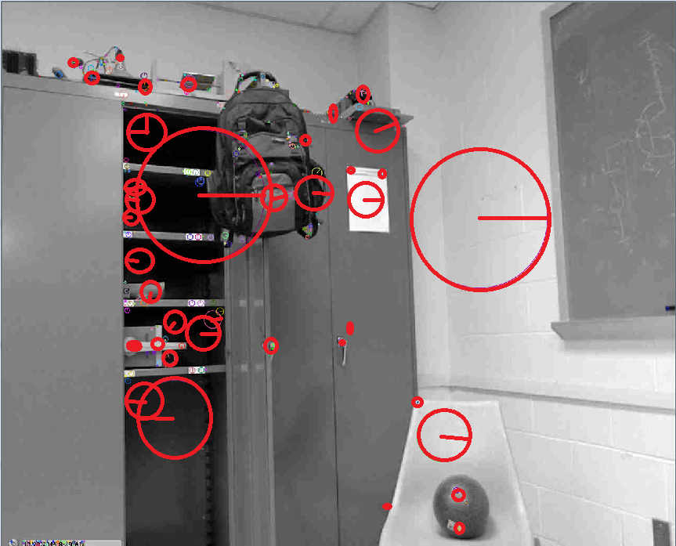
Work Accomplished: Image Keypoints
Fig. 44. SIFT keypoint detection C++ implementation

Slide 53
Work Accomplished: Point Cloud Keypoints
Point Cloud Library (PCL)
Open source point cloud processing
Linux compatible
SIFT algorithm
Fig. 45. Point Cloud Library (PCL) logo [18]

Slide 54
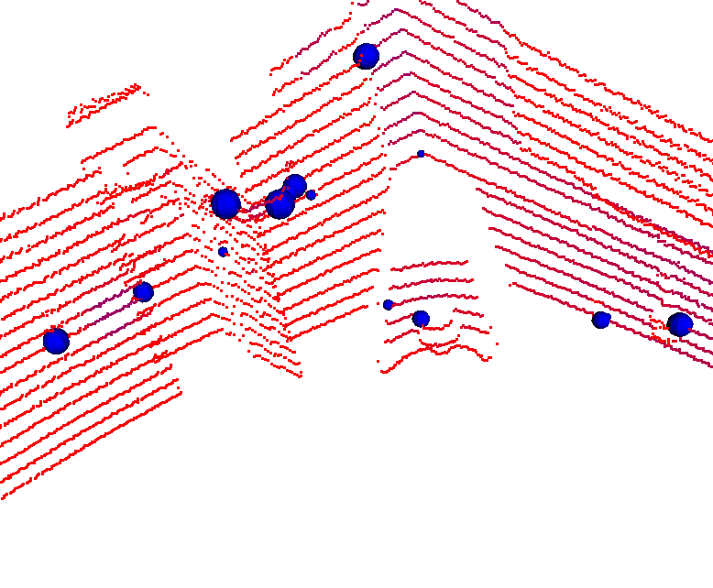
Work Accomplished: Point Cloud Keypoints
Chalkboard
Backpack
Shadow
Closet
Chair
Ball
Fig. 46. SIFT keypoint detection in point clouds for object detection

Slide 55
Presentation Outline
Problem Background
Functional Requirements
Project Overview
Division of Labor
Juan Vazquez
Dan Kubik
David Bumpus
Conclusion

Slide 56
Conclusion
Juan
Lidar Ethernet detection, image capture
Dan
Data storage and organization, depth overlay for image
David
Nearest object algorithm development

Slide 57
Conclusion
Difficulty acquiring data packets
Incoming data: speed of incoming data vs. read time
Lack of precision in Barnes interpolation

Slide 58
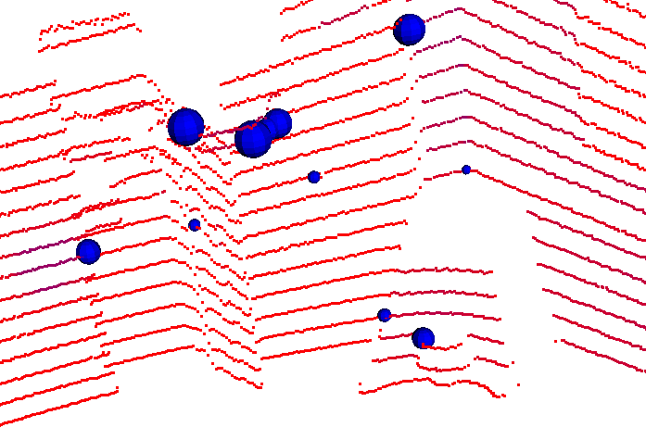
Conclusion
Fig. 47. Registration concept to improve precision of Barnes interpolation

Slide 59
Conclusion
Achievements:
Interfaced camera and laser scanner with Odroid XU4
Detected nearest objects with 95% accuracy
Generated depth overlay
Fig. 48. Object detection
Fig. 49. Depth overlay

Slide 60
3D Environmental Mapping and Imaging for AUVSI RoboBoat
David Bumpus, Dan Kubik, & Juan Vazquez
Advisor: Dr. José Sánchez
Customer: Mr. Nick Schmidt
Department of Electrical & Computer Engineering
April 26, 2016

Slide 61
Additional Slides

Slide 62
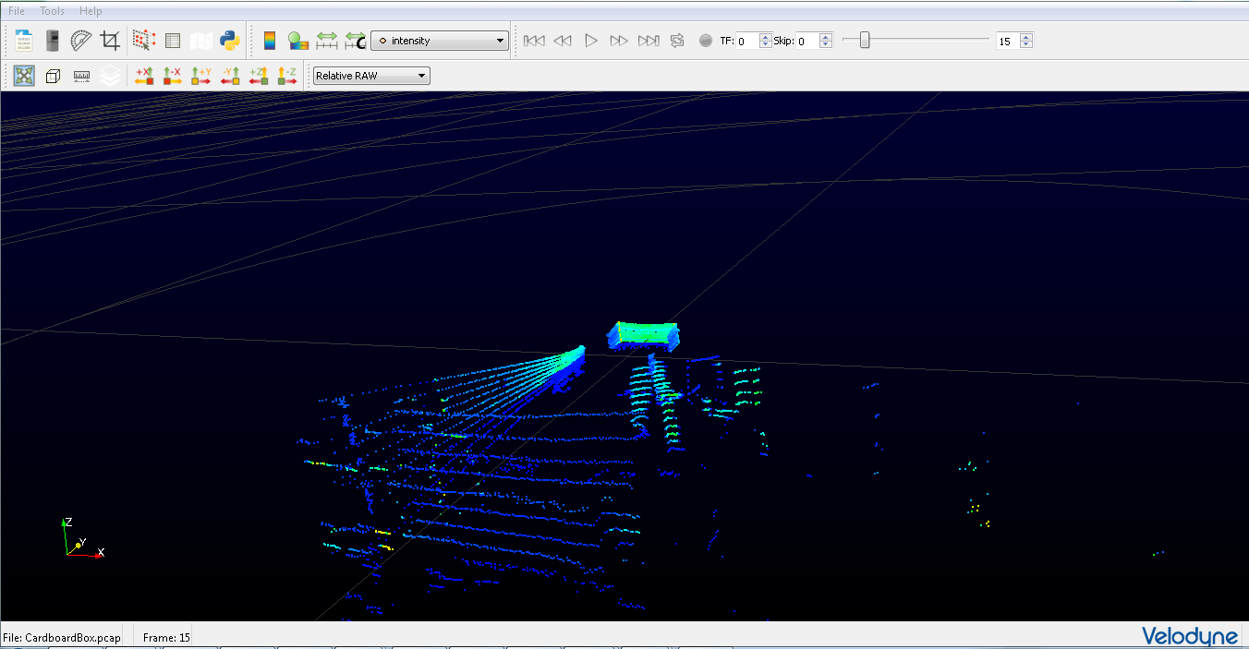
Testing of VLP-16 Puck™
Install Veloview Software
Test acquisition of data to Veloview and verify distances
Familiarize self with Veloview data manipulation
Fig. 50. Data acquisition to Veloview using VLP-16 Puck

Slide 63
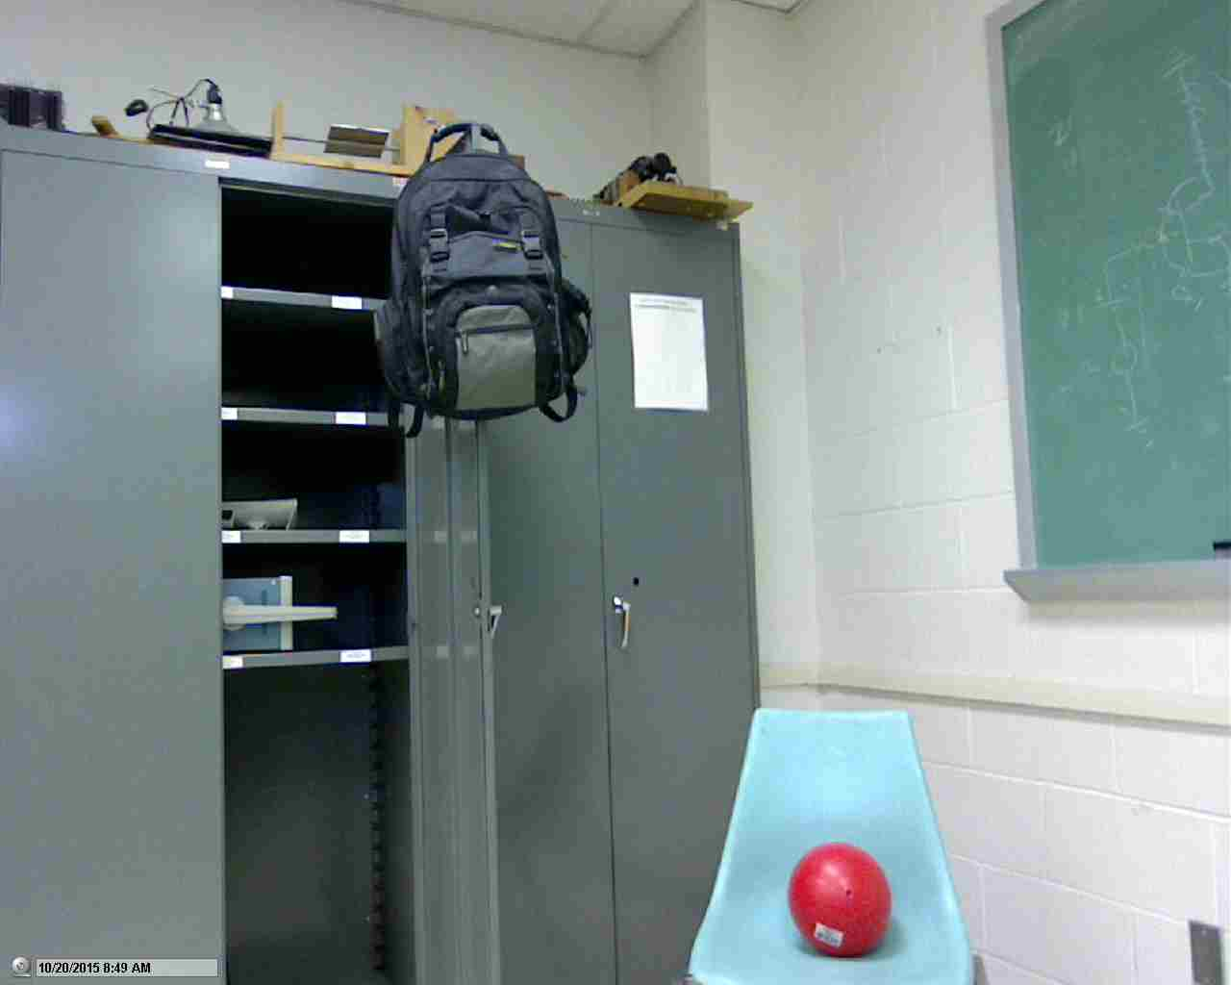
Testing of Logitech C500 Webcam
Install Logitech software
Capture images and Video
Fig. 51. Color image from Logitech C500

Slide 64
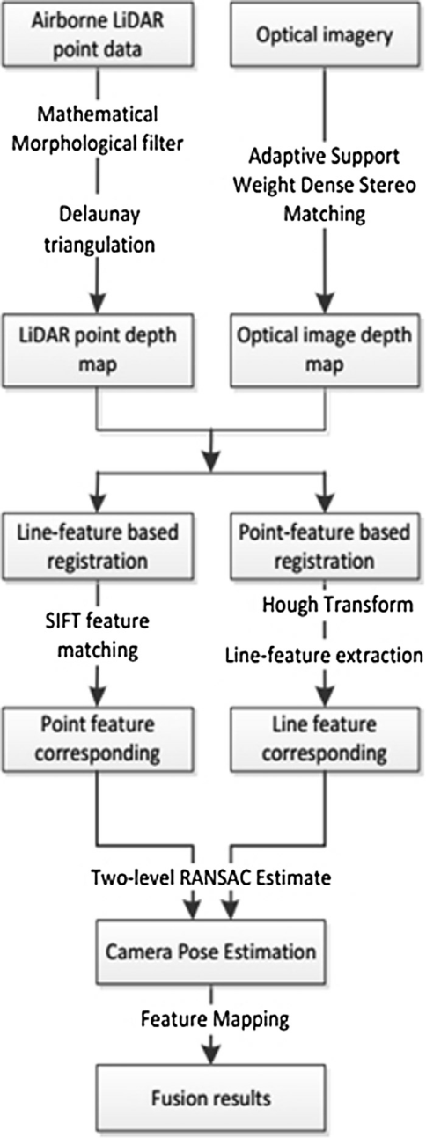
Registration Flowchart
Filter point cloud
Interpolate point cloud
Create depth maps
Feature detection
Outlier elimination
Feature matching
Fig. 52. Registration method flowchart [19]

Slide 65
EMMC vs. microSD Card
Fig. 53. Write/Read Speed Comparison [20]

Slide 66
UDP Detection
Fig. 54. VLP-16 UDP Detection [21]
Current Packet Sniffer Detection
TCP (Transmission Control Protocol)
UDP (User Datagram Protocol)
ICMP (Internet Control Message Protocol)
IGMP (Internet Group Management Protocol)
Others (Detects all Ethernet Frames)

Slide 67
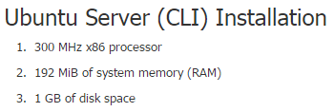
Ubuntu Desktop vs. Server
Fig. 55. Ubuntu Desktop Requirements [22]
Fig. 56. Ubuntu Server Requirements [23]

Slide 68
Creating a Bootable MicroSD Card
MiniTool Partition Wizard
Partition creation and wiping
7zip
Extraction of IMG.XZ file
Win32 Disk Imager
Writing the unpacked IMG file to Micro SD card
Process can also used for flashing eMMC

Slide 69
OpenCV System Requirements [24]
Operating System: Windows, Linux or Mac
Memory (RAM): 256 MB
Hard Disk Space: 50 MB
Processor: 900 MHz

Slide 70
JPG, PNG, & PPM Comparisons [25] [26]
JPG (Joint Photographic Experts Group)
Supports 24-bit color RGB
Compress image data by reducing sections of images to blocks or pixels
Compression is permanent
PNG (Portable Network Graphics)
Supports transparency, 8-bit color, and 24-bit color RGB
Largest of three compared formats
PPM (Portable Pixmap Utilities)
Lowest common denominator color image file format
Includes basic color
Easy to format to process

Slide 71
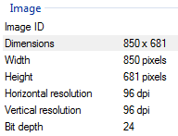
Webcam Image Properties

Slide 72
Read/Write Future Development
Data acquisition currently executing from EMMC
Directly affects read/write cycles
Performance will gradually deteriorate
Possible Solution
Utilize embedded device (Odroid-XU4) RAM
Shared memory
Use pipelines or signals to perform writing and storage

Slide 73
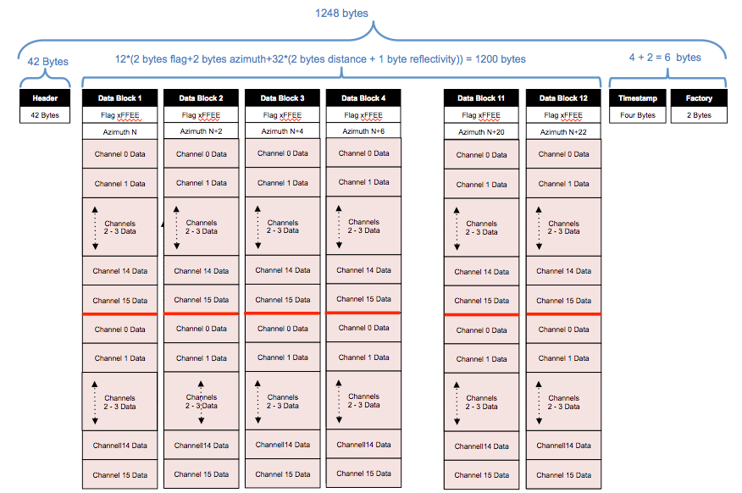
Data Diagram: Velodyne User’s Manual

Slide 74
Storage Classes
MasterBlock (“Interface”) – Flexible size
Ensures full 180° view and selected range are received
Keeps track if 360° worth of data has been checked yet
Contains multiple HalfDataPackets (as many as needed from one 360° sweep) taken from DataPackets
DataPacket: contains 12 DataBlocks and a time stamp
DataBlock: contains 2 HalfDataBlocks
HalfDataBlock: contains 16 DataPoints and an azimuth
DataPoint: contains one distance, reflectivity, and alt. ang.

Slide 75
Decoding lidar data
“ FF | EE | 7D | 70 | 6F | 06 | 02 | F3 | 06 …”
Calculating azimuth or distance:
Flip and combine bytes: 0x707D
Convert to decimal: 28797
Divide by 100: 287.97°
Reflectivity is a direct hexadecimal to decimal conversion
Initial flag
Azimuth
Reflectivity
Distance

Slide 76
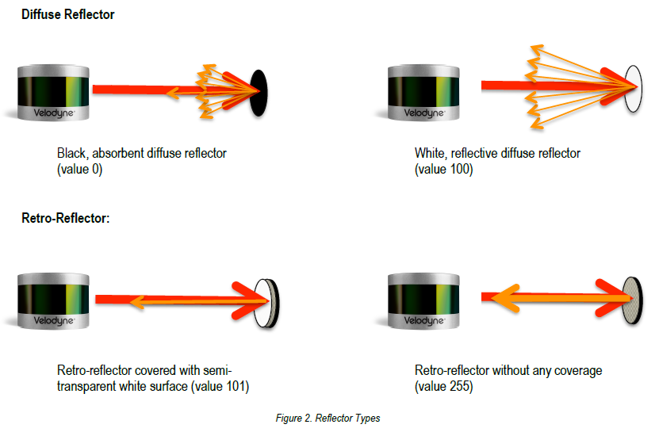
Reflectivity
Fig. 57. Reflectivity value meanings [21]

Slide 77
Visually comparing picture to interpolation

Slide 78
Barnes Interpolation
30s
40s
50s
60s
70s
80s
Distance value in grid: g(x,y) = $\frac{\sum_{j=0}^{M}{η}(r_{j})f_{j}}{\sum_{j=0}^{M}{η}(r_{j})}$ , [13]
where:
$η=e^{\frac{−r^{2}}{4k}}$,
M is the number of known values,
r is the radius to known value from grid point,
k is the “weight factor”,
(x,y) are the coordinates of griddled data,
f is the value of the known datum.

Slide 79
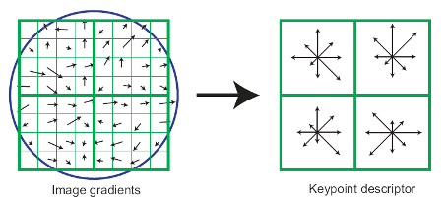
SIFT Keypoint Explanation:
Fig. 58. Computation of SIFT Keypoints [27]
First, compute gradient magnitude and orientation at each sample point around a keypoint
Use Gaussian window to provide weight to gradients
SIFT keypoint descriptors are basically a histogram of gradient orientations

Slide 80
SIFT Keypoint Explanation
Fig. 59. Computation of SIFT Keypoints [27]
SIFT descriptors have 128 dimensions at each keypoint resulting in a 128 element vector
Each keypoint descriptor is unique and can be matched to similar descriptors collected from the target image for registration

Slide 81
Constraints (1 of 2)
Operating voltage less than 12 V
Weight less than 3.6 kg
Current draw less than 4 A
Power consumption less than 50 W

Slide 82
Constraints (2 of 2)
Must fit within a 10 inch cube
Scanning time of less than 5 sec
Measures a horizontal distance of 9.1 m or greater
Measures a vertical distance of 3 m or greater
Operates for at least 40 minutes

Slide 83
Non-functional Requirements
System should be:
Weatherproof
Easy to configure
Mechanically stable
Lightweight
Quick, both computationally and in terms of acquisition

Slide 84
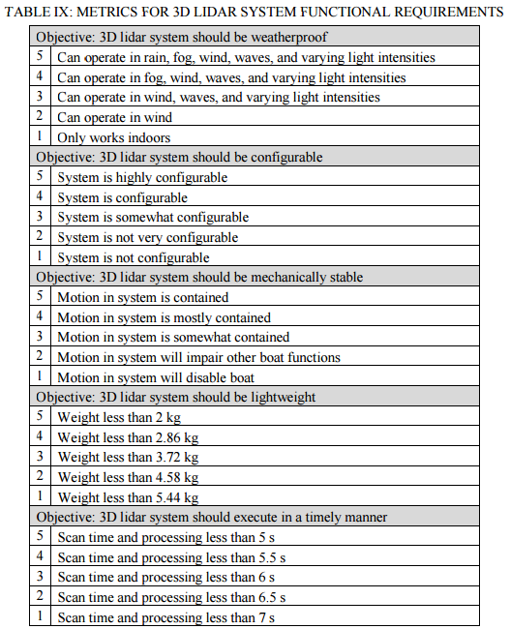
Metrics

Slide 85
Resources
[1] https://cdn-business.discourse.org/uploads/openrov/original/2X/3/33461a8e6b312ad84c17f7d0050241c34ef0cd70.jpg
[2]http://delphi.com/images/default-source/feature-stories/delphi-lidar-how-it-works.jpg?sfvrsn=2
[3] http://pointclouds.org/documentation/tutorials/_images/range_image1.jpg
[4] http://images.maskworld.com/is/image/maskworld/bigview/captain-professional-beards-made-of-real-hair--103724-kapitaen-captain-beard-bart.jpg
[5] http://www.laybourn.org/index.php/sample-page/
[6] http://www.techwaredist.com/wordpress/index.php/740/
[7] http://www.hardkernel.com/main/products/prdt_info.php
[8] https://upload.wikimedia.org/wikipedia/commons/thumb/3/32/OpenCV_Logo_with_text_svg_version.svg/390px-OpenCV_Logo_with_text_svg_version.svg.png
[9] http://www.engadget.com/products/logitech/webcam/c500/
[10] http://velodynelidar.com/vlp-16.html
[11] https://upload.wikimedia.org/wikipedia/commons/f/f7/Azimuth-Altitude_schematic.svg
[12] http://kidfun.com.au/images/8671140212.JPG
[13] Stanley L. Barnes, “A Technique for Maximizing Details in Numerical Weather Map Analysis,” Journal of Applied Meteorology, vol. 3, pp. 396–409, 1964.

Slide 86
Resources
[14]https://www.google.com/url?sa=i&rct=j&q=&esrc=s&source=images&cd=&ved=0ahUKEwjOpPiYjavMAhVDVj4KHZroAcwQjBwIBA&url=http%3A%2F%2Fwww.learningaboutelectronics.com%2Fimages%2FSpherical-to-cartesian-rectangular-coordinate-system.png&bvm=bv.120551593,d.d2s&psig=AFQjCNGsMBHcwGyMXJ8RNEeLFh0ZBIztLw&ust=1461718847423110
[15] http://www.mathworks.com/matlabcentral/answers/uploaded_files/16605/lena.jpg
[16] http://eric-yuan.me/wp-content/uploads/2013/10/sift1.jpg
[17] http://www.cs.princeton.edu/~andyz/ip/proj3/img/stack5.jpg
[18] http://pointclouds.org/assets/images/contents/logos/pcl/pointcloudlibrary_vert_large_pos.png
[19] Lv, Fang, and Kan Ren. "Automatic Registration of Airborne LiDAR Point Cloud Data and Optical Imagery Depth Map Based on Line and Points Features." Infrared Physics & Technology 71 (2015): 457-63. Web.
[20] http://www.hardkernel.com/main/products/prdt_info.php
[21] http://velodynelidar.com/docs/manuals/VLP-16%20User%20Manual%20and%20Programming%20Guide%2063-9243%20Rev%20A.pdf
[22] https://help.ubuntu.com/community/Installation/SystemRequirements
[23] http://getintopc.com/softwares/development/opencv-free-download/
[24] http://getintopc.com/softwares/development/opencv-free-download/
[25] http://netpbm.sourceforge.net/doc/ppm.html
[26] http://www.howtogeek.com/howto/30941/whats-the-difference-between-jpg-png-and-gif/

Slide 87
Resources
[27] https://littlecheesecake.files.wordpress.com/2013/05/sift2.png

