Slide 1
SAE Formula Car
Data Acquisition & Display System
February 25, 2015
Advisor : Professor Steven Gutschlag
Ahmed Albitar John Gertie
Justin Ibarra Sean Lenz

Slide 2
Problem Description
Acquire 5 Key data points from SAE Formula Car
  RPM
  Speed
  Oil Pressure
  Water Temperature
  Battery Voltage
Aggressive Notification system to alert driver if data exceeds threshold values
Multi-mode touch screen display
Wireless transmission of data to off-track computer
Data Logger

Slide 3
Agenda
System block diagram
Division of Labor
Sensor interfacing
Interfacing transceiver with LabVIEW
Interfacing microcontroller with Amulet

Slide 4
System Block Diagram
5V Power Supply
Amulet LCD
Microcontroller
(ATmega128)
UART
Sensors
UART
Wireless Transceiver
Laptop
(LabVIEW GUI)
RS-232
Notes:
Change rs-232 to UART

Slide 5
Division of Labor
Ahmed
  Sensor selection & interfacing
Justin & John
  Interface microcontroller with HyperTerminal
  Test microcontroller with simulated sensor data
  Interface microcontroller with LabVIEW
Sean
  Prepared LabVIEW to receive wireless data
  Interface microcontroller with Amulet

Slide 6
System Block Diagram
Ahmed
5V Power Supply
Sean
Amulet LCD
Microcontroller
(ATmega128)
UART
Sensors
John & Justin
UART
Wireless Transceiver
Laptop
(LabVIEW GUI)
RS-232

Slide 7
Outline for Ahmed
Original Schedule
Subsystem Block Diagram
Updated Schedule
Research
Temperature sensor
Pressure sensor
RPM and velocity sensor
Remaining tasks

Slide 8
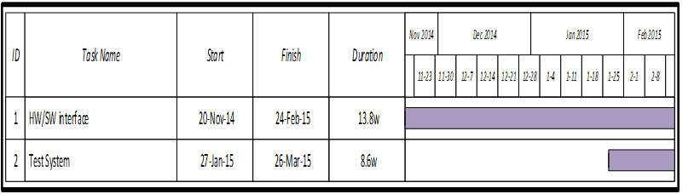
Original Schedule

Slide 9
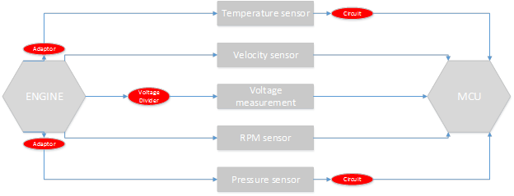
Subsystem Block Diagram

Slide 10


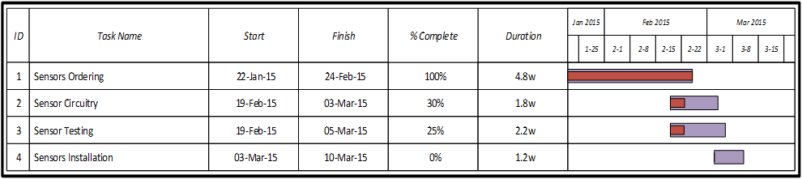
Updated Schedule

Slide 11
Research
Mechanical Engineering Meetings
  Temperature Sensor
  Dimensions
  Hall-Effect sensor
Cost Analysis

Slide 12
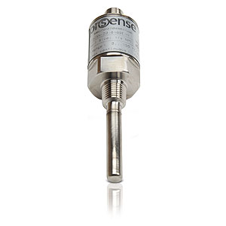
Current Temperature Sensor
ProSense TTD25N-20-0300F-H
$ 126
Analog output: 4 to 20mA
Operating Voltage: 10 to 30VDC
Temperature range: 0-300 F
¼ NPT
Cable : CD12L-0B-020-A0

Slide 13
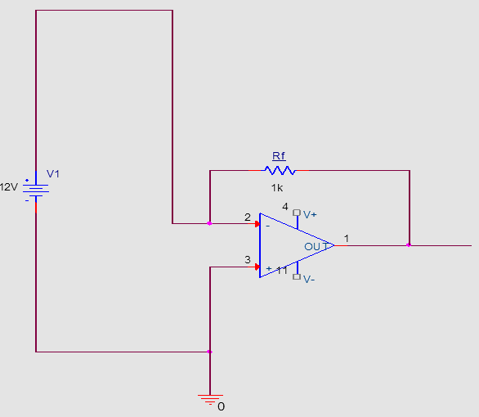
Temperature Sensor Circuitry
Inverting Op-amp

Slide 14
Temperature Sensor Testing
Within 3 percent accuracy
T = m × Io +k ( Io = V×Rf)
m = 10418.75
k = -59.48
Linear Sensor

Slide 15
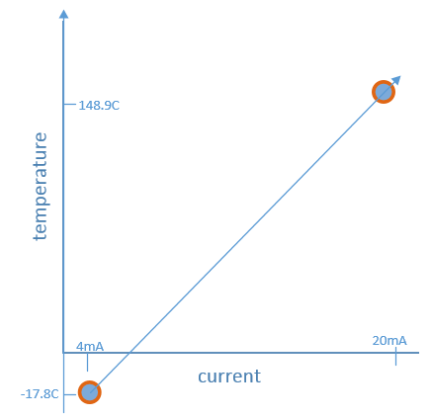
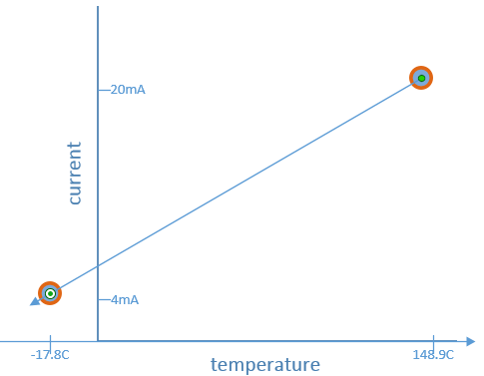
Temperature vs Current graphs

Slide 16
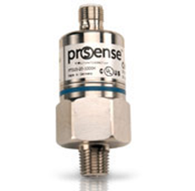
Current Pressure Sensor
ProSense PTD25-20-0100H
$126
Analog output: 4 to 20mA
Operating Voltage: 9.6 to 32VDC
PSI range: 0 to 100
¼ NPT
Cable : CD12L-0B-020-C0

Slide 17
Pressure Sensor Circuitry
Inverting Op-amp

Slide 18
RPM and Velocity Sensor
Mechanical Engineering sensor
Supply voltage: 4.5 - 24 V DC
Supply current: 10 - 20 mA
Output signal type: Pulse 0-50 V
Sensing distance : 0.5 to 2 mm
Operating temperature range: -40 to 150 Celsius

Slide 19
Remaining Work
Create Sensor’s Circuitry
Test the Sensors
Install the Sensors
Test the System

Slide 20
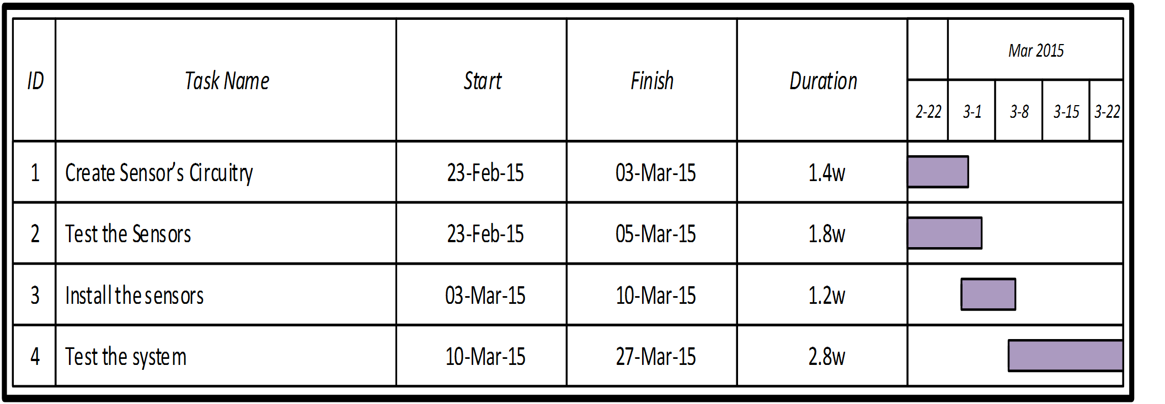
Remaining Schedule

Slide 21
Outline for John & Justin
Subsystem Block Diagram
Schedule/Percentage complete
Hardware & Software Used
Design analysis and approach
ADC Code
Testing with simulated sensor data
Interfacing with LabView
Research conclusion
Results
Remaining Work

Slide 22
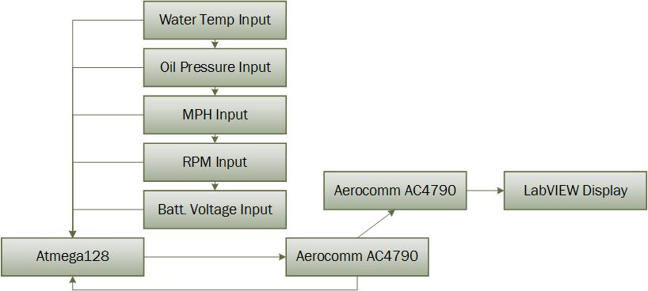
Subsystem Block Diagram

Slide 23
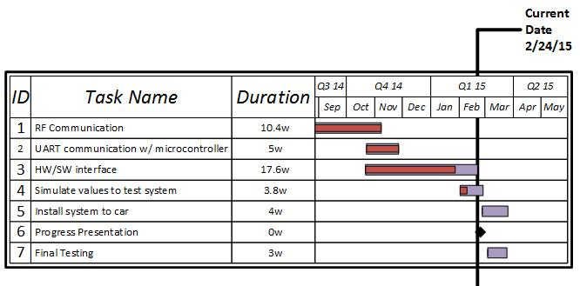
Schedule
Complete
Incomplete

Slide 24
Percentage Completed
    100% complete with microcontroller to Aerocomm transceiver communication
    100% complete with Aerocomm transceiver to Aerocomm transceiver wireless communication
    80% complete with wireless transmission to LABview

Slide 25
Hardware & Software Used
Hardware
Atmega128
Aerocomm AC4790
Laptop
Software
Atmel Studio
HyperTerminal
LabVIEW

Slide 26
Additional Research Needed
    Familiarize myself with progress John made last semester involving the wireless transmission.
    Look over Aercomm manual to understand how it sends and receives data wirelessly.
    Research how LABview interacts with incoming signals.
    Look over microcontroller datasheet as to understand what each of the pins on it are use for and how they are initialized in code.
    Researching error codes and what most likely cause certain ones we were receiving.

Slide 27
Design Approach
    Design a system that receives data from incoming signals.
      A to D converter
    Design a system that transmits the data receive wirelessly between two transceivers.
    Design a system that displays the wirelessly sent data values in LABview
      Real time
      Accurate

Slide 28
Analysis Approach
    First analyze wireless transmission
      Look on hyperterminal to make sure data sent is the correct number of bytes
      Look on hyperterminal to analyze the bytes and make sure the values change as input sensor values change
    Use oscilloscope to view output of pins
      Correct high and low voltage signals.
      Allows us to see the frequency of data being received and sent.
    View data received in LABview to make sure it is same as on hyperterminal.
      Allows us to verify LABview is analyzing incoming signals correctly.

Slide 29
Cost consderations
    Software
      No new software needed to be purchase
    Microcontroller
      Atmega128 -chip costs about 12$
    Aerocomm AC4790board and transceivers
      Board and transceivers -45$
      Using from previous years projects.

Slide 30
ADC
Needed to convert sensor data for LabVIEW
ADC code
  Initialization
  Interrupt Service Routine(ISR)
  Ascii function

Slide 31
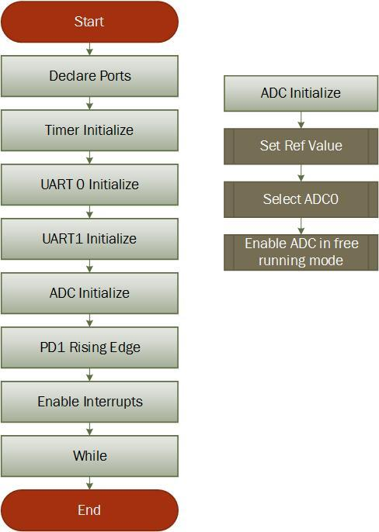
Initialization

Slide 32
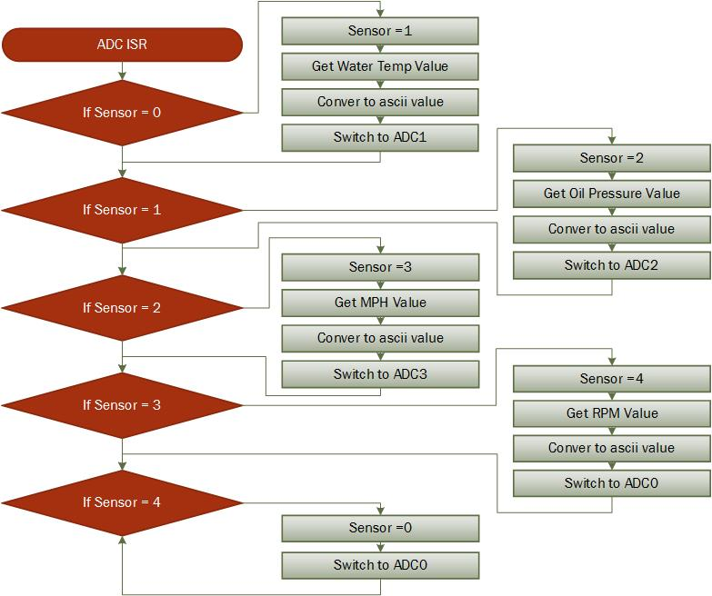
ISR

Slide 33
Testing with Simulated Data
Linear Output
  Oil Pressure, Water Temperature, Battery Voltage
  Simulated with Power Supply
Pulse Output
  Tachometer, Speedometer
  Simulated with the Wave Generator
Notes:
include sampling rates

Slide 34
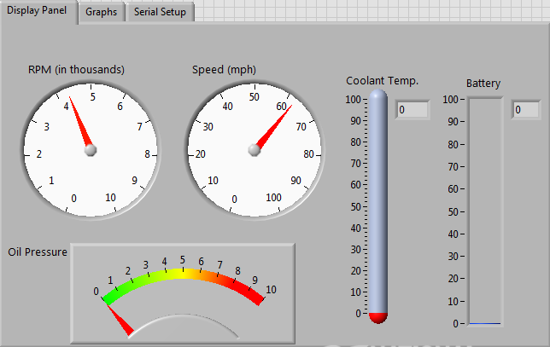
Interfacing with LabView
Communication Protocol
  Universal Asynchronous Receiver/Transmitter(UART)
Transmission Type
  Ascii
Sent using packets
Notes:
more discussion of packets

Slide 35
LabVIEW Packets
16 byte array
  2 bytes dedicated to water temperature
  2 bytes dedicated to oil pressure
  4 bytes dedicated to MPH
  4 bytes dedicated to RPM
  Other bytes to be used for flags

Slide 36
Research
Sensor output signal types
Sending packets through Aerocomm
Atmel Studio error codes
Notes:
pin signals

Slide 37
Results
Simulated sensor data displayed in HyperTerminal
LabVIEW interfaced with transceiver

Slide 38
Remaining Work
Finish interfacing transceiver with LabVIEW display
Finalize microcontroller and interface pc board
Install system on vehicle

Slide 39
Sean’s Agenda
Schedule
  Gantt Chart
Research
HW/SW Interface
  Serial Communication
    ATmega128 to Amulet LCD
    Aerocomm to LabVIEW
Results
Remaining Work

Slide 40
Sean’s Schedule
% Completed | Remaining Work
Notes:
Add legend

Slide 41
Research
Amulet serial communication protocol
LabVIEW Instrument I/O Assistant
Troubleshooting errors

Slide 42
Hardware & Software
Equipment
Software
Amulet LCD
ATmega128 (microcontroller)
GEMstudio Pro (Amulet display software)
Atmel Studio 6.1 (microcontroller software)
LabVIEW 2014

Slide 43
Amulet LCD
Serial Protocol
  UART
  Ascii
  9600 bps baud rate
  Transmit specific protocol to access variables
Microcontroller is master
  Initializes communication
Amulet is slave
  Full Protocol- Responds only if Amulet receives valid message

Slide 44
Amulet LCD
Internal RAM (IR) is memory on the Amulet.
  256 byte variables
  256 word variables (word = 2 bytes)
  199 string variables
Can receive 14 different command messages from microcontroller
  Can access internal RAM on Amulet
  Changing and copying variables
  Jump to different pages on display
  Draw pixel, line, or box

Slide 45
Amulet Serial Communication Flow Chart
Op-code = Tells Amulet what type of variable is being accessed (byte or word)
Address = The variables location on the RAM of the Amulet LCD
Value = The data to be displayed on the Amulet LCD
Op-code
Variable Address
(High nibble)
Variable Address
(Low nibble)
Variable Value
(High nibble)
Variable Value
(Low nibble)
Figure 1 – Transmit protocol for a byte variable.

Slide 46
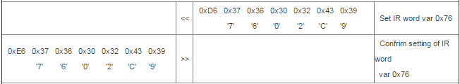
Amulet Protocol Ascii
Example: microcontroller sets internal RAM (IR) word variable to specific value (0x02C9)
Figure 3 – Serial communication flow chart

Slide 47
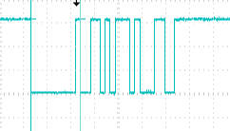
UART Transmit
1V per division
0.5ms per division
Transmission contains:
{0x00, 0xD6, 0x31}

Slide 48
LabVIEW GUI
Serial Protocol
  RS-232
  Ascii
  9600 baud rate
  Transmit packages of data
Instrument I/O Assistant
Front Panel vs. Block Diagram
Connect blocks to data type and viewing method
Aerocomm
Transceiver
Laptop
(LabVIEW GUI)
Instrument I/O Assistant
Display Data
Save Data

Slide 49
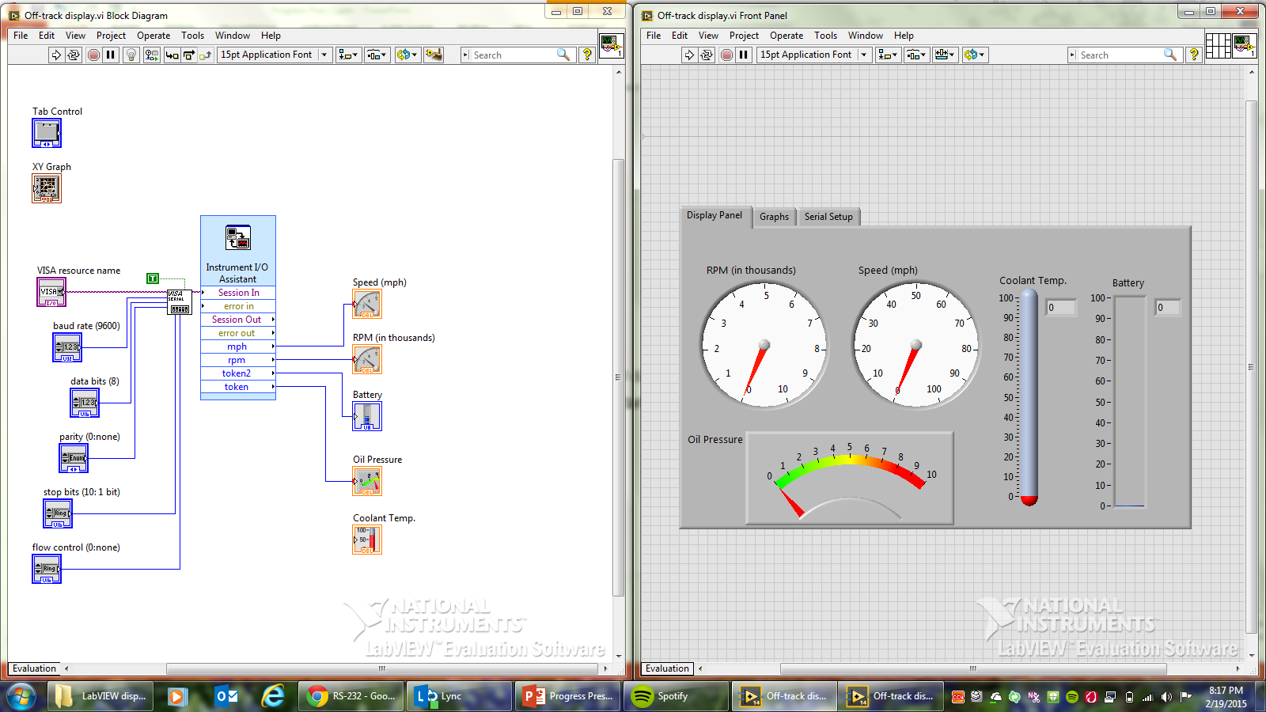
Front Panel

Slide 50
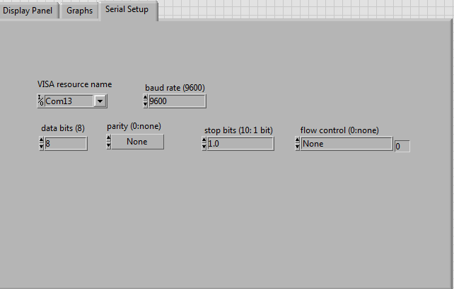
Serial Communication Setup

Slide 51
Block Diagram

Slide 52
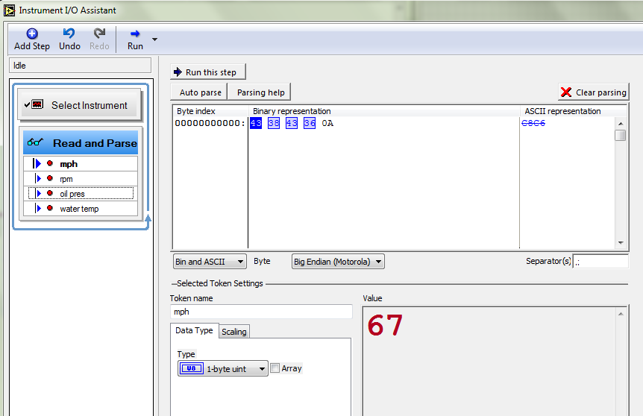

Slide 53


Slide 54
Results
Successful interface between ATmega128 and Amulet LCD
  Data sent and displayed on the Amulet LCD
Successful interface between Aerocomm Transceiver and LabVIEW GUI
  Data sent and displayed on the LabVIEW GUI

Slide 55
Remaining Work
LabVIEW
  Set up data log feature
  Connect data to graph results over time
Simulations to test system (on LabVIEW and Amulet LCD)
  From function generator
  From sensors
Hardware/Software Interface
  Power supply circuitry for Amulet

Slide 56
Questions?

Slide 57
Appendix

Slide 58
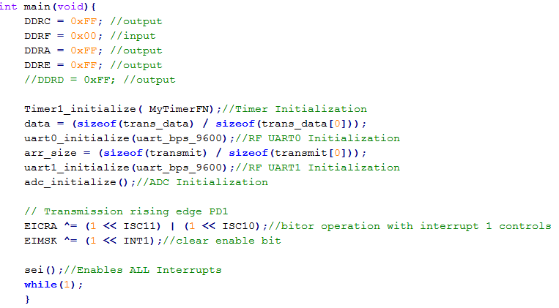
Initialization

Slide 59
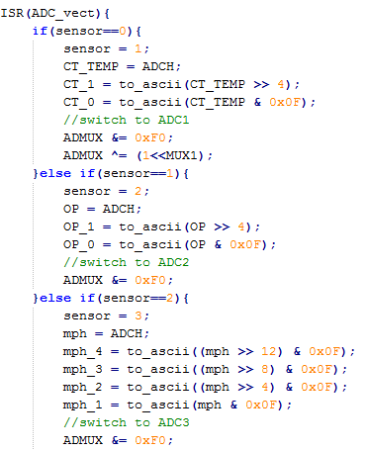
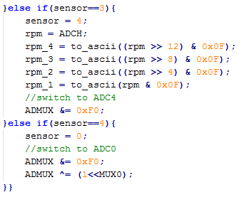
ISR

Slide 60
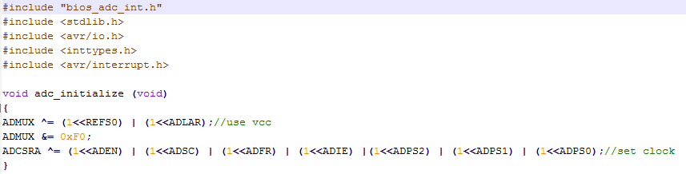
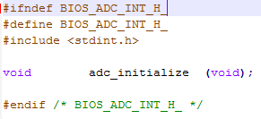
.C/.h files

Slide 61
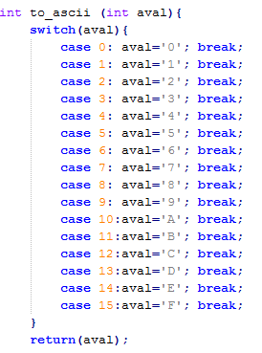
to_ascii

Slide 63
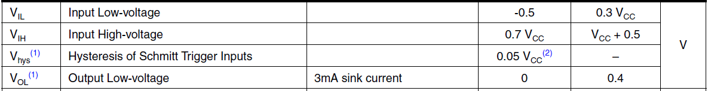
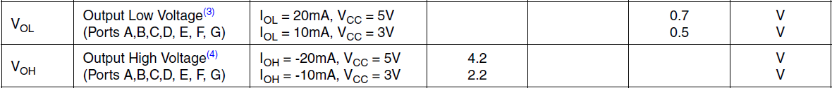
Atmega128 Electrical Characteristics
Vcc = 3.3V

Slide 64
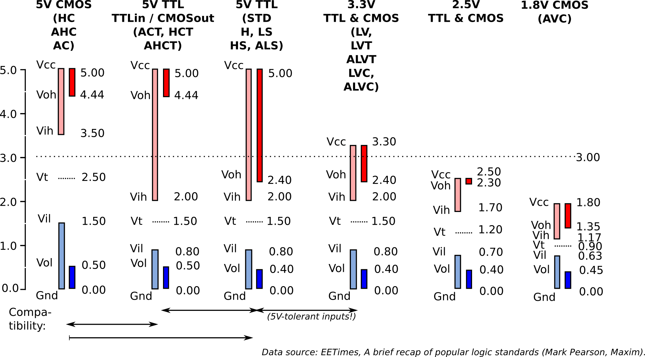
3.3V Logic Levels (TTL)
V_{oh} – output high
V_{ih} – input high
V_{ol} – output low
V_{il} – input low
V_{cc} – power supply
Gnd - Ground

Slide 65
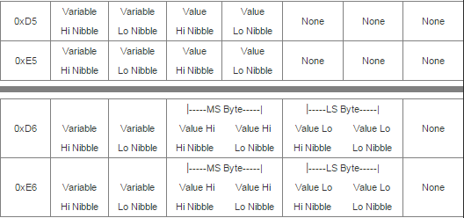
Amulet Ascii Transmit Protocol Example
Microcontroller Set Byte Variable
Amulet Response
Microcontroller Set Word Variable
Amulet Response
Figure 2 – Serial communication flow chart

Slide 66
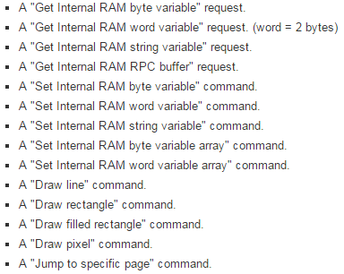

Slide 67
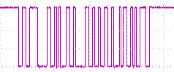
UART Receive (Echo)
1V per division
1ms per division

Slide 68
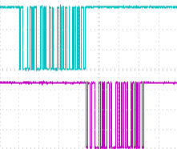
UART Transmit/ECHO
Blue: Transmit
Purple: Receive
1V per division
2.5ms per division

Slide 69
