Slide 1
Autonomous Underwater Robots
Ryan Lipski, Cameron Putz, AND Nick Sikkema
Advisor: Dr. Joseph Driscoll
Department of Electrical and Computer Engineering, Bradley University
October 2, 2014

Slide 2
Outline
Background
Design Approach
Economic Analysis
Milestones
Division of Labor
Societal and Environmental Impact

Slide 3
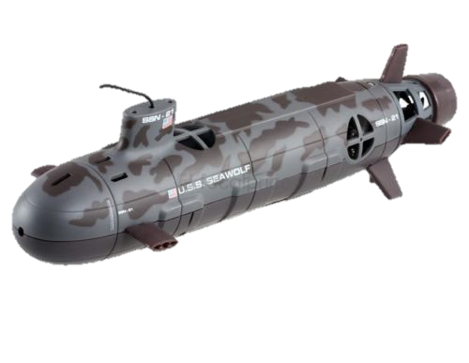
Problem
Map underwater terrain using multiple autonomous robots
Avoid collisions
Generate a final image of the terrain

Slide 4
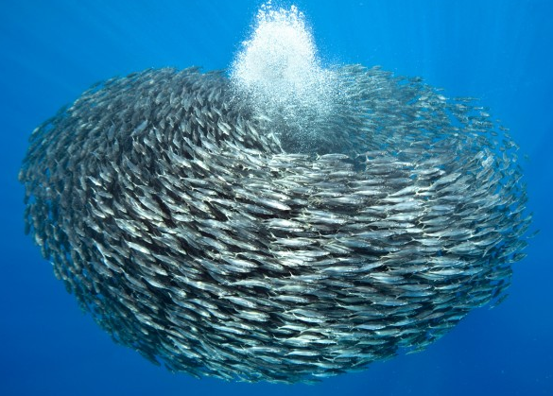
Literature Review
AUV history
AUV swarm research
Underwater minefield
Cocoro
Source: http://www.wired.com/2013/03/powers-of-swarms/all/

Slide 5
Constraints
Avoid harming underwater organisms
Battery life
Functional up to two feet of water
Robots must be reasonably sized

Slide 6
Detection Methods
Acoustic
Electromagnetic
Optical
Image processing
LEDs

Slide 7
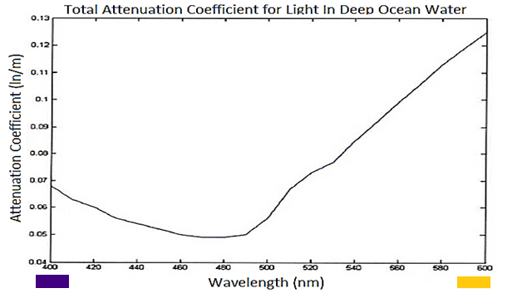
Blue LEDs - Visibility
Source: http://www.academia.edu/4161991/Designing_a_Wireless_Underwater_Optical_Com munication_SystemDesigning_a_Wireless_Underwater_Optical_Communication_System

Slide 8
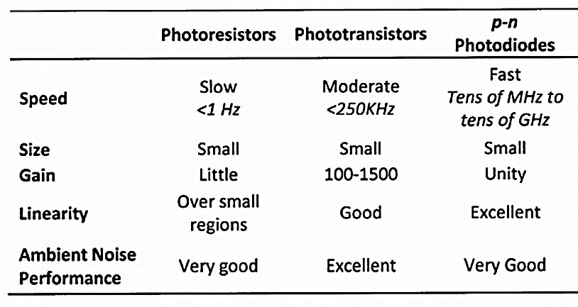
Blue LEDs - Detection
Source: http://www.academia.edu/4161991/Designing_a_Wireless_Underwater_Optical_Com munication_SystemDesigning_a_Wireless_Underwater_Optical_Communication_System

Slide 9
Related Patents
CN 102916744 A - Underwater LED visible light communication system
US 20140212142 A1 - Underwater optical communication system
US 20050232638 A1 - Methods and apparatus for underwater wireless optical communication

Slide 10
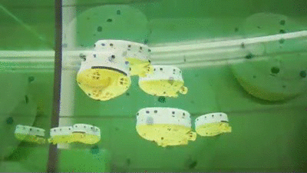
Cocoro
Source: https://www.youtube.com/watch?v=Hjkmm13Scm4
Source: http://i.ytimg.com/vi/XUk-qLfiwlc/0.jpg

Slide 11
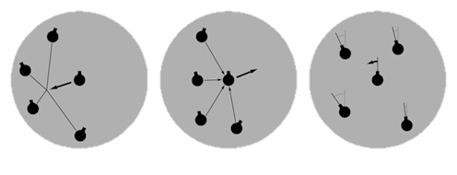
Swarming Techniques
Boids
Simulates the flocking of birds
Criteria include cohesion, separation and alignment
Cohesion
Separation
Alignment
Source: http://igeo.jp/tutorial/43.html

Slide 12
Swarming Techniques cont.
Minimalistic
Based upon Boids
Criteria include cohesion, separation and pseudo-alignment
Source: http://igeo.jp/tutorial/43.html

Slide 13
Design Approach
Standalone swarm
Swarming techniques
Directional guidance
Project disciplines
Testing

Slide 14
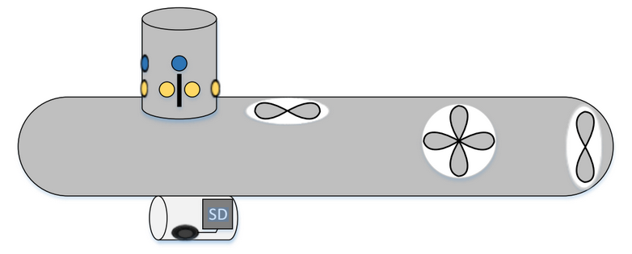
Design Approach - Individual Submarines
Motorworks Seawolf
Static diving
Literature
Power system
Camera module

Slide 15
Design Approach - Individual Submarines Cont.
Detection array
Sensors
IMU
Compass
Pressure
Motor control

Slide 16
Design Approach - Alternate Solutions
Add leader boat to swarm
Drop weight system
Bottom detection system
Spread out detection array
DIY submarine

Slide 17
Testing and Metrics
Minimize cost
Autonomous
Durable
Mobile underwater
Portability
Power efficiency

Slide 18
Economic Analysis
Cost of submarine: $189.00
Description | Cost
Swarm cost | $756.00
Testing | $78.16
Total cost | $834.16

Slide 19
Milestones and Schedule

Slide 20
Division of Labor
Detection array
Camera circuit
Construction of submarine
PCB
Program layout
Controls
Sensors algorithm
Swarming algorithm

Slide 21
Societal Impact
Development is ethical
Aquatic industries/research will be affected
Originally marketed as a toy RC submarine
Submarines will navigate at relatively slow speeds
Boats could collide with the swarm

Slide 22
Environmental Impact
Low natural resources costs
Lost submarines could pollute the water
Plant life could be disturbed
Large obstacles will be detected and avoided

Slide 23
Summary
Design Approach
Economic Analysis
Milestones
Division of Labor
Societal and Environmental Impact

Slide 24
Autonomous Underwater Robots
Ryan Lipski, Cameron Putz, AND Nick Sikkema
Advisor: Dr. Joseph Driscoll
Department of Electrical and Computer Engineering, Bradley University
October 2, 2014

Slide 25
References
http://neuron.tuke.sk/hudecm/PDF_PAPERS/DesignAndControlOfAutonomousUnderwaterrobotsASurvey.pdf
http://www.wired.com/2013/03/powers-of-swarms/all/
http://igeo.jp/tutorial/43.html
http://www.academia.edu/4161991/Designing_a_Wireless_Underwater_Optical_Communication_SystemDesigning_a_Wireless_Underwater_Optical_Communication_System
https://www.youtube.com/watch?v=Hjkmm13Scm4
http://i.ytimg.com/vi/XUk-qLfiwlc/0.jpg

Slide 26
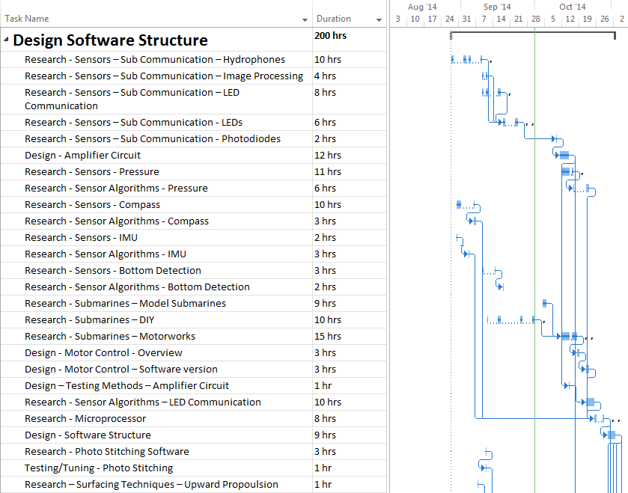
Gantt Chart – Design Software Structure

Slide 27
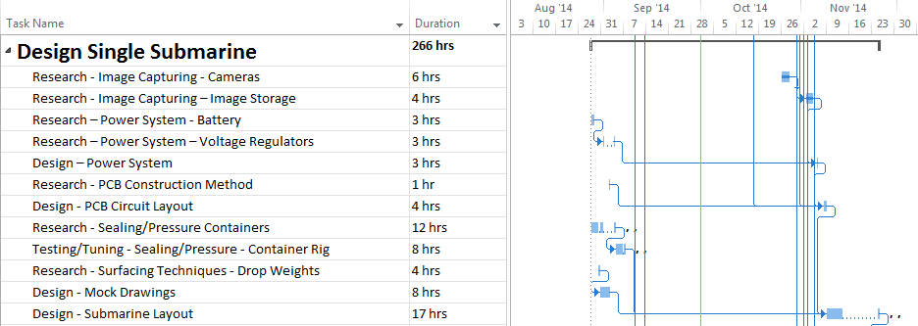
Gantt Chart – Design Single Submarine

Slide 28
Gantt Chart – Directional Guidance

Slide 29
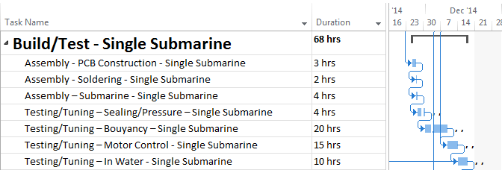
Gantt Chart - Build/Test – Single Submarine

Slide 30
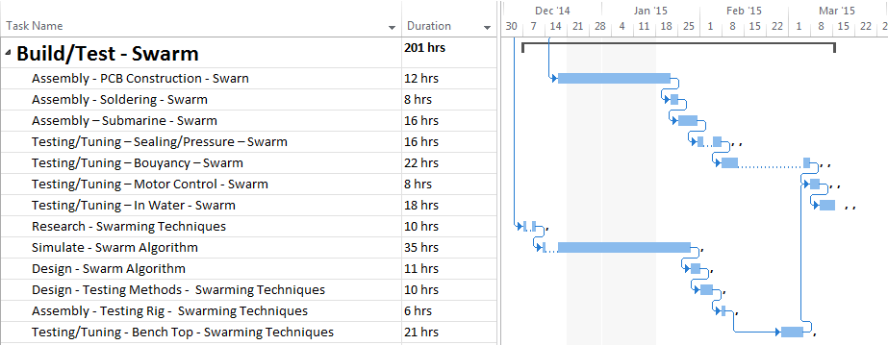
Gantt Chart - Build/Test - Swarm

Slide 31
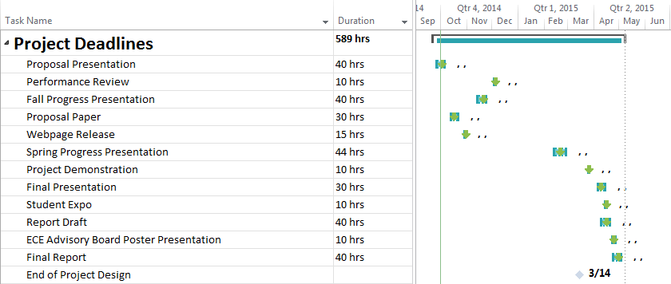
Gantt Chart – Project Deadlines

Slide 32
Detailed budget - Submarine
Quantity | Cost Per | Total Cost | Description
4 | $10 | $40 | Pressure Sensor
4 | $50 | $200 | Submarine
4 | $5 | $20 | Surface mount processor
12 | $3 | $36 | 3 Watt blue LEDS
24 | $10 | $240 | Blue Filtered Photodiodes
4 | $10 | $40 | Compass and IMU
4 | $10 | $40 | Camera Circuit
4 | $20 | $80 | Surface mount Components
4 | $15 | $60 | PVC material
4 | $10 | $40 | H-Bridge Chips
 | Total | $756
 | Per Submarine | $189

Slide 33
Detailed budget - Test Stand
Quantity | Cost Per | Total Cost | Description
3 | 5 | 15 | Processor Chips
1 | 17.05 | 17.05 | PVC Test Stands
1 | 46.11 | 46.11 | PVC Test Container
 | Total | 78.16

Slide 34
Circuit diagrams

Slide 35
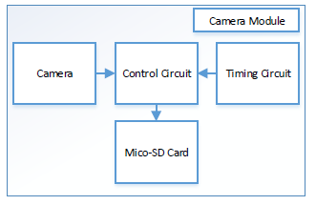
Flowcharts - Camera

Slide 36
Flowchart Motor Control

