Slide 1

Autonomous Underwater Robots
Spring Progress Presentation
Ryan Lipski, Cameron Putz, AND Nick Sikkema
Advisor: Dr. Joseph Driscoll
Department of Electrical and Computer Engineering, Bradley University
February 24, 2014

Slide 2
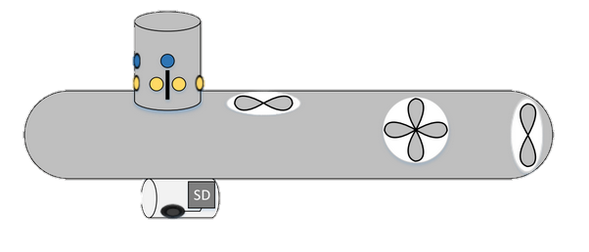
Project Objectives
Map underwater terrain
  Swarm of UAV’s
  Avoid obstacles
  Generate final image from smaller images

Slide 3
System Block Diagram

Slide 4
Division of Labor
Cameron – hardware
Nick - software
Ryan – hardware and software

Slide 5
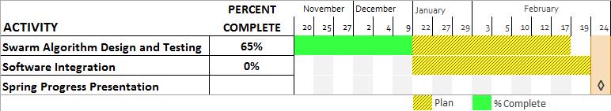
Gantt Chart – Nick Sikkema
Task 1

Slide 6
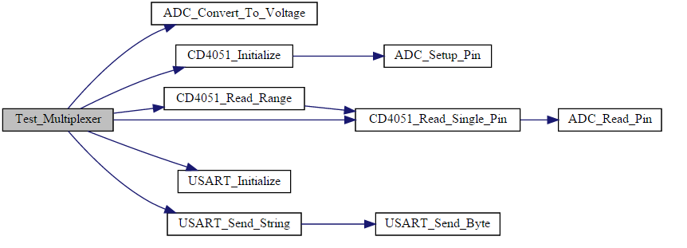
Task 1: Software Integration
Design
Combining code for subsystems
  Optimization
  Functional programming style
Doxygen output for the multiplexer

Slide 7
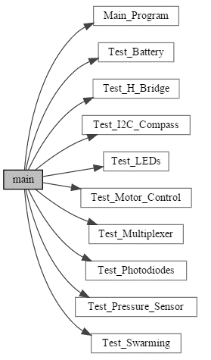
Task 1: Software Integration
Design
Debugging
  Unit testing
  Doxygen comments
Doxygen output for the main function

Slide 8
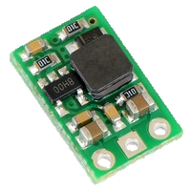
Task 1: Software Integration
Research
Step-up regulator
  Input minimum 2.5 volts
  Output 5 volts
Reference voltage
Noise isolation
Pololu U3V12F5 [3]

Slide 9
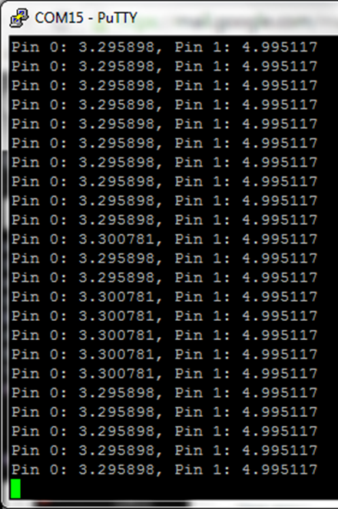
Task 1: Software Integration
Results
Step-up regulator
  Input minimum 2.5 volts
  Output 5 volts
Reference voltage
Noise isolation
Console Output for Regulator and Multiplexer

Slide 10
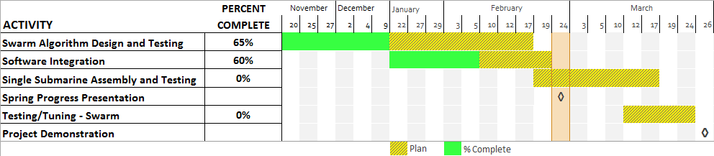
Gantt Chart – Nick Sikkema
Future work

Slide 11
Gantt Chart – Ryan Lipski
Task 1
Previously named directional guidance

Slide 12
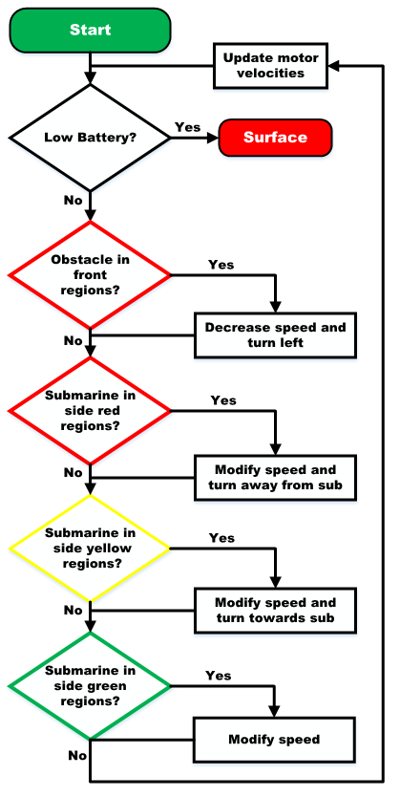
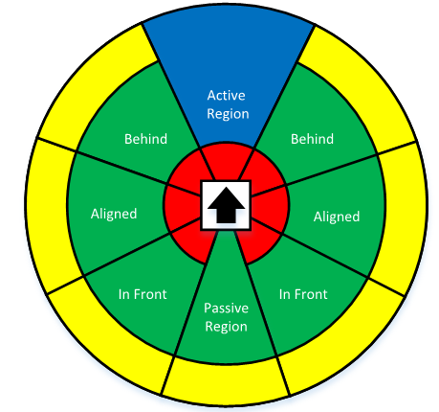
Task 1: Swarming Algorithm
Design
Flowcharts were first design step
Detection zones
Simplified swarming flowchart

Slide 13
Task 1: Swarming Algorithm
Design
Multiple iterations before coding
  Zone checking priority
  Integrating with rest of code
Zone checks alter variables that factor into the motor control
  Only applies to X and Y motors
Motors updated after all zones checked
Code runs until low battery voltage is detected
Simplified swarming flowchart

Slide 14
Task 1: Swarming Algorithm
Design
Design of this algorithm is complete
Algorithm can be partially tested on a bench top
Full testing will be possible only when the swarm is constructed
May need to alter weighting of variables or radii of the different zones

Slide 15
Gantt Chart – Ryan Lipski
Task 2

Slide 16
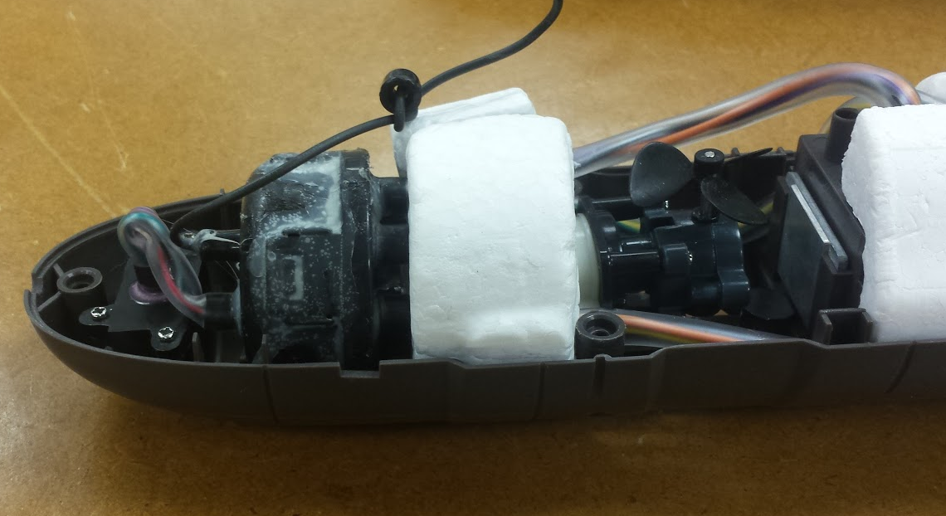
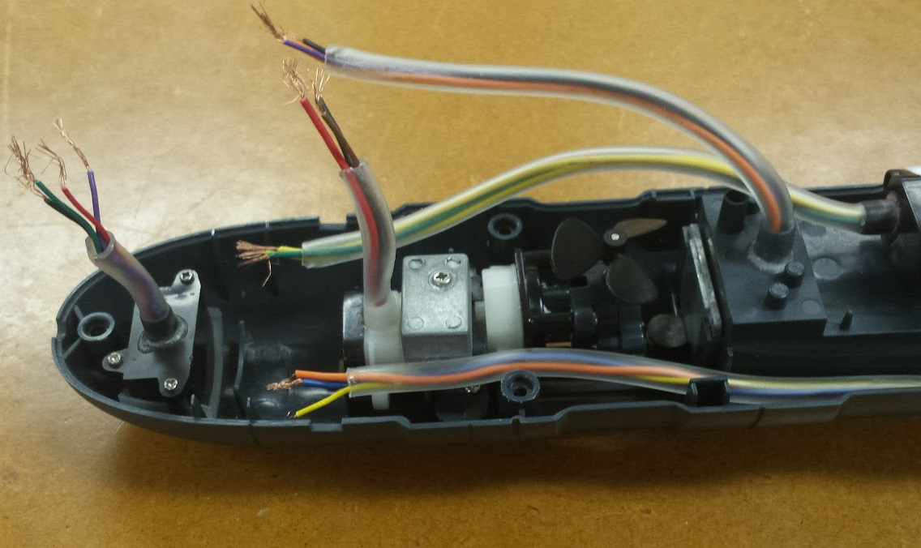
Task 2: Circuit and System Layout
Analysis
Submarine dissection
  Each motor has 2 leads along with a third wire
    Determined to be a ground wire
  Battery compartment has a
  4.8 V, 3.6 V and ground lead
  Switch has 4 leads
    Identified each lead
  First submarine is now prepped for assembly
Original submarine
Complete Swarming Flowchart
Disassembled submarine

Slide 17
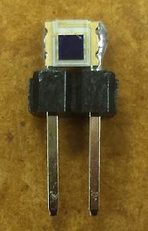
Task 2: Circuit and System Layout
Design
Everlight photodiodes
  Planned to solder strands wires to each side
    Difficult to solder without bridging the leads
    2.1 mm between the leads
  Solution: Use small section of straight header pins to extend leads
    Reduces soldering difficulty
    Much more rigid connection
    Plastic section of header pins doubles as a mounting point
Everlight photodiode soldered to section of header pins

Slide 18
Gantt Chart – Ryan Lipski
Future work

Slide 19
Gantt Chart – Cameron Putz

Slide 20
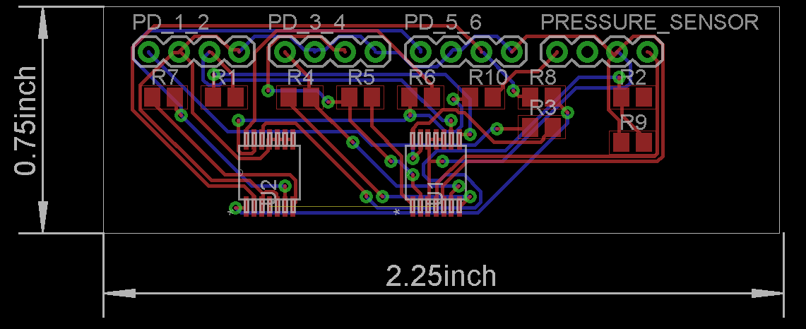
Task 1: Circuit Layout
Eagle 7.1.0
  Photodiode board rev. 1

Slide 21
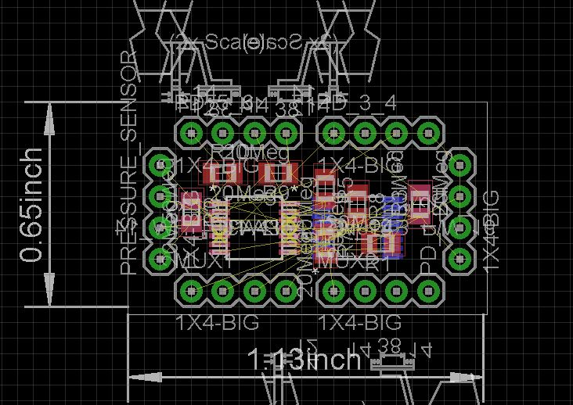
Task 1: Circuit Layout
Eagle 7.1.0
  Photodiode board rev. 2

Slide 22
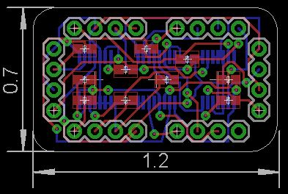
Task 1: Circuit Layout
Eagle 7.1.0
  Photodiode board rev.3

Slide 23
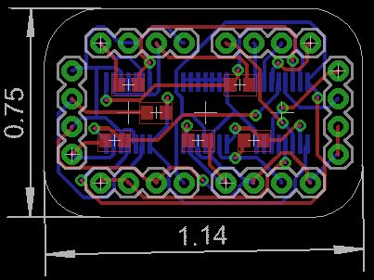
Task 1: Circuit Layout
Eagle 7.1.0
    Photodiode board rev.4

Slide 24
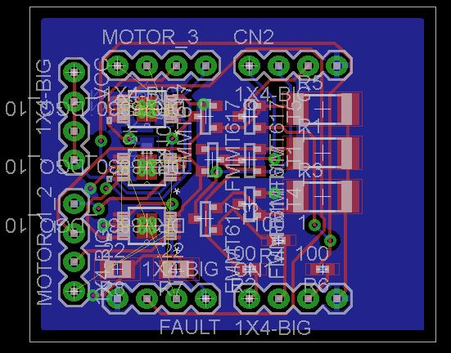
Task 1: Circuit Layout
Eagle 7.1.0
  High current board rev. 1

Slide 25
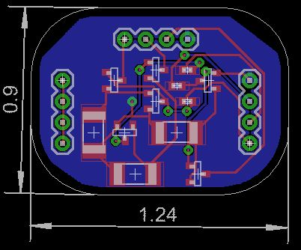
Task 1: Circuit Layout
Eagle 7.1.0
  LED driver board rev. 1

Slide 26
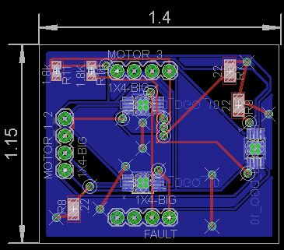
Task 1: Circuit Layout
Eagle 7.1.0
  Motor driver board rev. 1

Slide 27
Task 1: Circuit Layout
Eagle 7.1.0
  Boards Sent to OSH Park

Slide 28
Gantt Chart – Cameron Putz
Future work

Slide 29
Autonomous Underwater Robots
Spring Progress Presentation
Ryan Lipski, Cameron Putz, AND Nick Sikkema
Advisor: Dr. Joseph Driscoll
Department of Electrical and Computer Engineering, Bradley University
February 24, 2014

Slide 30
References
[1]"The 555 Timer IC." The 555 Timer IC. [Online]. 23 Feb. 2015.
[2] Pololu 5V Step-Up Voltage Regulator U3V12F5, Pololu, [online] 2015, https://www.pololu.com/product/2115 (Accessed: 23 February 2015).
[3] Integrated Silicon Pressure Sensor On-Chip Signal Conditioned, Temperature Compensated and Calibrated, Freescale Semiconductor, [online] 2012, http://www.freescale.com/files/sensors/doc/data_sheet/MPX5010.pdf (Accessed: 23 February 2015).
[4] LiPo Vs NiMH Batteries, Lipo Manufacturer, [online] 2014, http://lipomanufacturer.blogspot.com/2014/03/lipo-vs-nimh-batteries.html (Accessed: 23 February 2015).

Slide 31
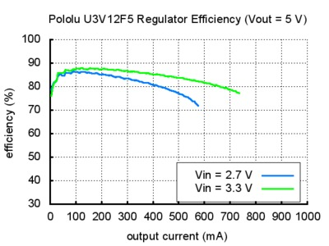
Step-Up Regulator Efficiency [2]

Slide 32
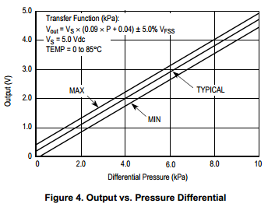
Pressure Sensor Output
MPX5010 [3]

Slide 33
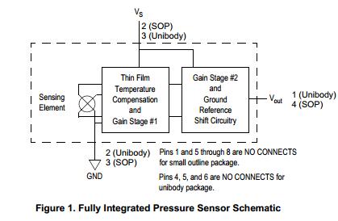
Pressure Sensor Circuit Diagram
MPX5010 [3]

Slide 34
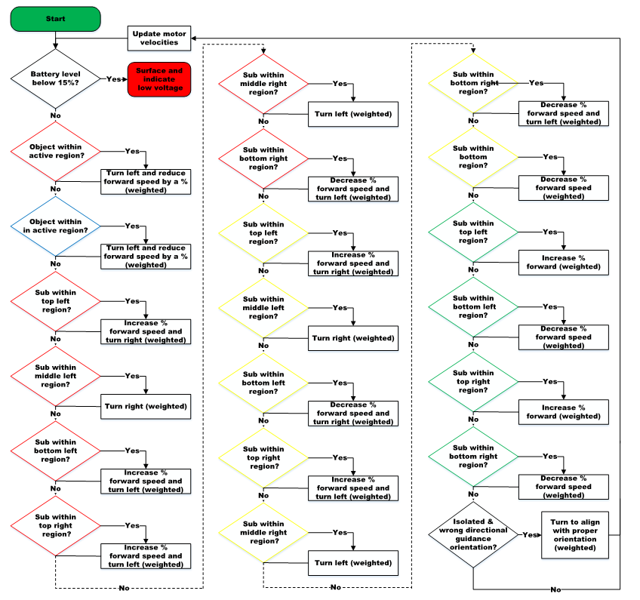
Complete Swarming Flowchart

Slide 35
Motor Control and Power
3 DC brushed motors (x, y, z configuration)
  Y motor highest current draw: 860 mA peak draw
    Recorded with only rear propeller submerged
  X and y motor feedback: IMU
  Z motor feedback: pressure sensor

Slide 36
Motor Control and Power
I2C h-bridge (DRV8830)
  Single channel, PWM controlled h-bridge
  1 A, 2.75 - 6.8 V
  Cost: $2.44
  Total cost per submarine: $2.44 * 3 = $7.32

Slide 37
Motor Control and Power
Power
  4 NIMH AA batteries
    1.2 V per cell
    2500 mAh
  Battery life estimation
    Estimated average current draw: 1770 mA
    Estimated run time: 1.4 hours

Slide 38
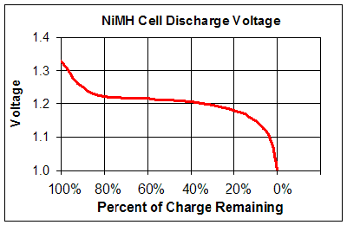
Motor Control and Power [4]

Slide 39
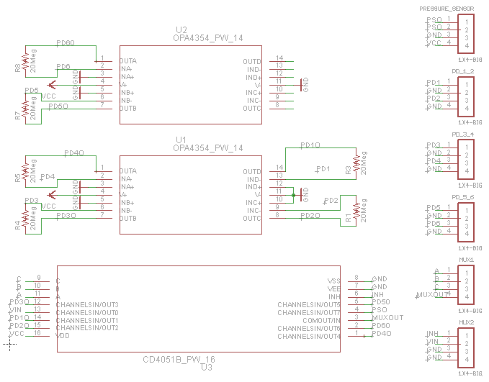
Eagle Schematic

Slide 40
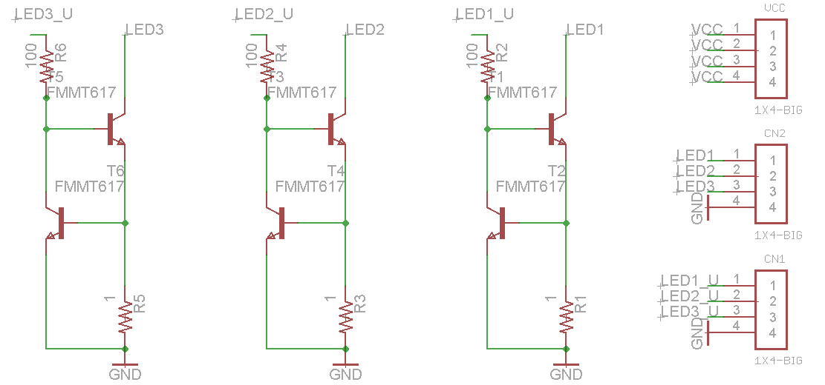
Eagle Schematic

Slide 41
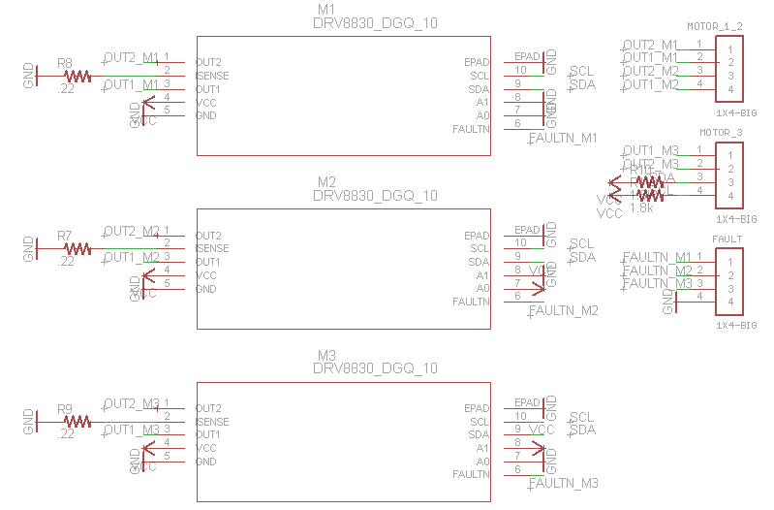
Eagle Schematic

Slide 42
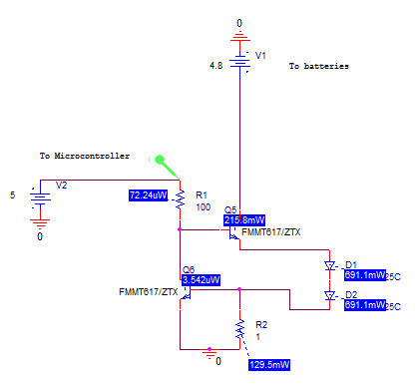
Current Source design

Slide 43
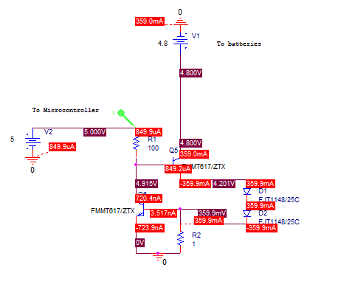
Current Source design

Slide 44
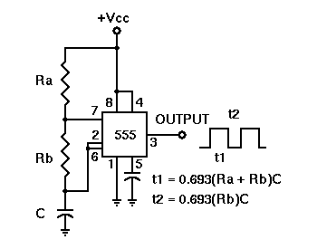
555 Timer for Camera
[1] 555 Timer

Slide 45
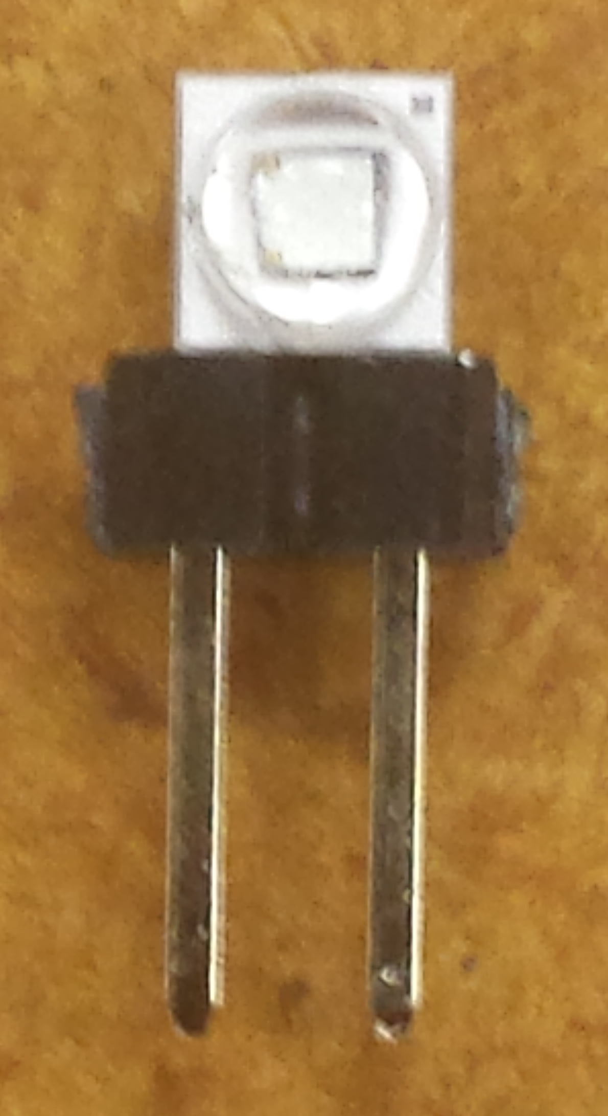
Assembly/Soldering
Everlight photodiode soldered to section of header pins
LED soldered to section of header pins

