Slide 1

Autonomous Underwater Robots
Progress Presentation
Ryan Lipski, Cameron Putz, AND Nick Sikkema
Advisor: Dr. Joseph Driscoll
Department of Electrical and Computer Engineering, Bradley University
NOvember 20, 2014

Slide 2
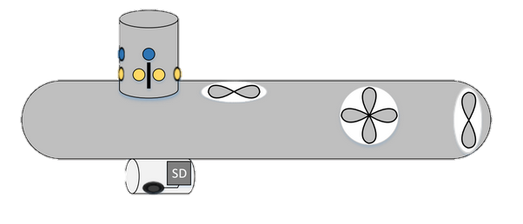
Project Objectives
Map underwater terrain
  Swarm of UAV’s
  Avoid obstacles
  Generate final image

Slide 3
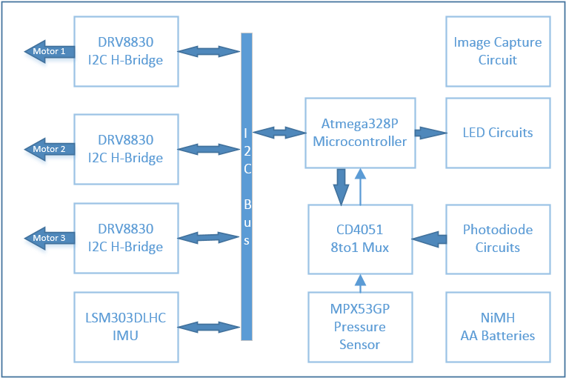
System Block Diagram

Slide 4
Original Gantt Chart – Cameron Putz

Slide 5
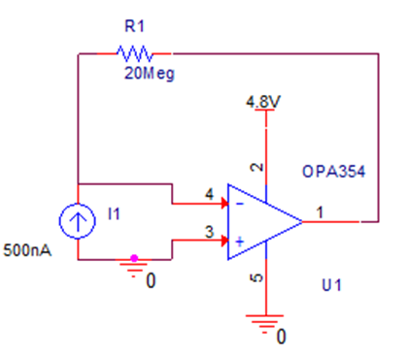
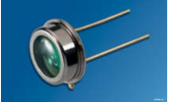
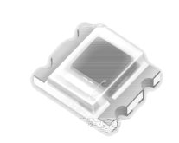
Task 1: Detection Array
Experiment
Amplifier testing
  Amplifier Design
Model of photodiode
Osram photodiode [1]
Everlight photodiode [2]
Transimpedance amplifier

Slide 6
Task 1: Detection Array
Results
Photodiode testing
Osram photodiode [1]
Everlight photodiode [2]
Saturation | 36 inches – 4.9 Volts | 4 inches – 4.89 Volts
Max Distance | 180 inches – 0.6 Volts | 132 Inches -- 0.120 Volts
Linearity | Linear | Non-Linear
Ambient Light | 100% Saturation | 29% Saturation
Price | $8.85 | $0.59
Photodiode comparison

Slide 7
Updated Gantt Chart – Cameron Putz
Task 2

Slide 8
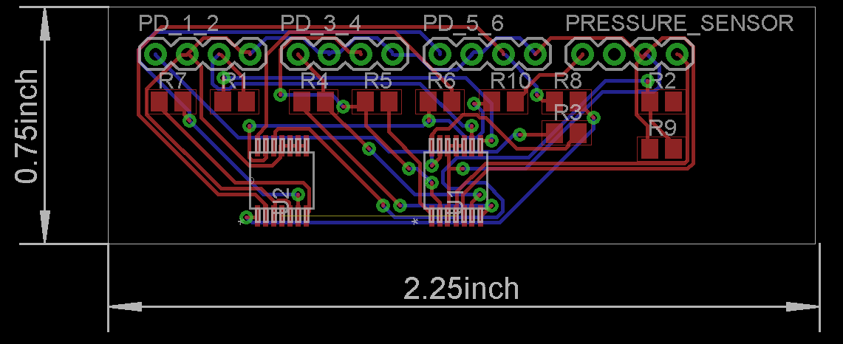
Task 2: Circuit Layout
Results
Eagle 7.1.0
  Dr. Driscoll has experience
First iteration of the detection array surface mount board

Slide 9
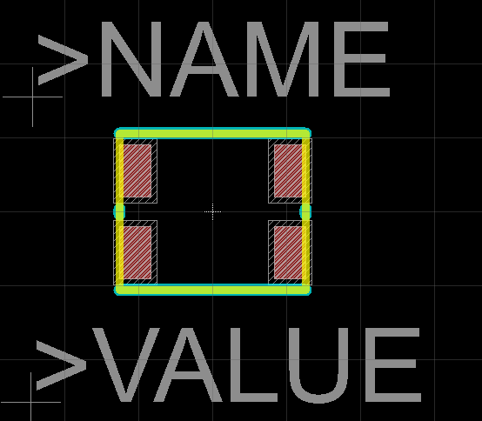
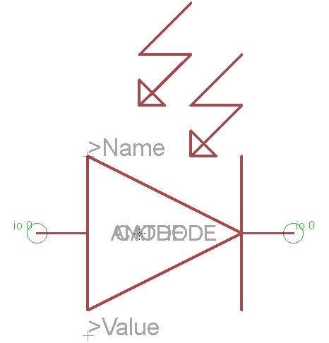
Task 2: Circuit Layout
Results
Eagle 7.1.0
  Still a lot to learn
First library package Everlight photodiode
First library symbol Everlight photodiode

Slide 10
Updated Gantt Chart – Cameron Putz
Future work

Slide 11
Original Gantt Chart – Ryan Lipski

Slide 12
Updated Gantt Chart – Ryan Lipski
Task 1

Slide 13
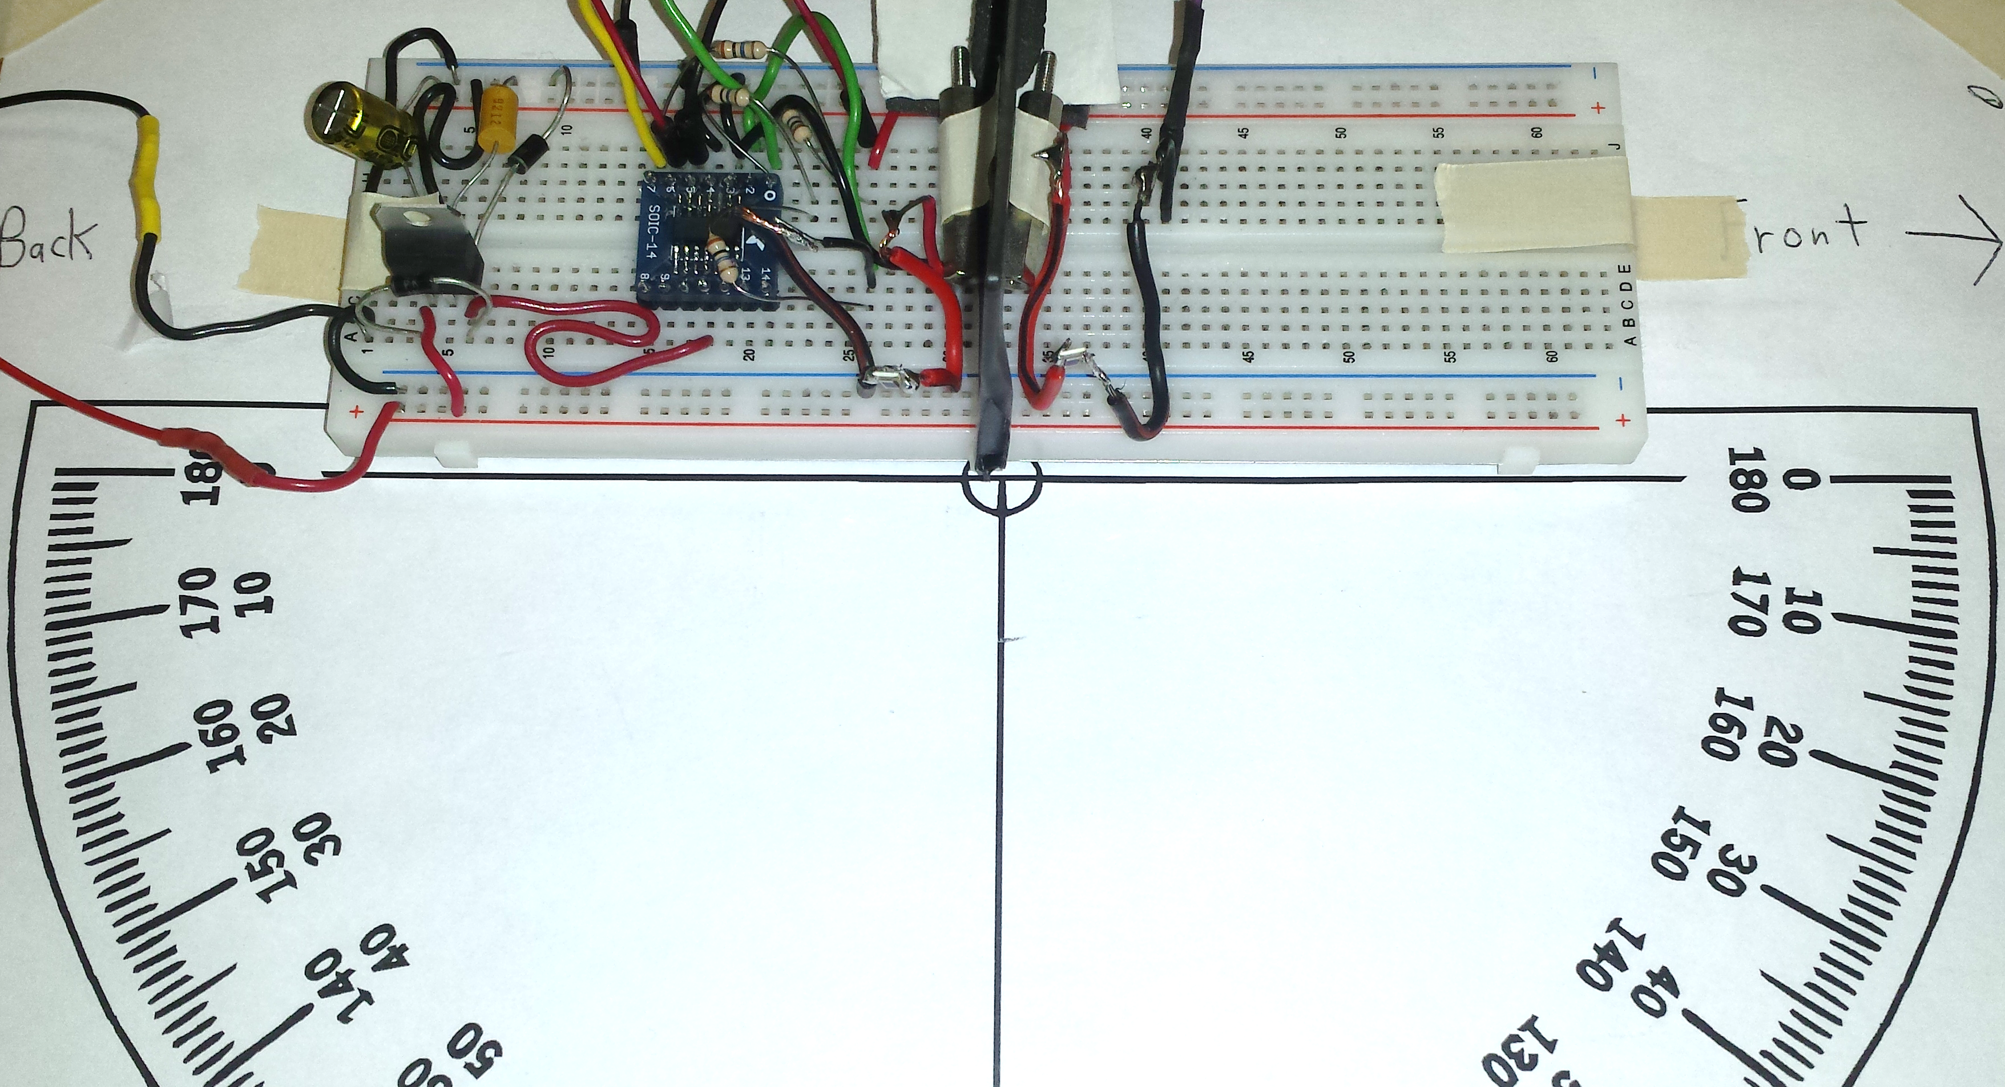
Task 1: Detection Array
Experiment
Bench top detection array
  Baffle configuration testing
    Baffle protrusion distance and LED distance experimented with
    LED swept from 0 to 180° while recording light intensity
Baffle
Photodiodes
Baffle test setup

Slide 14
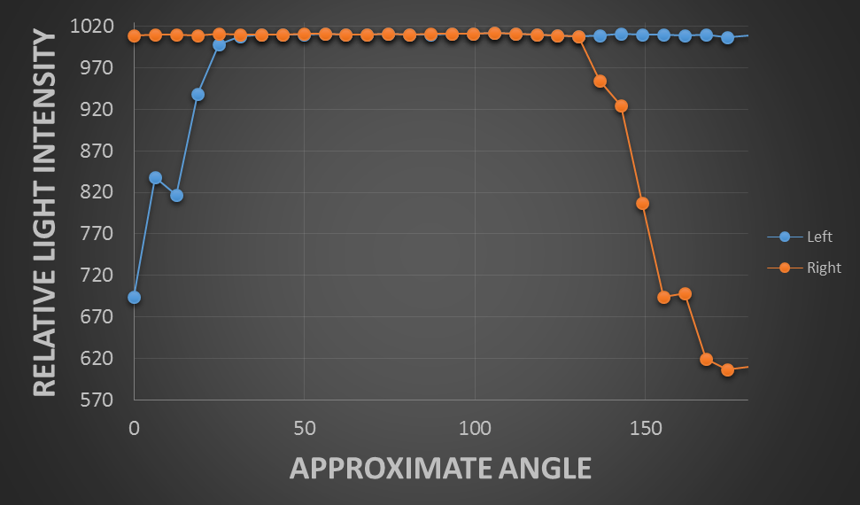
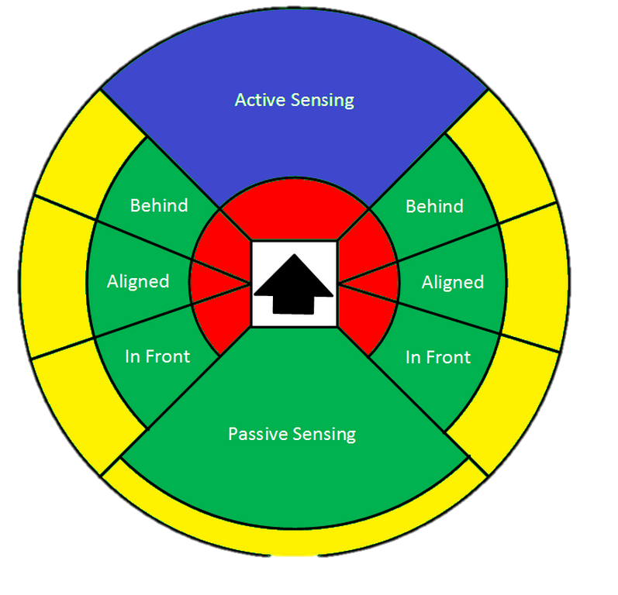
Task 1: Detection Array
Results
Bench top detection array
  Baffle configuration testing
    12cm LED distance
Left vs right photodiode (5 mm baffle)
Detection zones

Slide 15
Task 1: Detection Array
Experiment
Additional related work
  Detection array testing/validation
    Assisted Cameron with testing different op-amp/photodiode combinations
    Both in lab testing and off campus/through water testing

Slide 16
Updated Gantt Chart – Ryan Lipski
Task 2

Slide 17
Task 2: Motor Control and Power
Design and Experiment
3 DC brushed motors (x, y, z configuration)
  Y motor highest current draw: 860 mA peak draw
    Recorded with only rear propeller submerged
  X and y motor feedback: IMU
  Z motor feedback: pressure sensor

Slide 18
Task 2: Motor Control and Power
Design
I2C h-bridge (DRV8830)
  Single channel, PWM controlled h-bridge
  1 A, 2.75 - 6.8 V
  Cost: $2.44
  Total cost per submarine: $2.44 * 3 = $7.32

Slide 19
Task 2: Motor Control and Power
Design
H-bridge and I2C PWM generator
  H-Bridge (SN754410)
    1.1 A
    Cost: $2.57
  I2C PWM generator (PCA9685)
    Cost: $2.47
  Requires more PCB surface area
  Total cost per submarine: $2.57*2 + $2.47 = $7.61

Slide 20
Task 2: Motor Control and Power
Design
PID control
  All 3 motors in same interrupt control loop
  ECE467 PID code used as starting point
  Updated to work with the I2C h-bridge (DRV8830)

Slide 21
Task 2: Motor Control and Power
Design
Power
  4 NIMH AA batteries
    1.2 V per cell
    2500 mAh
  Battery life estimation
    Estimated average current draw: 1770 mA
    Estimated run time: 1.4 hours

Slide 22
Updated Gantt Chart – Ryan Lipski
Task 3

Slide 23
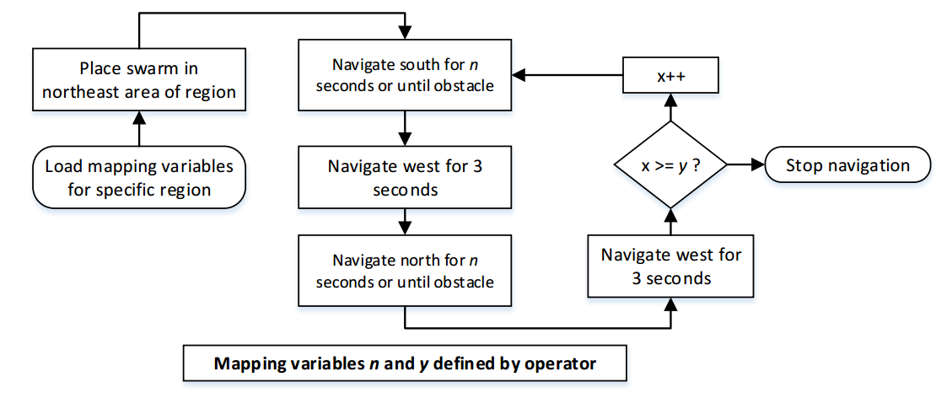
Task 3: Directional Guidance Algorithm
Design
Directional Guidance Flowchart

Slide 24
Updated Gantt Chart – Ryan Lipski
Future work

Slide 25
Original Gantt Chart – Nick Sikkema

Slide 26
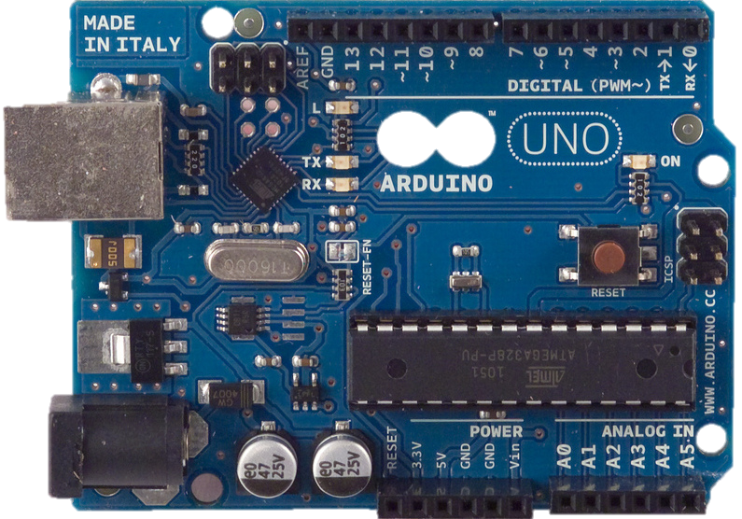
Task 1: Research Parts
Research
Microcontroller
  ADC
  Multiplexer (CD4051)
  Atmega328P
Atmega328P breakout board [3]

Slide 27
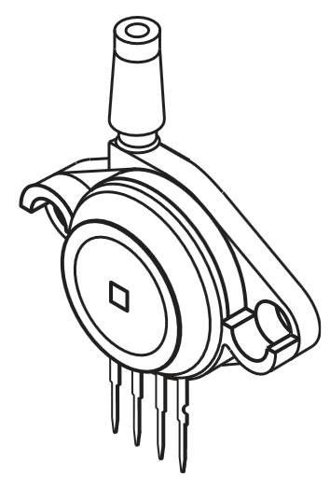
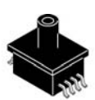
Task 1: Research Parts
Research
Pressure sensor
  Package
  Gauge vs absolute
MPAK package [4]
Unibody package [4]

Slide 28
Updated Gantt Chart – Nick Sikkema
Task 2

Slide 29
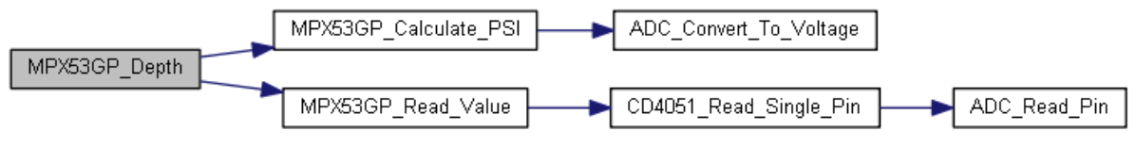
Task 2: Multiplexer and Pressure
Design and Experiment
8 to 1 multiplexer (CD4051)
Pressure sensor (MPX53GP)
  Differential output
  Gauge vs absolute
Call graph for the depth function

Slide 30
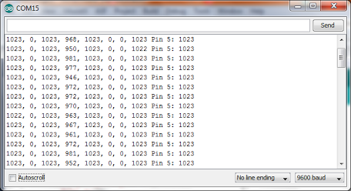
Task 2: Multiplexer and Pressure
Results
Multiplexer ADC test output

Slide 31
Updated Gantt Chart – Nick Sikkema
Task 3

Slide 32
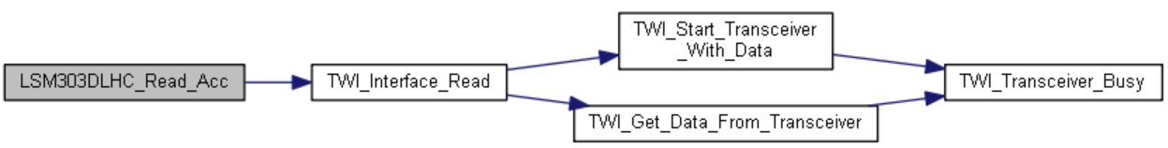
Task 3: Compass and Accelerometer
Design and Experiment
Pololu library
  C++ conversion
  Code cleanup
I2C
Call graph for the read acceleration register function

Slide 33
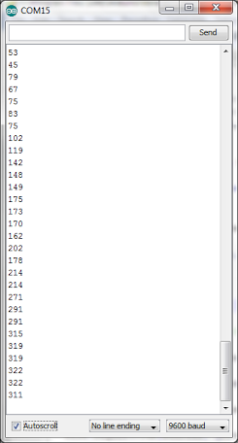
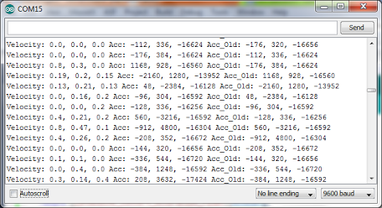
Task 3: Compass and Accelerometer
Results
Heading test output
Velocity test output

Slide 34
Updated Gantt Chart – Nick Sikkema
Future work

Slide 35
Autonomous Underwater Robots
Progress Presentation
Ryan Lipski, Cameron Putz, AND Nick Sikkema
Advisor: Dr. Joseph Driscoll
Department of Electrical and Computer Engineering, Bradley University
NOvember 20, 2014

Slide 36
References
[1] Silicon Photodiode for the Visible Spectral Range, OSRAM, [online] 2014, http://www.everlight.com/file/ProductFile/201407061648128798.pdf (Accessed: 19 November 2014).
[2] RGB Color Light Sensor Surface – Mount, Everlight, [online] 2013, http://www.everlight.com/file/ProductFile/201407061648128798.pdf (Accessed: 19 November 2014).
[3] "Arduino," Arduino SA, [Online]. Available: http://arduino.cc/en/Main/arduinoBoardUno. [Accessed 19 11 2014].
[4] "Freescale," 10 2012. [Online]. Available: http://cache.freescale.com/files/sensors/doc/data_sheet/MPX2202.pdf. [Accessed 19 11 2014].

Slide 37
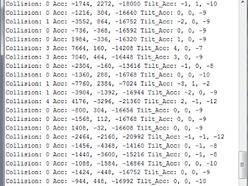
Collision Detection
Collision detection and tilt compensation

Slide 38
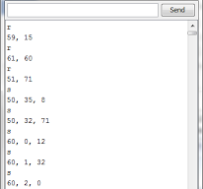
I2C Test LSM303DLHC
Initialization I2C test

Slide 39
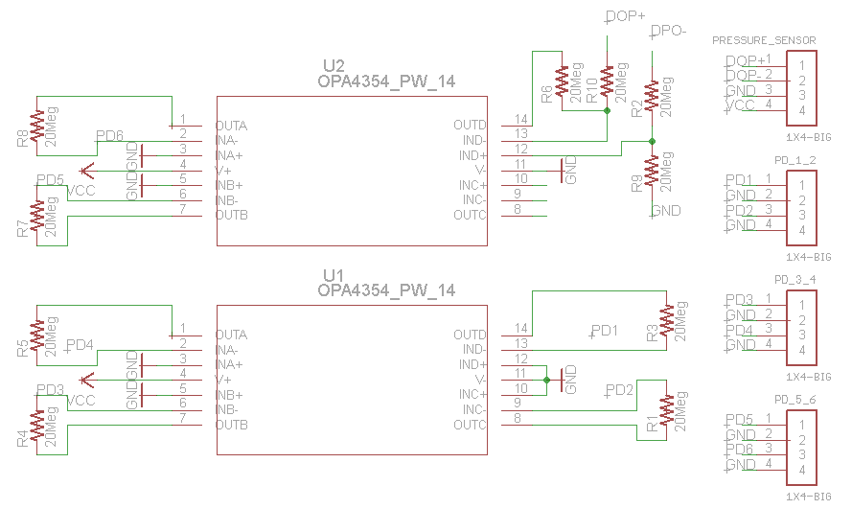
Eagle Schematic

Slide 40
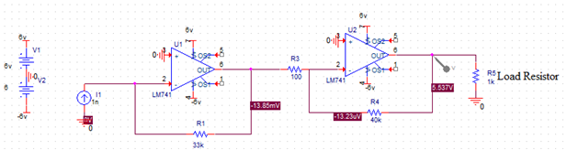
First amplifier design

Slide 41
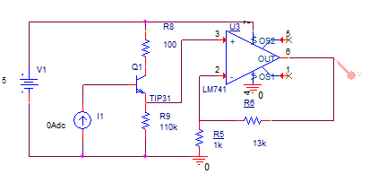
Second photodiode design

Slide 42
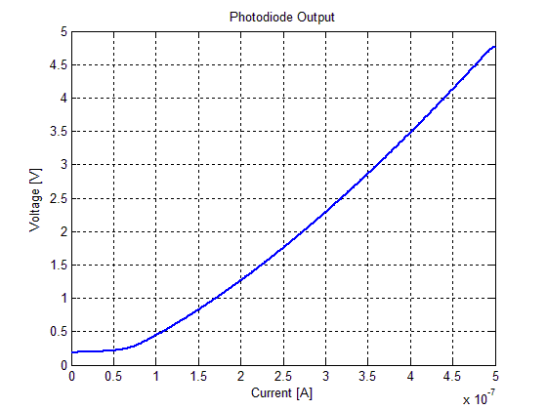
Second design iteration output

