Slide 1

Autonomous Underwater Robots
Final Presentation
RYAN LIPSKI, CAMERON PUTZ, AND NICK SIKKEMA
ADVISOR: DR. JOSEPH DRISCOLL
DEPARTMENT OF ELECTRICAL AND COMPUTER ENGINEERING, BRADLEY UNIVERSITY
APRIL 9, 2015

Slide 2
Outline
Problem statement
Objective and metrics
Functional requirements
Background information
System block diagram
Division of labor
Subsystems
Results
Conclusions

Slide 3
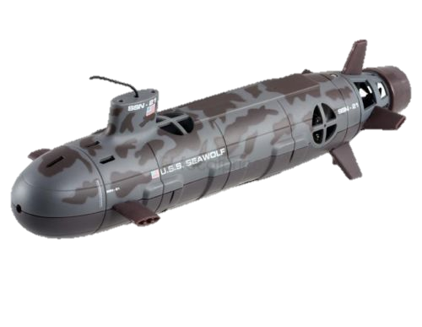
Problem Statement
Map underwater terrain using multiple autonomous robots
Avoid collisions
Generate a final image of the terrain

Slide 4
Objectives and Metrics
Objective | Metric
Minimize Cost | Determined by the production cost of one member of the swarm.
Autonomous | The amount of human interaction needed for the swarm to function.
Mobile Underwater | The turn radius of each swarm member and how close the swarm member is to neutrally buoyant.
Durable | The amount of places that fail per swarm member.
Portability | The perceived size and weight of each swarm member.

Slide 5
Functional Requirements
Functional Requirements
The submarines shall have a battery life of at least 15 minutes.
The swarm shall maneuver through a body of water.
Each submarine shall detect other submarines.
The swarm members shall operate as a swarm when near each other.
The swarm shall take images of underwater terrain.
Each submarine shall surface upon its battery level dropping below 5%.
Software shall create an image that is collected from the individual submarine images.

Slide 6
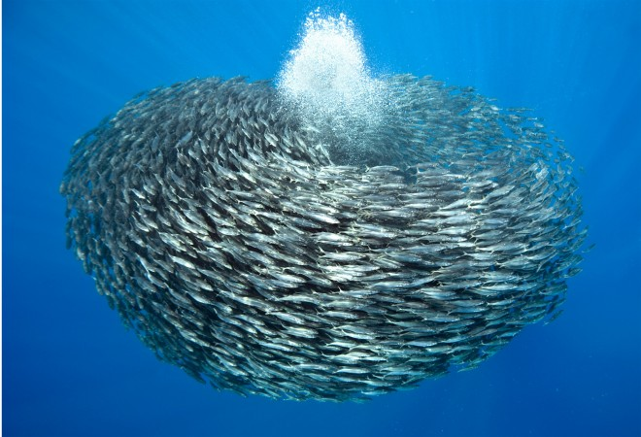
Literature Review
AUV history
AUV swarm research
  Cocoro
Swarm of Fish [1]

Slide 7
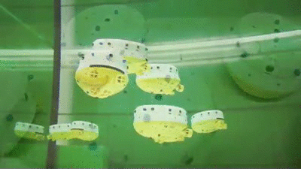
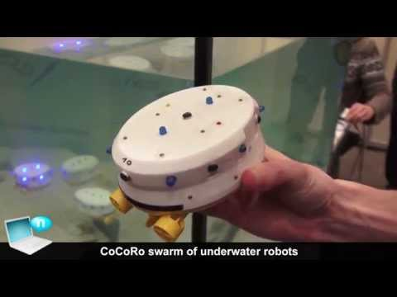
Cocoro
Cocoro normal operation [2]
Image of Cocoro [3]

Slide 8
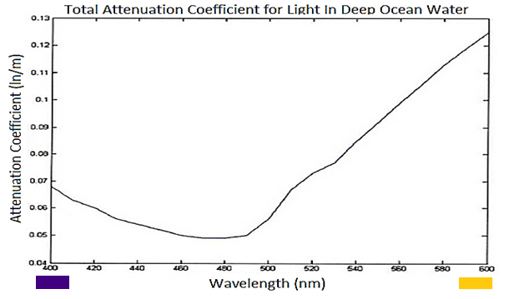
Blue LEDs - Visibility
Attenuation of ligh in ocean water [4]

Slide 9
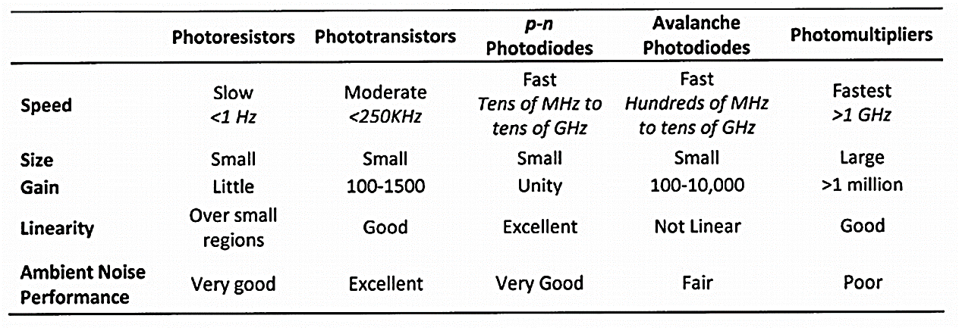
Blue LEDs - Detection
Characteristics of detection methods [4]

Slide 10
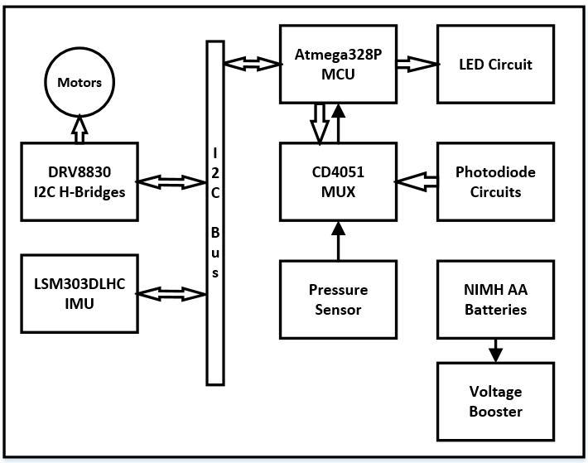
System Block Diagram

Slide 11
Division of Labor
Cameron – hardware
Camera system
Detection array
Power system
Ryan – hardware and software
Detection array
Motor control
Power system
Nick – software
Camera system
Motor control
Power system

Slide 12
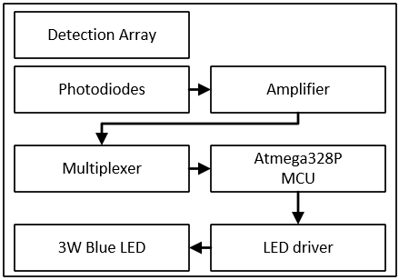
Detection Array
Block Diagram

Slide 13
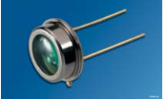
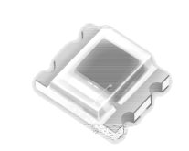
Detection Array
Results
Osram photodiode [5]
Everlight photodiode [6]
Saturation | 36 inches – 4.9 Volts | 4 inches – 4.89 Volts
Max Distance | 180 inches – 0.6 Volts | 132 Inches -- 0.120 Volts
Linearity | Linear | Non-Linear
Ambient Light | 100% Saturation | 29% Saturation
Price | $8.85 | $0.59
Photodiode comparison

Slide 14
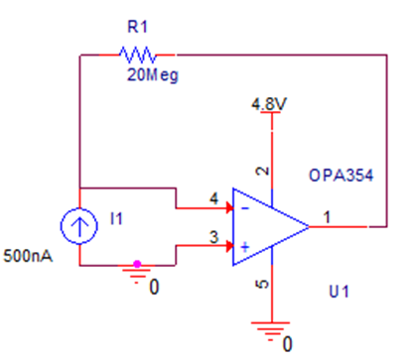
Detection Array
Design
Model of photodiode
Everlight photodiode [6]
Transimpedance amplifier

Slide 15
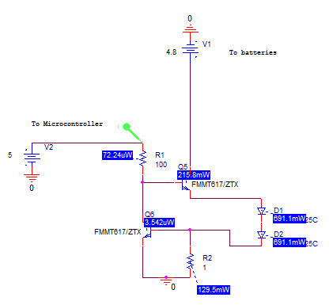
Current Source design
Simulation
Model of 3 W LED

Slide 16
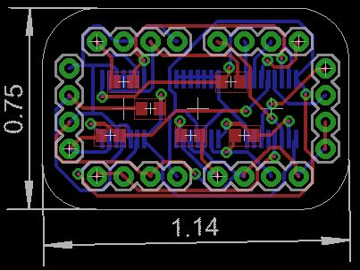
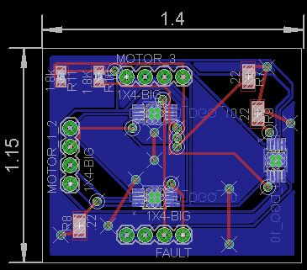
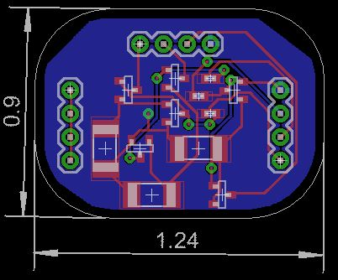
Circuit Layout
Design
Eagle 7.1.0
Boards sent to OSH Park
Photodiode interface board
H-bridge board
LED driver board

Slide 17
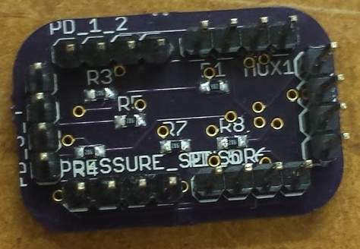
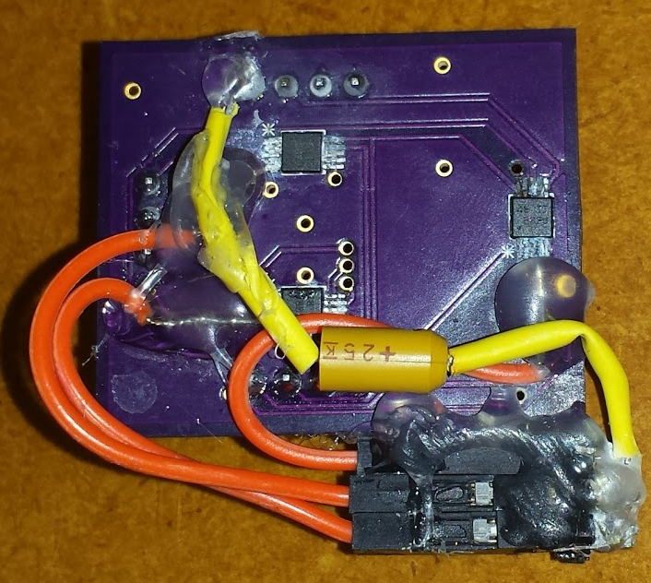
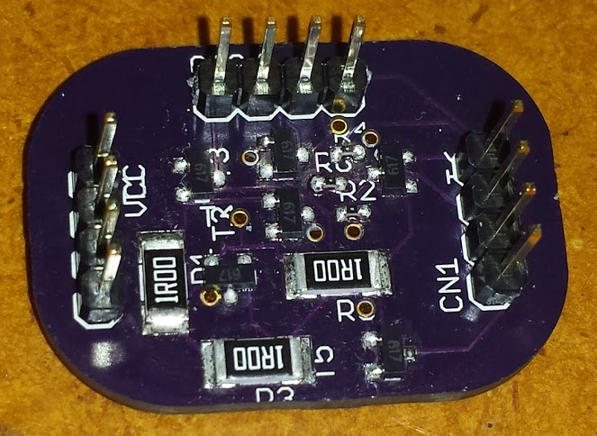
Circuit Layout
Results
Finalized OSH Park boards
Photodiode interface board
H-bridge board
LED driver board

Slide 18
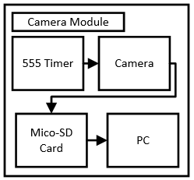
Camera System
Block Diagram

Slide 19
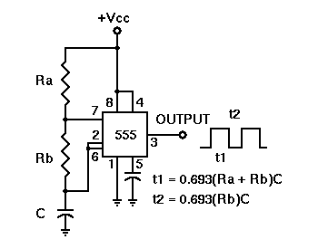
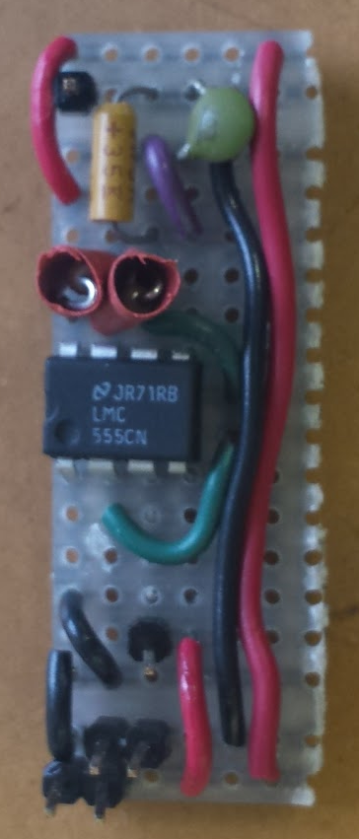
Camera System
Results
555 timer [7]
555 timer on perfboard

Slide 20
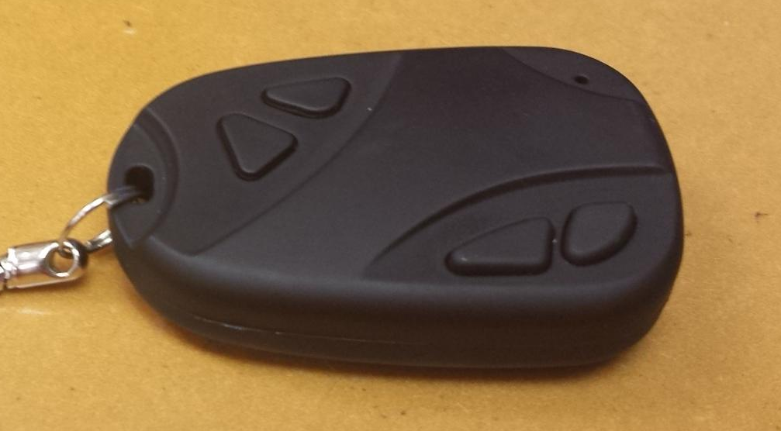
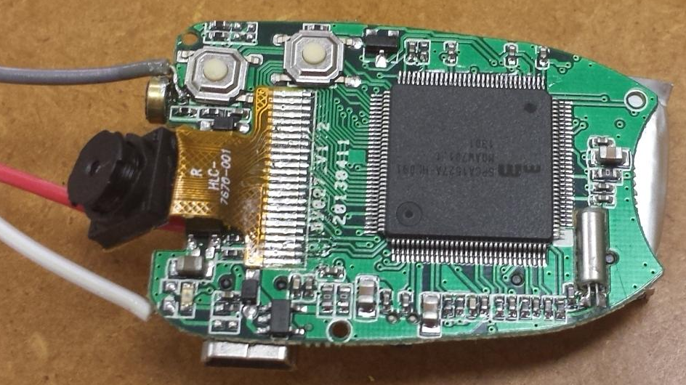
Camera System
Method
Camera key fob
Camera interface board

Slide 21
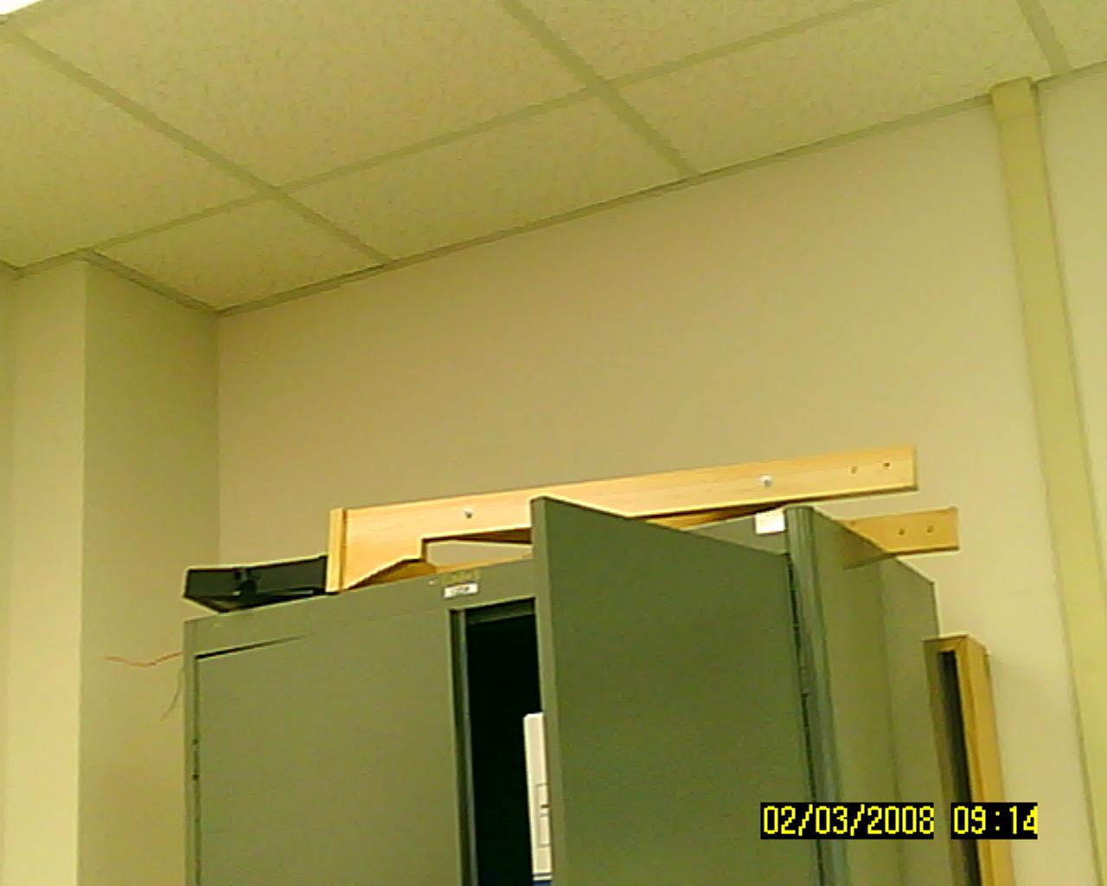
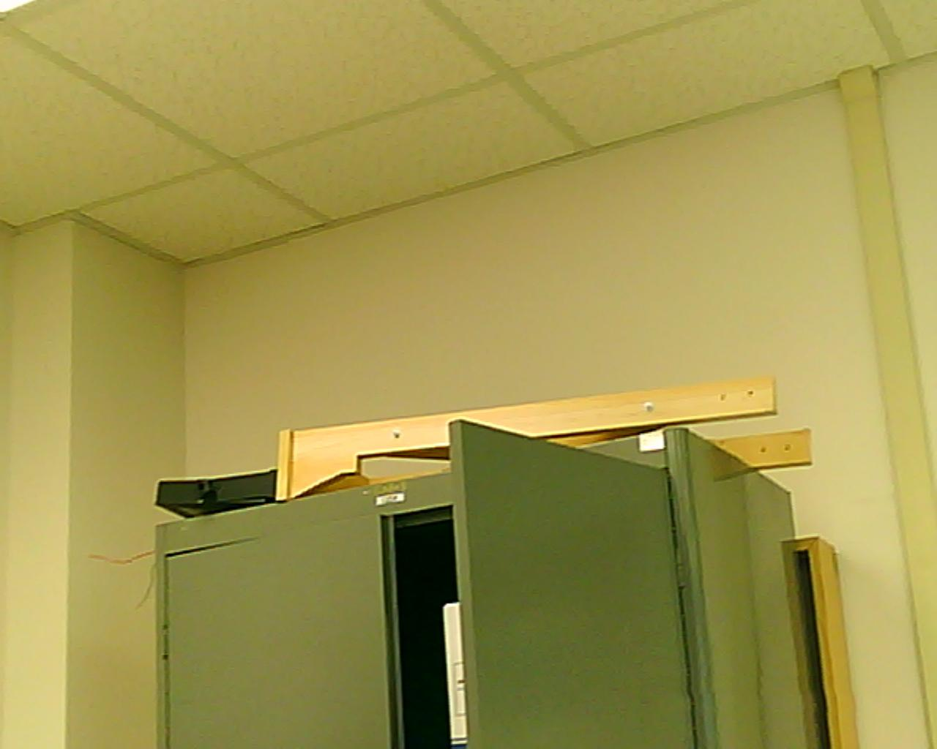
Camera
Method
With timestamp
Without timestamp

Slide 22
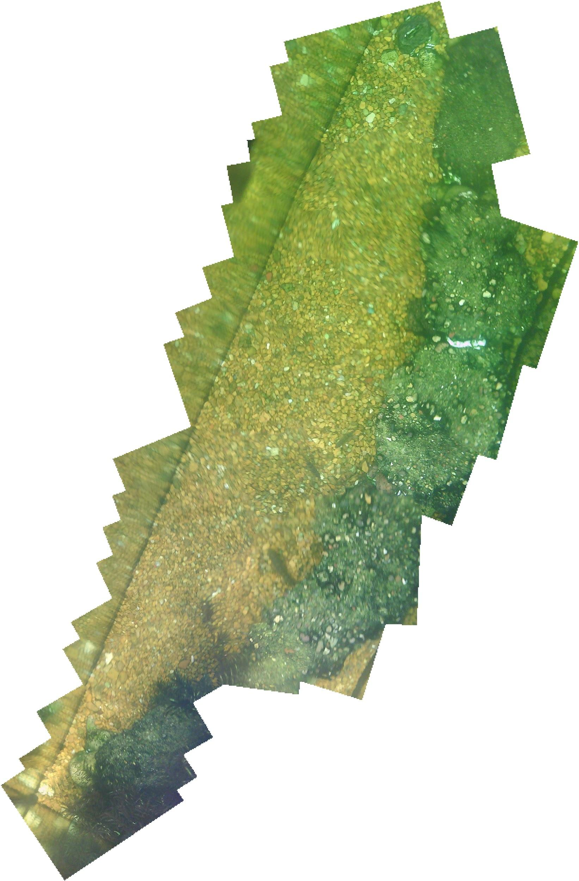
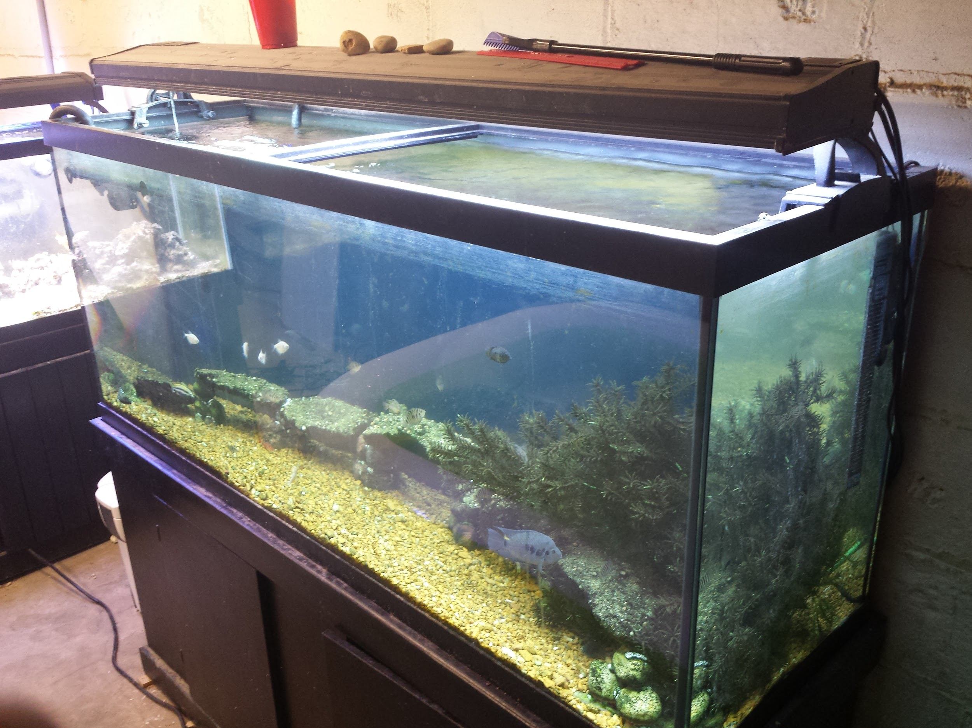
Camera
Results
Meets spec for 10% gap in final image
Picture of fish tank
Final image

Slide 23
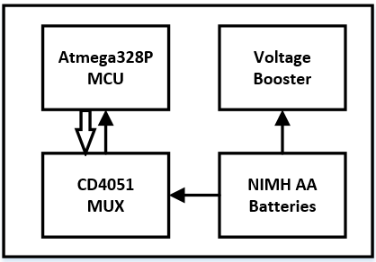
Power System
Block Diagram

Slide 24
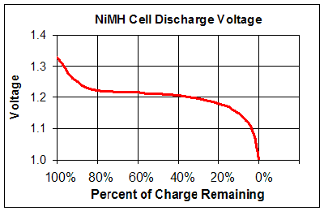
Power System
Research
Discharge of NiMH batteries [8]

Slide 25
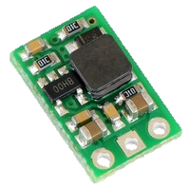
Power System
Method
Step-up regulator
  Input minimum 2.5 volts
  Output 5 volts
Reference voltage
Noise isolation
Diode
Meets spec for surfacing at 10%
Pololu U3V12F5 [9]

Slide 26
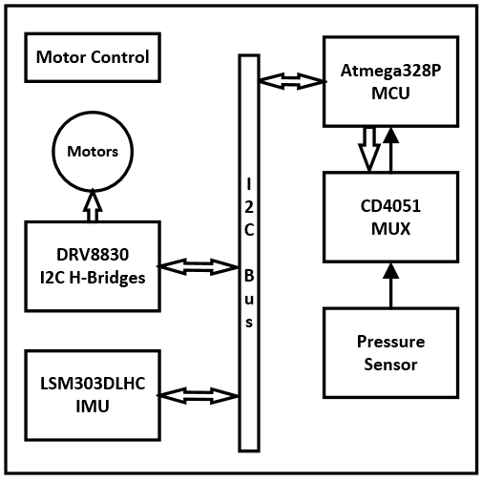
Motor Control
Block Diagram

Slide 27
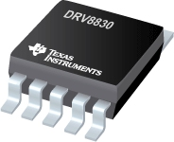
Motor Control
Design
I2C h-bridge (DRV8830)
Single channel, PWM controlled h-bridge
Heatsinking through PowerPADTM
1 A, 2.75 - 6.8 V
Cost: $2.44
DRV8830 [10]

Slide 28
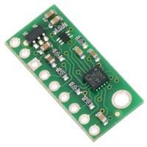
Motor Control
Design
I2C IMU (LSM303D)
Use the accelerometer
Meets spec for
velocity control
and using I2C
LSM303D [11]

Slide 29
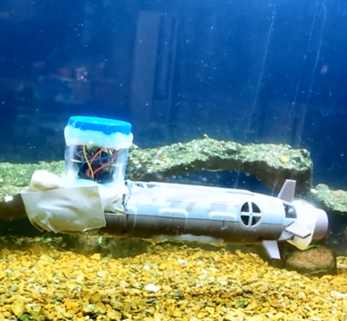
Motor Control
Design
Depth tracking
  6 cm dead band
  Testing at 52 cm deep
  PID control
Testing setup in aquarium

Slide 30
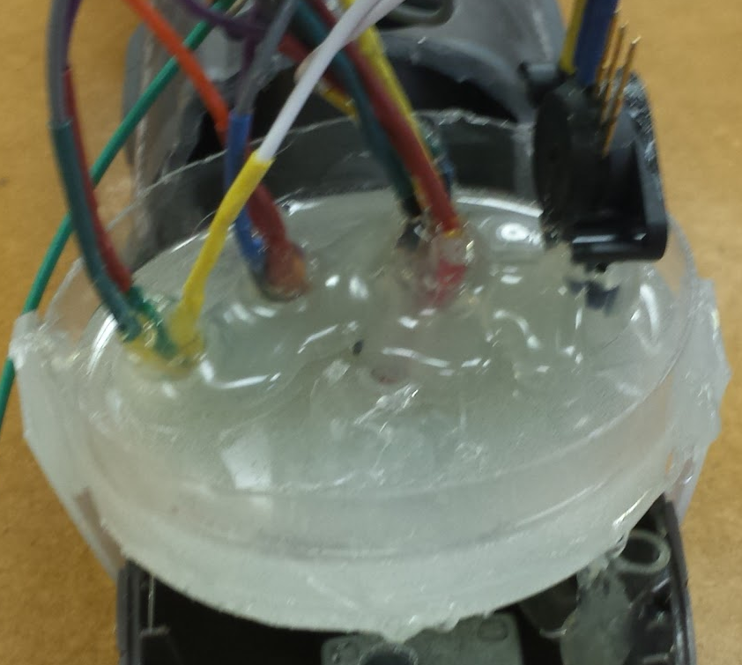
Motor Control
Design
Waterproofing
  Plastic cylinder
  Hot glue
  Epoxy
Waterproofed bottom of sail

Slide 31
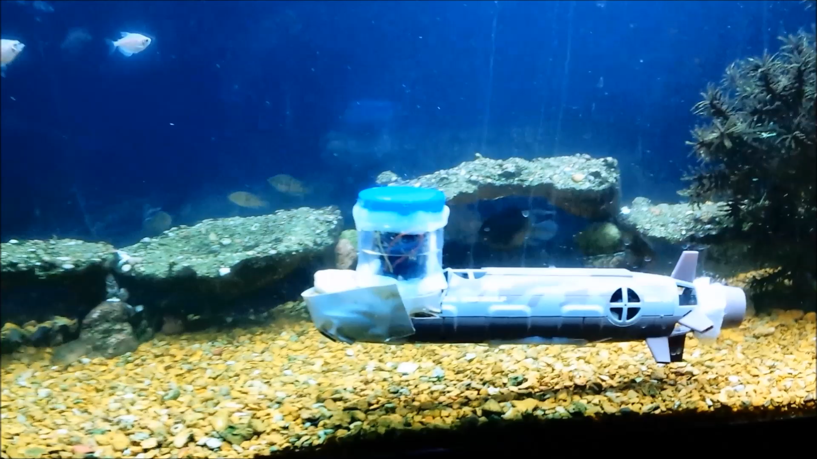
Motor Control
Results
Depth tracking
https://www.youtube.com/watch?v=KP_CVridH08
https://www.youtube.com/watch?v=-tTprnzq--I
https://www.youtube.com/watch?v=9dOgWr1T1QA

Slide 32
Power System
Block Diagram

Slide 33
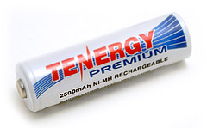
Power System
Design
Battery supply
  4 NIMH AA batteries
    1.34 V per cell
    2500 mAh
  5.36 V: h-bridges, LED drivers and pressure sensor
  4 V: voltage booster → all other hardware
Tenergy AA battery [12]

Slide 34
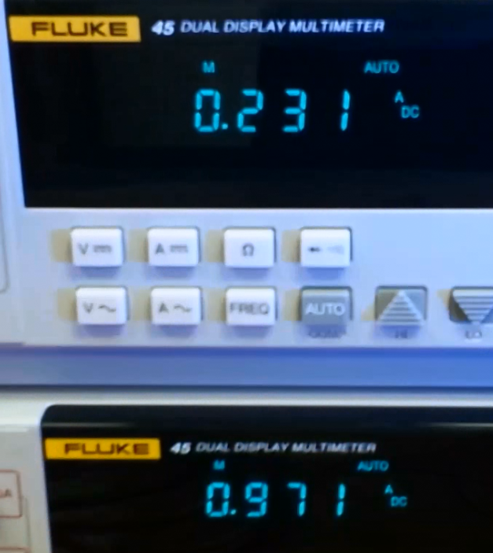
Power System
Results
Battery life calculation
  Bench-top test
    Average current draw: 1202 mA
    Estimated run time: 124 minutes
  Battery life spec is 25 minutes
3 batteries
4 batteries
Bench-top current draw

Slide 35
Power System
Result
Worst case battery life calculation
  All three motors at max duty cycle
    Peak current draw: 1202 + 2550 - 450 = 3302 mA
    Estimated run time: 45 minutes
  Still meets 25 minute spec

Slide 36
System Test Results
Objective | Metric
Minimize Cost | Determined by the production cost of one member of the swarm.
Autonomous | The amount of human interaction needed for the swarm to function
Mobile Underwater | The turn radius of each swarm member and how close the swarm member is to neutrally buoyant.
Durable | The amount of places that fail per swarm member.
Portability | The perceived size and weight of each swarm member

Slide 37
System Test Results
Minimize cost

Slide 38
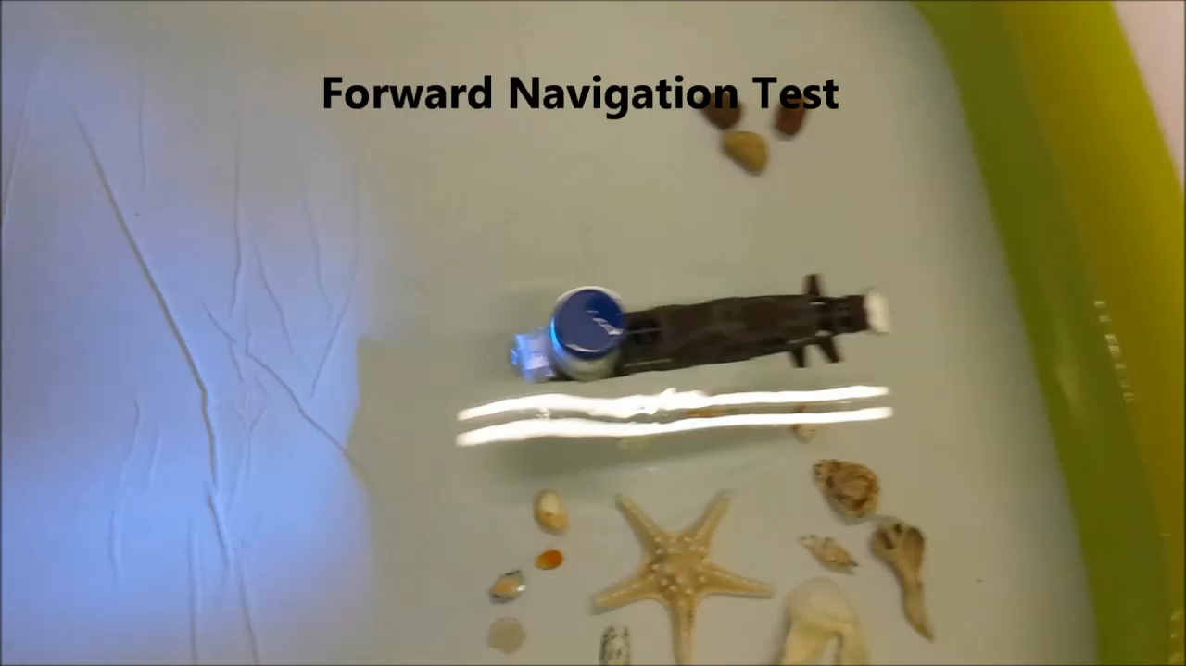
System Test Results
Autonomous & mobile underwater
https://www.youtube.com/watch?v=wOSrQxpOtXE

Slide 39
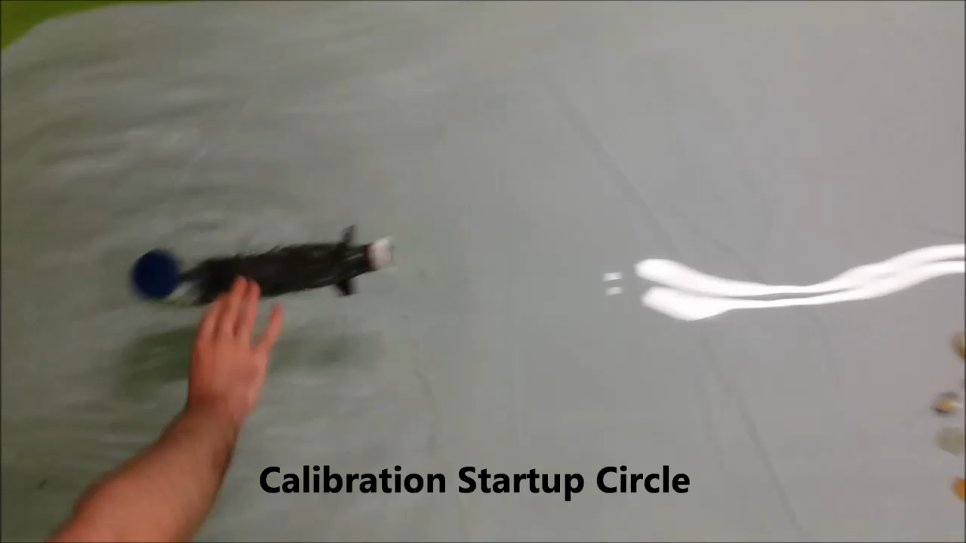
System Test Results
Autonomous & mobile underwater
https://www.youtube.com/watch?v=wOSrQxpOtXE

Slide 40
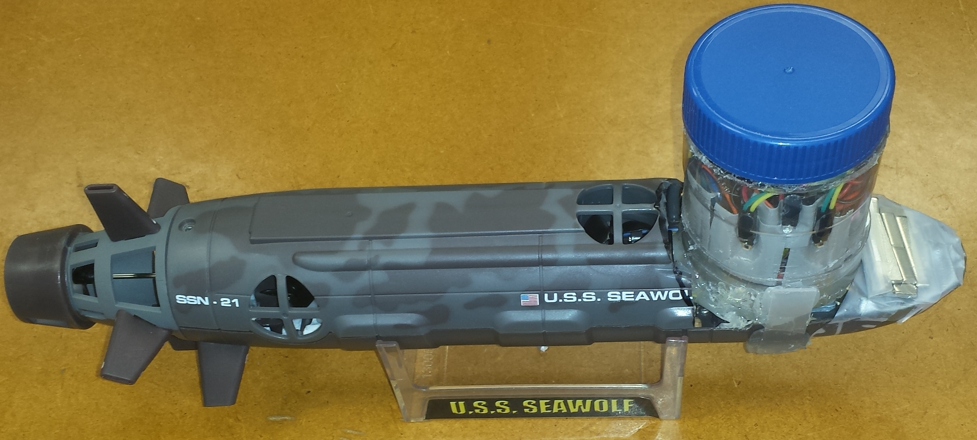
System Test Results
Durable

Slide 41
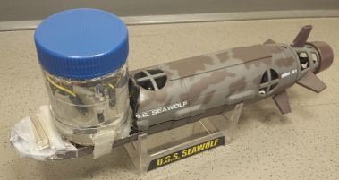
System Test Results
Portability
  35 cm long
  12.5 cm tall at the sail

Slide 42
Autonomous Underwater Robots
Final Presentation
RYAN LIPSKI, CAMERON PUTZ, AND NICK SIKKEMA
ADVISOR: DR. JOSEPH DRISCOLL
DEPARTMENT OF ELECTRICAL AND COMPUTER ENGINEERING, BRADLEY UNIVERSITY
APRIL 9, 2015

Slide 43
References
[1] E. Yong, Wired. (2013). How the Science of Swarms Can Help Us Fight Cancer and Predict the Future [Online]. Available: http://www.wired.com/2013/03/powers-of-swarms/all/
[2] CoCoRo Largest AUV swarm 2013 (2013, May 29) [Online]. Available: https://www.youtube.com/watch?v=Hjkmm13Scm4
[3] CoCoRo swarm of underwater Robots (n.d.) [Online]. Available: i.ytimg.com/vi/XUk-qLfiwlc/0.jpg
[4] H. Brundage. “Designing a Wireless Underwater Optical Communication System” unpublished.
[5] Silicon Photodiode for the Visible Spectral Range (2014, Jan 10) [Online]. Available: http://www.osram-os.com/Graphics/XPic3/00101632_0.pdf
[6] RGB Color Light Sensor Surface – Mount (2012) [Online]. Available: http://www.everlight.com/file/ProductFile/201407061648128798.pdf
[7] K. Bigelow (2014). The 555 Timer IC [Online]. Available: http://www.play-hookey.com/digital/555/timer_555.html
[8] LiPo Vs NiMH Batteries, Lipo Manufacturer (2014 Mar.) [Online]. Available: http://lipomanufacturer.blogspot.com/2014/03/lipo-vs-nimh-batteries.html

Slide 44
References Continued
[9] Pololu 5V Step-Up Voltage Regulator U3V12F5 (n.d.) [Online]. Available: https://www.pololu.com/product/2115
[10] DRV8830 (n.d.) [Online]. Available: http://www.ti.com/product/drv8830
[11] Pololu LSM303D 3D Compass and Accelerometer Carrier with Voltage Regulator (n.d.) [Online]. Available: https://www.pololu.com/product/2127
[12] Tenergy Premium 1.2V 2500mAh Ni-MH AA Rechargeable Battery, (n.d.) [Online]. Available: http://www.tenergy.com/10320
[13] Integrated Silicon Pressure Sensor On-Chip Signal Conditioned, Temperature Compensated and Calibrated (2012, Oct.) [Online]. Available: http://www.freescale.com/files/sensors/doc/data_sheet/MPX5010.pdf
[14] Low-Voltage Motor Driver with Serial Interface, Texas Instruments, [Online]. Available: http://www.ti.com/lit/ds/symlink/drv8830.pdf
[15] S. Sugihara (2014). Three Rules of Swarm Algorithm [Online]. Available: http://igeo.jp/tutorial/43.html
[16] J. YUH (2000). Design and Control of Autonomous Underwater Robots: A Survey [Online]. Available: neuron.tuke.sk/hudecm/PDF_PAPERS/DesignAndControlOfAutonomousUnderwaterrobotsASurvey.pdf

Slide 45
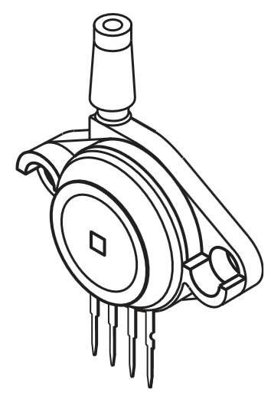
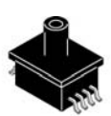
Research Parts
Reasearch
Pressure sensor
  Package
  Gauge vs absolute
MPAK package [13]
Unibody package [13]

Slide 46
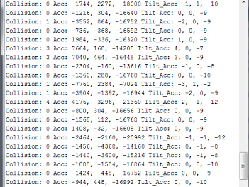
Collision Detection
Collision detection and tilt compensation

Slide 47
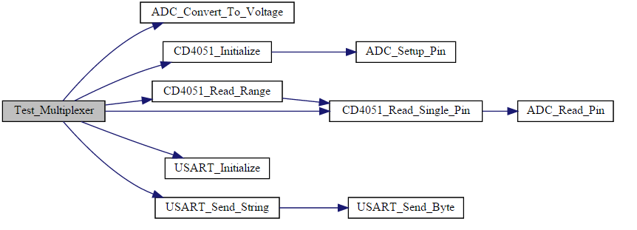
Software Integration
Design
Combining code for subsystems
  Optimization
  Functional programming style
Doxygen output for the multiplexer

Slide 48
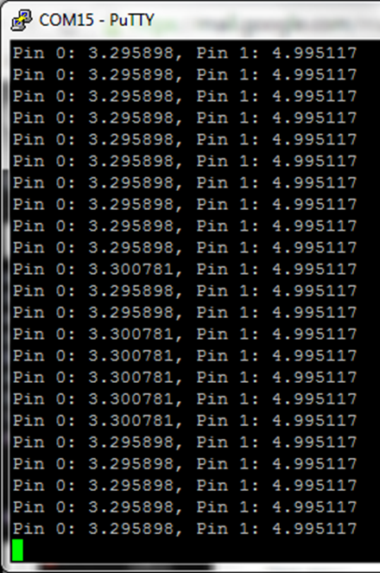
Regulator Output
Result
Step-up regulator
  Input minimum 2.5 volts
  Output 5 volts
Reference voltage
Noise isolation
Console Output for Regulator and Multiplexer

Slide 49
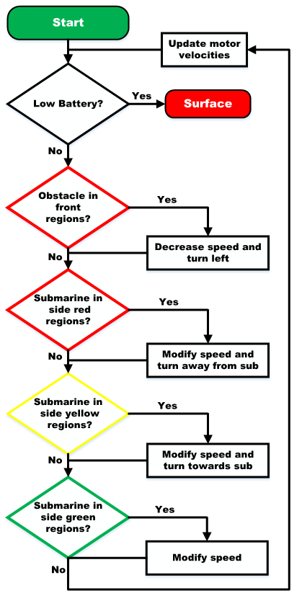
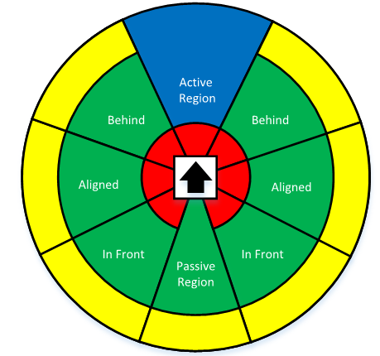
Swarming Algorithm
Design
Flowcharts were first design step
Detection zones
Simplified swarming flowchart

Slide 50
Swarming Algorithm
Design
Multiple iterations before coding
  Zone checking priority
  Integrating with rest of code
Zone checks alter variables that factor into the motor control
  Only applies to X and Y motors
Motors updated after all zones checked
Code runs until low battery voltage is detected
Simplified swarming flowchart

Slide 51
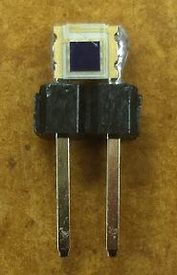
Circuit and System Layout
Design
Everlight photodiodes
  Planned to solder strands wires to each side
    Difficult to solder without bridging the leads
    2.1 mm between the leads
  Solution: Use small section of straight header pins to extend leads
    Reduces soldering difficulty
    Much more rigid connection
    Plastic section of header pins doubles as a mounting point
Everlight photodiode soldered to section of header pins

Slide 52
Motor Control and Power
3 DC brushed motors (x, y, z configuration)
  Y motor highest current draw: 860 mA peak draw
    Recorded with only rear propeller submerged
  X and y motor feedback: IMU
  Z motor feedback: pressure sensor

Slide 53

Detection Array
Experiment
Bench top detection array
  Baffle configuration testing
    Baffle protrusion distance and LED distance experimented with
    LED swept from 0 to 180° while recording light intensity
Baffle
Photodiodes
Baffle test setup

Slide 54


Detection Array
Result
Bench top detection array
  Baffle configuration testing
    12cm LED distance
Left vs right photodiode (5 mm baffle)
Detection zones

Slide 55


Compass and Accelerometer
Heading test output
Velocity test output

Slide 56

Efficiency of Motor [14]

Slide 57

Step-Up Regulator Efficiency [9]

Slide 58

Pressure Sensor Output
MPX5010 [13]

Slide 59

Pressure Sensor Circuit Diagram MPX5010 [13]

Slide 60

Complete Swarming Flowchart

Slide 61


Circuit and System Layout
Analysis
Submarine dissection
  Each motor has 2 leads along with a third wire
    Determined to be a ground wire
  Battery compartment has a
  4.8 V, 3.6 V and ground lead
  Switch has 4 leads
    Identified each lead
  First submarine is now prepped for assembly
Original submarine
Complete Swarming Flowchart
Disassembled submarine

Slide 62
Swarming Algorithm
Design
Design of this algorithm is complete
Algorithm can be partially tested on a bench top
Full testing will be possible only when the swarm is constructed
May need to alter weighting of variables or radii of the different zones

Slide 63

First amplifier design

Slide 64

Second photodiode design

Slide 65


555 Timer Output

Slide 66

Second design iteration output

Slide 67

Current Source design

Slide 68

Circuit Layout
Eagle 7.1.0
First iteration of the detection array surface mount board

Slide 69


Circuit Layout
Eagle 7.1.0
First library package Everlight photodiode
First library symbol Everlight photodiode

Slide 70
Circuit Layout
Eagle 7.1.0
  Photodiode board rev. 1

Slide 71

Circuit Layout
Eagle 7.1.0
  Photodiode board rev. 2

Slide 72

Circuit Layout
Eagle 7.1.0
  Photodiode board rev.3

Slide 73
Circuit Layout
Eagle 7.1.0
  Photodiode board rev.4

Slide 74

Circuit Layout
Eagle 7.1.0
  High current board rev. 1

Slide 75
Circuit Layout
Eagle 7.1.0
  LED driver board rev. 1

Slide 76
Circuit Layout
Eagle 7.1.0
  Motor driver board rev. 1

Slide 77

Eagle Schematic

Slide 78

Eagle Schematic

Slide 79

Eagle Schematic

Slide 80
Constraints
Avoid harming underwater organisms
Battery life
Functional up to two feet of water
Robots must be reasonably sized

Slide 81
Detection Methods
Acoustic
Electromagnetic
Optical
  Image processing
  LEDs

Slide 82

Swarming Techniques
Boids
  Simulates the flocking of birds
  Criteria include cohesion, separation and alignment
Cohesion
Separation
Alignment
Principles of swarming [15]

Slide 83
Swarming Techniques
Minimalistic
  Based upon Boids
  Criteria include cohesion, separation and pseudo-alignment
Cohesion
Separation
Alignment
Principles of swarming [15]

Slide 84

Assembly/Soldering
Result
Everlight photodiode soldered to section of header pins
LED soldered to section of header pins

Slide 85
Functional Requirements
Functional Requirement | Specification/Method
Each submarine shall detect other submarines. | 1.22 meters, on PCB's
The swarm shall take images of underwater terrain. | 640x480, compiled image
The swarm shall maneuver through a body of water. | Depth: ± 10 cm, up to 60cm, constant speed ± 5%, I2C controlled
The submarines shall have a battery life of at least 15 minutes. | Battery life: 25 min
The swarm members shall operate as a swarm when near each other. | Passive sensing while close
Software shall create an image that is collected from the individual submarine images. | 10% image gaps or less
Each submarine shall surface upon its battery level dropping below 5%. | Surface at 10% battery life

Slide 86
Societal Impact
Development is ethical
Aquatic industries/research will be affected
Originally marketed as a toy RC submarine
Submarines will navigate at relatively slow speeds
Boats could collide with the swarm

Slide 87
Environmental Impact
Low natural resources costs
Lost submarines could pollute the water
Plant life could be disturbed
Large obstacles will be detected and avoided

Slide 88
Related Patents
CN 102916744 A - Underwater LED visible light communication system
US 20140212142 A1 - Underwater optical communication system
US 20050232638 A1 - Methods and apparatus for underwater wireless optical communication

