Slide 1

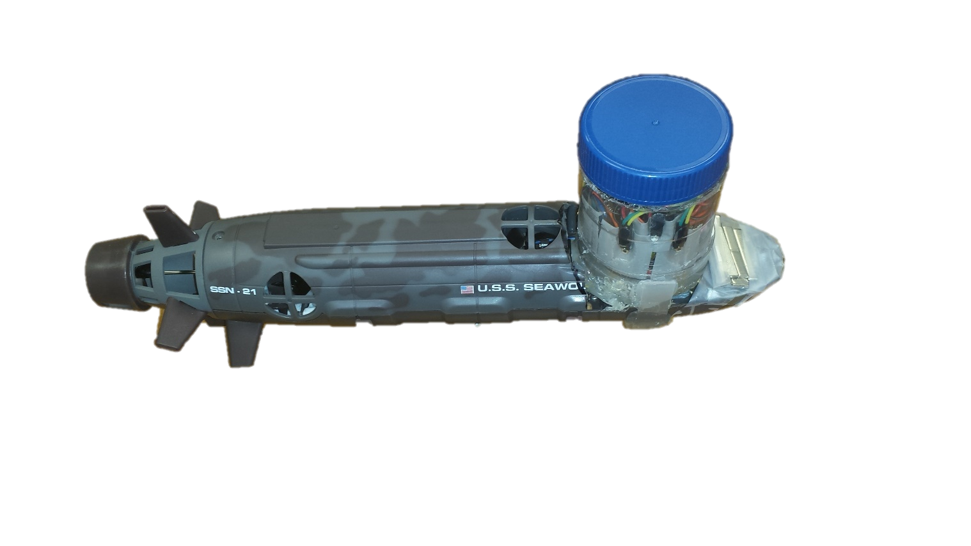
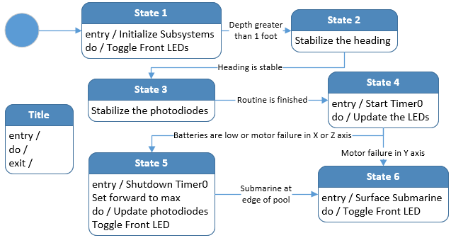
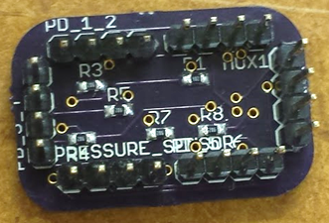
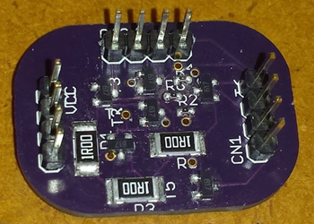
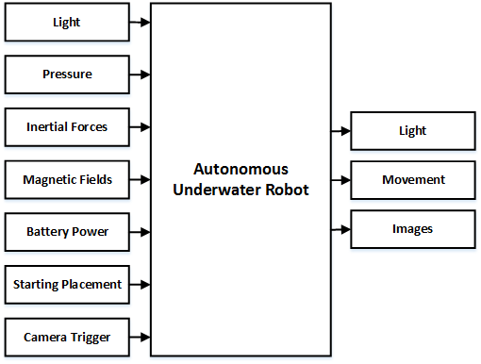
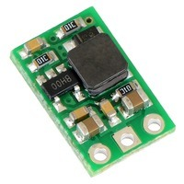
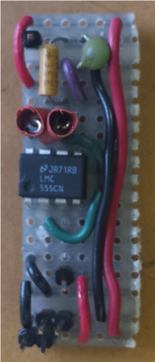
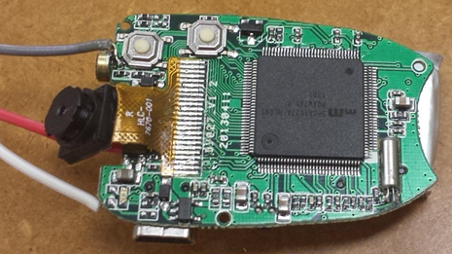
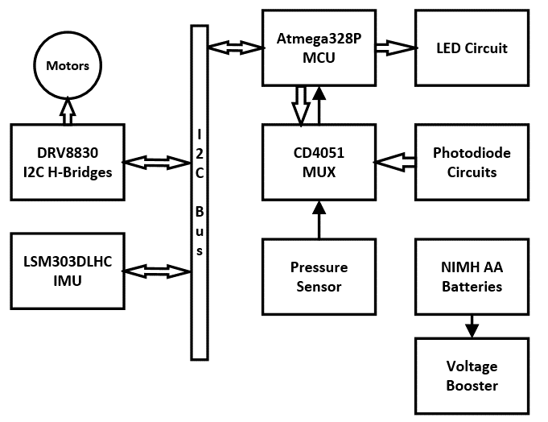
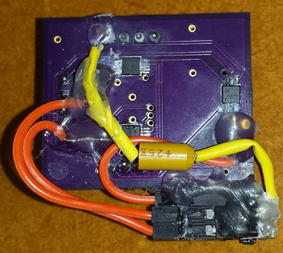
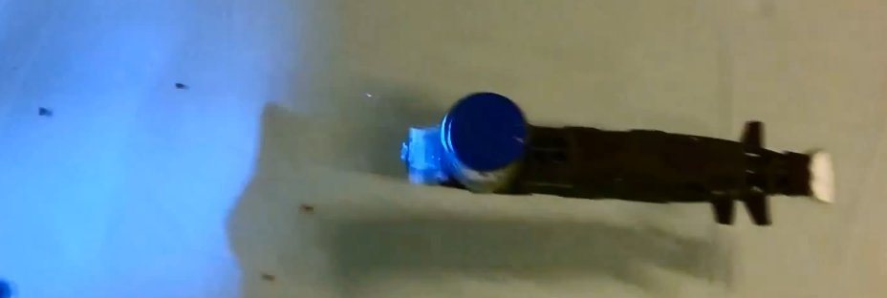
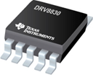
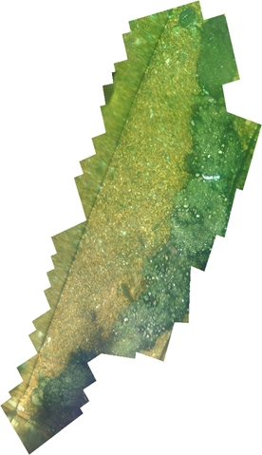
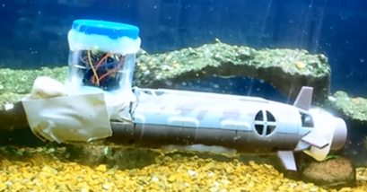
Autonomous Underwater Robots
Ryan Lipski, Cameron Putz, and Nicholas Sikkema
Joseph A. Driscoll, Ph.D.
Department of Electrical and Computer Engineering, Bradley University, Peoria, IL, USA
AUR
Introduction
Power System
System Results
The goal of this project was to build a swarm of autonomous robots to map underwater terrain. Specialized detection methods were generated using blue LEDs and blue filtered photodiodes. The physical design of the robots involved using RC submarine platforms that were modified to include additional subsystems.
The submarine’s main power source were NiMH AA batteries with capacity of 2500 mAh and supplied 1.34 V at full charge. The batteries were connected in two configurations, providing a 4.02 V and 5.36 V supply. A voltage booster was used as a regulated power source to sensitive components and to determine when the batteries were below 10%, the condition for the submarine to enter the surfacing subroutine.
The entire system was tested in a small swimming pool. The fully constructed submarine is shown in Fig. 14. The only hardware that was not on the submarine during testing was the camera system, as this was being tested separately. Videos were taken that demonstrate the mobility and autonomy of one of the submarines underwater.
The submarine begins its navigation by doing the calibration startup circle. It will then begin navigating until it measures the battery voltage dropping below 10%. The submarine will then surface and move to the end of the testing pool where it can be easily retrieved. A submarine is shown navigating in a small pool in Fig. 15.
Fig. 5. Photodiode PCB
Fig. 6. LED Driver PCB
The AUR team developed two surface mount boards for the detection array. They were developed using Eagle 7.1.0, and manufactured at OSH Park.
Fig. 3. Software state diagram
To control the overall operation of the submarine, the main state machine has three main portions: the initialization, the normal operation, and end of operations.
Motor Control
The motor control system involves three h-bridges, three DC motors, and three control systems. The x-axis and y-axis motors were implemented using PID speed control with the IMU for feedback. The IMU returned acceleration values which were then integrated to provide velocity values. The z-axis motor was implemented using PID position control with the pressure sensor for feedback. The pressure sensor returned PSI values which were then converted into a depth values.
Detection Array
Fig. 10. Voltage booster
Fig. 14. Modified submarine platform
The team needed an inexpensive, reliable, and low-power way to detect other submarines underwater. The method the team decided to go with uses light-emitting diodes (LEDs) and photodiodes.
Camera System
The camera system was designed to be independent of the other systems and to take pictures autonomously.
Fig. 1. AUR black box
TABLE I
PHOTODIODE COMPARISION
The inputs and outputs of a single submarine are shown in Fig. 1.
 | Osram | Everlight
Saturation | 36 inches - 4.9 Volts | 4 inches - 4.89 Volts
Max Distance | 180 inches - 0.6 Volts | 132 inches - 0.12 Volts
Linearity | Linear | Non-Linear
Ambient Light | 100% Saturation | 29% Saturation
Price | $8.85 | $0.59
Fig. 11. 555 timer circuit
Fig. 12. Camera PCB
Using a 555 timer connected in an astable oscillator configuration, the team interfaced the 555 timer circuit to the image capturing button. The 555 timer was designed to capture pictures every 1.5 seconds.
Each submarines has 20 detection zones, shown in Fig. 4. The front zones are used for obstacle detection. The remaining zones are used for inputs in a minimalistic swarming algorithm.
Fig. 7. DRV8830 h-bridge
Fig. 8. H-bridge PCB
Fig. 15. Submarine navigating underwater
Depth tracking testing was conducted in a large aquarium. The tests proved that the submarine could maintain a constant depth. A PCB was also designed to interface the three h-bridges to the microcontroller. Small fixes were added to this board to supply adequate power and to reduce noise. The PCB was designed to include TI’s PowerPad^{TM.}.
Conclusions
The AUR team was able to get two individual submarines built and tested. Setbacks prevented the group from performing testing with the entire swarm in water. These sets primarily involved the hardware and the waterproofing methods. The biggest setback was the design of the detection array. Despite this, the team was able to get all the subsystems functioning individually. In the case of the depth tracking, three of the four subsystems were integrated successfully. The result was a submarine that could submerge and maneuver underwater autonomously.
Fig. 2. AUR hardware
Fig. 13. Photo-merging example
The entire hardware system for a single submarine, as seen in Fig. 2, shows how each of the subsystems are connected. The team used a multiplexer to interface seven devices: five photodiodes, a battery voltage, and a pressure sensor, through one ADC on the ATMega328P microcontroller. An I²C bus is used to communicate with three h-bridges and an IMU.
After the submarines have finished taking the pictures, the micro-SD cards are taken to a computer. On the computer there are two tasks that are done using Photoshop: time-stamp removal and photo-merging. The result is a compiled image, as seen in the aquarium example in Fig. 13.
Fig. 4. Detection zones
Fig. 9. Submarine depth tracking

