Slide 1
Wireless Power Transfer System
Team Members: Sergio Sanchez, Elie Baliss, and Tyler Hoge
Advisor: Dr. Prasad Shastry

Slide 2
Outline
Motivation (cut the cord, competitors)
ISM Band
FCC & A4WP Regulations
Project Summary
Detailed Description
Schedule of Tasks

Slide 3
Motivation
Existing WTPS
-Power Beam
-Witricity
-Qualcomm
-Duracell
-Various Mobile Phone Producers
Far-Field
(PowerBeam& Our system)
Near-Field
(Witricity, Qualcomm, Duracell, Sony, & some mobile phone companies)
Advantages | Disadvantages | Advantages | Disadvantages
Range up to 30m | Low efficiency 15%-30% | High Efficiency about 60%-70% | Range up to 30cm

Slide 4
Motivation Cont.
Advantages | Disadvantages
The range of our system is 1.5 meters, this is over a meter farther than the competition | antenna alignment (The power received by the receiver will decrease if the antenna are not aligned at optimal angles. This may reduce the effective range are to below 1.5 meters
True freedom with the device. This is because the device does not have to be within centimeters of the transmitting source | Low overall efficiency when charging only one device
Reduces the number of wires running into the center of your room | No micro-controller controlling the system (no stand-by state or protection state)
Versatility of being able to still use your phone in a comfortable manner
Device uses 915MHz to transmit the power instead of induction charging
Ability to charge multiple devices

Slide 5
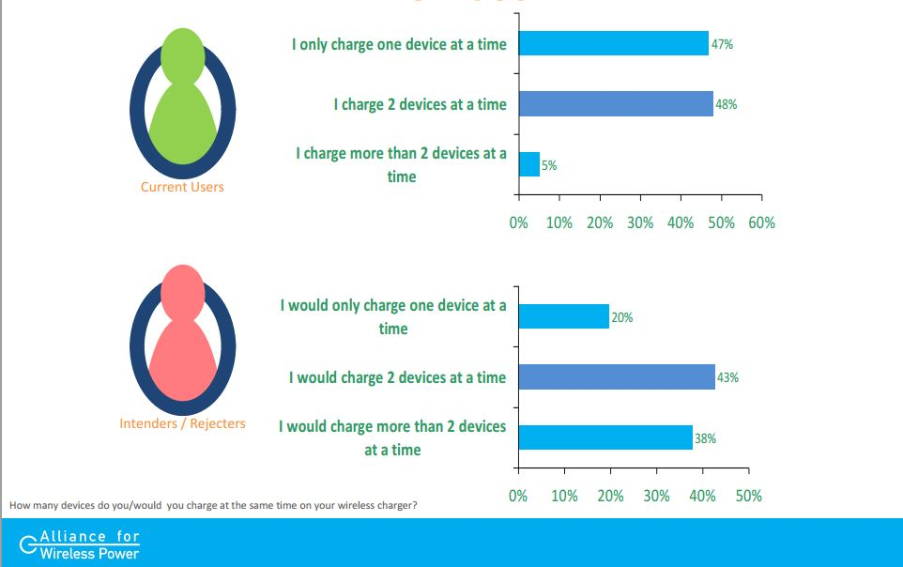
Motivation Cont.
http://www.a4wp.org/A4WP_WPS2012_Presentation.pdf
Survey Question: How many devices do you/would you charge at the same time with your wireless charger?
Notes:
System 1:

Slide 6
ISM Band
ISM Band Frequency | Typical Use
6.765 MHz – 6.795 MHz
13.553 MHz – 13.567 MHz | RFID(Passports, smart cards)
26.957 MHz – 27.283 MHz
40.660 MHz – 40.700 MHz
902.000 MHz – 928.000 MHz
2.400 GHz – 2.500 GHz | Bluetooth,WiFi, microwave
5.725 GHz – 5.875 GHz | WiFi, cordless phones
24.000 GHz – 24.250 GHz
61.000 GHz – 61.500 GHz
122.000 GHz – 123.000 GHz
244.000 GHz – 246.000 GHz
The ISM (Industrial, Scientific, Medical) Bands are reserved for unlicensed RF systems
All Frequencies are controlled by the Federal Communications Commission (FCC)
FCC.gov

Slide 7
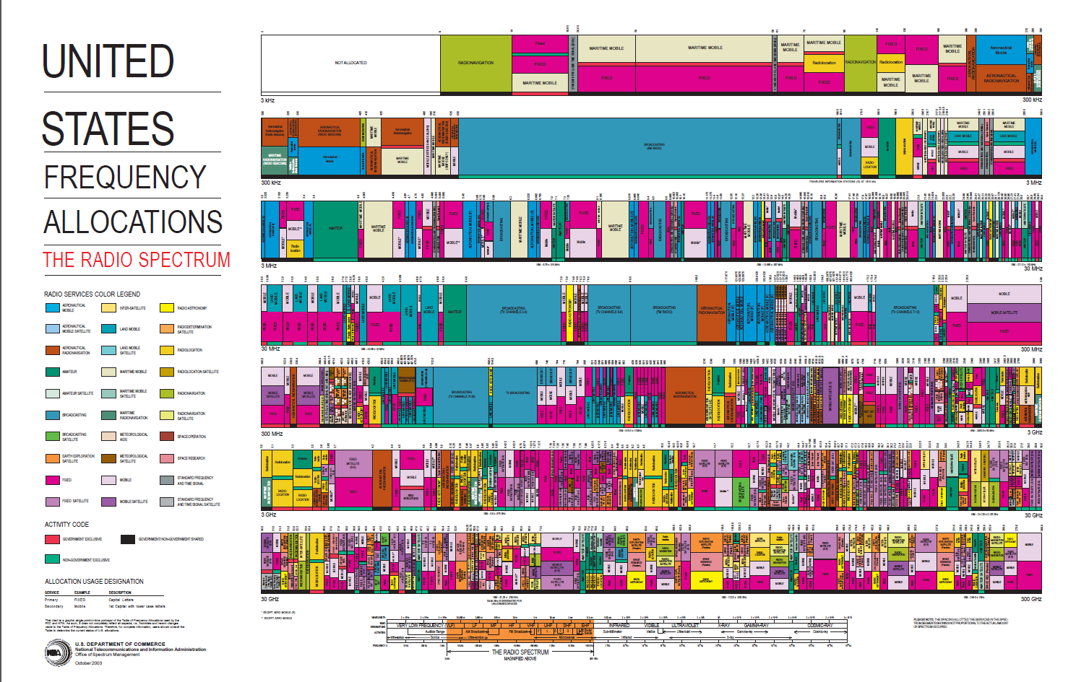
ISM Band
http://www.ntia.doc.gov/files/ntia/publications/2003-allochrt.pdf

Slide 8
FCC Regulations and A4WP
FCC
A4WP
Maximum Power rating is 1W (30dBm)
Maximum Effective Isotropic Radiated Power (EIRP) 4W (36dBm)
Alliance for Wireless Power is a group that is fighting for standards in the wireless power transfer realm.
Members include – Intel, Qualcomm, LG, Samsung, HTC, Etc.
Specification of this group have yet to be released to the public
Emphasis on modes of operation
Transmitter – Off, Stand-by, Power Transfer
Receiver – Off, On, Protection

Slide 9
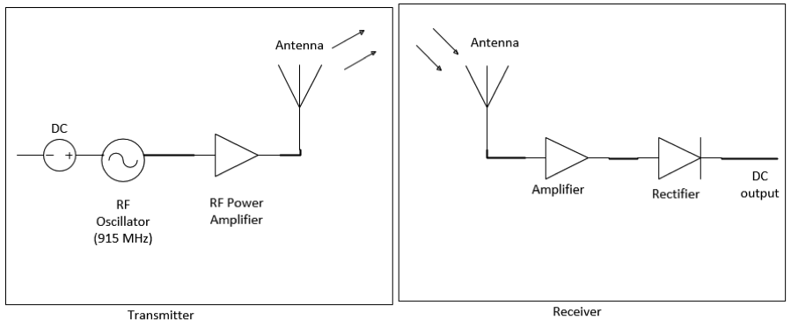
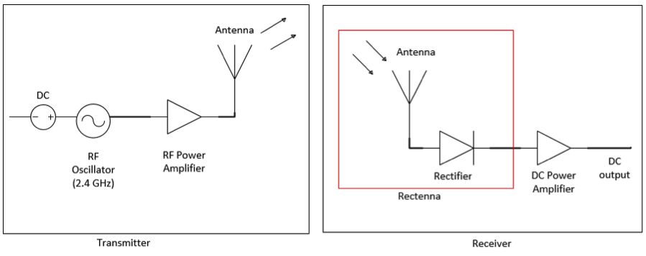
Project Summary
System 1
System 2

Slide 10
System 1
Powercast module – 915 MHz Rectifier chip
About 74% RF-to-DC Conversion efficiency at 24.5 mW
Transmits about 1.2 W of power
Theoretical radius of transmission is 1.5 meters
Receives about 1.4 mW of power
Includes Omni-Directional antennae with gain of 3dBi
Low Profile – 4 in x 3 in
Overall Efficiency of 25%-30% (Initial Calculation)

Slide 11
Putting Efficiency into Perspective
System | Efficiency
Solar Panels | 15%-21%
Power Supply (laptop) | 60%-75%
PowerBeam (Far-Field) | 15%-30%
Witricity (Near-Field) | ≈ 70%
Our System | 25%-30%
The ability to charge multiple devices means that the system will enhance the utilization of power.

Slide 12
System 2
Frequency – 2.4 GHz
Range of 1.5 meters
Incorporate a Rectenna
Mitigate high-order harmonics
Include impedance matching network
Aiming for 60% RF-to-DC conversion efficiency
Transmit about 822 mW of power
Receive about .144 mW of power

Slide 13
Detailed Description
System 1 covered by Elie Baliss
System 2 covered by Sergio Sanchez

Slide 14
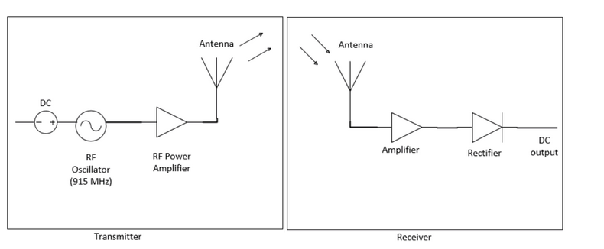
System 1
System 1 will contain two main parts, which each contains three components:
Transmitter
RF Oscillator
Power Amplifier
Antenna
Receiver
Receiving Antenna
Power Amplifier
Rectifier Circuit
Note: Operating frequency for System #1 will be 915 MHz

Slide 15
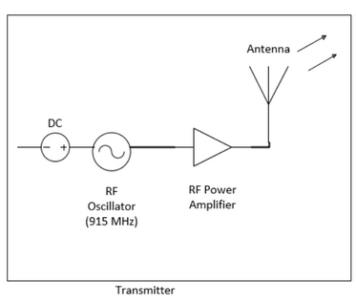
Transmitter Circuit
RF Oscillator
Converts DC signal to RF
Power Amplifier
Amplifies RF signal
Antenna
Radiates amplified RF Signal

Slide 16
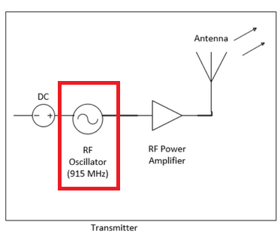
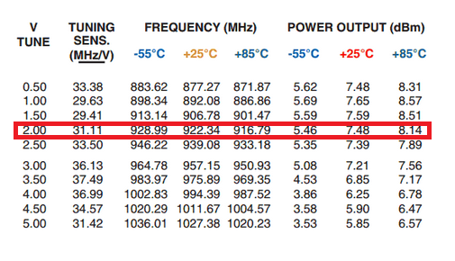
RF Oscillator
The RF Oscillator chip used will be the ROS-1000PV from Mini-Circuits. This will convert the input DC signal into RF.
The RF signal generated will have a frequency of 915MHz
According to the data sheet, it can operate between 0.5V and 5.0V.
The maximum power output comes from a 2.0V DC input, which will result in about 6.5 mW output power.

Slide 17
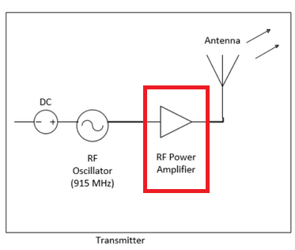
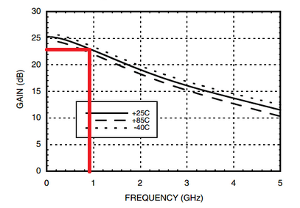
Power Amplifier
The output power from the RF oscillator will then be amplified using a power amplifier.
The 6.5 mW will be amplified to about 1.2W based on the 22.5 dB Gain of the amplifier @ 915 MHz

Slide 18
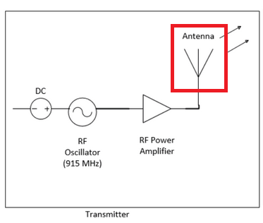
Transmitting Antenna
The antenna radiates the signal over to the receiving antenna.
Friis Equation:
Gt is the gain of the transmitting antenna which is 3dB @ 915 MHz
Lambda = c/f
R = 5 ft

Slide 19
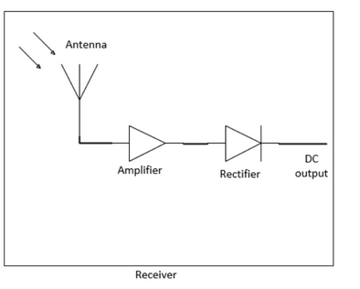
Receiver Circuit
Receiving Antenna
Receives RF signal
Power Amplifier
Amplifies RF signal
Rectifier Circuit
Converts RF signal back to DC to charge the load

Slide 20
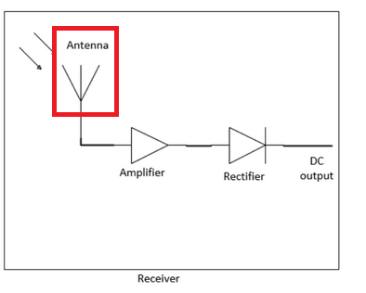
Receiving Antenna
Using Friis Equation, we can calculate the receiving power. (Pt = 1.2W)
P_{rec} is calculated to be around 1.4 mW. (Gr = 3 dB)

Slide 21
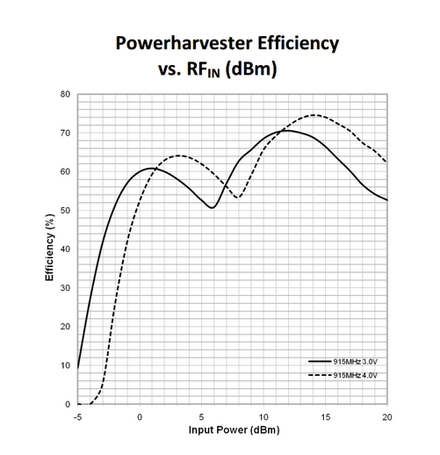
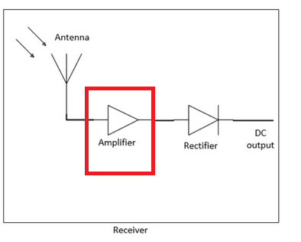
Power Amplifier
The Powercast rectifier chip operates between 1mW ~ 100mW.
In order to get maximum efficiency from the Powercast chip (74%), we need to include a power amplifier to boost the received power (P_{rec} = 1.4mW), to about 24.5mW.

Slide 22
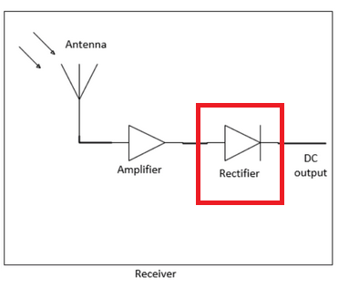
Rectifier Circuit
The Rectifier Circuit Chip (Powercast Chip) will convert the amplified RF signal into DC signal.
The chip can operate @ 915MHz

Slide 23
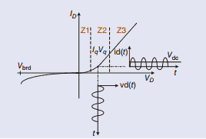
Rectifier Circuit
The circuit contains diodes in a certain configuration (One, two, or four diodes). When fed with an RF signal, the diode(s) generates a DC component that serves as a biasing point.
Three different operating zones (Z1, Z2, & Z3) can be defined according to the bias level. (Figure 1)
Z1: Output signal is proportional to the square of the input signal. This is the ideal zone needed as it will generate the square of the input function (All DC)
Z2: Will have some DC and some RF
Z3: No DC component at all
Figure taken from IEEE Magazine, Article: Optimum Behavior

Slide 24
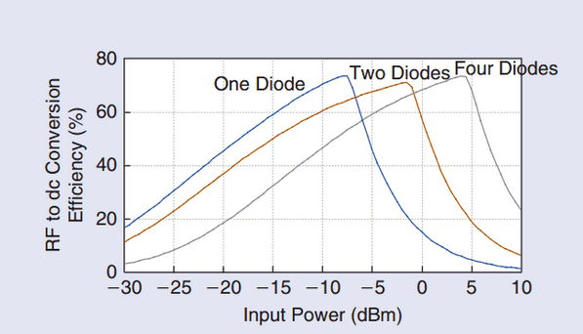
Rectifier Circuit
The RF to DC conversion efficiency depends on the topology selected for the rectifier circuit.
By choosing one diode, you can get the same efficiency as choosing four diodes at a higher gain.

Slide 25
System 2
Transmitter operating @ 2.4 GHz
-RF oscillator, RF power amplifier, and antenna
Receiver operating @ 2.4 GHz
-Rectenna and a dc power amplifier

Slide 26
RF Oscillator
Note: 10.8 dBm @ 2.4 GHz (chosen for max gain)
*Datasheet from Mini-Circuits

Slide 27
RF amplifier
Output power must be less than 4.0 Watts @ 2.4 GHz (according to the FCC)
*Datasheet from Mini-Circuits

Slide 28
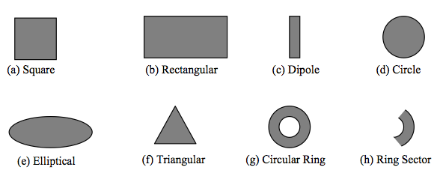
Transmitter’s Antenna
Consideration:
-Gain (approx. 3-5 dB)
Figure 29-1: Possible antenna shapes

Slide 29
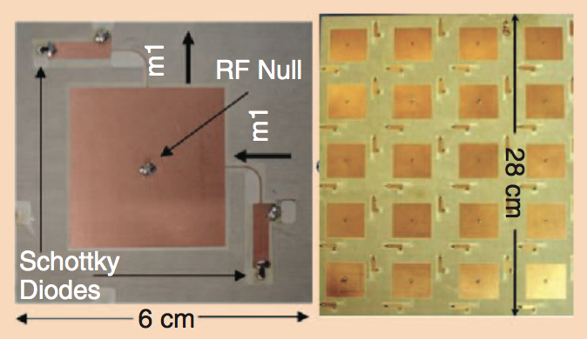
Receiver’s Rectenna
Type
-Microstrip patch
Design consideration
-RF-to-DC conversion efficiency
Figure 11-1: Patch Rectenna and Rectenna array¹

Slide 30
Design Consideration
RF-to-DC conversion efficiency
Figure 31-1: Complete receiver system

Slide 31
Antenna & Impedance Matching Network
Antenna: Designed for maximum gain w/ appropriate shape. (approx. 3-5 dB)
Impedance Matching Network:
-Increases power delivered to the rectifier circuit by reducing reflections at the input port of the rectifier circuit.

Slide 32
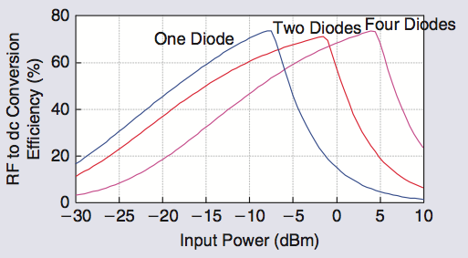
Rectifier Circuit
Rectifier: The RF-to-DC conversion efficiency depends on the rectifying device (schottky diode), the rectifier topology (single diode), available input power to rectifying device, and the output load.
Figure 33-1: Input power Vs. RF-to-DC conversion efficiency¹

Slide 33
Low-pass Filter
Low Pass Filter: Mitigates the second, third, and fourth order harmonics produced by the rectifier circuit to leave only the dc component.

Slide 34
Equipment & Parts List
System 1
-RF Oscillator_transmitter (ROS_1000PV)
-RF Amplifier_transmitter (HMC478SC70)
-RF Amplifier_receiver (ERA-6SM+)
-Rectifier Circuit (Powercast’s P1110)
-Antenna from TE Connectivity
System 2
-RF Oscillator (ROS-3200)
-RF Amplifier_transmitter (MERA-533)
-Antenna & Receiver System (TBA)
Tools
-Vector Network Analyzer
-Agilent CAD Tools

Slide 35
Schedule of Tasks
Week 1 & 2:
Order & test each component
Finalize research over system # 2
Week 3 & 4:
Start development of system # 1 (Simulations)
Week 5 to 7:
Fabricate and test system # 1
Finalize results
Week 8 & 9:
Order & test components for system # 2
Perform some simulations
Week 10 & 11
Develop Rectenna and test it
Finalize results
Week 12 & 13
Develop proposal and project presentation
Final Week
Present project

Slide 36
Questions?

Slide 37
References
[1] Boaventura, Alírio, Ana Collado, Nuno B. Carvalho, and Apostolos Georgiadis. "Optimum Behavior." IEEE Microwave Magazine 6 Mar. 2013: 26-35. Print.
[2] "Sony Develops Highly Efficient Wireless Power Transfer System Based on Magnetic Resonance." News Releases. N.p., 02 Oct. 2009. Web. 20 Sept. 2013.
[3] Nadakuduti,, Jagadish, Lin Lu, and Paul Guckian. "Operating Frequency Selection for Loosely Coupled Wireless Power Transfer Systems with Respect to RF Emissions and RF Exposure Requirements." (2013): 1-6. The Alliance for Wireless Power, 15 May 2013. Web. 22 Sept. 2013.
[4] Kesler, Morris. "Highly Resonant Wireless Power Transfer: Safe, Efficient, and over Distance." (2013): 1-32. WiTricity Corporation, 2013. Web. 20 Sept. 2013.
[5] Ravaioli, Umberto. "9.6." Fundamentals of Applied Electromagnetics. By Fawwaz T. Ulaby and Eric Michielssen. 6th ed. N.p.: Prentice Hall, 2010. 425. Print.
[6] Powercast products and technology are covered by one or more of the following patents and other patents pending: 6,289,237 | 6,615,074 | 6,856,291 | 7,027,311 | 7,057,514 | 7,639,994 | 7,643,312 | 7,812,771 | 7,844,306 | 7,868,482 | 7,898,105 | 7,925,308 | 8,159,090
[7] http://coffeetablescience.files.wordpress.com/2013/03/wireless-power.jpg (Picture from page 1 )

