Slide 1
Variable Frequency AC Source
Students:
Kevin Lemke
Matthew Pasternak
Advisor:
Steven D. Gutschlag

Slide 2
Outline
Summary
Patents and Standards
Functional Description and Complete System Block Diagram
Functional Requirements List and Performance Specifications
Lab Work
Equipment & Parts List
Schedule

Slide 3
Project Summary
Variable Frequency AC Source (VFACS)
Capable of delivering 208 Vrms and 5 A (35.5V rms for initial testing)
Frequency range from 0 to 60 Hz

Slide 4
Patents & Standards
UL-61800-5-1 Safety Requirements for AC Drives
NEC, NFPA 70E National Electric Code
IEEE-519-1992 Harmonic Control

Slide 5
High Level System Block Diagram

Slide 6
PWM Generation Controller
Produces PWM signals for the Gate Drive Circuitry
Use a LabVIEW based cDAQ controller from National Instruments
Able to control both single phase and three phase systems

Slide 7
PWM Generation Controller

Slide 8
PWM Generation Controller
Produce TTL level PWM signals
Produce waveforms representative of sine waves from 0-60 Hz
Produce waveforms following proper V/Hz ratio of 0.5892

Slide 9
Gate Drive Circuitry
High speed signal isolator and driver
Use optical isolators and gate driver chips to isolate and amplify signal to the Inverter
Optical isolators and gate drivers chosen for speed and robustness

Slide 10
Gate Drive Circuitry

Slide 11
Gate Drive Circuitry
Along with inverter, capable of switching at 1% duty cycle of 15 kHz switching frequency without clipping
Optical Isolator
6N137 Optocoupler
Isolate cDAQ outputs from Inverter, Filter, and Load
Gate Driver
IR-2110
Amplify PWM from TTL to +15V 2A level adequate for driving the Inverter

Slide 12
Inverter
PWM Signal Amplifier for AC machine application
Use IGBT pairs and DC rails to amplify PWM signal
IGBTs used for high voltage capabilities and availability
Single- and three-phase configurations

Slide 13
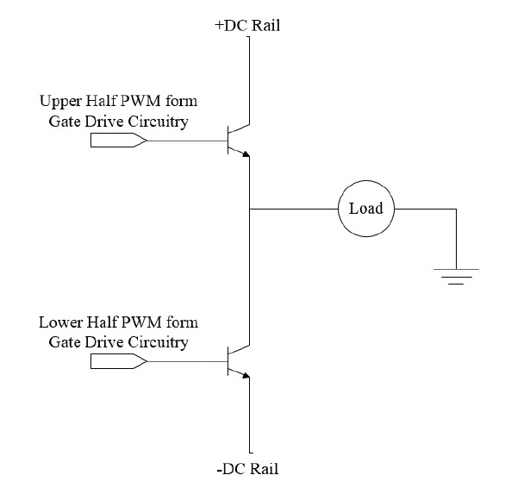
Inverter

Slide 14
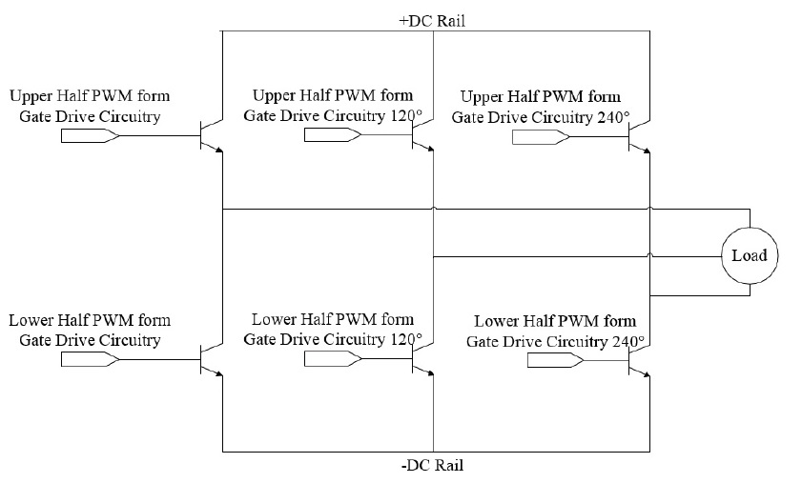
Inverter

Slide 15
Inverter
Single-phase Inverter
Fairchild FMG2G75US60 IGBT Pair
Each IGBT will receive one PWM signal
Output one dual-sided PWM signal representing the necessary sine wave
Have 0 and 100 VDC rails capable of providing 15 A
Three-phase Inverter
Three single-phase inverters
Single-phase inputs 120⁰ out of phase from any other input
Capable of 5 A per phase

Slide 16
Filter
Used to extract sine wave encoded in PWM signal
Three identical filters used (one for each phase)
LC filter

Slide 17
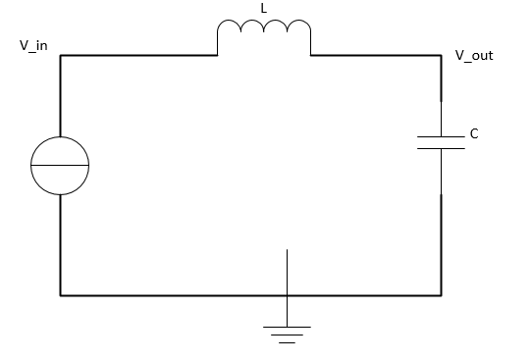
Filter

Slide 18
Filter
LC Filter
Components rated for 400V and 15A
Output sinusoidal waveform extracted from PWM signal

Slide 19
Load
Overall system output used for testing
Initially resistive-inductive (RL) for both single- and three-phase systems
Final tests will be performed on a three-phase motor
Shall be able to draw the rated power from the system

Slide 20
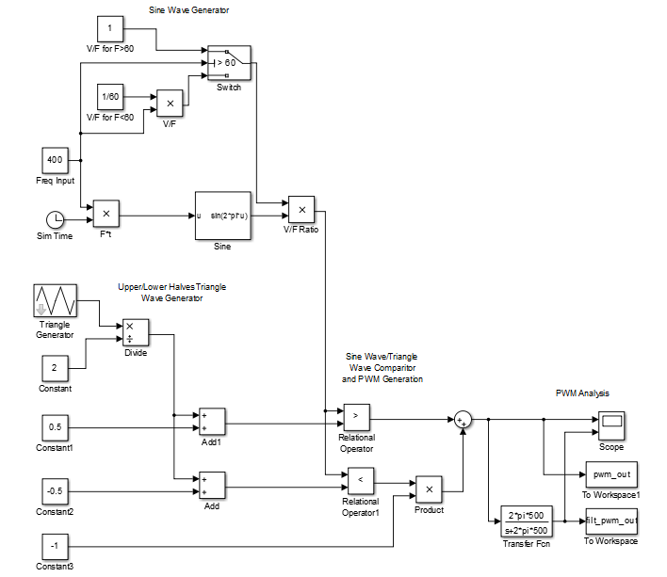
Lab Work
Volts/Hertz Ratio Testing
Simulink Model of controller
0 to 60 Hz

Slide 21
Lab Work

Slide 22
Equipment & Parts List
LabVIEW Student Edition
NI-cDAQ-9174 Data Acquisition Chassis
NI-9401 Digital I/O
NI-9221 Analog-to-Digital Converter
NI-9211 Thermal Couple
IR 2110 Gate Driver
6N137 Optical Isolator
FMG2G75US60 IGBT Pair with anti-parallel diodes
Sources and Scopes available in Power Lab

Slide 23
Schedule
Remaining Fall Semester – Exposure to LabVIEW environment
1/27/2013 -LabVIEW Tutorials
2/3/2013 -Build & test single phase optical isolator/build single phase gate driver & inverter
2/10/2013 -Finish & test single phase gate driver & inverter
2/17/2013 -Basic LabVIEW controller design
2/24/2013 -Build & test three phase optical isolator/build three phase gate driver & inverter
3/3/2013 -Finish & test three phase gate driver & inverter

Slide 24
Schedule
3/10/2013 -LC filter & three phase resistive load design
3/17/2013 -Build and test LC filter & three phase resistive load
3/24/2013 -Testing with three phase AC machine
3/31/2013 -Controller tuning
4/7/2013 -Source conversion design
4/14/2013 -Source conversion building and testing
4/21/2013 -Final system testing and analysis

Slide 25
Questions?

Slide 26
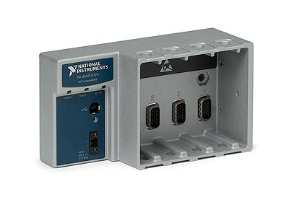
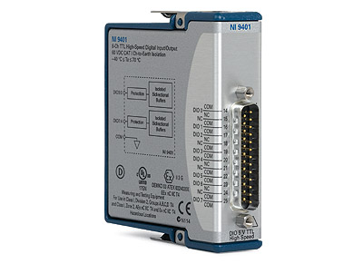
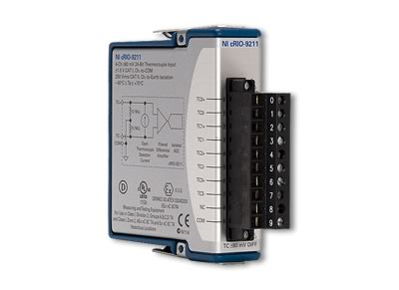
Pictures

Slide 27
Datasheets
http://www.fairchildsemi.com/ds/6N/6N137.pdf
http://www.daedalus.ei.tum.de/attachments/article/257/IR2110_IR2110S_IR2113_IR2113S.pdf
http://pdf.datasheetcatalog.com/datasheet/fairchild/FMG2G75US60.pdf

Slide 28
Flow Chart

Slide 29
RLC Filter Design Equations

Slide 30
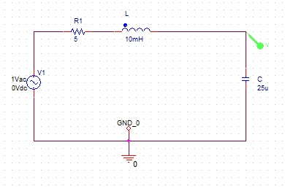
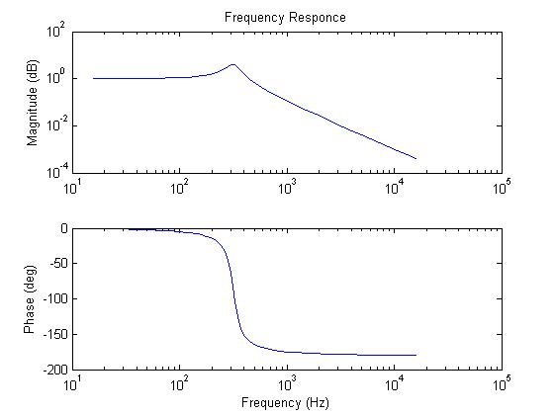
RLC Filter Response

