Slide 1
Variable Frequency AC Source
Students:
Kevin Lemke
Matthew Pasternak
Advisor:
Steven D. Gutschlag

Slide 2
Project Goals
Variable Frequency AC Source (VFACS)
Capable of delivering 208 Vrms and 5 A (35.5V rms for initial testing)
Frequency range from 0 to 60 Hz

Slide 3
High Level System Block Diagram

Slide 4
PWM Generation Controller
Produces PWM signals for the Gate Drive Circuitry
Use a LabVIEW based cDAQ controller from National Instruments
Able to control both single phase and three phase systems

Slide 5
PWM Generation Controller

Slide 6
PWM Generation Controller
Produce TTL level PWM signals
Produce waveforms representative of sine waves from 0-60 Hz
Produce waveforms following proper V/Hz ratio of 0.5892

Slide 7
Gate Drive Circuitry
High speed signal isolator and driver
Use optical isolators and gate driver chips to isolate and amplify signal to the Inverter
Optical isolators and gate drivers chosen for speed and robustness

Slide 8
Gate Drive Circuitry

Slide 9
Gate Drive Circuitry
Along with inverter, capable of switching at 1% duty cycle of 15 kHz switching frequency without clipping
Optical Isolator
6N137 Optocoupler
Isolate cDAQ outputs from Inverter, Filter, and Load
Gate Driver
IR-2110
Amplify PWM from TTL to +15V 2A level adequate for driving the Inverter

Slide 10
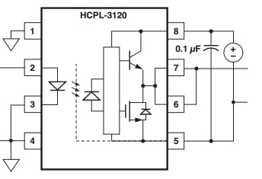
Gate Drive Circuitry Changes
Replaced IR2110/6n137 with HCPL3120
Robustness
Real-estate
Simplicity
Verify that this chip would meet specifications
Speed capability
Drive capability
www.avagotech.com/docs/AV02-0161EN

Slide 11
Inverter
PWM Signal Amplifier for AC machine application
Use IGBT pairs and DC rails to amplify PWM signal
IGBTs used for high voltage capabilities and availability
Single- and three-phase configurations

Slide 12
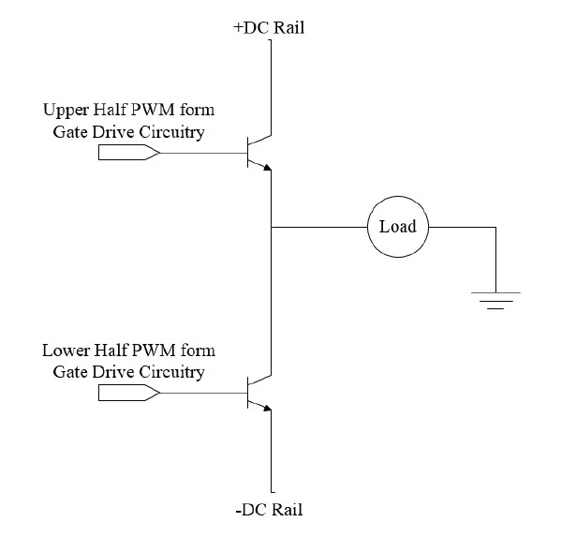
Inverter

Slide 13
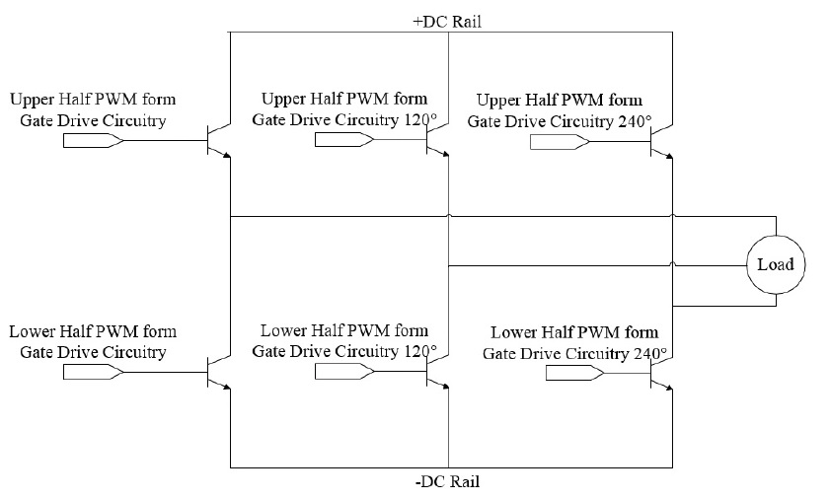
Inverter

Slide 14
Inverter
Single-phase Inverter
Fairchild FMG2G75US60 IGBT Pair
Each IGBT will receive one PWM signal
Output one dual-sided PWM signal representing the necessary sine wave
Have 0 and 100 VDC rails capable of providing 15 A
Three-phase Inverter
Three single-phase inverters
Single-phase inputs 120⁰ out of phase from any other input
Capable of 5 A per phase

Slide 15
Inverter Updates
IRF520N MOSFETS
Used for testing of single phase inverter
Current limiting resistor system protection
IGBTs will be used when filter, controller, and load are designed and built

Slide 16
Filter
Used to extract sine wave encoded in PWM signal
Three identical filters used (one for each phase)
LC filter

Slide 17
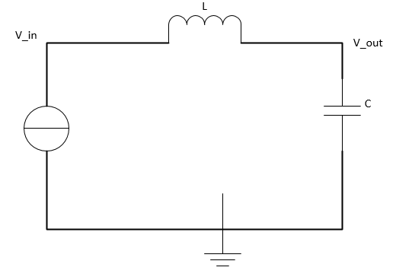
Filter

Slide 18
Filter
LC Filter
Components rated for 400V and 15A
Output sinusoidal waveform extracted from PWM signal

Slide 19
Load
Overall system output used for testing
Initially resistive-inductive (RL) for both single- and three-phase systems
Final tests will be performed on a three-phase motor
Shall be able to draw the rated power from the system

Slide 20
Lab Work
Opto-coupler Simulation (6N137)
Gate Driver and Opto-coupler construction
HCPL3120 Gate Driver construction
Single phase, single side inverter test
With IRF520N MOSFET

Slide 21
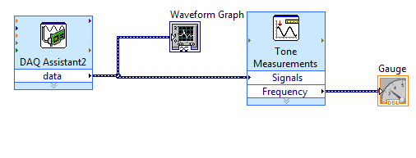
Lab Work
Basic cDAQ Interface
Analog Input
Digital Output (TTL)

Slide 22
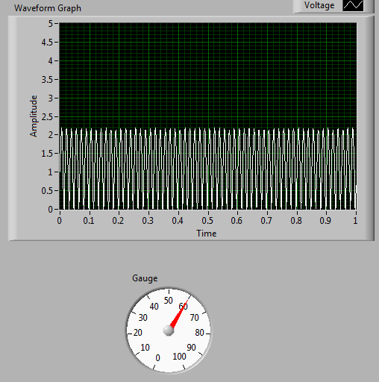
Lab Work

Slide 23
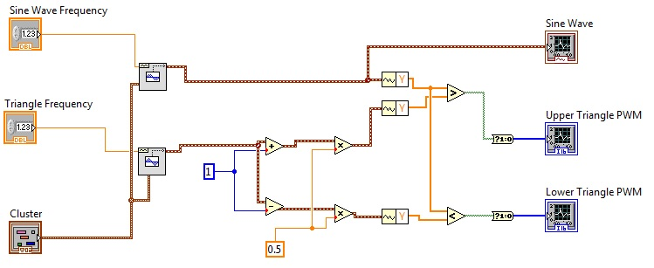
Lab Work
Basic PWM Generation Controller in LabVIEW
Point by Point vs Waveform Signals

Slide 24
Lab Work

Slide 25
Equipment & Parts List
LabVIEW Student Edition
NI-cDAQ-9174 Data Acquisition Chassis
NI-9401 Digital I/O
NI-9221 Analog Input Module
NI-9211 Thermal Couple
IR2110/2113
6N137 Opto-coupler
HCPL3120 Gate Driver*
IRF520 MOSFET*
FMG2G75US60 IGBT Pair with anti-parallel diodes
Sources and Scopes available in Power Lab

Slide 26
Schedule
Schedule
Week | Date | Task
1 | 1/27/2013 | LabVIEW Tutorials
2 | 2/3/2013 | Build & test single phase optical isolator Build & test single phase gate driver and inverter
3 | 2/10/2013
4 | 2/17/2013 | Interfacing LabVIEW with NI cDAQ
5 | 2/24/2013 | Basic LabVIEW controller design
6 | 3/3/2013 | LC filter design & single phase resistive/inductive load selection
7 | 3/10/2013 | Apply LC filter and load to single phase VFACS
8 | 3/17/2013 | Controller tuning/modification with voltage feedback
9 | 3/24/2013 | Performance testing of single phase VFACS
10 | 3/31/2013 | Re-evaluation of schedule/evaluation of implementing three-phase VFACS
11 | 4/7/2013 | DC to AC source conversion design
12 | 4/14/2013 | DC to AC source conversion building and testing
13 | 4/21/2013 | Final system testing and analysis
14 | 4/28/2013 | Oral Presentation Preparation/ Final Project Report

Slide 27
Questions?

Slide 28
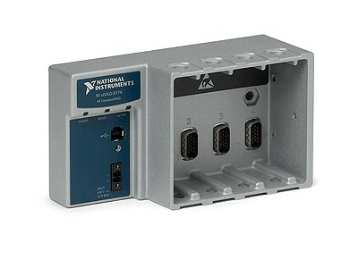
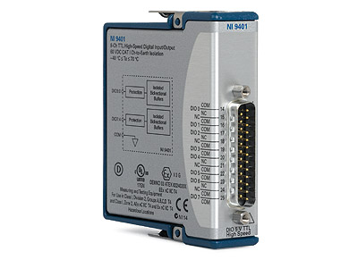
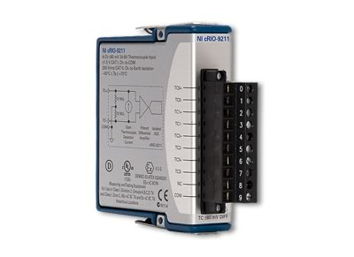
Pictures

Slide 29
Datasheets
http://www.fairchildsemi.com/ds/6N/6N137.pdf
http://www.daedalus.ei.tum.de/attachments/article/257/IR2110_IR2110S_IR2113_IR2113S.pdf
http://pdf.datasheetcatalog.com/datasheet/fairchild/FMG2G75US60.pdf
http://www.datasheetcatalog.com/datasheets_pdf/H/C/P/L/HCPL-3120.shtml
https://www.futurlec.com/Transistors/IRF520.shtml

Slide 30
Flow Chart

Slide 31
RLC Filter Design Equations

Slide 32
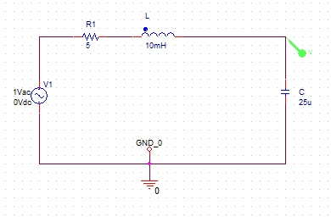
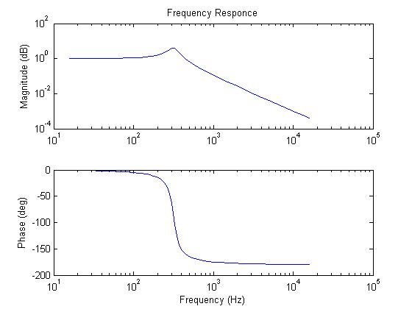
RLC Filter Response

Slide 33
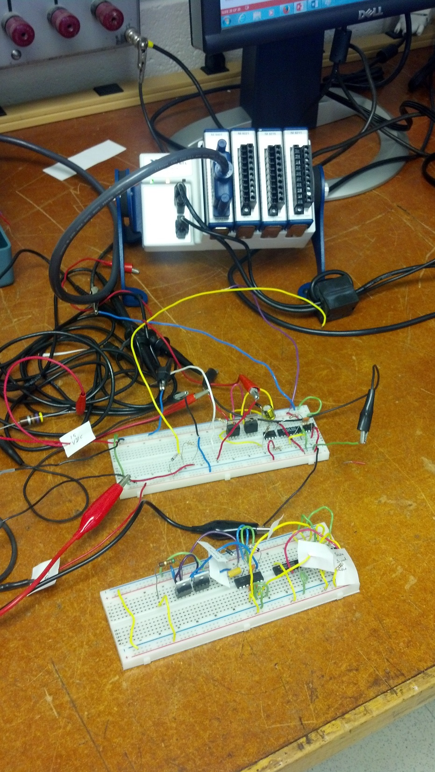

Slide 34
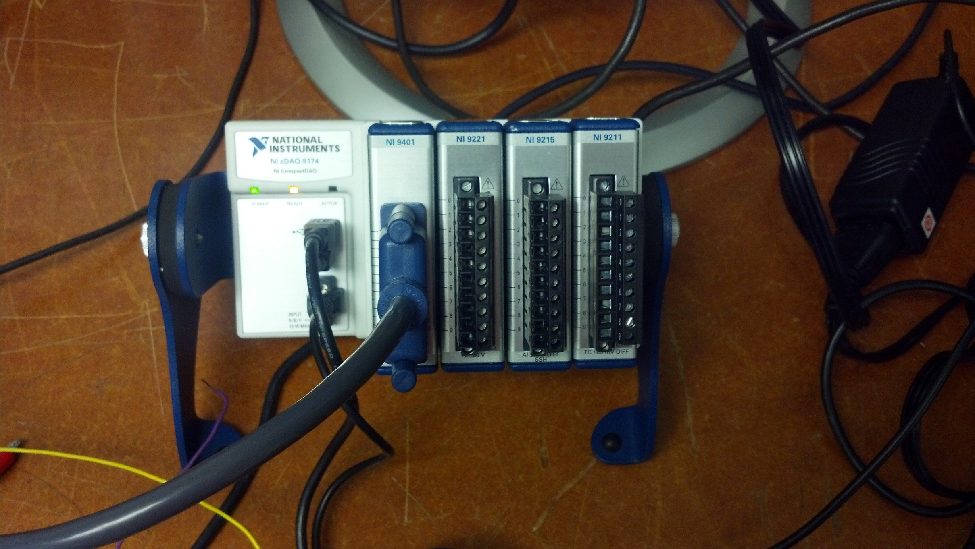

Slide 35
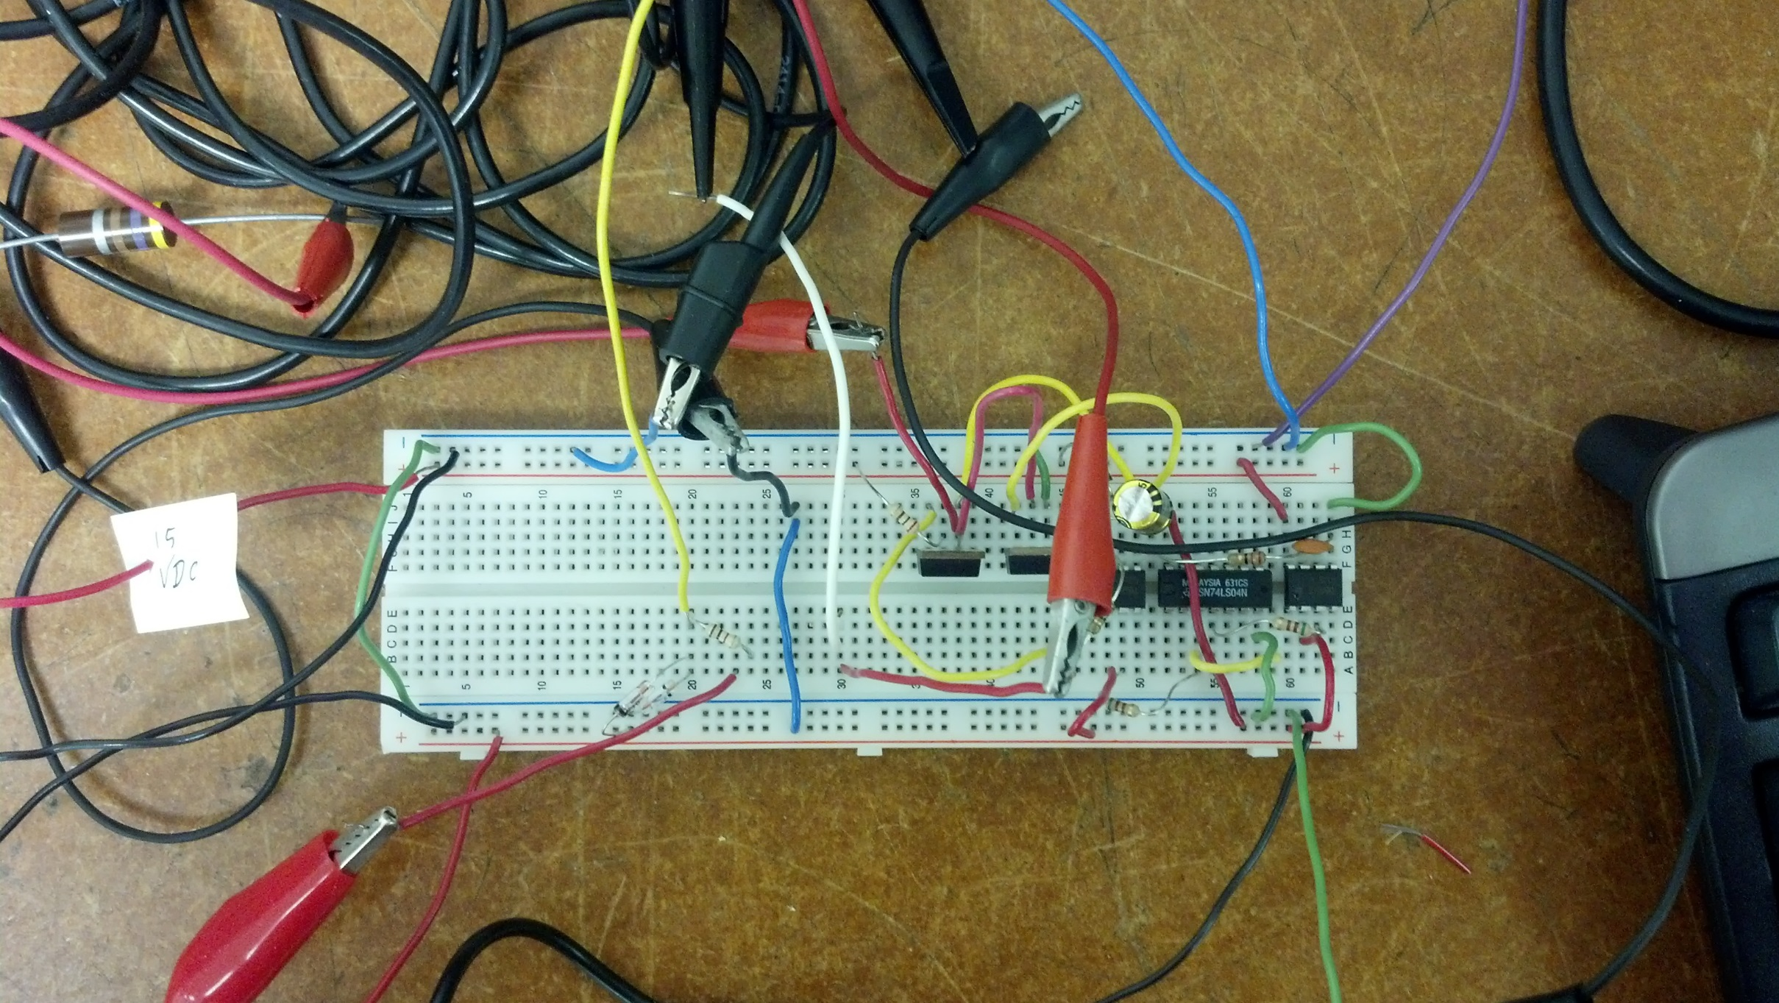

Slide 36
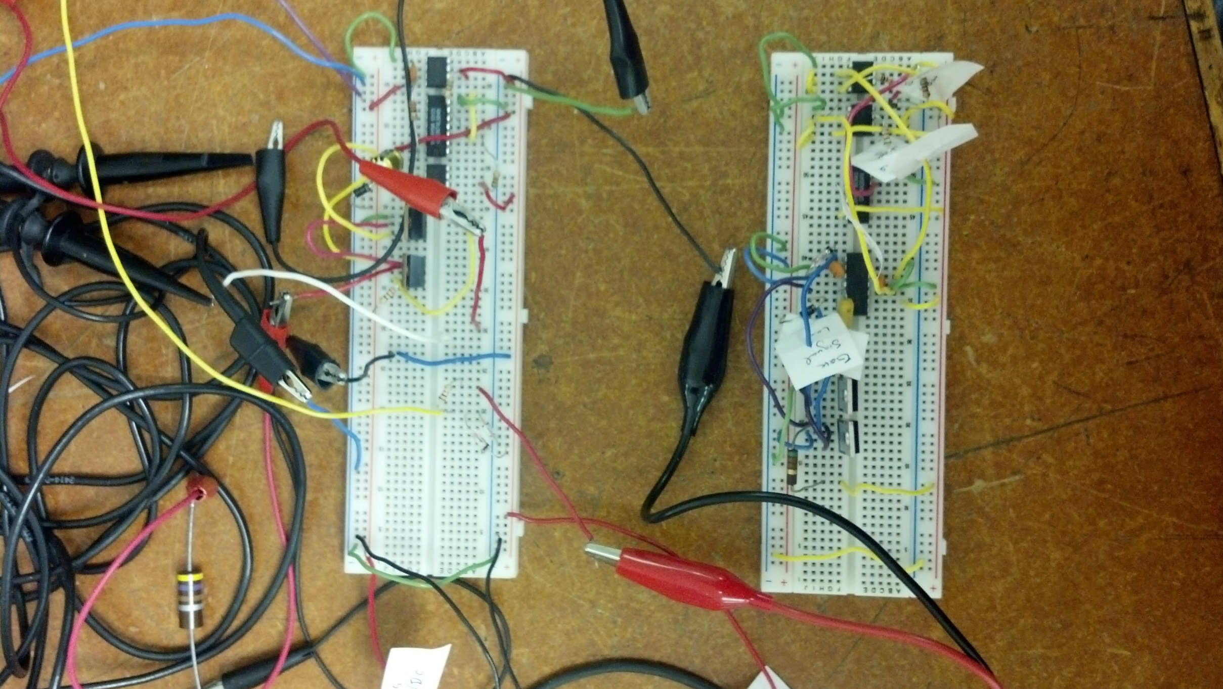

Slide 37
