Slide 1
Autonomous Quadrocopter Design Review
Brad Bergerhouse, Nelson Gaske, Austin Wenzel
Dr. Malinowski

Slide 2
Outline
Original Goals
Abridged Project Description
Progress
Revised Goals
Current Schedule and Milestones

Slide 3
Outline
Original Goals
Abridged Project Description
Progress
Revised Goals
Current Schedule and Milestones

Slide 4
Original Goals
Implement backup fly-by-wire controls for safety and testing
Avoid obstacles using video and sensor feedback
Autonomously navigate through narrow passages using onboard sensors
Develop a quadrocopter platform for future senior projects

Slide 5
Outline
Original Goals
Abridged Project Description
Progress
Revised Goals
Current Schedule and Milestones

Slide 6
Functional Description
Interface BeagleBoard with XAircraft X650 Quadrocopter platform
Use BeagleBoard I/O to interface with sensors and remote controls
Develop passage following algorithm using minimal sensor input
Utilize image processing techniques for navigational purposes and goal criteria

Slide 7
System Diagram

Slide 8
Outline
Original Goals
Abridged Project Description
Progress
Revised Goals
Current Schedule and Milestones

Slide 9
Progress
Platform Arrived. Assembly is complete, we are now working on a rotor guard solution
Close to having a working PWM solution
We have started on I2C
5V regulator is ready for installation
SUSAN corner detection on images in progress

Slide 10
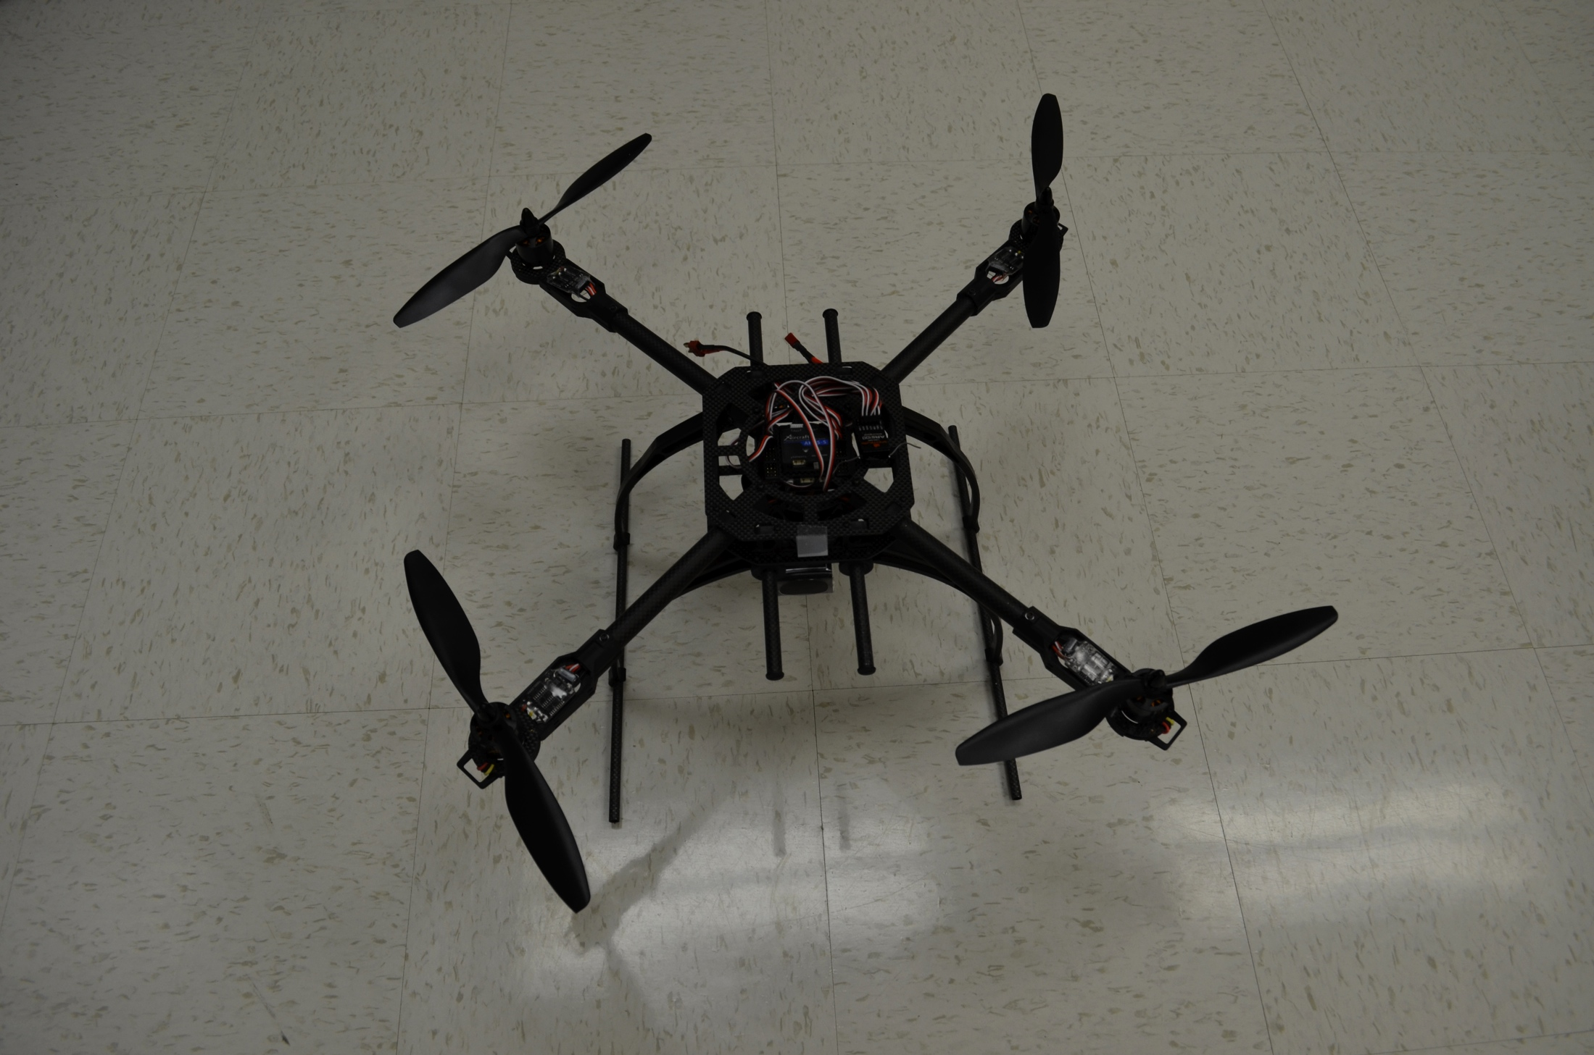
Completed Platform

Slide 11
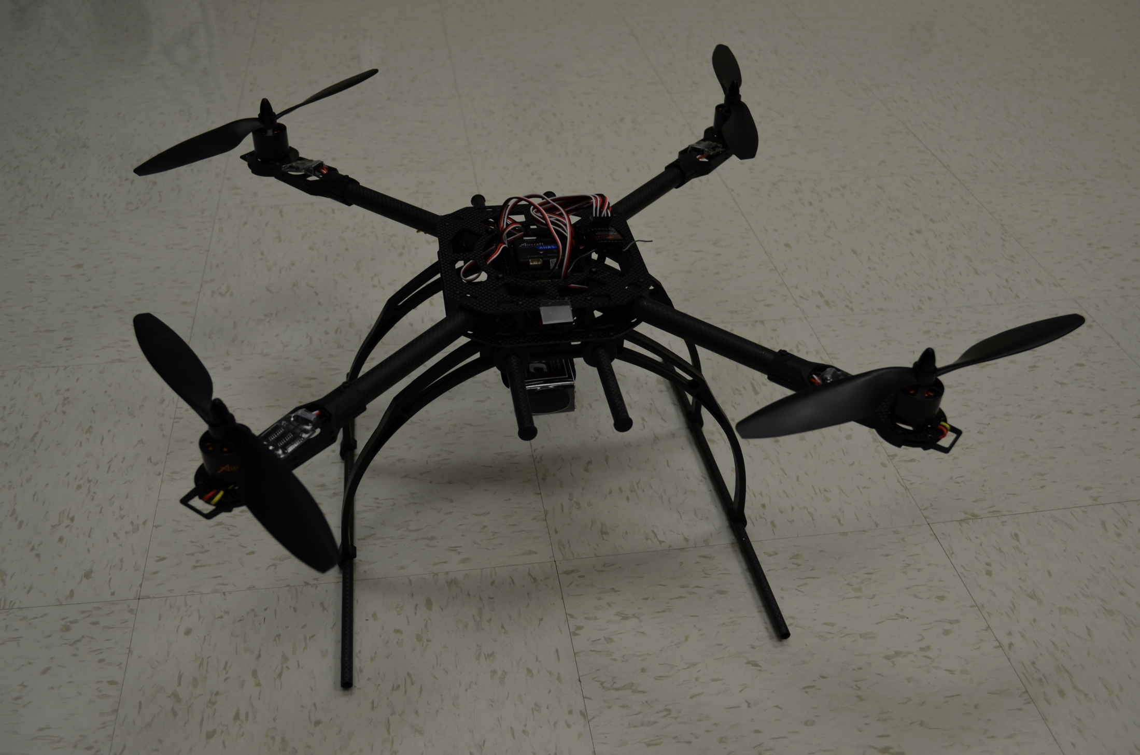

Slide 12
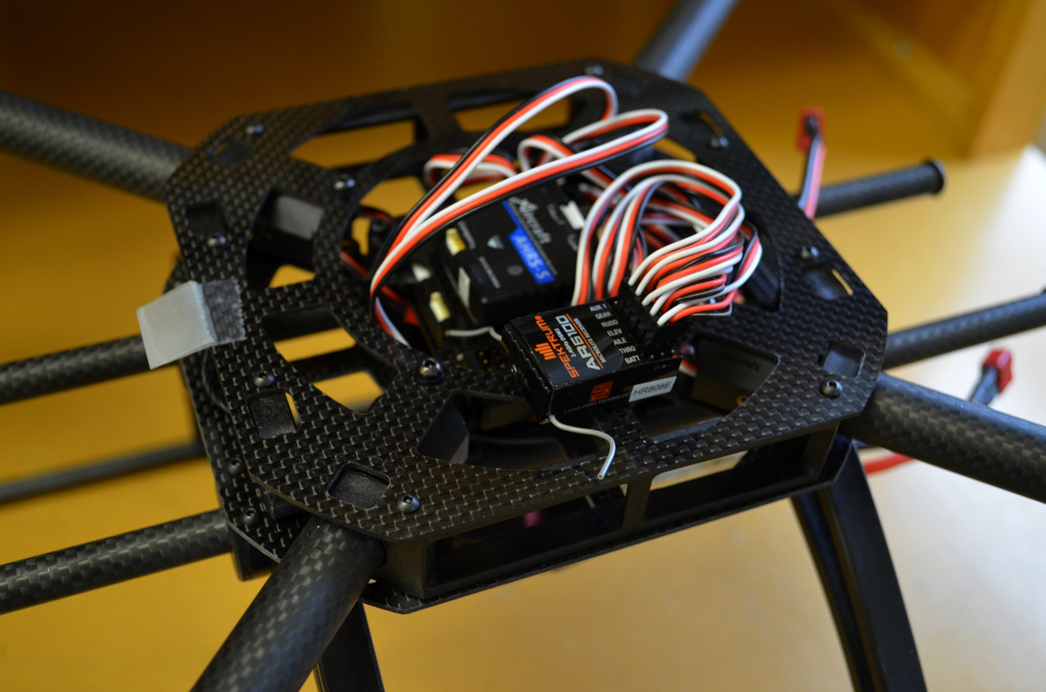

Slide 13
Quadrocopter Building

Slide 14
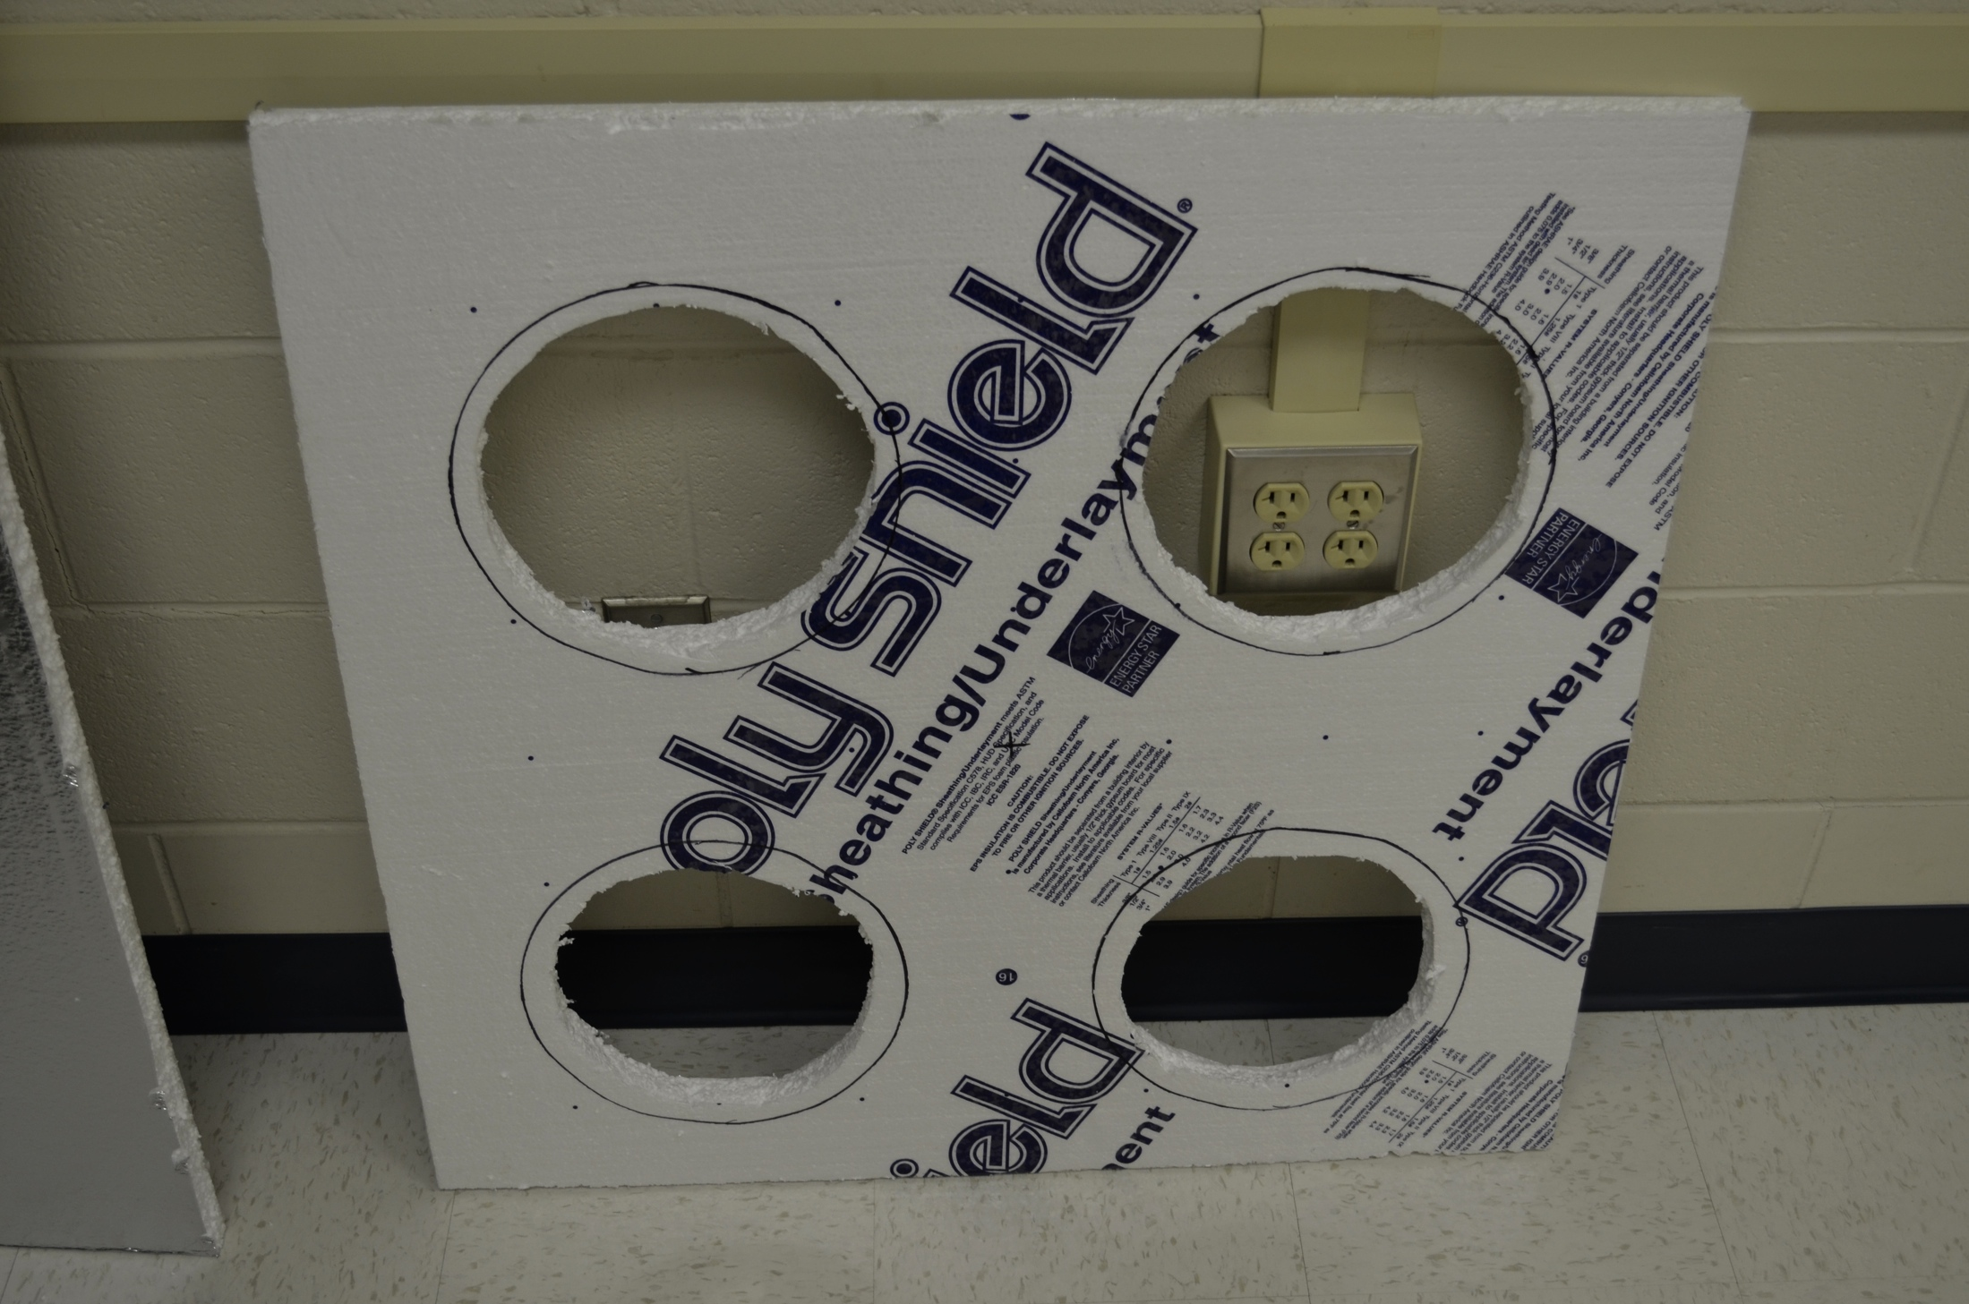
Rotor Guards

Slide 15
General DSP flowchart

Slide 16
SUSAN corner detection

Slide 17
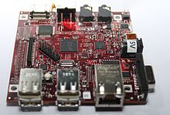
Hindrances to Progress
BeagleBoard documentation (or lack there of)
Lack of standardized interfaces for major hardware components
Cross compiling kernel issues

Slide 18
Attempts to output PWM to GPIO pins
Bash Script
C code
Servodrive kernel module
Openembedded
Bitbake

Slide 19
Outline
Original Goals
Abridged Project Description
Progress
Revised Goals
Current Schedule and Milestones

Slide 20
Revised Goals
Use sensors to avoid obstacles
Use camera to observe navigational marking and goal criteria
Fly-by-wire

Slide 21
Outline
Original Goals
Abridged Project Description
Progress
Revised Goals
Current Schedule and Milestones

Slide 22
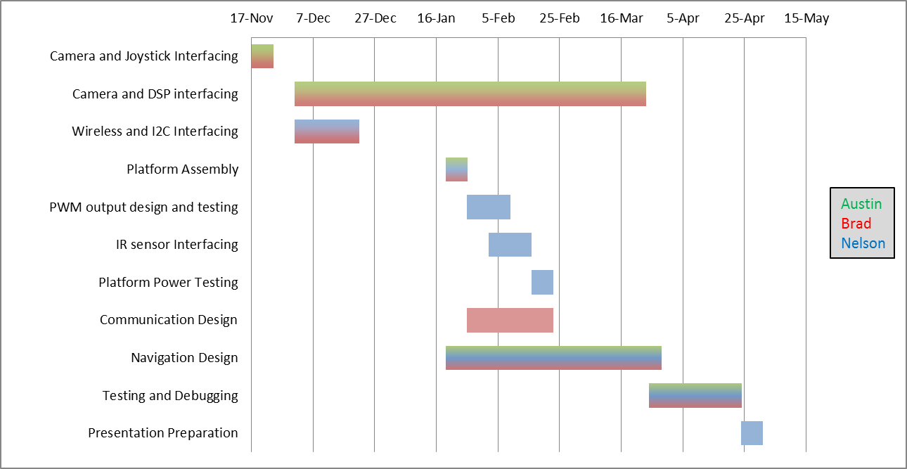
Original Schedule

Slide 23
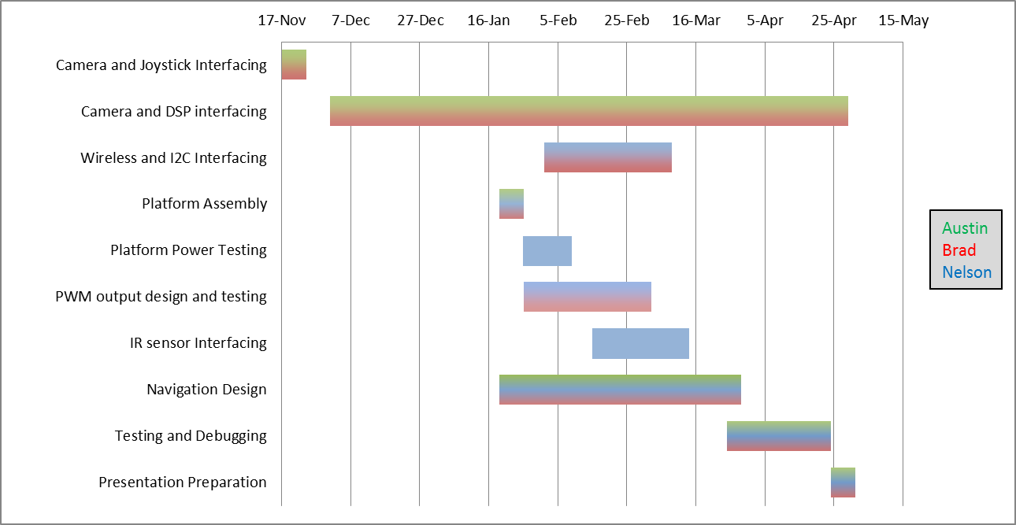
Revised Schedule

Slide 24
Questions?

