Slide 1
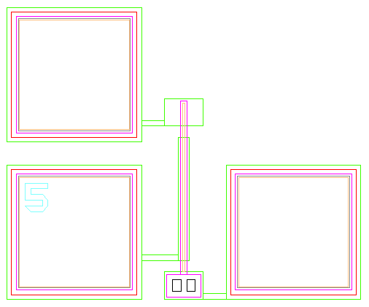
Capacitive Sensing for MEMS Motion Tracking
By Dave Brennan
Advisors: Dr. Shannon Timpe, Dr. Prasad Shastry

Slide 2
Introduction
Part 1) Quick MEMS introduction
Part 2) Capacitive Sensing
Part 3) Goal

Slide 3
MEMS background
Microelectrical mechanical systems (USA), Microsystems Technology (Europe), Micromachines, Japan…etc
MEMS are in the micro-meters range
Arranged hundreds on a small cm by cm chip typically

Slide 4
MEMS background
Manufactured by various etching techniques
Silicon based technology

Slide 5
MEMS applications
Sensors such as to sense collisions for air bag deployment
Bio MEMS similar to the Bradley MEMS project
Inkjet printers

Slide 6
Bradley Bio MEMS Project
Main purpose is to analyze plant samples for medical applications
Chip can be targeted with a specific receptor, such that a plant bonding with the chip alerts us of possible biomedical applications of that plant
Electrical Engineering component is capacitive sensing

Slide 7
Capacitive sensing
Useful to solve for an unknown mass (of plant sample) after it is adsorbed on the MEMS chip
Very small scale (atto farads = 10^-18, smaller than parasitic capacitance in most devices EE’s typically use)

Slide 8
Useful equations
Where k is beam stiffness, wn is natural frequency in rad hz, m is mass in kg
C is capacitance (F), epsilon is permittivity of free space constant, A is area in meters^2, d is distance in meters

Slide 9
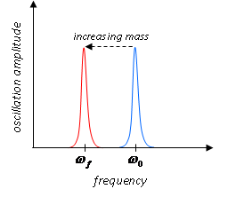
Capacitive Sensing

Slide 10
Measuring capacitance
Two main ways to measure capacitance
Change in area over time
Change in distance over time

Slide 11
Cantilever beam capacitance
We can find the oscillation distance by measuring capacitance by:

Slide 12
MEMS basic cantilever design

Slide 13
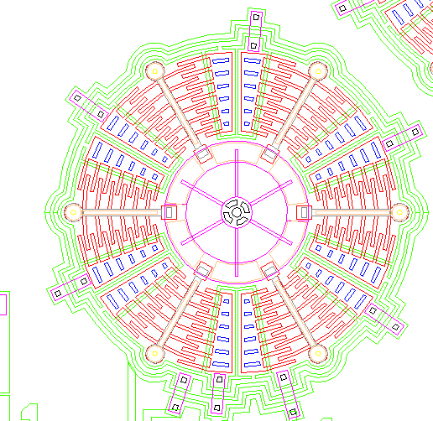
MEMS device with non constant area

Slide 14
Sample capacitance values for a fixed distance (at rest)
Sample of 4 different MEMS devices each with a different capacitance

Slide 15
Initial tests
Set up an RC circuit with 10pF capacitor (smallest in lab)
Parasitic capacitance on breadboard warped data greatly
Fixed by using vector board thanks to Mr. Gutschlag’s suggestion
Cut down leads on capacitor/resistor to minimize error

Slide 16
Initial tests
Used system ID to identify the capacitor based on RC time constant
Compared capacitor value found with system ID vs measured on LCR meter
~20% error

Slide 17
Initial tests
Currently modeling probe capacitance and resistance, reattempting system ID experiment ASAP with probe model included
Will this work for smaller capacitors?

Slide 18
Instrumentation
Andeen-Hagerling 2700A Bridge can measure down in aF range
$30,000+
Not realistic for this project
Agilent LCM in Jobst can only measure down to ~.1pF range

Slide 19
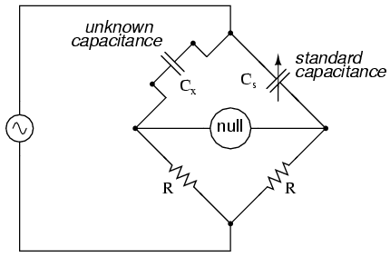
Instrumentation
Will explore the possibility of creating a bridge circuit for measuring capacitance

Slide 20
Eliminating error
Ideally, want to measure capacitance as accurate as possible, however settle for 5% error
Parasitic capacitance is approximately desired capacitance in magnitude, this will skew results highly

Slide 21
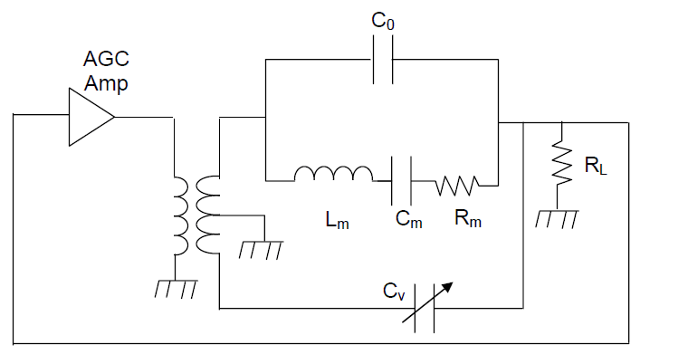
Eliminating error

Slide 22
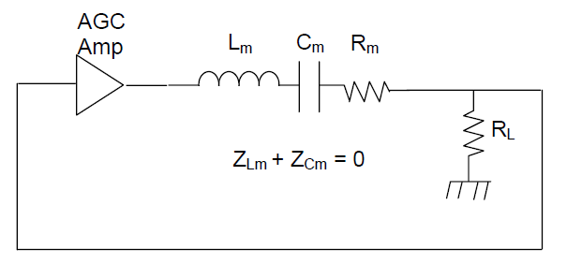
Eliminating error
Since Cv is adjustable, “tune” out the parasitic capacitance

Slide 23
Goals
Minimize the error of all calculations by doing multiple trials
Learn about MEMS topology
Learn about capacitive sensing methods
If time permits, add a control system that monitors the maximum peak of the voltage wave and adjusts the frequency of the applied voltage signal to ensure the peak is always known

Slide 24
Goals
Learn how to use the probe station to make connections to a MEMS chip
Learn how to accurately measure and verify capacitance of the selected MEMS device(s)
Obtain the natural frequency of the MEMS device
Accurately track the mass adsorbed by the cantilever beam and have it verified

Slide 25
System inputs
System inputs are voltage wave (special attention paid to the frequency)
Plant mass

Slide 26
System outputs
Oscillation distance
Capacitance
Natural frequency
Mass

Slide 27
Complete system

Slide 28
Project Summary
By accurately measuring capacitance, we can determine the natural frequency of various MEMS chips
The natural frequency will be at the peak of the oscillation distance
Oscillation distance can be found through capacitance

Slide 29
Project Summary
This will allow us to determine the mass of the plant sample adsorbed
Once mass is verified externally, possibilities are endless

Slide 30
References
Baltes, Henry, Oliver Brand, G. K. Fedder, C. Hierold, Jan G. Korvink, and O. Tabata. Enabling Technology for MEMS and Nanodevices. Weinheim: Wiley-VCH, 2004. Print.
Elwenspoek, Miko, and Remco Wiegerink. Mechanical Microsensors with 235 Figures. Berlin: Springer, 2001. Print.
Timpe, Shannon J., and Brian J. Doyle. Design and Functionalization of a Microscale Biosensor for Natural Product Drug Discovery. Tech. Print.

Slide 31
Questions?

