Slide 1
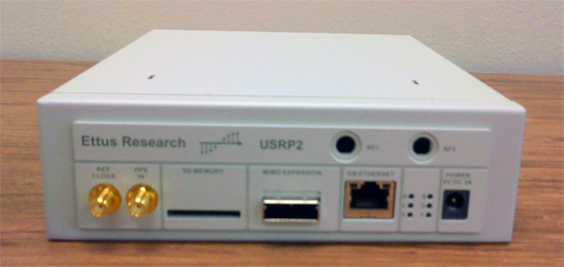
Implementation of a Software Defined 16 QAM System Using the USRP2 Board
By Patrick Ellis and Scott Jaris
Advisors: Dr. Ahn & Dr. Lu

Slide 2
Presentation Outline
Project Summary
Previous Work
Background on SDR
Equipment and Software List
Overall Block Diagram
Subsystems
Functional Requirements
Progress
Project Schedule
Questions and Discussion

Slide 3
Project Summary
Use two USPR2 boards and implement a 16QAM communication system using a baseband receiver and transmitter.

Slide 4
Previous Work
No previous Bradley projects
Solid Documentation difficult to find.
Entire setup is based around free software and open source software and hardware
USRP2
GNU Radio
Very Recent Developments
SDR
USRP2

Slide 5
Software Defined Radio (SDR)
WHAT it is:
"Radio in which some or all of the physical layer functions are software defined“
WHY use SDR :
- Takes what used to be physically ingrained and provides hardware and software
alternatives.
- Adds Flexibility
-Adds Functionality
-Ease of Modification (Reduces cost)
WHO uses it:
- EVERYONE (Businessmen, military, etc)
WHERE it’s going:
- thousands of SDRs have been deployed in defense applications
- cell phone systems are using SDR devices to make a multiband protocols
- Satellite modems in commercial and defense markets

Slide 6
Presentation Outline
Project Summary
Previous Work
Background on SDR
Equipment and Software List
Overall Block Diagram
Subsystems
Functional Requirements
Progress
Project Schedule
Questions and Discussion

Slide 7
Equipment and Software
Two USRP2 Boards
BasicTX and Basic RX Daughterboards
GNU Radio
Python Interpreter
Ubuntu

Slide 8
Overall Block Diagram

Slide 9
USRP2
Note: Drivers are open source and uses GNU Radio Software to interface.
FEATURES:
Xilinx Spartan 3-2000 FPGA
Gigabit Ethernet interface
Two 100MS/s, 14 bit, AD converters
LTC2284
72.4dB SNR and 85dB SFDR for signals at Nyquist Frequency
Two 400MS/s, 16 bit, DA converters
AD9777
160 MSPS w/o interpolation
Up to 400 MSPS with 8x interpolation
SD card reader
MicroBlaze Processor Core
aeMB software implementation of MicroBlaze

Slide 10
BasicTX & BasicRX Daughterboards
BasicTX and BasicRX features:
Serve as RF frontend
Modulates output signal to higher frequency
Takes away input signal carrier frequency
BasicRX is a 1-250MHz Receiver
BasicTX is a 1-250MHz Transmitter

Slide 11
GNU Radio, Python, and Ubuntu
FEATURES:
GNU radio is a free software toolset for building and implementing SDR.
A signal processing package
The signal processing blocks are written in C++ and are accessed, called, and wrapped by Python
GNU radio, when implemented with the USRP2 must be on a Linux-based system.

Slide 12
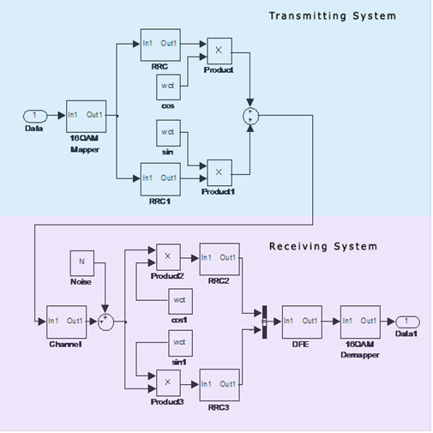
16 QAM System

Slide 13
Presentation Outline
Project Summary
Previous Work
Background on SDR
Equipment and Software List
Overall Block Diagram
Subsystems
Functional Requirements
Progress
Project Schedule
Questions and Discussion

Slide 14
Progress
Tutorials
GNU radio
Python
USRP2
SD card
Simulation

Slide 15
Progress (continued)

Slide 16
Preliminary Schedule
Dates | Task
1/20 - 1/26 | Create and simulate a 16 QAM system using GNU radio companion
1/27 - 2/2 | Continue creating system
2/3 - 2/9 | Introduce fading and multipath effect. Create DFE for signal recovery
2/10 - 2/16 | Continue creating recovery system
2/17 - 2/23 | Continue creating recovery system
2/24 -3/2 | Continue creating recovery system
3/3 - 3/9 | Explore the USRP2 board by creating simple FM receiver and other systems
3/10 - 3/11 | Continue exploring USRP2 capabilities
3/21 - 3/23 | Continue exploring USRP2 capabilities
3/24 - 3/30 | Continue exploring USRP2 capabilities
3/31 - 4/6 | Test the 16 QAM system by sending various data between two USRP2 boards
4/7 - 4/13 | System debugging and documentation
4/14 - 4/20 | System debugging and documentation
4/21 - 4/27 | System debugging and documentation
4/28 - 5/3 | Presentation preparation and practice

Slide 17
QUESTIONS?

Slide 18
References
[1] "Exploring GNU Radio." The GNU Operating System. Web. 11 Nov. 2010. <http://www.gnu.org/software/gnuradio/doc/exploring-gnuradio.html>.
[2] Couch, Leon W. Digital and Analog Communication Systems. Upper Saddle River, NJ: Pearson Prentice Hall, 2007. Print.
[3] Hanzo, Lajos, Thomas Keller, Soon Xin. Ng, and William Webb. Quadrature Amplitude Modulation: from Basics to Adaptive Trellis-coded, Turbo-equalised and Space-time Coded OFDM, CDMA and MC-CDMA Systems. [Piscataway, NJ]: IEEE, 2004. Print.

