Slide 1
Multiple Robot navigation and Mapping for Combat environment
By: Scott Tipton and Nick Halabi
Advisor: Dr. Aleksander Malinowski
Bradley University
December 3, 2010

Slide 2
Outline
Project Summary
Previous Work
Project Description
System Overview
Subsystems
Work completed and important equations
Equipment and Parts List
Progress
Schedule of Tasks

Slide 3
Project Summary
Military application – proof of concept
Combat/unknown environment
Indoor or outdoor
Map area and detect potential threats
Guide autonomous supply caravans or troops safely through a combat zone

Slide 4
System Platform
Pioneer 3D-X
8 Sonar sensors (+90 to -90)
2 wheels for navigation, 1 for stability
Navigation Computer (Laptop)
C++ program with Visual Studio 2005
Aria
MobileSim

Slide 5
Goals
Robot Navigating
Sonar Sensors
IR Sensors
Environment Mapping
Metal Detector
Path Finding
Server Infrastructure
Localization

Slide 6
Previous Work
IR sensors integration
Dr. Malinowski’s mapping program
Updated by John Hessling

Slide 7
Project Description
First robot scans and maps environment
Second robot uses path finding algorithm to designate safe route
Server/Central command
Pass information (map files)
User override via joystick

Slide 8
System Overview

Slide 9
Subsystems – Mode 1
Find closest wall and drive to it
Use wall following algorithm
Perform random movement when finished to scan interior
Optional operator override
Map environment
Detect threats with metal detectors
Relay map to server

Slide 10
Mode 1 – Trigonometry

Slide 11
Mode 1 – Equations
Wall distance
(a*b*sin(20/rad_to_deg))/sqrt(a^2*+b^2-2*a*b*cos(20/rad_to_deg))
(a*b*sin(20/rad_to_deg))/c
Move parallel to wall
angle = asin(height/a)*rad_to_deg +10
angle = 180 - angle;
Wall following
error = (((xr90 + ideal_distance)/2)-xr90)

Slide 12
Mode 1 – Mapping

Slide 13
Subsystems – Server
Maintain constant connection with both robots
Receive and update map from mode 1
Relay map to mode 2
User override with joystick control

Slide 14
Subsystems - Mode 2
Read map from server
Path Planning - determine safest route
Navigate to destination

Slide 15
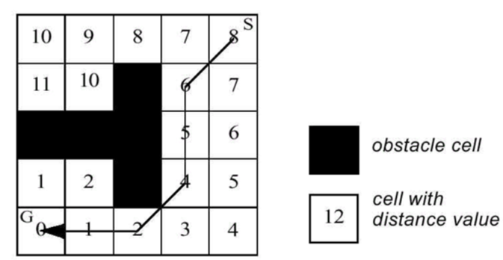
Mode 2 – Path Planning
Grassfire approach
Obstacles – 32,000
Non-reachable – 0

Slide 16
Path Planning

Slide 17
Path Planning

Slide 18
Equipment and Parts List
Pioneer 3D-X
Metal detectors – Electronics123.com Product # Velleman K7102
IR sensors - Sharp GP2Y0A02YK0F
Force Feedback Joystick
Silicon Labs 80C51F120 + UART/USB adaptor

Slide 19
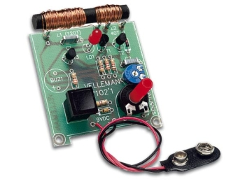
Velleman Metal Detectors
Kit- Requires Soldering
Metal detecting distance adjustable: up to 3.15"
We will use 4 detectors on the mapping robot
This will be a proof of concept, to see if we can detect mines

Slide 20
Progress
Mode 1 – 70% Complete
Mapping and navigation
Manual override with joystick
Metal Detector
Improve wall following
Mode 2 – 50%
Path planning using the grassfire approach
Possibly use the potential field approach or a combination of the two
Server – 0%

Slide 21
Schedule of Tasks
12/17/2009 – 1/20/2010
Improve wall following algorithm
Develop potential field path planning
Start server setup
Setup testing environments
1/21/2010 – 2/11/2010
Continue server work
Begin integrating metal detector sensors and possible IR sensors
2/18/2010 – 3/11/2010
Work with Mike Firman
Implement force feedback joysticks
Localization if time permits.
3/13/2010 – 3/22/2010
Spring break
Begin final presentation
Conference paper

Slide 22
Questions?

